Slide 1

INT332 DEVOPS VIRTUALIZATION AND CONFIGURATION MANAGEMENT

Slide 2
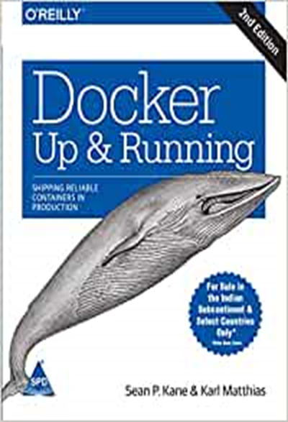
L:2 T:0 P:2 Credits:3
Text Books:
DOCKER DEEP DIVE by NIGEL POULTON, SHROFF/O'REILLY
References:
1. DOCKER: UP AND RUNNING by KARL MATTHIAS, SEAN P. KANE, O'REILLY
2. JENKINS CONTINUOUS INTEGRATION COOKBOOK by ALAN MARK BERG, O'REILLY 3. JENKINS 2 UP AND RUNNING by BRENT LASTER, O'REILLY

Slide 3
Vision
To be a globally recognised school through excellence in teaching, learning and research for creating Computer Science professionals, leaders and entrepreneurs of future contributing to society and industry for sustainable growth.

Slide 4
Mission
To build computational skills through hands-on and practice-based learning with measurable outcomes.
To establish a strong connect with industry for in-demand technology driven curriculum.
To build the infrastructure for meaningful research around societal problems.
To nurture future leaders through research-infused education and lifelong learning.
To create smart and ethical professionals and entrepreneurs who are recognized globally

Slide 5
Course Outcomes
CO1 :: Understand the concept of virtualization and containerization.
CO2 :: Understand the implementation and operation of Docker and microservices.
CO3 :: Understand and implement the concept of Docker swarm.
CO4 :: Understand the concept of continuous integration.
CO5 :: Apply the concept of CI/CD using Jenkins.
CO6 :: Design of software using CI/CD concept

Slide 6
Skills that will be learned in this course
Understand the implementation and operation of Docker and microservices.
Understand the concept of continuous integration.
Design of software using CI/CD concept.

Slide 7
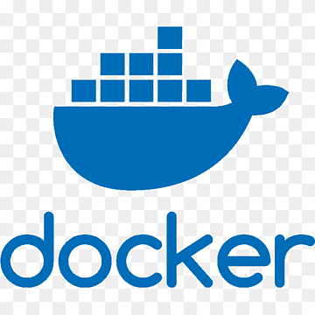
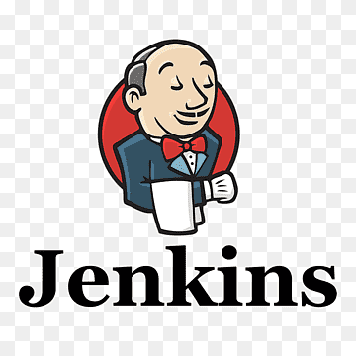
Software Requirement
Docker Desktop/AWS platform
Jenkins for CI/CD

Slide 8
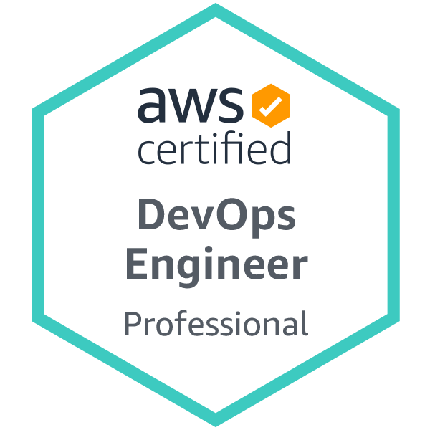
Certification/MOOC
Certification: AWS CERTIFIED DEVOPS ENGINEER – PROFESSIONAL
Platform: AMAZON WEB SERVICES
URL:https://aws.amazon.com/certification/certified-devops-engineer-professional/
Benefits: 1 AT (BYOD Practical)

Slide 9
INT332:DEVOPS VIRTUALIZATION AND CONFIGURATION MANAGEMENT(CA Details)
CA category A0202
Exam Category X6 (Att 5, CA 45, ETP 50 )
ETP viva, Written and execution (100)
Category | Marks
Attendence | 5
CA | 45
ETP | 50
ETP(Details) | 100 (viva=30,Written=20,Execution=50)

Slide 10
INT332:DEVOPS VIRTUALIZATION AND CONFIGURATION MANAGEMENT(CA Details)
AT1-BYOD practical (Allocation 5th week)Compulsory
AT2- Project (Allocation 4th week) Compulsory
Phase-1-Synopsis submission(Details of outcome to be achieved in the project)
Phase-2-Final submission and evaluation of the project based on outcomes.

Slide 11

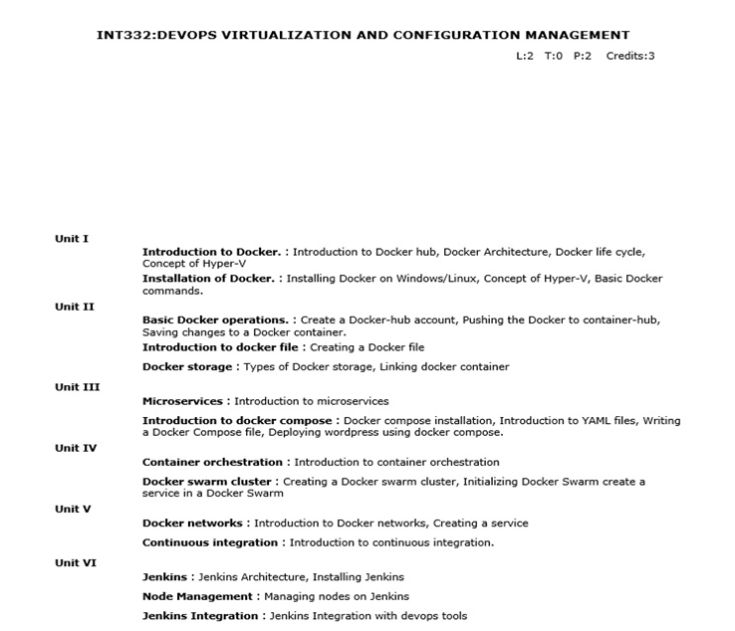
Syllabus

Slide 12
Why there is a need to Learn Docker (business need) for the companies.

Slide 13

Docker Energizes SmartCart
Sara Walter
(CTO SmartCart)
Company Background:
SmartCart is a digital grocery startup founded 2 years ago that has quickly grown to over 5 million users of its app.
Sara is the young CTO of that growing startup.

Slide 14

Docker Energizes SmartCart
Sara Walter
(CTO SmartCart)
Current Situation and Challenges
As SmartCart rapidly grew to over 5 million users, the company faced several key challenges including:
As more customers use SmartCart, the app struggles with scaling
The dev team spends significant time setting up environments for new features
Pushing new builds to production causes downtime and delays
Hard to replicate bugs locally that only occur in production
Infrastructure costs are high due to fragmented systems

Slide 15

Docker Energizes SmartCart
Sara Walter
(CTO SmartCart)
Solution
To address these scaling and efficiency challenges, SmartCart's CTO Sara spearheaded solutions focused on Docker:
Adopt Docker containerization to package SmartCart as portable images
Use Docker Compose for standardized dev environments
Implement CI/CD pipelines to smoothly update productions
Leverage Docker networking for secure communications
Consolidate fragmented systems into containers
Impact
By adopting Docker practices, SmartCart improved app performance, accelerated releases, reduced costs, and enhanced reliability.

Slide 16
Virtualization and containerization
With the changing times, businesses started looking for solutions to reduce overhead costs, enhance scalability, and standardize application deployment process.
They started considering the following two approaches to reduce costs −
Virtualization
Containerization

Slide 17
What is Virtualization?
Virtualization is the process of partitioning a physical server into multiple virtual servers.
The process of partitioning is carried out using a software called 'hypervisor'.
After partitioning, the virtual servers act and perform just as a physical server.
Essentially, it means using the same hardware set-up more efficiently, thereby freeing the resources for other tasks or retiring the resources altogether.

Slide 18
Advantages of Virtualization
Enhanced performance
Promotes agile IT infrastructure
Promotes use of resources in optimum manner
Better disaster management if any physical hazards take place to resources
Better security as the infected VM can be isolated from other VMs and the host server
Space saving
The capital investment cost on hardware is saved, and thereby maintenance cost is saved, hence overall cost savings for a business.

Slide 19
For example, instead of dedicating 1 server and 1 operating system to execute 1 dedicated task, the same server is partitioned such as 1 server and 2 operating systems, which can allow independent tasks running on each of them.

Slide 20
What is Containerization?
When code is developed in a specific computing environment and transferred to a different environment, there is a high possibility of the code to result in bugs and errors due to missing dependencies, libraries, or any configuration setting files.
For example, if a Windows-based version was ported to Linux operating system, or when an application was developed in the business environment and ported to the customer’s environment, the application would often throw errors. If the dependencies are provided along with the code, the potential bugs and errors can be eliminated.

Slide 21
Containerization is the process of bundling the application code along with the libraries, configuration files, and dependencies required for the application to run cross-platform.
Containerization is an application-packaging approach where the code is written once and capable of executing anywhere, making the application highly portable. Docker is the example of a containerization platform.

Slide 22
What is a Container?
The single package of software built using containerization technology is called a ‘Container’. The container is a standalone package, independent of the host operating system. Being as such, it can then execute across multiple platforms, without any issues.
Following are the advantages of using Containers
1.Containers share the machine’s operating system Kernel. They do not require to associate the operating system from within the application hence they are lightweight.
2.It takes less start-up time in the environment where it is deployed.

Slide 23
What is a Hypervisor?
A hypervisor, also known as Virtual Machine Monitor (VMM), is a software program that executes on a computer to manage multiple VMs.
A Hypervisor creates an abstract layer on the computer hardware, handles resource allocation, and monitors the virtual machines.

Slide 24
Virtualization − Virtualization is the technology that can simulate your physical hardware (such as CPU cores, memory, disk) and represent it as a separate machine. It has its own Guest OS, Kernel, process, drivers, etc. Therefore, it is hardware-level virtualization. Most common technology is "VMware" and "Virtual Box".
Containerization − Containerization is "OS-level virtualization". It doesn't simulate the entire physical machine. It just simulates the OS of your machine. Therefore, multiple applications can share the same OS kernel. Containers play similar roles as virtual machine but without hardware virtualization. Most common container technology is "Docker".a

Slide 25
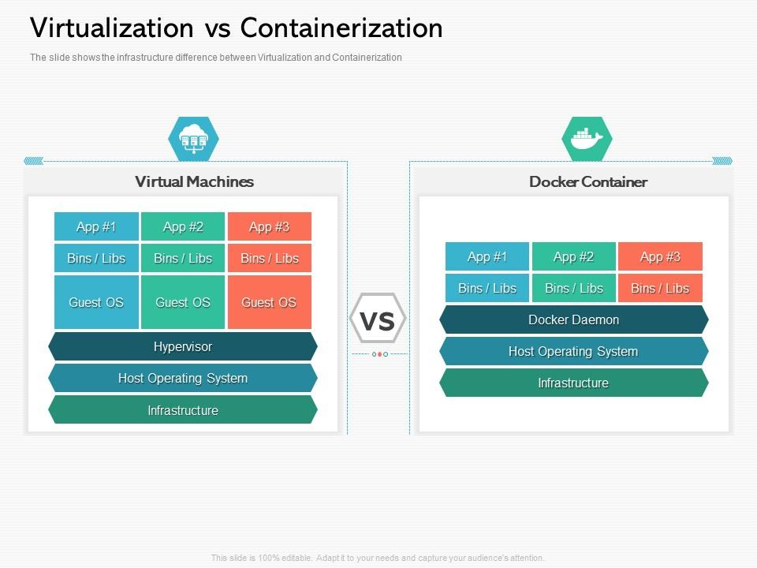

Slide 26
Module Coverage
Installing and Using Docker
Docker architecture diagram with Client, Daemon, and Registry
Docker Daemon (Container Platform)
Docker REST API
Docker Architecture and Components
Installing Docker on various Oss
Basic Docker Commands
Understanding Different Environments
Building Docker Images
Dockerfile fundamentals
Docker image creation from a Dockerfile
Docker Networking
Docker Networking Models
Docker Networking Commands

Slide 27
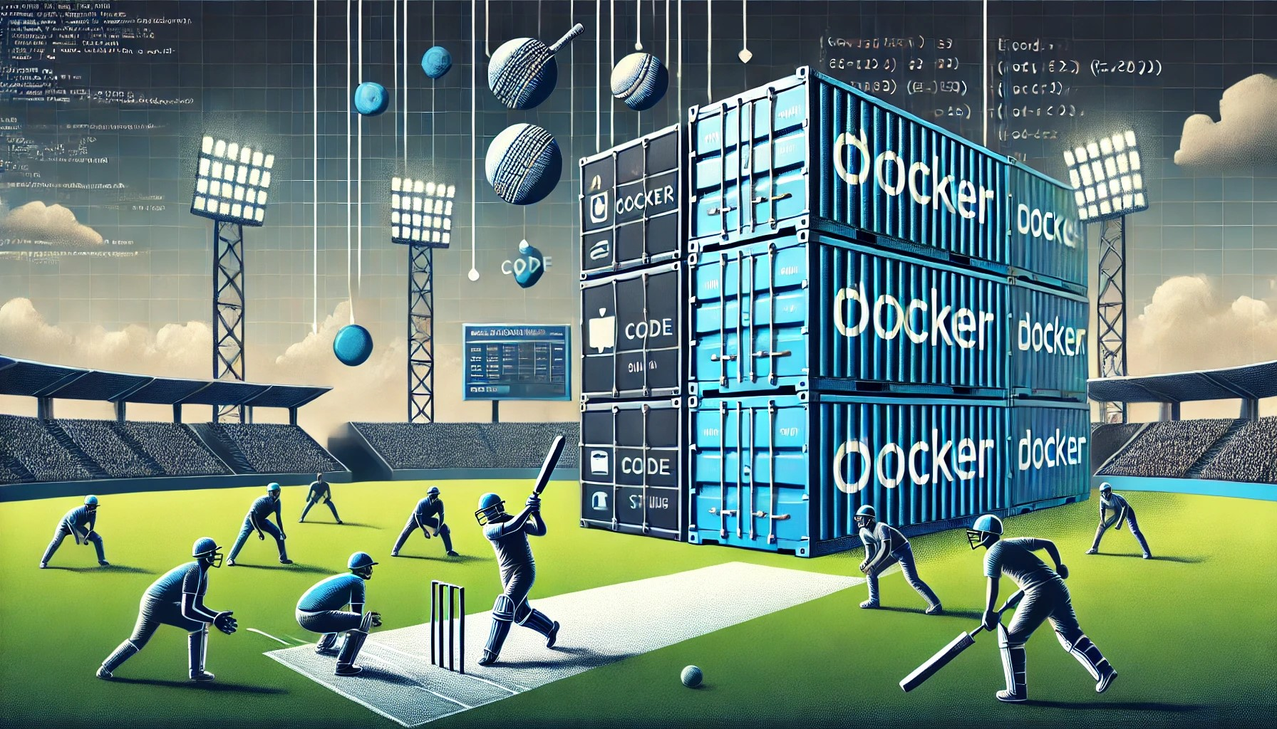

Slide 28
Problem:
During a live cricket tournament, multiple digital services must run simultaneously:
Live Scoreboard: Displays real-time scores.
Player Statistics: Updates player performance metrics.
Video Highlights: Processes and serves video clips of key moments.
Fan Engagement App: A platform for polls, trivia, and comments.
Each service needs different software dependencies, which could lead to configuration conflicts if run on the same machine.

Slide 29
Solution Using Docker:
Live Scoreboard Service: A container runs a web application (e.g., Node.js) connected to a live score database.
Dockerfile includes the app, Node.js runtime, and necessary libraries.
Player Statistics Service: Another container handles analytics using Python and its data libraries.
Isolated to avoid conflicts with the scoreboard service.
Video Highlights Service: A container running FFmpeg to process and serve video clips.
Can scale independently during peak usage.
Fan Engagement App: Deployed as a separate container, running React.js on a Node.js backend.

Slide 30
How It Works:
Each service runs in its own Docker container with the required dependencies and configurations.
Docker Compose orchestrates the containers, ensuring they communicate effectively.
Scaling is effortless—e.g., if the Fan Engagement App sees a surge in usage, new containers can be set up.
The entire setup can be deployed consistently on any server, ensuring smooth operation during the tournament.

Slide 31
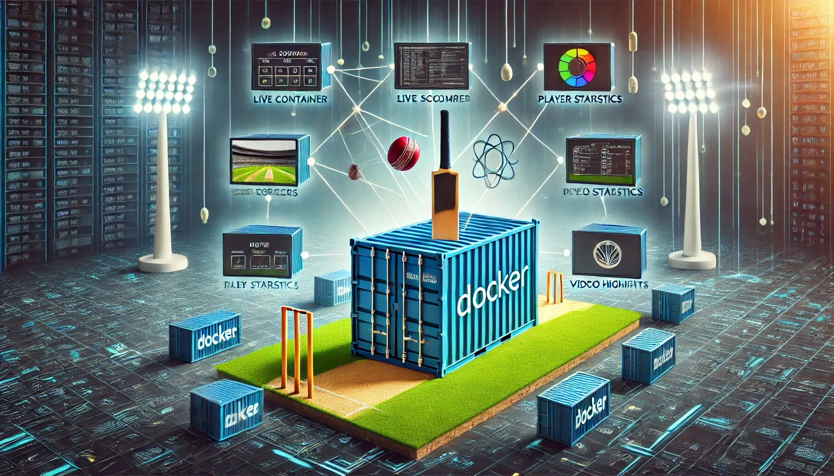

Slide 32
Aspect | Before Docker | After Docker
Environment Setup | Complex and time-consuming | Simple and quick
Dependencies | Conflicts between projects | Isolated per container
Deployment | Manual, error-prone | Automated, consistent
Scalability | Limited and difficult | Easy and efficient
Resource Usage | Heavy and inefficient | Lightweight and optimized
Portability | Environment-specific issues | Runs anywhere consistently
Testing | Slow, hard to replicate | Fast, identical environments

Slide 33
Docker is an open platform for developing, shipping, and running applications using containers that package code and dependencies together.
What is Docker?
Notes:
What is Docker?
Docker is an open platform for developing, shipping, and running applications using containers that package code and dependencies together.

Slide 34
In a nutshell
Aspect | Description
Container | A lightweight, standalone, executable package that includes everything needed to run an app.
Image | A read-only template used to create containers.
Layered File System | Containers use a layered file system, allowing efficient sharing and reuse of layers.
Isolation | Containers run in isolated environments, using namespaces and control groups (cgroups).
Portability | Containers can run consistently across environments (development, staging, production).
Resource Management | Docker allocates specific CPU, memory, and other resources to each container using cgroups.
Notes:
- Docker daemon is a background service that manages the state and lifecycle of containers
- The Docker client communicates with the daemon through REST API, sending commands to manage containers
- Registries are services where Docker images are stored and shared, with Docker Hub being a popular public registry
- Docker objects include containers, which are running instances of images, and images themselves, which are static templates for containers
- Docker's REST API provides programmatic access, allowing for automation and integration with other tools and services

Slide 35
In a nutshell
Networking | Containers can communicate using Docker networks, enabling flexibility in network configurations.
Storage | Data can persist using volumes, bind mounts, or tmpfs for containers.
Lifecycle Commands | Commands like docker run, docker start, docker stop, and docker rm manage containers.
Docker Daemon | A background service that handles requests to build, run, and manage containers.
Orchestration | Tools like Docker Compose or Kubernetes can manage multi-container applications.
Notes:
- Docker daemon is a background service that manages the state and lifecycle of containers
- The Docker client communicates with the daemon through REST API, sending commands to manage containers
- Registries are services where Docker images are stored and shared, with Docker Hub being a popular public registry
- Docker objects include containers, which are running instances of images, and images themselves, which are static templates for containers
- Docker's REST API provides programmatic access, allowing for automation and integration with other tools and services

Slide 36
Installation Of Docker
Docker installed on Windows
Docker can be installed on Mac
Docker can be installed on Ubuntu

Slide 37
Jenkins
The leading open source automation server, Jenkins provides hundreds of plugins to support building, deploying and automating any project.

Slide 38
Any Query
Please Ask your queries
Thank You

