Slide 1
UNIT -1 INT 332 DEVOPS VIRTUALIZATION AND CONFIGURATION MANAGEMENT
By : Divya Thakur
28300

Slide 2
Syllabus
Introduction to Docker. :
Introduction to Docker hub
Docker Architecture
Docker life cycle
Concept of Hyper-V
Installation of Docker. :
Installing Docker on Windows/Linux
Concept of Hyper-V
Basic Docker commands.

Slide 3
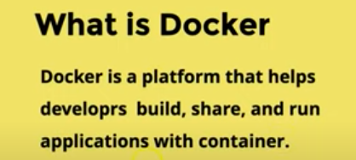

Slide 4
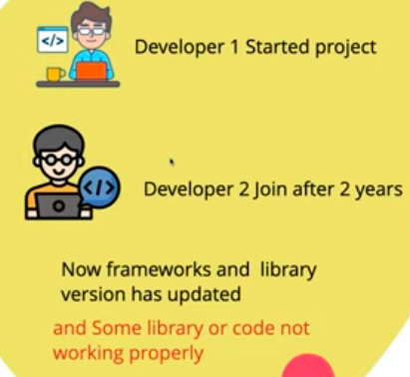
Need of Docker

Slide 5
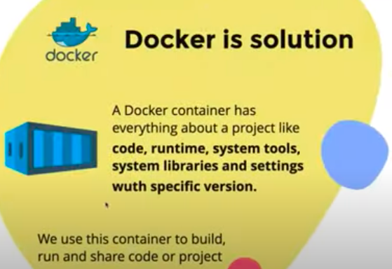

Slide 6
Architecture of Docker

Slide 7
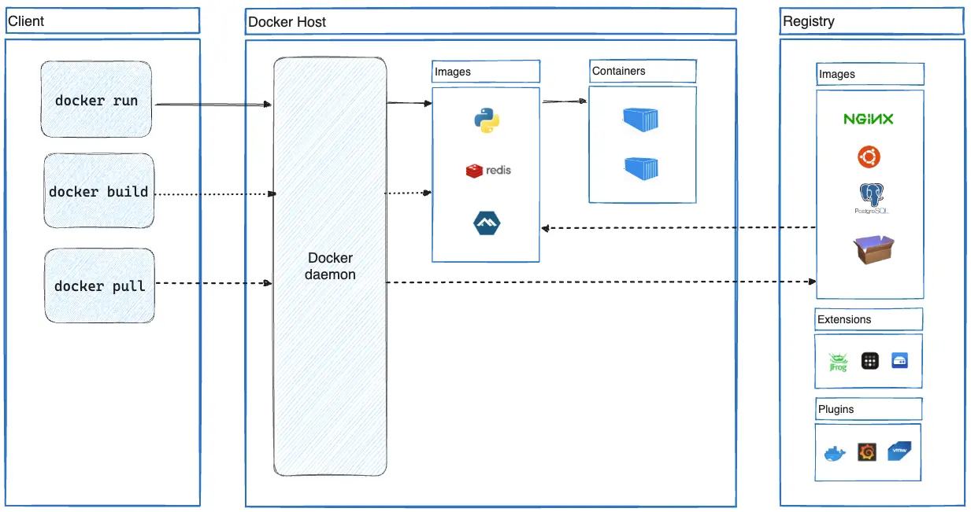

Slide 8
Docker
Docker Client:
Client (Where commands are executed)
On the left side, we see the Docker Client. This is where users interact with Docker using commands.
Examples shown in the image:
1️ docker run
Creates and starts a container from an image.
If the image is not available locally, Docker pulls it from the registry first.
docker run nginx

Slide 9
Docker 2...
docker build
Builds a Docker image from a Dockerfile.
The built image is stored in the local image repository.
Example: docker build -t myapp .

Slide 10
Docker 3
docker pull
Downloads an image from a Docker registry (like Docker Hub).
Example: docker pull redis
All these commands are sent to the Docker daemon.

Slide 11
Docker 4
Docker Host (Where Docker actually runs)
The Docker Host is the machine where Docker Engine runs.
It contains:
🧠 Docker Daemon (dockerd)
This is the core component.

Slide 12
Docker 5
Responsibilities:
Builds images
Runs containers
Manages networks
Manages storage
Communicates with registries
The client sends commands → Docker daemon executes them.

Slide 13
Docker 6
Docker Images
Inside the Docker host we see the Images section.
Examples shown:
Python
Redis
Alpine
What is an Image?
An image is a template used to create containers.

Slide 14
Docker 7
What is an Image?
An image is a template used to create containers.
Characteristics:
Read-only
Contains application + dependencies
Can be reused multiple times
Example:
An image might contain:
Python runtime
Application code
Libraries
Environment variables

Slide 15
Docker 8
Containers
Containers are running instances of images.
Example:
Image → Python App
Container → Running Python Application
Multiple containers can be created from one image.
Example:
Redis Image
├── Container 1
├── Container 2
└── Container 3

Slide 16
Docker 9
Containers are:
Lightweight
Isolated
Fast to start

Slide 17
Docker 10
Registry (Where images are stored)
On the right side, we see the Registry.
This is where Docker images are stored.
Examples shown:
Nginx
Ubuntu
PostgreSQL

Slide 18
Docker 11
The most common registry is:
Docker Hub
Example:
docker pull nginx
Flow:
Registry → Image → Docker Host → Container

Slide 19
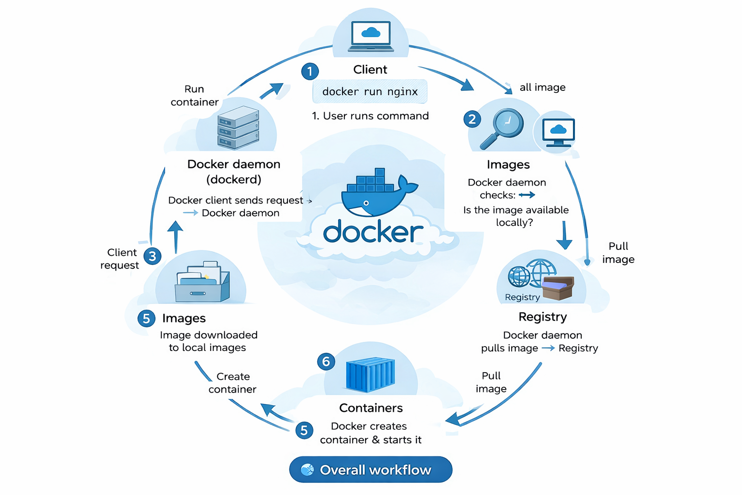
Docker 12

Slide 20
Docker uses a client-server architecture.
The Docker client talks to the Docker daemon, which does the heavy lifting of building, running, and distributing your Docker containers.
The Docker client and daemon communicate using a REST API, over UNIX sockets or a network interface.
Main Components :
The Docker daemon
The Docker client
Docker Host
Docker Desktop
Docker registries
Docker objects

Slide 21
1
REST API = Representational State Transfer Application Programming Interface
📌 Meaning:
A REST API is a way for applications to communicate over the internet using HTTP methods like:
GET
POST
PUT
DELETE

Slide 22
2
| HTTP Method | CRUD Operation | Purpose |
| ----------- | -------------- | -------------------- |
| GET | Read | Retrieve data |
| POST | Create | Add new data |
| PUT | Update | Modify existing data |
| DELETE | Delete | Remove data |

Slide 23
3
| Action | HTTP Request |
| ---------------- | ------------------- |
| Get all products | GET /products |
| Get one product | GET /products/1 |
| Add product | POST /products |
| Update product | PUT /products/10 |
| Delete product all | DELETE /products/all |

Slide 24
The Docker daemon
The Docker daemon listens for Docker API requests.
Manages Docker objects such as images, containers, networks, and volumes.
A daemon can also communicate with other daemons to manage Docker services.

Slide 25
The Docker client
The Docker client is away that many Docker users interact with Docker.
The docker command uses the Docker API.
When a docker client runs any docker command on the docker terminal then the terminal sends instructions to the daemon.
The main objective of the docker client is to provide a way to direct the pull of images from the docker registry and run them on the docker host.
The common commands which are used by clients are docker build, docker pull, and docker run.

Slide 26
Docker Host
A Docker host is a type of machine that is responsible for running more than one container.
It comprises the Docker daemon, Images, Containers, Networks, and Storage.

Slide 27
Docker Desktop
Docker Desktop is an easy-to-install application for your Mac, Windows or Linux environment that enables you to build and share containerized applications and microservices.

Slide 28
Docker registries
All the docker images are stored in the docker registry.
Docker Hub is a public registry that anyone can use.
Witth docker pull or docker run commands, Docker pulls the required images from your configured registry.
With docker push command, Docker pushes your image to your configured registry.

Slide 29
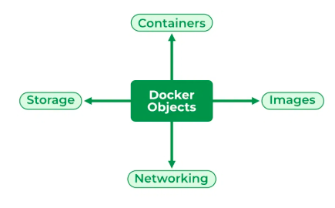
Docker Objects

Slide 30
Docker Storage
We can store data within the writable layer of the container but it requires a storage driver.
Storage driver controls and manages the images and containers on our docker host.
Types of Docker Storage :
Data Volumes
Volume Container
Directory Mounts
Storage Plugins

Slide 31
Docker Networking
Docker networking provides complete isolation for docker containers.
It means a user can link a docker container to many networks.
Types of Docker Network :
Bridge
Host
Overlay
None
macvlan

Slide 32
Docker 3
Macvlan = MAC Virtual LAN
It is a networking feature in Linux and Docker where:
Each container gets its own unique MAC address
Each container gets an IP address from the physical network
Containers behave like separate physical machines on the LAN

Slide 33
Normally Docker containers run behind NAT (bridge network).
Default Docker network:
Container → Docker bridge → Host → Network
With Macvlan:
Container → Directly connected to physical network
Network Address Translation

Slide 34
Docker 4
| Architecture Type | Description | Example |
| ----------------------------------- | -------------------------------------------------------------- | --------------------------------- |
| Monolithic Architecture | Entire application is built as a single unit | Traditional Java/PHP applications |
| Microservices Architecture | Application is divided into small independent services | Netflix, Amazon |
| Client–Server Architecture | Client requests services and server provides them | Web applications |
| Layered Architecture | Application divided into layers (presentation, business, data) | Enterprise applications |
| Event-Driven Architecture | Services communicate through events/messages | Kafka systems |
| Serverless Architecture | Application runs without managing servers | AWS Lambda |
| Peer-to-Peer Architecture | Devices communicate directly without central server | BitTorrent |
| Service-Oriented Architecture (SOA) | Services communicate through enterprise service bus | Enterprise systems |

Slide 35
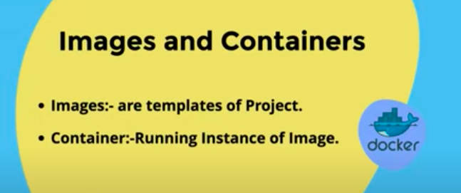

Slide 36
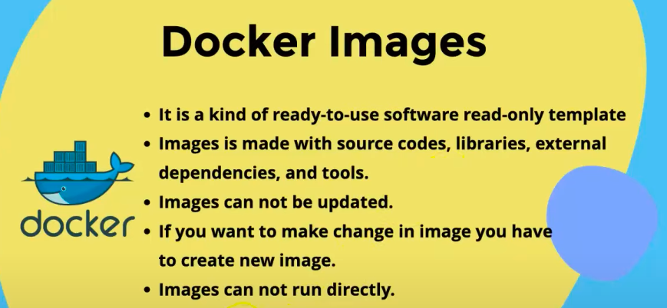

Slide 37
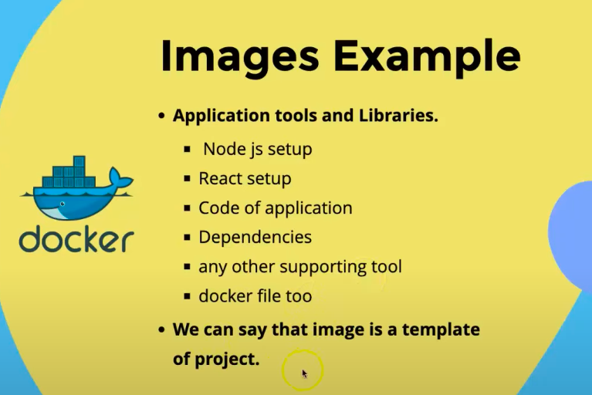

Slide 38
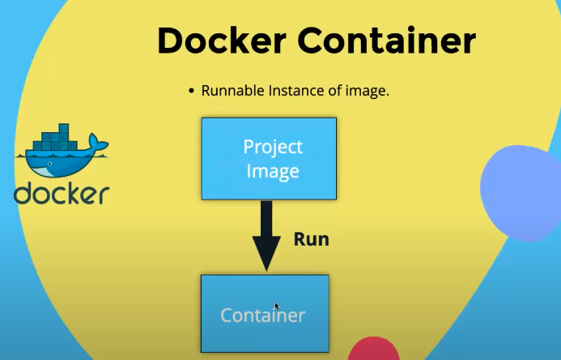

Slide 39
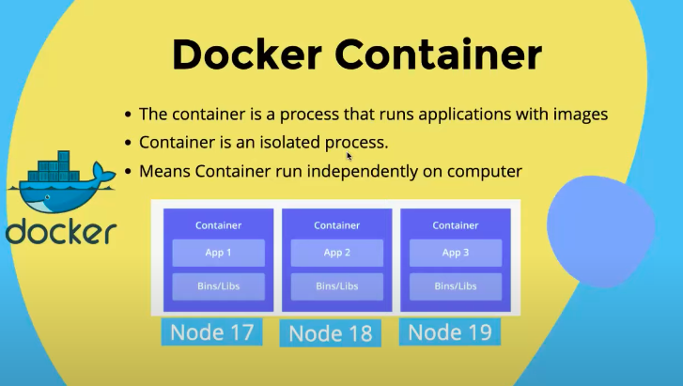

Slide 40
Docker Container Lifecycle Management
The lifecycle of a docker container consists of five states:
Created state
Running state
Paused state/unpaused state
Stopped state
Killed/Deleted state

Slide 41
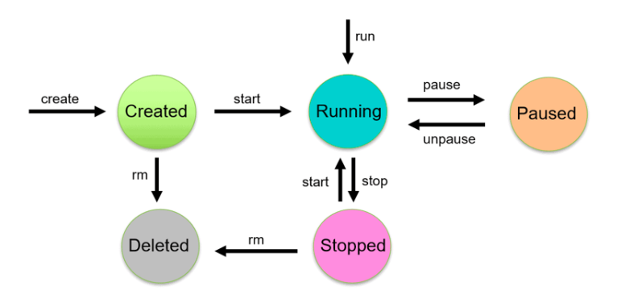

Slide 42
1. Created state:
Using the docker create command will create a new Docker container with the specified docker image.
$ docker create --name <container name> <image name>
Start Container:
To start a stopped container, we can use the docker start command.
$ docker start <container name>

Slide 43
2. Running State:
The docker run command will do the work of both “docker create” and “docker start” command.
This command will create a new container and run the image in the newly created container.
docker run <container-id>
or
docker run <container-name>
or
$ docker run -it --name <container name> <image name>
interactive terminal node

Slide 44
3. Paused state :
The current executing command in the docker container is paused.
Use the docker pause command to pause a running container.
$docker pause container <container-id or container-name>
Note: docker pause pauses all the processes in the container. It sends the SIGSTOP signal to pause the processes in the container.

Slide 45
4. Unpaused state
In the unpaused state, the paused container resumes executing the commands once it is unpaused.
$docker unpause <container-id or container-name>
Docker sends the SIGCONT signal to resume the process.

Slide 46
5. Stopped State:
In the stopped state, the container’s main process is shutdown gracefully.
Docker sends SIGTERM for graceful shutdown
$docker stop <container-id or container-name>

Slide 47
6.Kill State:
In the killed state, the container’s main processes are shutdown abruptly.
Docker sends a SIGKILL signal to kill the container’s main process.
$docker kill <container-id or container-name>

Slide 48
Concept of Hyper-Visor
A hypervisor is a system software that acts as an intermediary between computer hardware and virtual machines.
The hypervisor allocates the resources to VM’s.
Known as virtual machine manager.

Slide 49
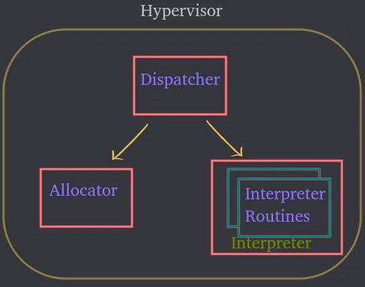
Modules of HV:

Slide 50
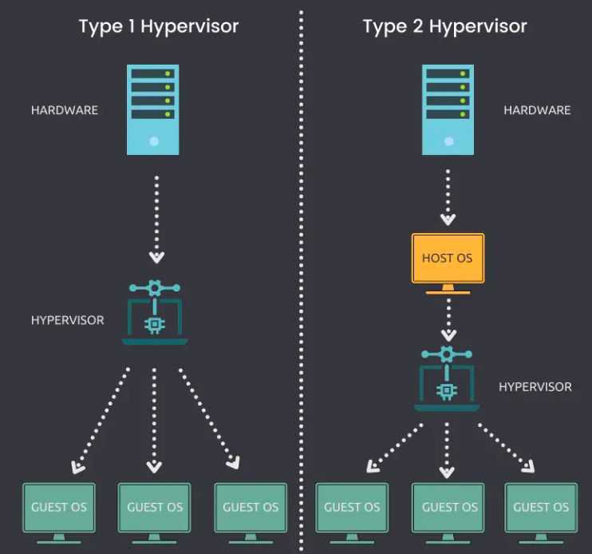

Slide 51
Types of Hypervisors
Two types:
Type 1 : bare metal hypervisor
: Installed and Directly runs on physical host.
: Direct access to resources.
: Eg :VMware ESXi, Citrix Hypervisor and Microsoft Hyper-V
Type 2 : hosted or embedded hypervisor
: Installed and requires an OS to run on a physical host.
: Indirect access to resources .
: Eg : VMware Workstation Player, VMware Workstation Pro and VirtualBox

Slide 52
Hypervisors vs containers
Hypervisors are used to create and run virtual machines (VMs), which each have their own complete operating systems, securely isolated from the others.
whereas
Containers package up just an app and its related services. This makes them more lightweight and portable than VMs, so they are often used for fast and flexible application development and movement.

Slide 53
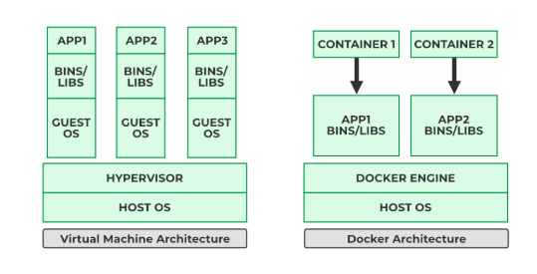

Slide 54
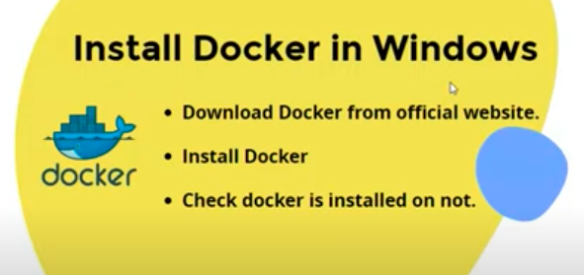
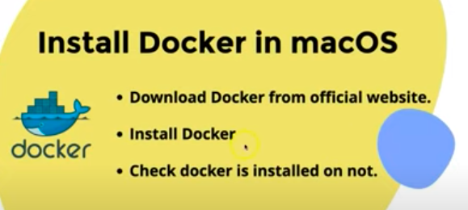
Link for installation :
https://www.docker.com/products/docker-desktop/

Slide 55
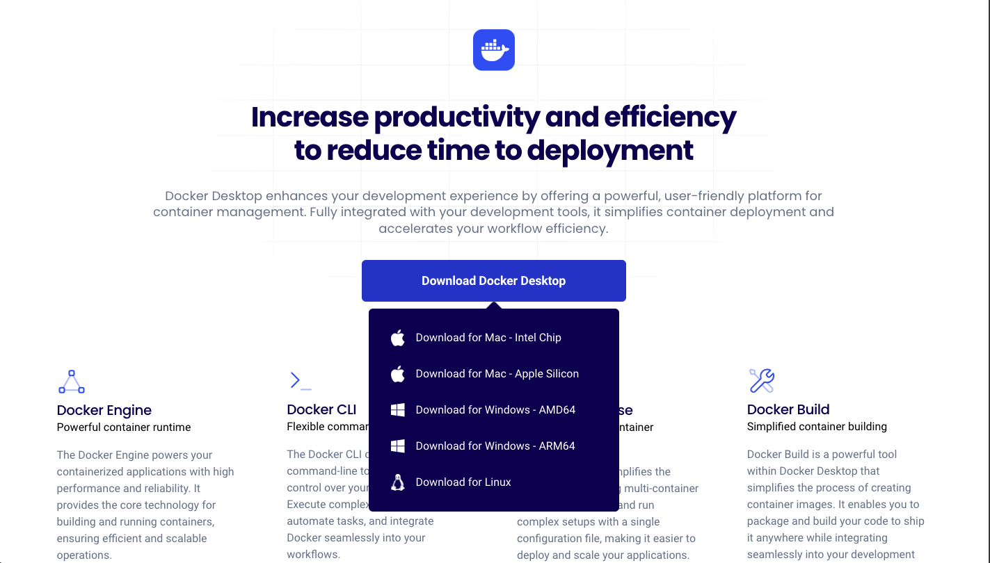

Slide 56
Commands to check the docker installation
To check the installation:
docker
To check version :
docker -v

Slide 57
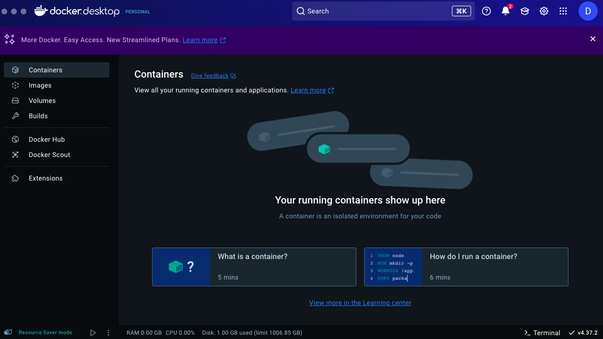

Slide 58
The Docker platform
Ability to package and run an application in a loosely isolated environment called a container.
The isolation and security lets you run many containers simultaneously on a given host.
Containers are lightweight and contain everything needed to run the application

Slide 59
Docker provides tooling and a platform to manage the lifecycle of your containers:
Develop your application and its supporting components using containers.
The container becomes the unit for distributing and testing your application.
When you're ready, deploy your application into your production environment, as a container or an orchestrated service.
This works the same whether your production environment is a local data center, a cloud provider, or a hybrid of the two.

Slide 60
Uses of Docker
Fast, consistent delivery of your applications.
Responsive deployment and scaling
Running more workloads on the same hardware

Slide 61
Docker Hub:
Docker Hub is a repository service and a cloud-based service.
Manage the sharing and storage of Docker images.
Contains the Push and Pull process for container images.
Can push your images as private or public.
Efficient Image Management

Slide 62
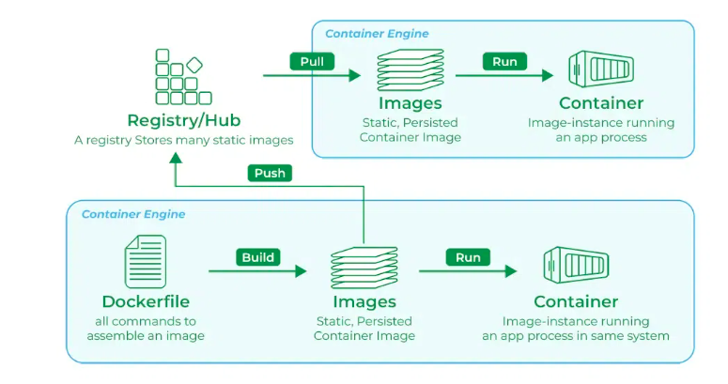
Docker hub Working

