Slide 1

Pedagogical Aid
Line Segment Intersection
Anuj Patel (ap8942)

Slide 2

Table of contents
01
02
03
04
05
06
Problem
Applications
Project Goal
Planned Layout
Timeline
References

Slide 3

Problem
Given a set of line segments, find all the points where they cross each other.

Slide 4
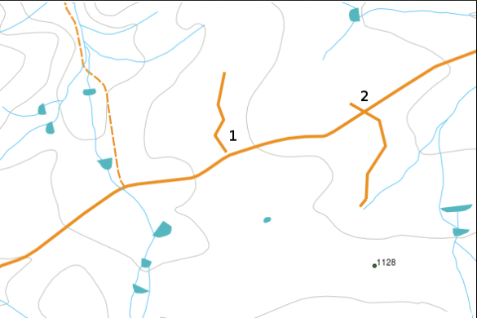
Applications
To optimize route planning, find all the locations where roads intersect.
Alternatively, Find all the possible locations of bridges, by checking the intersections between roads and rivers. (basically spatial analysis)
Used in computer graphics for tasks such as collision detection, ray tracing, and determining whether geometric shapes intersect
Used in physics simulations for particle interactions and collision detection in simulations of physical systems.
And much more...
Figure: 1 Spatial Analysis Application for Line Segment Intersection Problem
Figure 1: credits: https://docs.qgis.org/3.28/en/docs/gentle_gis_introduction/topology.html

Slide 5
Project Goal
Input
Initial list of line segments - Manual or Randomized Initializations
Output
List of Intersection Points
Features
Allows user to initialize line segments randomly in one click.
Allows user to click on graphs to initialize line segments.
Pause, Resume, Step and Reset buttons to observe algorithm execution.
Pseudocode highlighting.
Data Structure Visualization in real-time.
Animations to make everything look cleaner and nicer.

Slide 6
Planned Layout
Screen
Pseudocode
Chart
Pause
Resume
Step
Reset
Data Structure Visualization
Results

Slide 7
Timeline
Week No | Goals
Week 6 | Implementing Base Algorithm and Data Structures
Week 7 & 8 | Adding Graphs and Animations on Code Execution
Week 9 & 10 | Pseudocode Highlighting and Action Buttons
Week 11 | Random and Manual Initializations
Week 12 | Data Structure visualization
Week 13 - end | Code cleanup, bug fixes and preparing final documentation

Slide 8
References
CSCI 716 - Week 4 Lecture Slides
Line Segment Intersection Blogpost
Line Intersection problem - Philipp Kindermann (YouTube)

Slide 9
Questions ?

