Slide 1

Pedagogical Aid
Line Segment Intersection
Anuj Patel (ap8942)
Notes:
Hello and good afternoon everyone, I am anuj patel and the topic for my project (well which is same as the previous group) is a simulation tool for Line segment intersection problem USING line sweep method (same thing as everyone learned in week 4).

Slide 2

Table of contents
01
02
03
04
05
06
Problem
Applications
Algorithm
Technologies Used
Project Demo
References
Notes:
So this, is the table of contents for this presentation. I will first talk about the problem and its applications followed by project information and timeline for the same.

Slide 3

Problem
Given a set of line segments, find all the points where they cross each other.
Notes:
Talking about the problem, we have a set of different line segments, what our task is to find all the intersection points between them. I am not going too deep about how part of the problem because that’s out of scope for this talk and I assume everyone is already familiar.

Slide 4
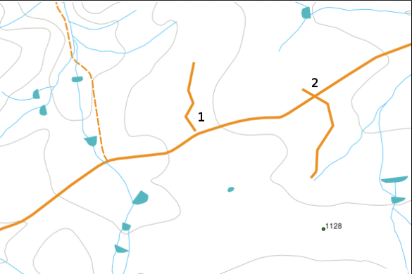
Applications
To optimize route planning, find all the locations where roads intersect.
Alternatively, Find all the possible locations of bridges, by checking the intersections between roads and rivers. (basically spatial analysis)
Used in computer graphics for tasks such as collision detection, ray tracing, and determining whether geometric shapes intersect
Used in physics simulations for particle interactions and collision detection in simulations of physical systems.
And much more...
Figure: 1 Spatial Analysis Application for Line Segment Intersection Problem
Figure 1: credits: https://docs.qgis.org/3.28/en/docs/gentle_gis_introduction/topology.html
Notes:
Here is a small list of applications where it is useful to find the intersection points. In the image, we have water bodies represented by blue strokes and roads represented by gold color. Assume that our job is to find the location of possible bridges from the image, we can find the intersections of roads and rivers to do so.
We can also use the same algorithm to check if 2 objects are colliding with each other by finding their intersections.
And that’s just a part of whats possible with same, so its important for students to know and understand this problem and its solution.

Slide 5
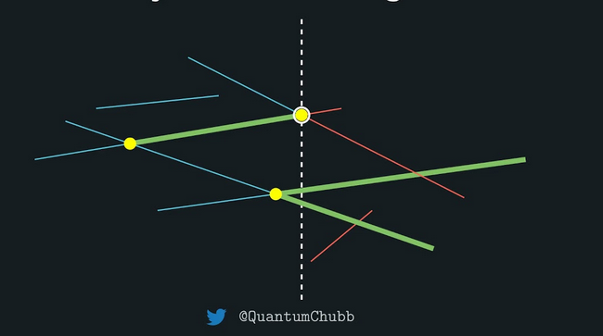
Algorithm
Bentley-Ottoman Line Segment Intersection Algorithm.
Time Complexity – O((n + k) * log(n)) where n is the number of line segments and k is the number of intersection points.
https://en.wikipedia.org/wiki/Bentley%E2%80%93Ottmann_algorithm

Slide 6
Technologies Used
HTML
CSS
Javascript (for algorithm implementation)

Slide 7
Project Demo

Slide 8
References
CSCI 716 - Week 4 Lecture Slides
Line Segment Intersection Blogpost
Line Intersection problem - Philipp Kindermann (YouTube)
Project Link - https://anuj67851.github.io/CompGeoProject/

Slide 9
Questions ?

