Slide 1

Pedagogical Aid
Line Segment Intersection
Anuj Patel (ap8942)
Notes:
Hello and good afternoon everyone, I am anuj patel and the topic for my project (well which is same as the previous group) is a simulation tool for Line segment intersection problem USING line sweep method (same thing as everyone learned in week 4).

Slide 2

Table of contents
01
02
03
04
05
06
Problem
Applications
Project Goal
Planned Layout
Timeline
References
Notes:
So this, is the table of contents for this presentation. I will first talk about the problem and its applications followed by project information and timeline for the same.

Slide 3

Problem
Given a set of line segments, find all the points where they cross each other.
Notes:
Talking about the problem, we have a set of different line segments, what our task is to find all the intersection points between them. I am not going too deep about how part of the problem because that’s out of scope for this talk and I assume everyone is already familiar.

Slide 4
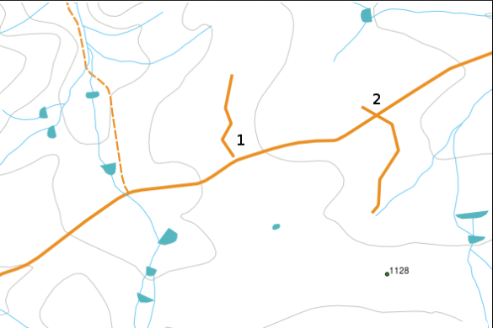
Applications
To optimize route planning, find all the locations where roads intersect.
Alternatively, Find all the possible locations of bridges, by checking the intersections between roads and rivers. (basically spatial analysis)
Used in computer graphics for tasks such as collision detection, ray tracing, and determining whether geometric shapes intersect
Used in physics simulations for particle interactions and collision detection in simulations of physical systems.
And much more...
Figure: 1 Spatial Analysis Application for Line Segment Intersection Problem
Figure 1: credits: https://docs.qgis.org/3.28/en/docs/gentle_gis_introduction/topology.html
Notes:
Here is a small list of applications where it is useful to find the intersection points. In the image, we have water bodies represented by blue strokes and roads represented by gold color. Assume that our job is to find the location of possible bridges from the image, we can find the intersections of roads and rivers to do so.
We can also use the same algorithm to check if 2 objects are colliding with each other by finding their intersections.
And that’s just a part of whats possible with same, so its important for students to know and understand this problem and its solution.

Slide 5
Project Goal
Input
Initial list of line segments - Manual or Randomized Initializations
Output
List of Intersection Points
Features
Allows user to initialize line segments randomly in one click.
Allows user to click on graphs to initialize line segments.
Pause, Resume, Step and Reset buttons to observe algorithm execution.
Pseudocode highlighting.
Data Structure Visualization in real-time.
Animations to make everything look cleaner and nicer.
Notes:
And that’s where this project comes in, the main aim of this project is to help others understand line segment intersection problem using the line sweep algorithm which has an nlogn time complexity, so more on the efficient side of spectrum.
The application will take set of line segments as input, either randomly initialized by clicking one button or manually initialized by clicking different points on graph, both of which be possible.
The output will be a list of intersection points for all those line segments.
There is also a list of features I plan to implement for the application including pseudocode highlighting and code control flow buttons.

Slide 6
Planned Layout
Screen
Pseudocode
Chart
Pause
Number of Line Segments
Initialize
Pause
Resume
Step
Reset
Data Structure Visualization
Results
Notes:
This is the planned layout for the application, we have pseudocode area, chart area, results, stepper buttons, and random initialization button. Should be pretty easy to understand and use. I do hope everything fits in a 1080p screen because having a scrollbar will make it look bit ugly.

Slide 7
Timeline
Week No | Goals
Week 6 | Implementing Base Algorithm and Data Structures
Week 7 & 8 | Adding Graphs and Animations on Code Execution
Week 9 & 10 | Pseudocode Highlighting and Action Buttons
Week 11 | Random and Manual Initializations
Week 12 | Data Structure visualization
Week 13 - end | Code cleanup, bug fixes and preparing final documentation
Notes:
This is the general timeline for the project, a little bit more detailed one is on the website.

Slide 8
References
CSCI 716 - Week 4 Lecture Slides
Line Segment Intersection Blogpost
Line Intersection problem - Philipp Kindermann (YouTube)
Project Link - https://anuj67851.github.io/CompGeoProject/
Notes:
We have references here.

Slide 9
Questions ?
Notes:
Erm, questions ?

