Slide 1
HAPPIEST HEALTH · DIGITAL TWIN CHALLENGE 2026
BODY × ENVIRONMENT DIGITAL TWIN
PranaGuard
24 hours
A connected respiratory twin.
An honest forecast of what comes next.
48 hours
72 hours
COPD exacerbation forecasting · 24 / 48 / 72 hours
[TEAM NAME PENDING]
[COLLEGE / INCUBATOR PENDING]
All patients synthetic.
Not clinically validated.
PRANAGUARD / SYNTHETIC PROOF OF CONCEPT · NOT CLINICALLY VALIDATED
01 / 16
Notes:
PranaGuard research prototype. All patient physiology/outcomes synthetic. No clinical validation. Use docs/demo/DEMO_SCRIPT.md for the timed narration. Actual metrics: artifacts/evaluation.json. Environmental attribution: Open-Meteo / CAMS, CC BY 4.0. Public repository/video status remains pending until actually verified.

Slide 2
01 / PROBLEM & INDIAN HEALTHCARE USE CASE
Respiratory health is a moving picture.
A clinician needs changing patient context, not another disconnected measurement.
The clinical question
Synthetic COPD outpatient cohort
Could a personalized combination of history, body signals, symptoms and environment support an earlier review conversation?
Clinician review, acknowledgement and action logging
Pune · Mumbai · Delhi · Bengaluru ambient examples
The prototype boundary
This build explores the workflow. It does not demonstrate fewer admissions, clinical warning lead time or treatment benefit.
No clinical participants or hospital partnership claimed
PRANAGUARD / SYNTHETIC PROOF OF CONCEPT · NOT CLINICALLY VALIDATED
02 / 16
Notes:
PranaGuard research prototype. All patient physiology/outcomes synthetic. No clinical validation. Use docs/demo/DEMO_SCRIPT.md for the timed narration. Actual metrics: artifacts/evaluation.json. Environmental attribution: Open-Meteo / CAMS, CC BY 4.0. Public repository/video status remains pending until actually verified.

Slide 3
02 / TARGET OUTCOME
Three horizons. Three actual models.
New synthetic onset in (t, t+h] — not diagnosis, triage or validated lead time.
24
48
72
HOUR HORIZON
HOUR HORIZON
HOUR HORIZON
Independent fitted + calibrated estimate
Independent fitted + calibrated estimate
Independent fitted + calibrated estimate
Active episodes, initial72h calibration and incomplete future follow-up are excluded from evaluation. Independent horizons can be non-monotonic.
PRANAGUARD / SYNTHETIC PROOF OF CONCEPT · NOT CLINICALLY VALIDATED
03 / 16
Notes:
PranaGuard research prototype. All patient physiology/outcomes synthetic. No clinical validation. Use docs/demo/DEMO_SCRIPT.md for the timed narration. Actual metrics: artifacts/evaluation.json. Environmental attribution: Open-Meteo / CAMS, CC BY 4.0. Public repository/video status remains pending until actually verified.

Slide 4
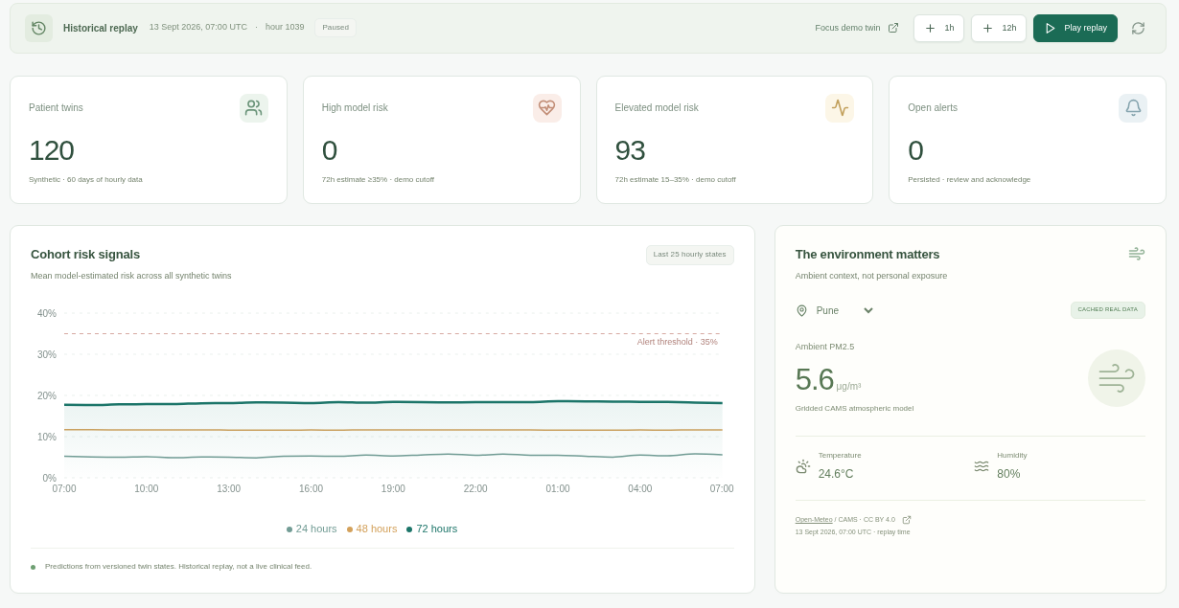
03 / PRANAGUARD SOLUTION
One clinician workspace, connected end to end.
Cohort risk & source freshness
Patient-specific baseline and history
Explanations and isolated scenarios
Persisted alerts and review trail
Actual running React frontend screenshot. Values are API-fed synthetic model estimates, not a mockup.
PRANAGUARD / SYNTHETIC PROOF OF CONCEPT · NOT CLINICALLY VALIDATED
04 / 16
Notes:
PranaGuard research prototype. All patient physiology/outcomes synthetic. No clinical validation. Use docs/demo/DEMO_SCRIPT.md for the timed narration. Actual metrics: artifacts/evaluation.json. Environmental attribution: Open-Meteo / CAMS, CC BY 4.0. Public repository/video status remains pending until actually verified.

Slide 5
04 / WHY IT QUALIFIES AS A RESEARCH DIGITAL TWIN
A stateful twin — not a static prediction page.
01
Persistent identity
Patient-specific state and immutable SQLite versions.
02
Personal calibration
First72h baseline precedes fitted and replayed predictions.
03
Hourly updates
Observed body/environment context advances deterministically.
04
Future exploration
Three fitted risk models plus separate conditional branches.
05
Auditable review
Saved explanations-by-state, alerts, actions and scenarios.
PRANAGUARD / SYNTHETIC PROOF OF CONCEPT · NOT CLINICALLY VALIDATED
05 / 16
Notes:
PranaGuard research prototype. All patient physiology/outcomes synthetic. No clinical validation. Use docs/demo/DEMO_SCRIPT.md for the timed narration. Actual metrics: artifacts/evaluation.json. Environmental attribution: Open-Meteo / CAMS, CC BY 4.0. Public repository/video status remains pending until actually verified.

Slide 6
PRANAGUARD / IMPLEMENTED SYSTEM ARCHITECTURE
A persistent twin, not a static score
twin observed past → independent scenario branch
01
Data sources
02
Ingestion & replay
03
Validation & features
04
Digital-twin state
Synthetic body/clinical streams
Cached real ambient/weather
Hourly cohort-wide replay
Seeded UTC clock
Ranges, duplicates, timestamps
Causal6h /24h windows
Identity + first72h baseline
Current data + version history
Synthetic + cached inputs
engine.py
validation.py · features.py
engine.py
08
SQLite persistence
07
What-if simulation
06
Explainability & alerts
05
ML & calibration
States, cursor, alerts, actions
Scenarios saved separately
Cloned past + projected inputs
Separate branches, no future data
Native TreeSHAP on demand
Persisted threshold alerts
Three LightGBM + Platt models
24h /48h /72h · LR baseline
store.py · SQLite WAL
engine.py
ml.py · engine.py
ml.py · models.joblib
prediction → atomic state persistence
09
FastAPI APIs / WS
10
React dashboard
Offline training & evaluation artifacts
REST + WebSocket invalidation
Optional write-access token
7 working clinician views
Real API charts and controls
15 executed experiments · patient/time-disjoint splits · ≥72h purge
Models, calibration, ROC/PR, ablations and provenance versioned
main.py · /docs
React clinician frontend
Solid arrows: logical capability chain. Dashed: cross-cutting runtime branches. SQLite writes occur on every twin update; explanations and scenarios are API-triggered. All patients synthetic; cached ambient data are historical. The 72h model is weak and its calibration slope is negative.
RESEARCH PROTOTYPE · NO CLINICAL VALIDATION · ORIGINAL EDITABLE VECTOR SHAPES

Slide 7
06 / DATA PROVENANCE
Know what is real. Know what is synthetic.
SYNTHETIC · clinical/body/outcomes
REAL CACHED · ambient model products
120 patients × 60 days = 172,800 hourly records
263 stochastic artificial onsets
Seed2026 · no real people or hospital records
Generator is not medically calibrated
8 successfully retrieved public API responses
4 cities × air + weather; 1,440 hours/cache
2026-08-01 to 2026-09-29 UTC
Open-Meteo / CAMS · CC BY 4.0
Ambient grids are not personal exposure. Historical products are not live or verified as-issued forecasts. URLs, retrieval times, licenses and SHA-256 checksums are versioned.
PRANAGUARD / SYNTHETIC PROOF OF CONCEPT · NOT CLINICALLY VALIDATED
07 / 16
Notes:
PranaGuard research prototype. All patient physiology/outcomes synthetic. No clinical validation. Use docs/demo/DEMO_SCRIPT.md for the timed narration. Actual metrics: artifacts/evaluation.json. Environmental attribution: Open-Meteo / CAMS, CC BY 4.0. Public repository/video status remains pending until actually verified.

Slide 8
07 / AI & ML METHODOLOGY
The split comes before the score.
No patient identity, future events, future exposure or full-course baseline averages enter the models.
TRAIN
CALIBRATION
TEST
72 patients
24 patients
24 patients
14,605 sampled rows
Imputer/scaler fitted here
1,377 sampled rows
Separate Platt fits here
4,699 hourly windows
Later dates; untouched for tuning
Patient-disjoint and calendar-time-disjoint, with ≥72h purges.
Fixed hyperparameters; LR baseline + 4 LightGBM input groups × 3 horizons.
Causal trailing features; first72h warm-up; no test-selected threshold or tuning.
PRANAGUARD / SYNTHETIC PROOF OF CONCEPT · NOT CLINICALLY VALIDATED
08 / 16
Notes:
PranaGuard research prototype. All patient physiology/outcomes synthetic. No clinical validation. Use docs/demo/DEMO_SCRIPT.md for the timed narration. Actual metrics: artifacts/evaluation.json. Environmental attribution: Open-Meteo / CAMS, CC BY 4.0. Public repository/video status remains pending until actually verified.

Slide 9
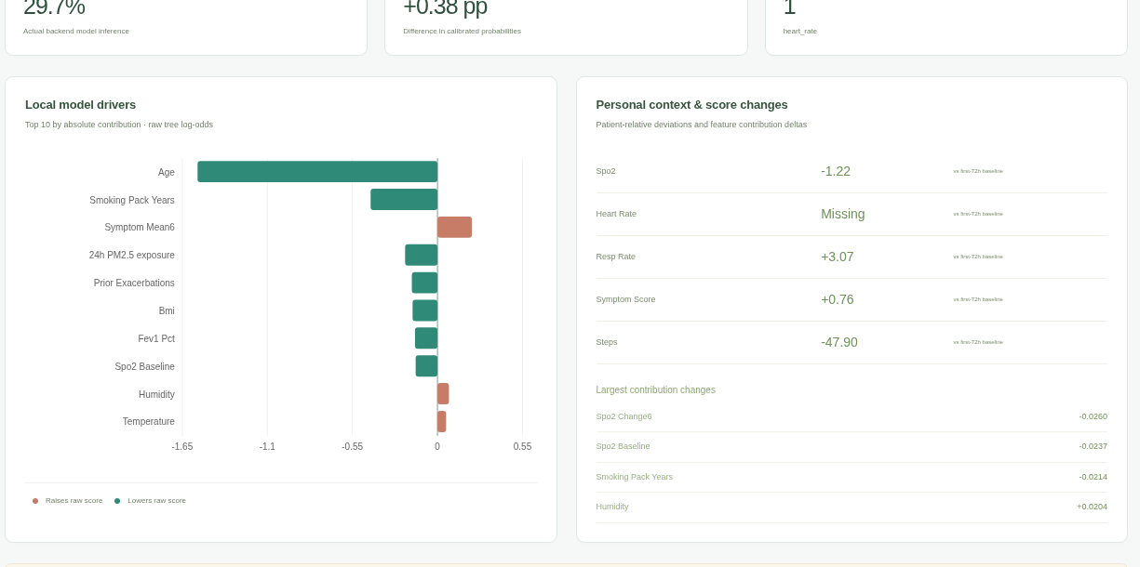
08 / ACTUAL EXPLAINABILITY
Explain the model — and its failure modes.
Native exact TreeSHAP
Base + contributions = raw log-odds
Patient-relative deviations and driver deltas
Critical caveat: 72h Platt slope is negative. Raw contribution direction is not calibrated-risk direction. Association ≠ causation.
PRANAGUARD / SYNTHETIC PROOF OF CONCEPT · NOT CLINICALLY VALIDATED
09 / 16
Notes:
PranaGuard research prototype. All patient physiology/outcomes synthetic. No clinical validation. Use docs/demo/DEMO_SCRIPT.md for the timed narration. Actual metrics: artifacts/evaluation.json. Environmental attribution: Open-Meteo / CAMS, CC BY 4.0. Public repository/video status remains pending until actually verified.

Slide 10
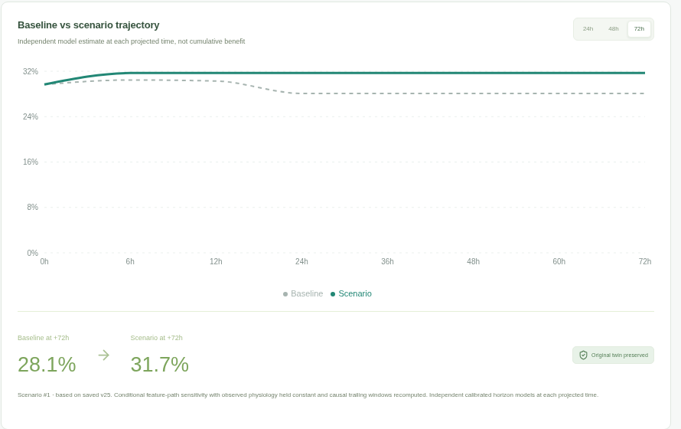
09 / CONDITIONAL WHAT-IF STUDIO
What changes when assumptions change?
A model sensitivity branch, not a validated treatment or physiological response simulator.
PM2.5 −80% to +100%
Adherence feature0–1
Activity0.5–1.5× steps
Observed physiology held constant
Original twin never overwritten
Counterintuitive results are possible. No proven health benefit is implied.
PRANAGUARD / SYNTHETIC PROOF OF CONCEPT · NOT CLINICALLY VALIDATED
10 / 16
Notes:
PranaGuard research prototype. All patient physiology/outcomes synthetic. No clinical validation. Use docs/demo/DEMO_SCRIPT.md for the timed narration. Actual metrics: artifacts/evaluation.json. Environmental attribution: Open-Meteo / CAMS, CC BY 4.0. Public repository/video status remains pending until actually verified.

Slide 11
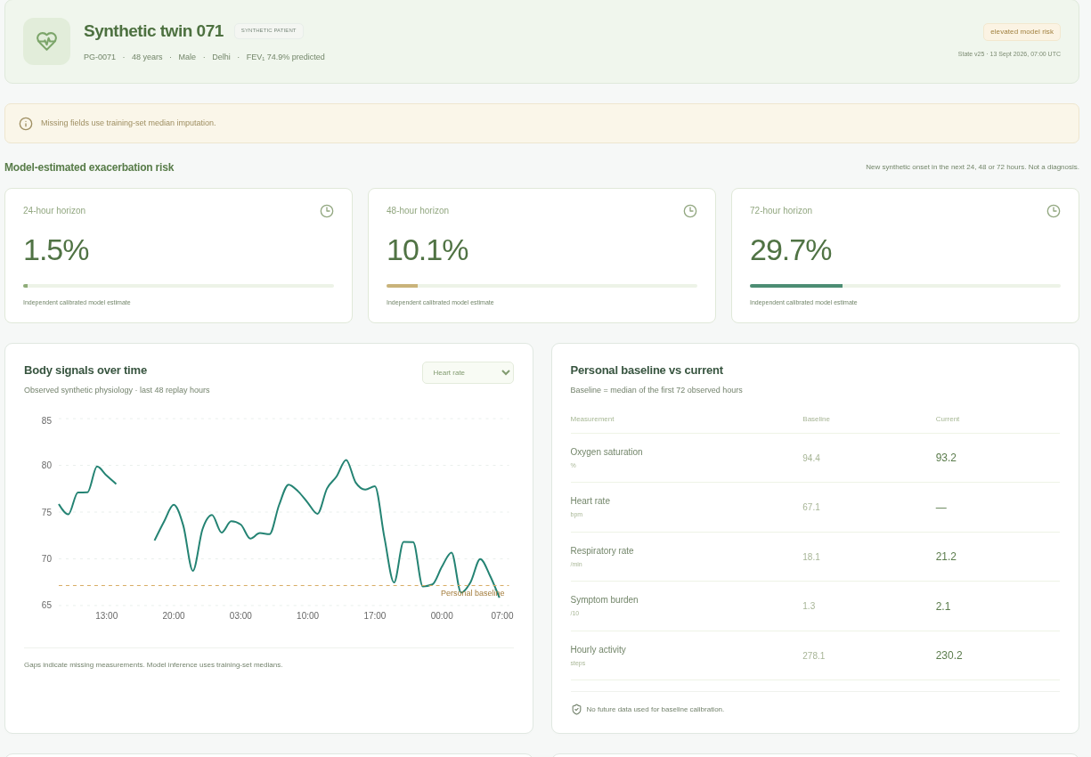
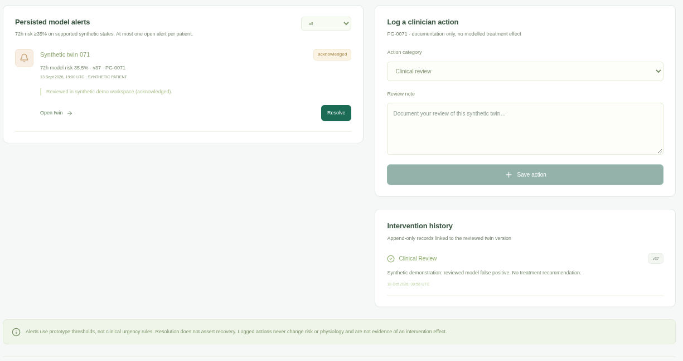
10 / ACTUAL FRONTEND WORKFLOW
From review to an auditable action.
Open a twin → inspect evidence → review an alert → document an action → reload persisted state.
Actual patient twin, personal baseline and versioned risks
Actual model-generated false-positive alert and persisted review note
PRANAGUARD / SYNTHETIC PROOF OF CONCEPT · NOT CLINICALLY VALIDATED
11 / 16
Notes:
PranaGuard research prototype. All patient physiology/outcomes synthetic. No clinical validation. Use docs/demo/DEMO_SCRIPT.md for the timed narration. Actual metrics: artifacts/evaluation.json. Environmental attribution: Open-Meteo / CAMS, CC BY 4.0. Public repository/video status remains pending until actually verified.

Slide 12
11 / ACTUAL EXECUTED EVALUATION
The engineering works. The model needs work.
Synthetic held-out results only. Poor72h discrimination and zero sensitivity at the fixed.35 cutoff.
MODEL / HORIZON | AUROC | AUPRC | BRIER
24h · LightGBM | 0.6916 | 0.0882 | 0.0279
24h · Logistic Reg. | 0.6619 | 0.1993 | 0.0260
48h · LightGBM | 0.6144 | 0.0968 | 0.0557
48h · Logistic Reg. | 0.6285 | 0.1841 | 0.0537
72h · LightGBM | 0.3951 | 0.0593 | 0.0853
72h · Logistic Reg. | 0.6253 | 0.2281 | 0.0800
72h prevalence:0.0773
72h AUPRC:0.0593 (below baseline)
Test:24 patients,4,699 correlated hours.150 patient-cluster bootstrap resamples in JSON.
PRANAGUARD / SYNTHETIC PROOF OF CONCEPT · NOT CLINICALLY VALIDATED
12 / 16
Notes:
PranaGuard research prototype. All patient physiology/outcomes synthetic. No clinical validation. Use docs/demo/DEMO_SCRIPT.md for the timed narration. Actual metrics: artifacts/evaluation.json. Environmental attribution: Open-Meteo / CAMS, CC BY 4.0. Public repository/video status remains pending until actually verified.

Slide 13
12 / ACTUAL ABLATION OUTCOMES
More features did not establish better forecasts.
Same leakage-aware split, fixed model choices and separate calibration for every experiment.
72H INPUT GROUP | AUROC | AUPRC | BRIER
Static Only | 0.2197 | 0.0550 | 0.0816
Body Stream | 0.6358 | 0.1086 | 0.0815
Full Environment | 0.3119 | 0.0514 | 0.0816
Personalized | 0.3951 | 0.0593 | 0.0853
No improvement claim
Full environment72h is worse than body streams. Personalization does not establish benefit. Calibration instability is retained, not concealed.
Only5 held-out test-window onsets.0 detected at72h ≥35%; median lead time is undefined. All primary horizons have zero sensitivity at that cutoff. Small synthetic samples and shared exposure create major uncertainty.
PRANAGUARD / SYNTHETIC PROOF OF CONCEPT · NOT CLINICALLY VALIDATED
13 / 16
Notes:
PranaGuard research prototype. All patient physiology/outcomes synthetic. No clinical validation. Use docs/demo/DEMO_SCRIPT.md for the timed narration. Actual metrics: artifacts/evaluation.json. Environmental attribution: Open-Meteo / CAMS, CC BY 4.0. Public repository/video status remains pending until actually verified.

Slide 14
13 / DETERMINISTIC DEMONSTRATION SCENARIO
A reproducible demo, including a false positive.
RESET
ADVANCE
REVIEW
DISCLOSE
1039
+12h
35.51%
label = 0
24h persisted history · focus PG-0071
Replay to1051 · state version37
Actual calibrated72h risk crosses.35
Retrospective score-selected false positive
Show the full workflow
Play/pause → reset → +12h → explanation → acknowledge/log/resolve → scenario → reload → actual validation.
PRANAGUARD / SYNTHETIC PROOF OF CONCEPT · NOT CLINICALLY VALIDATED
14 / 16
Notes:
PranaGuard research prototype. All patient physiology/outcomes synthetic. No clinical validation. Use docs/demo/DEMO_SCRIPT.md for the timed narration. Actual metrics: artifacts/evaluation.json. Environmental attribution: Open-Meteo / CAMS, CC BY 4.0. Public repository/video status remains pending until actually verified.

Slide 15
14 / SAFETY, LIMITATIONS & FUTURE VALIDATION
Clinical claims require clinical evidence.
Synthetic generator and labels are not clinically calibrated.
Next, before real-world use
Ethics/consent + adjudicated real outcomes
New pre-registered development data
External prospective patient/time/site validation
Calibration, fairness and uncertainty assessment
Secure ingestion and clinician safety governance
72h model/calibration are unstable; no useful warning is established.
Ambient grids ≠ personal dose; scenarios are non-causal.
Local demo token ≠ production identity, privacy or governance.
PRANAGUARD / SYNTHETIC PROOF OF CONCEPT · NOT CLINICALLY VALIDATED
15 / 16
Notes:
PranaGuard research prototype. All patient physiology/outcomes synthetic. No clinical validation. Use docs/demo/DEMO_SCRIPT.md for the timed narration. Actual metrics: artifacts/evaluation.json. Environmental attribution: Open-Meteo / CAMS, CC BY 4.0. Public repository/video status remains pending until actually verified.

Slide 16
15 / CONCLUSION & SUBMISSION GATE
Build the workflow. Measure honestly.
Persistent state. Real inference.
Transparent limitations.
120 synthetic twins · 60 days · 3 horizons
Reproducible experiments and a working clinician workspace.
Team / institution details: PENDING
Public GitHub + signed-out file checks: PENDING
Actual20min Unlisted YouTube upload: PENDING
NOT FULLY SUBMISSION-READY until the mandatory external items are genuinely complete.
PRANAGUARD / SYNTHETIC PROOF OF CONCEPT · NOT CLINICALLY VALIDATED
16 / 16
Notes:
PranaGuard research prototype. All patient physiology/outcomes synthetic. No clinical validation. Use docs/demo/DEMO_SCRIPT.md for the timed narration. Actual metrics: artifacts/evaluation.json. Environmental attribution: Open-Meteo / CAMS, CC BY 4.0. Public repository/video status remains pending until actually verified.

