Slide 1

May 30, 2023
Anuja Ajay
245235

Slide 2
What is Terraform?
Terraform is an open-source Infrastructure as Code (IaC) tool developed by HashiCorp.
It allows you to automate and manage your infrastructure, your platform and your services that run on that platform.
Terraform uses a declarative approach, allowing you to define infrastructure configurations as code.

Slide 3
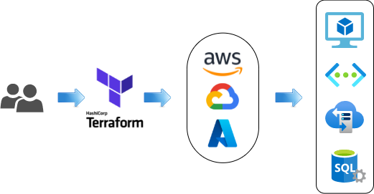
Key features and benefits of Terraform
Infrastructure as Code (IaC): Terraform treats infrastructure configurations as code, making it easy to manage, version, and collaborate on infrastructure changes.
Multi-Cloud Provisioning: Terraform supports multiple cloud providers, allowing you to provision resources on AWS, Azure, Google Cloud, and more using a single configuration.
State Management: Terraform keeps track of your infrastructure state, making it easy to update and manage resources over time.
Plan and Preview: Terraform provides a preview of changes before applying them, helping you understand the impact and avoid unintended modifications.
Scalability and Reusability: Terraform lets you create reusable infrastructure modules, enabling scalability and consistency across projects.

Slide 4
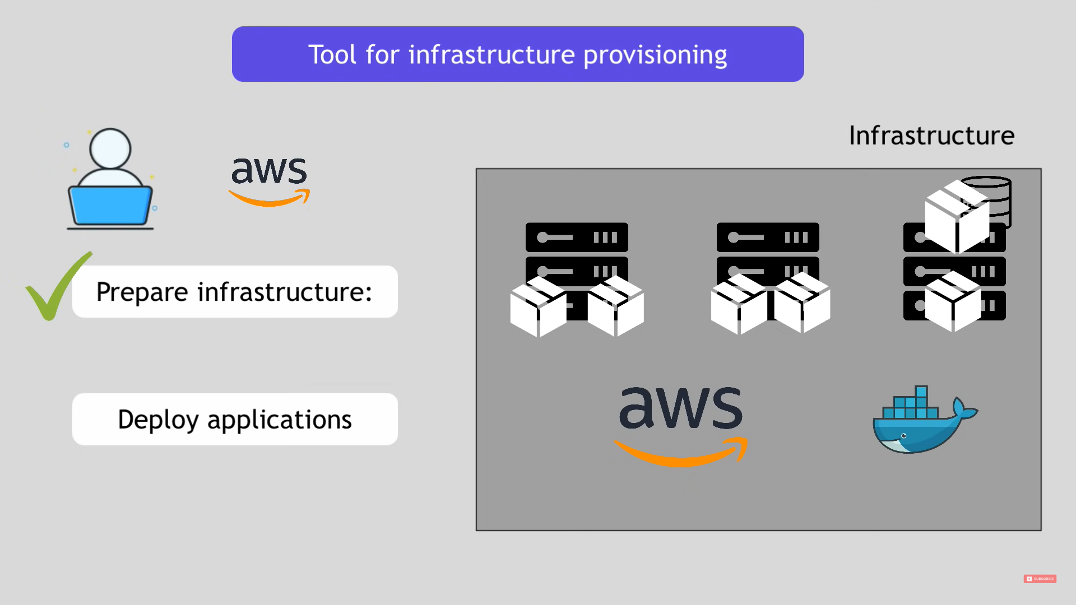

Slide 5
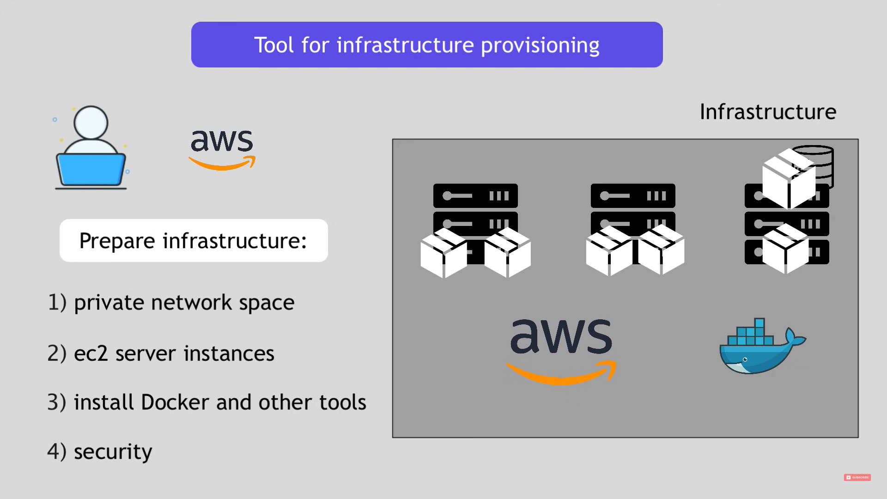

Slide 6
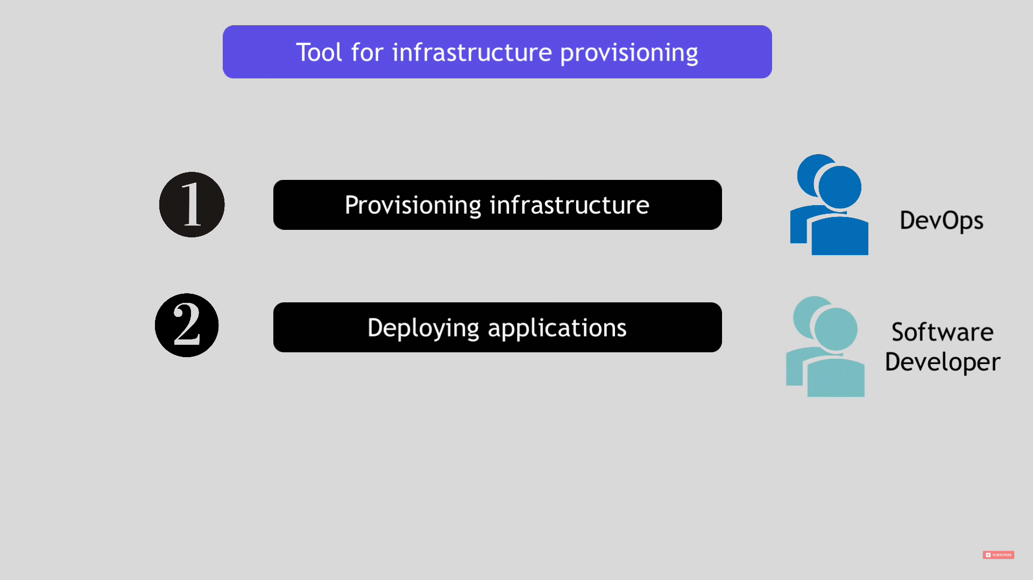

Slide 7
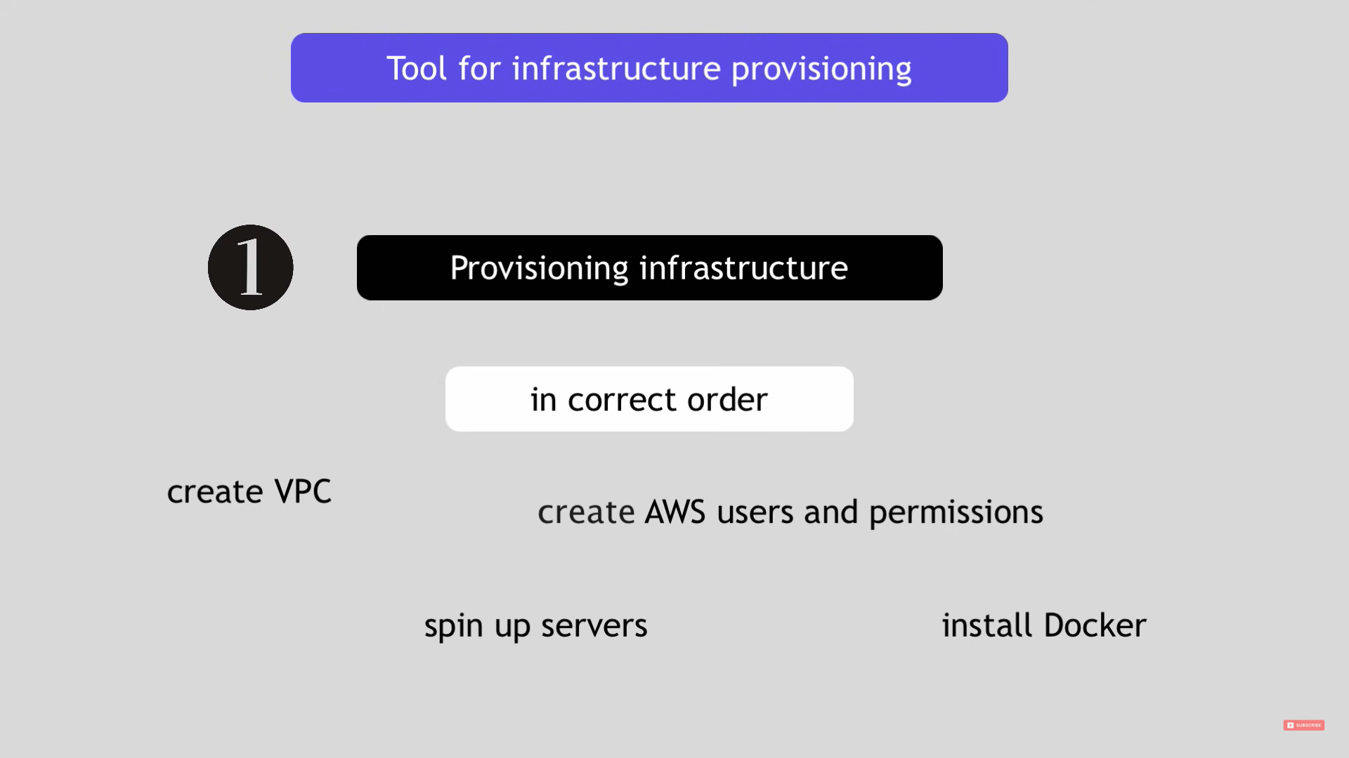

Slide 8
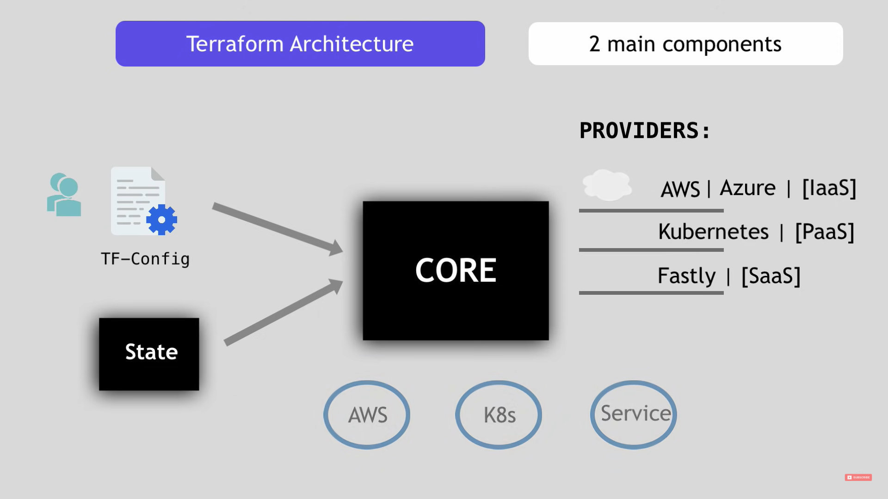
Terraform Architecture

Slide 9
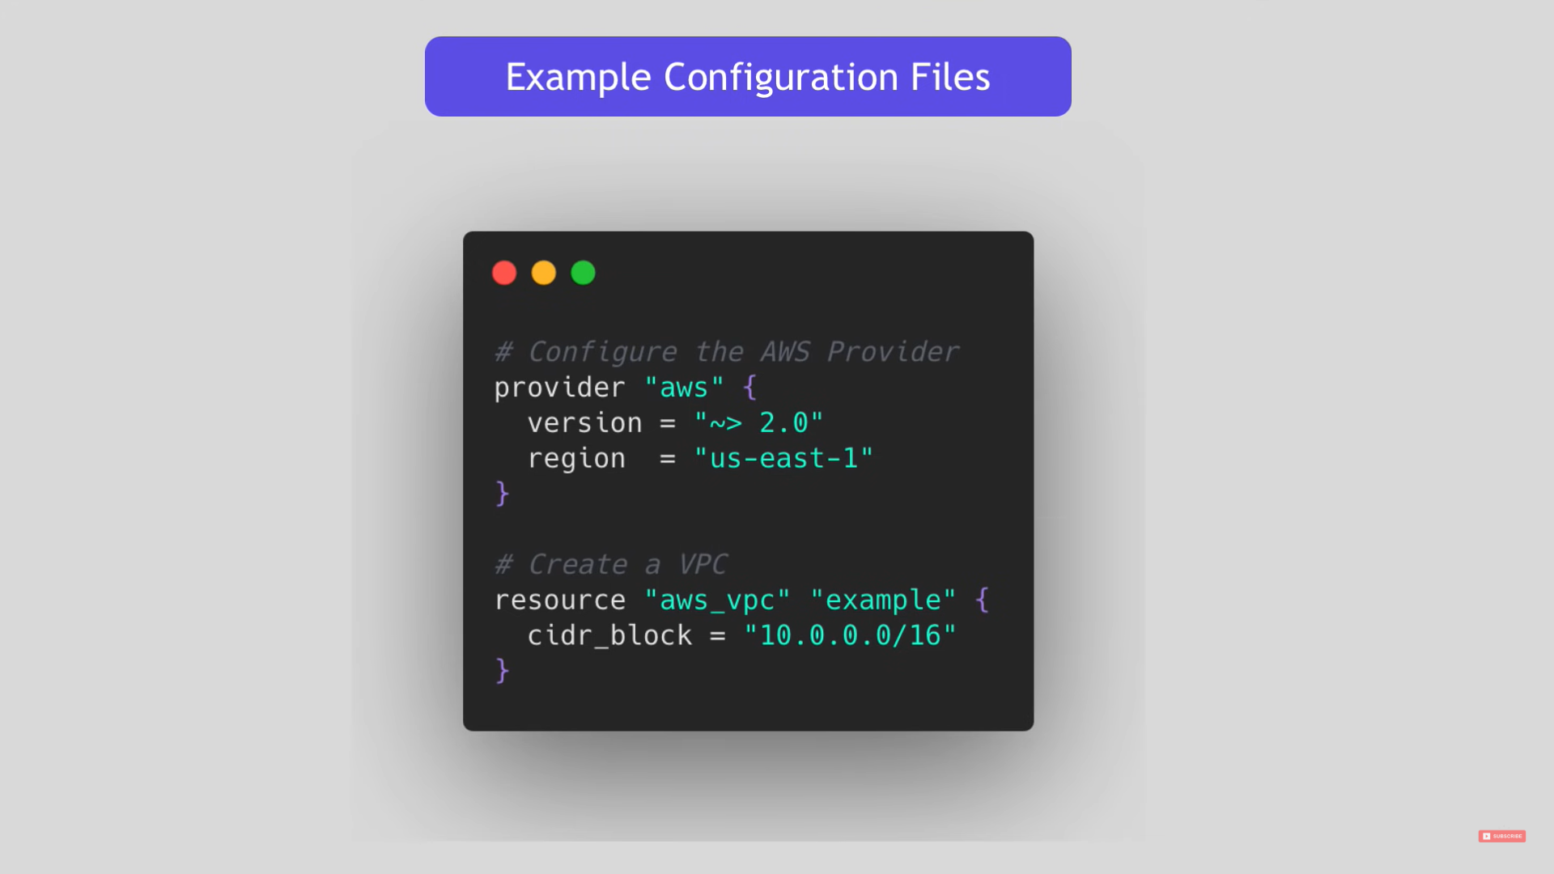
Example Configuration Files

Slide 10
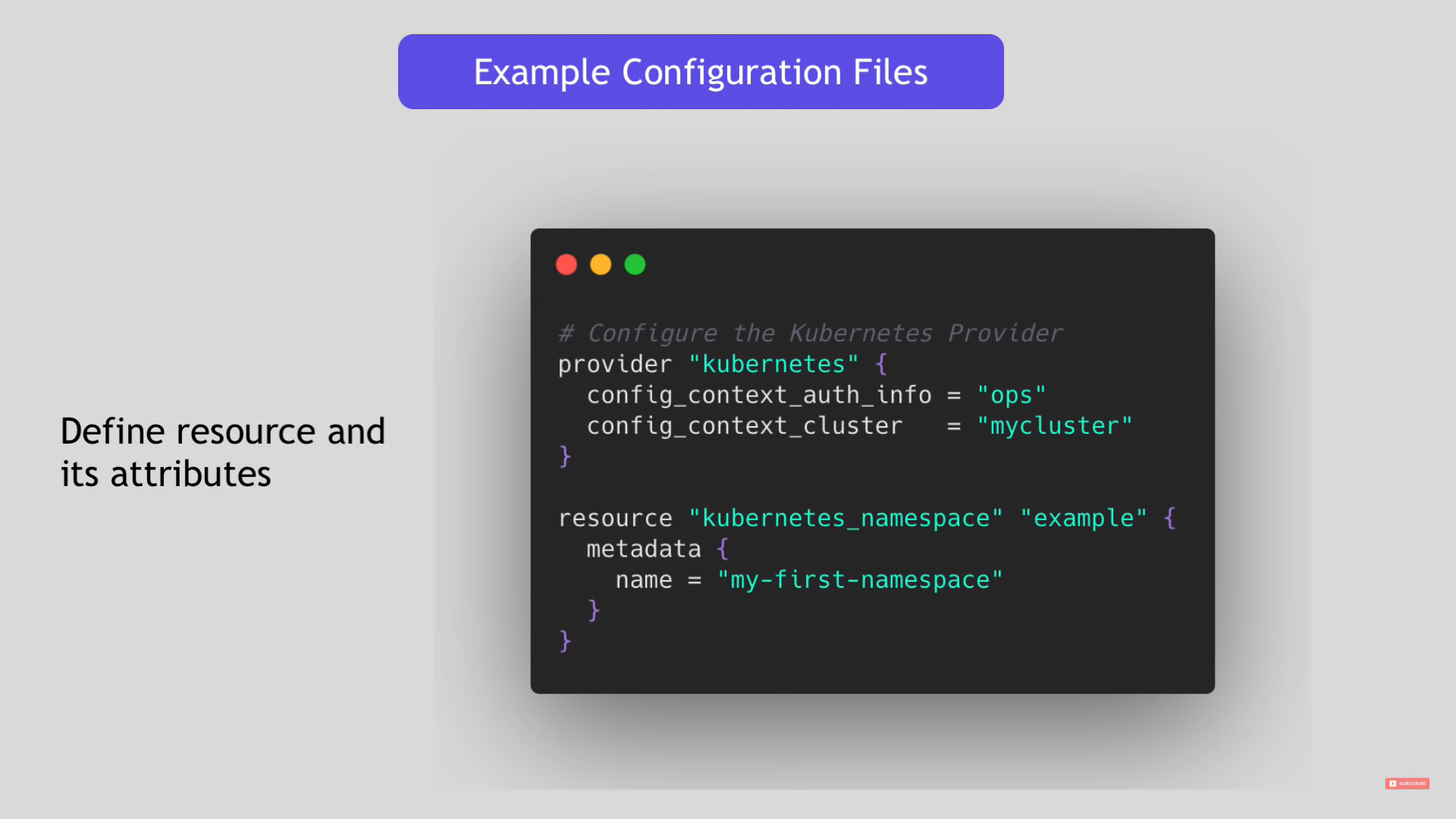

Slide 11
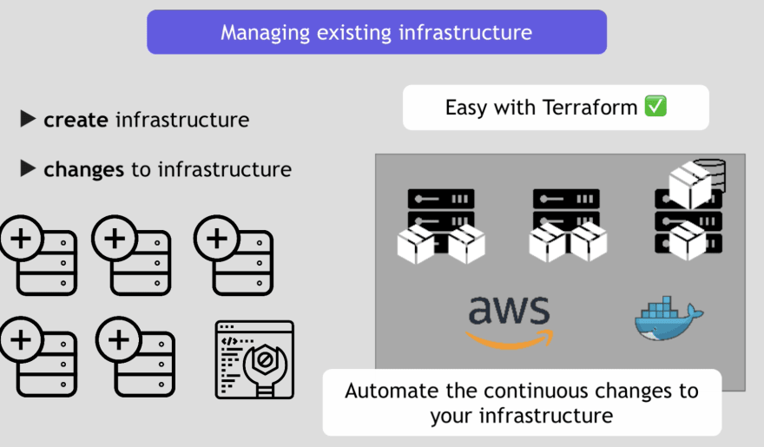

Slide 12
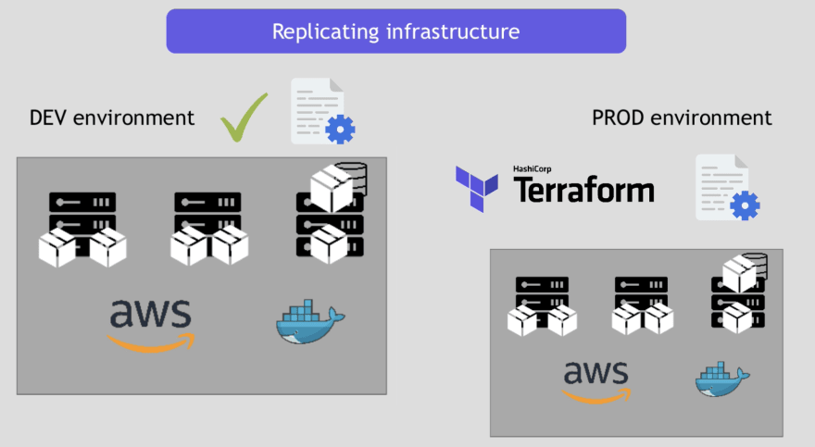

Slide 13
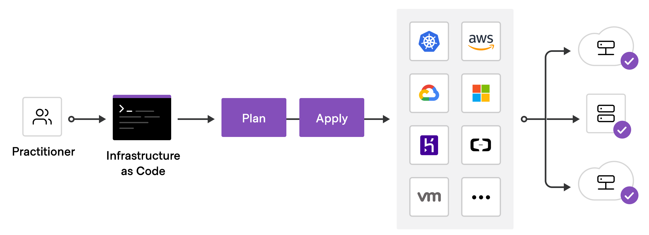
Workflow of Terraform
To deploy infrastructure with Terraform:
Scope - Identify the infrastructure for your project.
Author - Write the configuration for your infrastructure.
Initialize - Install the plugins Terraform needs to manage the infrastructure.
Plan - Preview the changes Terraform will make to match your configuration.
Apply - Make the planned changes.

Slide 14
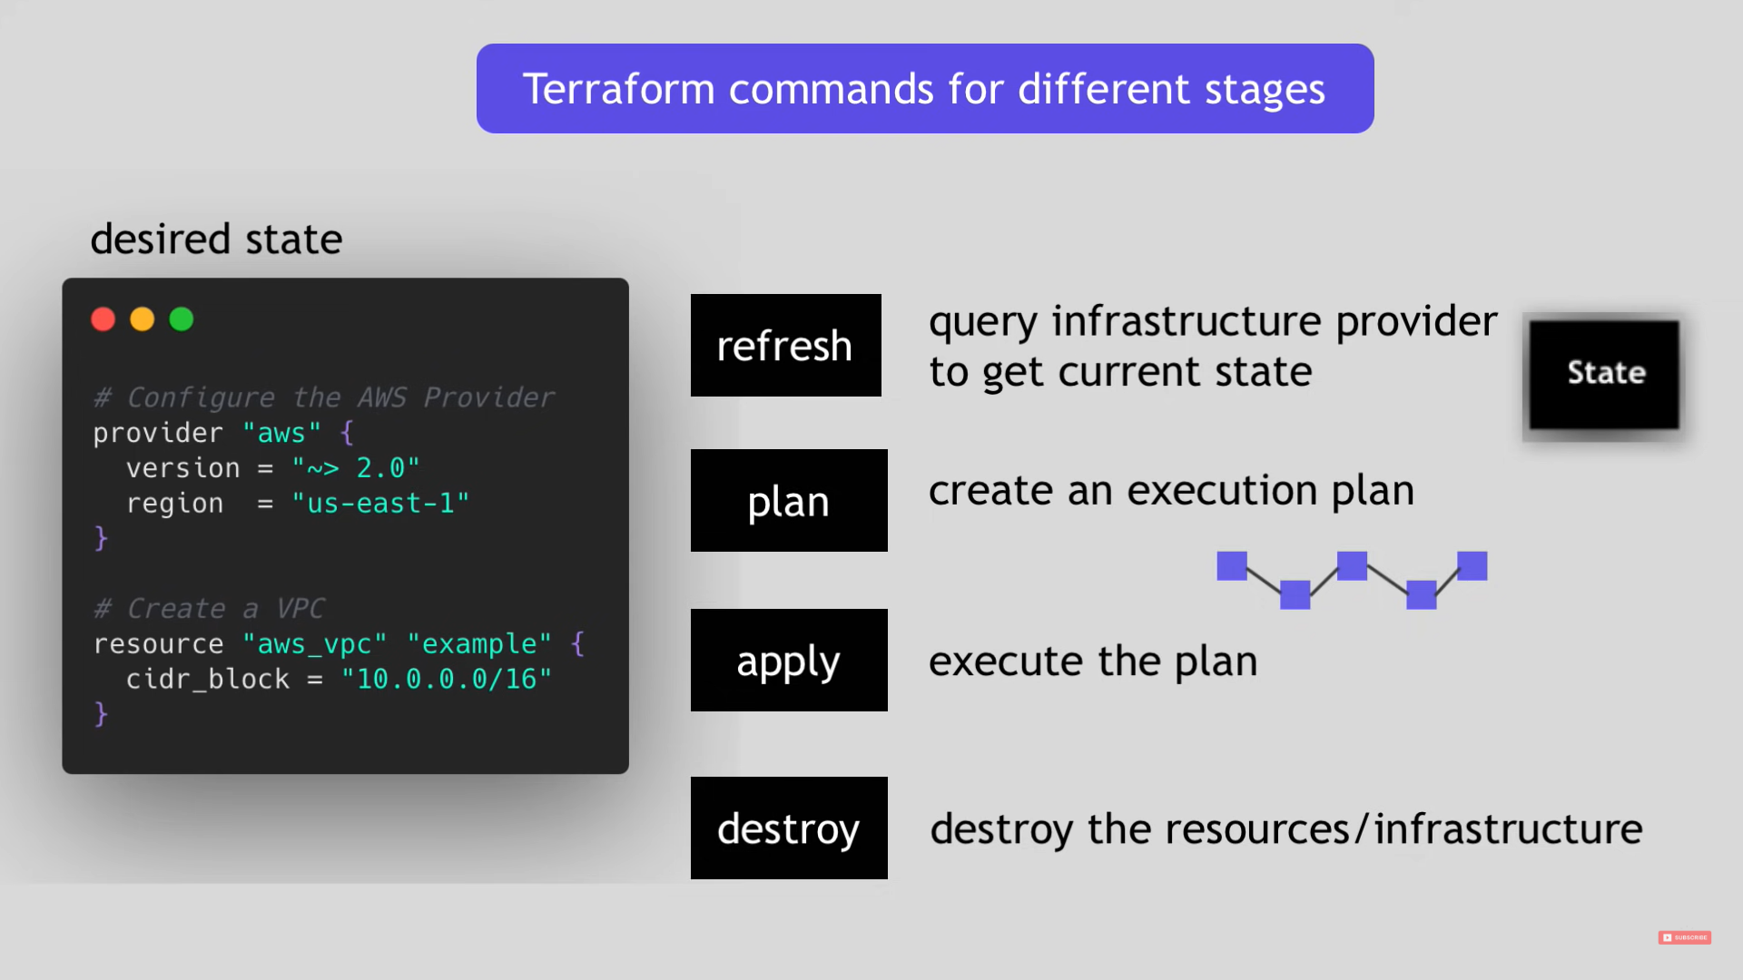

Slide 15
Steps to Follow
Install Terraform: Download and install Terraform from the official website
(https://www.terraform.io/downloads.html) based on your operating system.
Configure AWS Credentials: Set up your AWS credentials to allow Terraform to interact with your AWS account.
You can either set the environment variables AWS_ACCESS_KEY_ID and AWS_SECRET_ACCESS_KEY or use the AWS CLI command aws configure to configure your credentials.
Create a working directory: Create a new directory on your local machine to hold your Terraform files.

Slide 16
Initialize the working directory: Open a terminal or command prompt, navigate to the directory created in the previous step, and run the following command to initialize the working directory:
terraform init
Create a Terraform configuration file: Create a file named main.tf in your working directory and add the following code:
Initialize the Terraform configuration: Run the following command to initialize the Terraform configuration:
terraform init
Preview the changes: Run the following command to preview the changes Terraform will make to your AWS infrastructure:
terraform plan
Apply the changes: Run the following command to apply the Terraform configuration and create the AWS resources:
terraform apply

Slide 17
References
Terraform Documentation: https://developer.hashicorp.com/terraform
Terraform Tutorial YouTube Video: https://youtu.be/l5k1ai_GBDE
GitHub Link : https://github.com/terraform-aws-modules/terraform-aws-ec2-instance.git

