Slide 1

Cargo Connect: Improving Airport Freight Flow
Group -1
Anuja, Smit, Bradley, Chijioke

Slide 2
Core requirements
The system shall monitor incoming aircraft and their arrival times to predict the estimated freight release time
The system shall manage and assign loading / unloading bays to trucks
The system shall manage and assign parking lots to trucks
The system must prioritize cargo loading based on urgency and designated exit routes
The system must handle emergency situations and adjust for sudden traffic congestion
The system must provide optimized outbound routes for freight trucks after delivery
The system shall direct vehicles to use particular exits based on final destination and current congestion
The system must integrate fragmented data sources (e.g., airport systems, customs, transportation providers) into a single platform for seamless data access
The system shall display assignments on a mobile app
The app should have an intuitive and user-friendly interface for easy navigation and operation

Slide 3
Challenges & requirements

Slide 4
Challenge 1: Access Control and Restrictions
Restricted access zones within the airport limit vehicle movement, often requiring security clearance and approvals to enter. This could cause delays due to lengthy security checks, and complex entry procedures
Software Features: A digital access control system that tracks airport entry points, verifying vehicle authorization and ensuring seamless access to restricted zones for DALI-registered vehicles
Software requirements: RFID or Barcode scanning for real-time vehicle identification, And authentication system to verify the authorization of DALI vehicles entering restricted zones; Integration with airport security and clearance systems to streamline entry and ensure regulatory compliance

Slide 5

Requirements:
The system shall authenticate DALI-registered vehicles using RFID or barcode scanning, ensuring only authorized vehicles gain access and reducing manual security checks.
The system shall dynamically verify and update vehicle authorization statuses by integrating with airport security databases and clearance systems.
The system shall log all vehicle entry/exit events at restricted zones and trigger alerts for unauthorized access attempts, providing audit trails for security reviews.

Slide 6
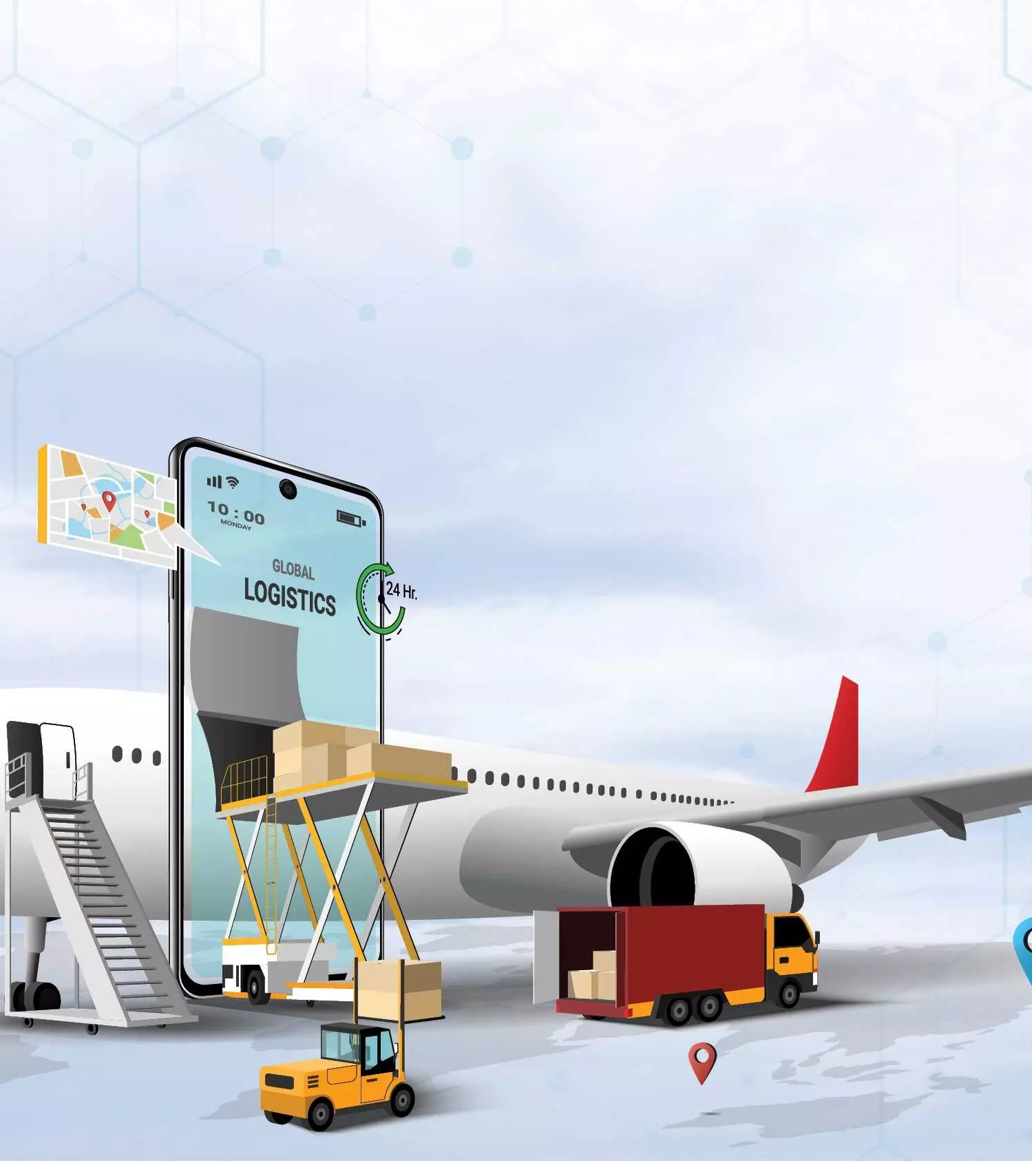
Challenge 2: Fragmented Data Ecosystems
The fragmented data delays real-time decision-making and makes the system inefficient.
Required data for the Freight operations is dispersed across multiple stakeholders.
Cargo Companies
Delivery Partners
Truck Operators
Airports & Custom Authorities
Integration Barriers:
System Incompatibility
Accessibility & Policy Restrictions

Slide 7

Requirements:
The system shall aggregate and synchronize real-time data from all stakeholders.
The system shall ensure interoperability across different systems.
The system shall enforce role-based access controls to dynamically share critical operational data.
The system shall provide stakeholders with a unified dashboard displaying real-time metrics.

Slide 8
Challenge 3: Real-Time Scheduling and Coordination
Why this challenge arrived?
Freight schedules are often disrupted by delays, weather conditions, or unexpected events, requiring real-time adjustments.
Coordination between freight operators, drivers, airport authorities, and customs officials is complex and time-sensitive.
Lack of Real-Time Visibility
Software features to address the challenge:
Collaborative platform
Real time notifications and alerts.
Integrating with external APIs
Resource allocation management.
Scheduling slots interface

Slide 9
Requirements
The system should send push notifications to users for schedule changes, delays, or urgent updates.
Users should be able to view, edit, book, and update schedules/slots in real-time.
The system must integrate with airport systems, customs databases, and transportation providers to fetch real-time data and updates.
The system should be updated with resource availability dynamically based on usage.

