Slide 1

Enhancing DALI Smart Traffic System with Logistic Vehicles Integration
Group 2

Slide 2
Problem Statement
To enhance the existing DALI Smart Traffic System by integrating logistics vehicles with the system's real-time data processing and traffic management capabilities, minimizing trip durations via route optimization and reduction of red light stops.

Slide 3
Case Studies:
Logistic Companies
Public Congestion in the Rural Area
Safety Concerns

Slide 4
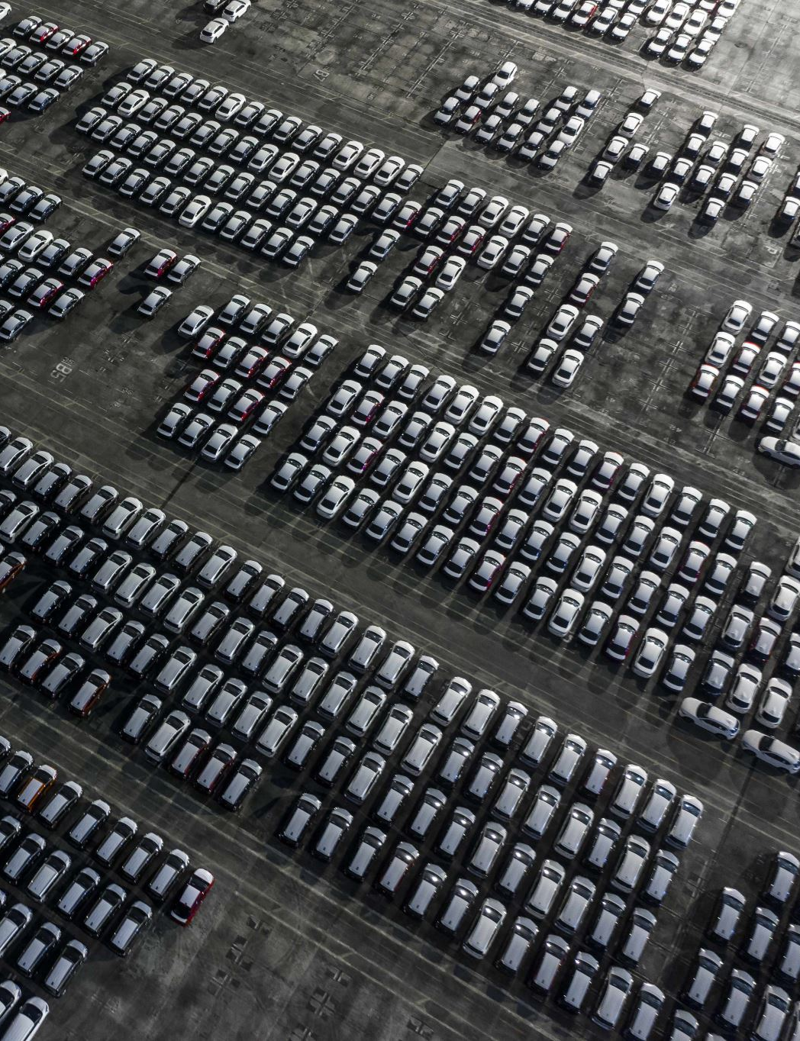
Case Study 1: Logistic Companies
Large logistics companies such as FedEx, UPS, USPS, and Amazon are experiencing significant operational inefficiencies due to urban traffic congestion.
Up to 30% of urban traffic delays are caused by delivery vehicles searching for parking spaces.
To meet delivery schedules, companies frequently violate parking regulations in dense urban areas.
FedEx paid $9.8 million for 146,019 parking violations in New York City in a single year whereas UPS paid $23 million for 348,890 parking violations.
Chang, S. (2020, February 18). UPS, FedEx Rack Up Parking Violations As City Struggles To Reduce Congestion. Gothamist. Retrieved from https://gothamist.com/news/ups-fedex-rack-parking-violations-city-struggles-reduce-congestion

Slide 5
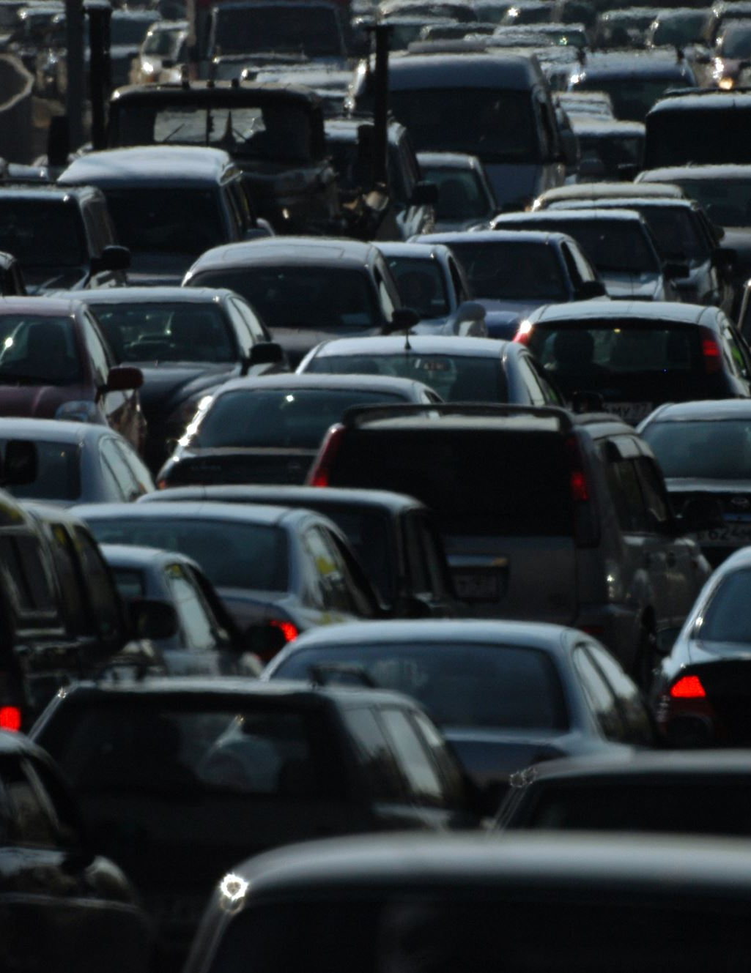
Case Study 2: Public Congestion (in rural areas)
Some cascading effects of port congestion
Delay of 'innocent' and unsuspecting vehicles due to port congestion
Increased resolution cost: time and money to unblock traffic
Examples:
2020: Backlog piling due to cargo and covid-19 supply chain disruptions which caused ships to wait off the coast for days to unload
2016: New York recorded significant delays for public transportation due to sudden rice in freight truck activities during road repairs and bridge maintenance

Slide 6
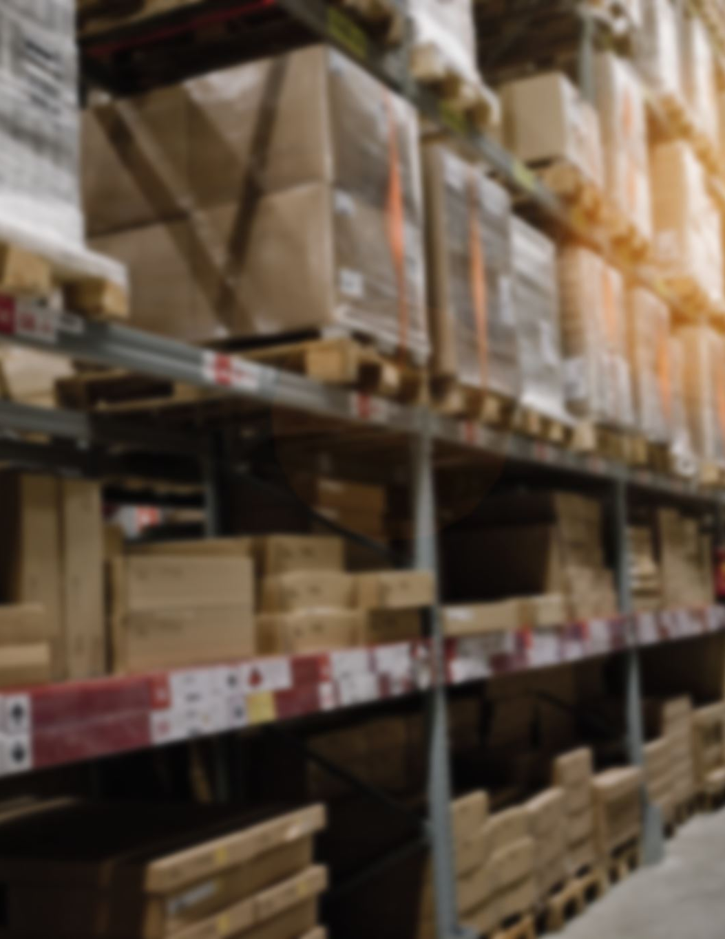
Case Study 3: Safety Concerns
In 2018, a large grocery delivery service warehouse opened in New York City.
Measurements (pre and post) were taken at eight sites around the area. Black carbon and fine particulate matter readings were taken to characterize air pollution, while decibel readings were used to measure noise pollution.
The result was that increased traffic translated into mean predicted increases of 0.003 ug/m^3 (black carbon) and 0.06 dBA (noise).
This increase in air pollution was considered significant by the study.
This case study shows that the impact of increased delivery transit on air quality is significant and poses a safety concern to residents living proximal to the routes.
Shearston, J. A., Johnson, A. M., Domingo Relloso, A., Kioumourtzoglou, M. A., Hernandez, D., Ross, J., Chillrud, S. N., & Hilpert, M. (2021). A South Bronx Community-based Study: Impacts on Traffic, Air Pollution, and Noise from a Large Delivery Service Warehouse. Environmental Health Perspectives. Supplements, 2021(1). https://doi.org/10.1289/isee.2021.P-360

Slide 7
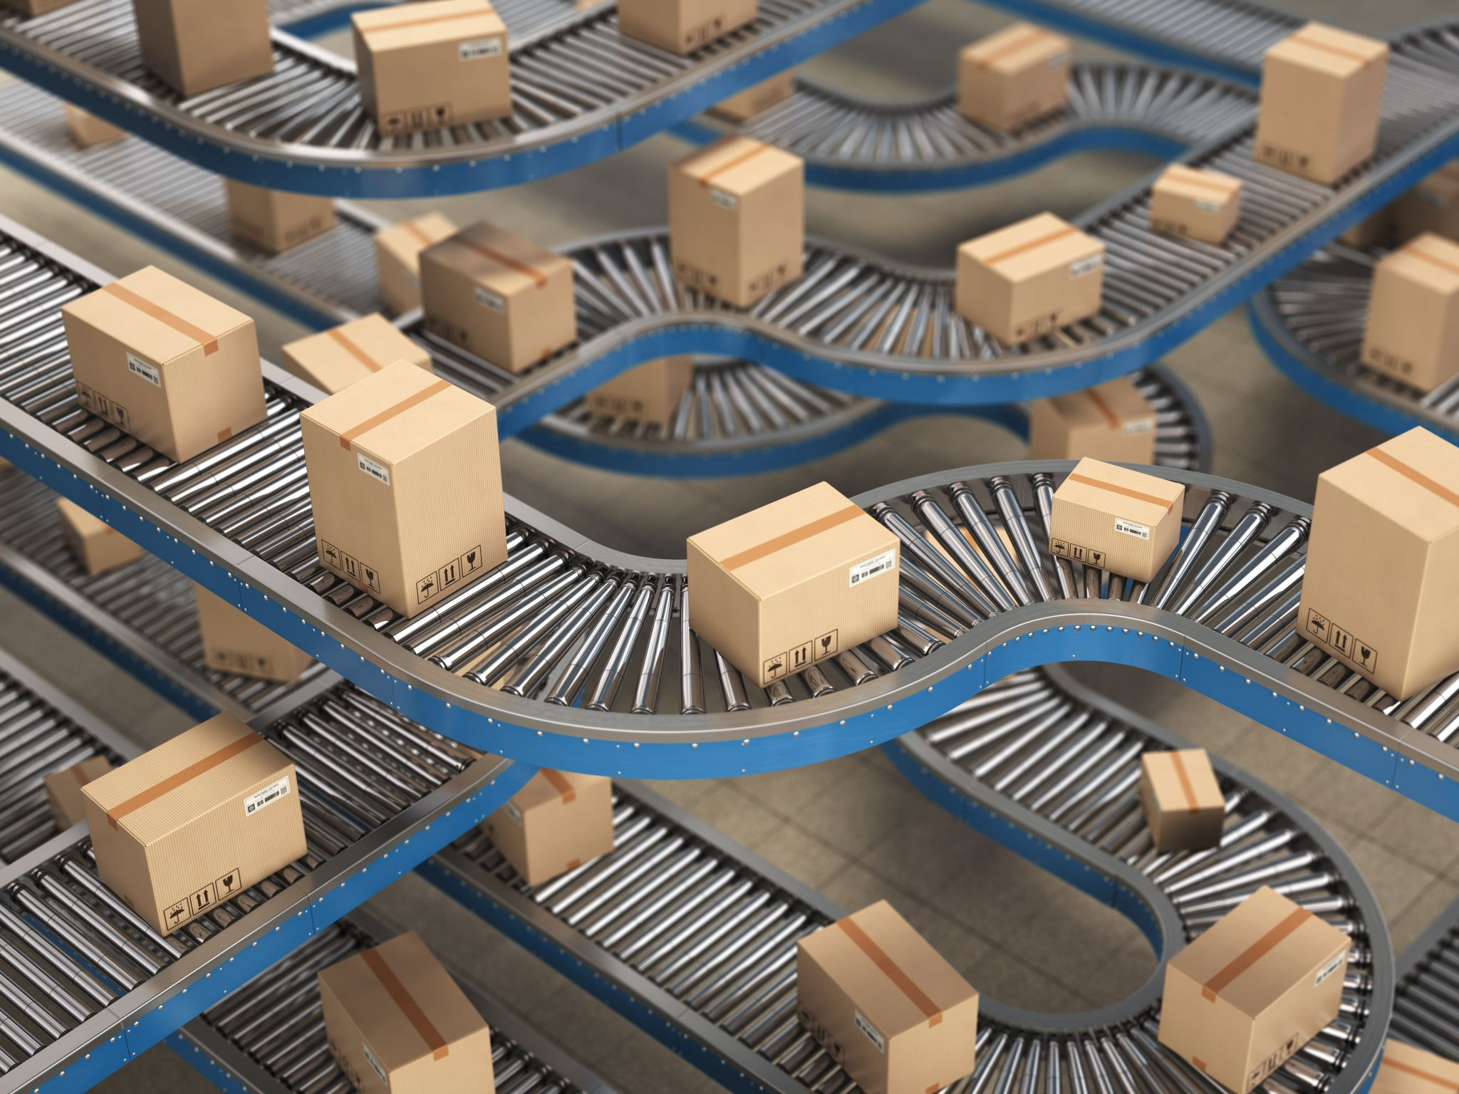
Challenges
Active Challenges (Direct impact on logistics companies)
Static Routing Systems
Lack of Priority Access
Fragmented Data Ecosystems

Slide 8
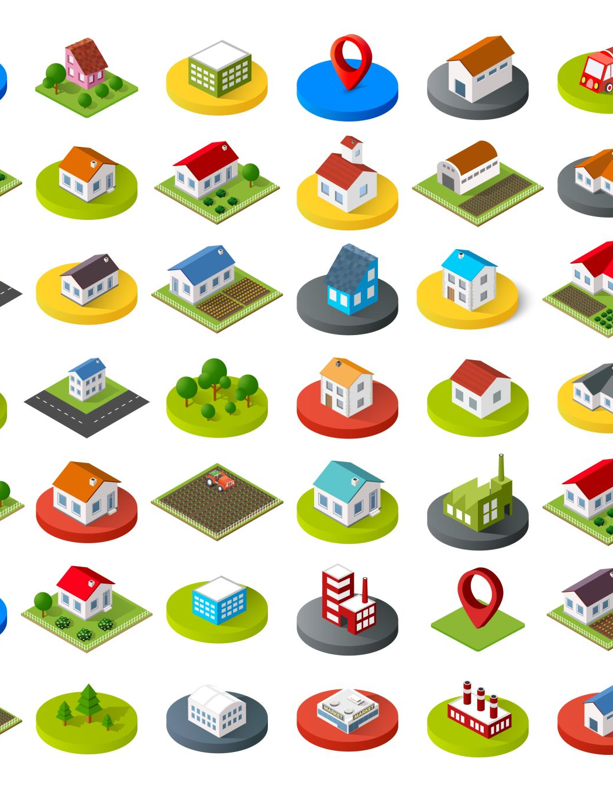
Passive Challenges (Indirect impact on public / environment)
Public Congestions in the rural area
Environmental Degradation
Community Disruption

Slide 9
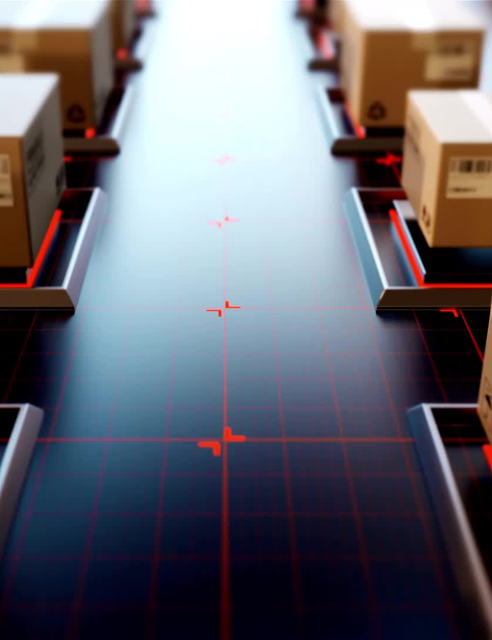
Requirements:
The system must support multiple vehicle coordination.
The system must forecast signal timings and optimize vehicle movement to modify routes in order to reduce stops at red lights.
The system must be able to easily integrate with current supply chain management and logistics platforms in order to provide real-time updates.
The system must analyze historical and real-time data for predictive analytics
The system must enforce speed limit to achieve safety concerns.

Slide 10
Thank You

