Slide 1

Development of Ontological Architecture for Capability-based Co-simulation Configuration
—
Master‘s Thesis, RPTU Kaiserslautern
Anuja Chakraborty, Department of Computer Science
Matriculation number: 425838
E-Mail: vyr58gad@rhrk.uni-kl.de
Presented on July 1st, 2025
Supervised by: Prof. Dr.-Ing. Peter Liggesmeyer & Siwara Schmitt

Slide 2
Agenda
1. | Introduction
2. | Related Work & Research Gap
3. | Concept Diagram
4. | Implementation
5. | Evaluation & Discussion
6. | Conclusion & Future work

Slide 3
Introduction
Research Motivation: Simulation is critical in automotive systems, where multiple subsystems interact via heterogeneous models.
Key Issues:
Current co-simulation configuration is manual, error-prone, and hard to scale.
Ontologies offer formal semantics and reuse potential but existing work lacks a comprehensive layered architecture.
Research Objective: Design a modular, standards-aligned ontology architecture to enable semantic reasoning, capability matching, and reusable co-simulation configurations.

Slide 4
Related Work & Research Gap
Use of TBox, ODPs for modular design to enhance reusability and reduce engineering effort.
Layered ontology architecture mainly in manufacturing, production, supply chain contexts.
Ontology-Driven Simulation Frameworks such as DeMO, OSIF, OSMF for semantic interoperability and model discovery.
No unified ontology framework to integrate simulation models, capabilities, and quality metrics with co-simulation configuration.
Lack of standardized, domain-independent architecture that can scale across different co-simulation contexts.
Most work focuses on manufacturing/production; automotive communication networks underexplored.

Slide 5
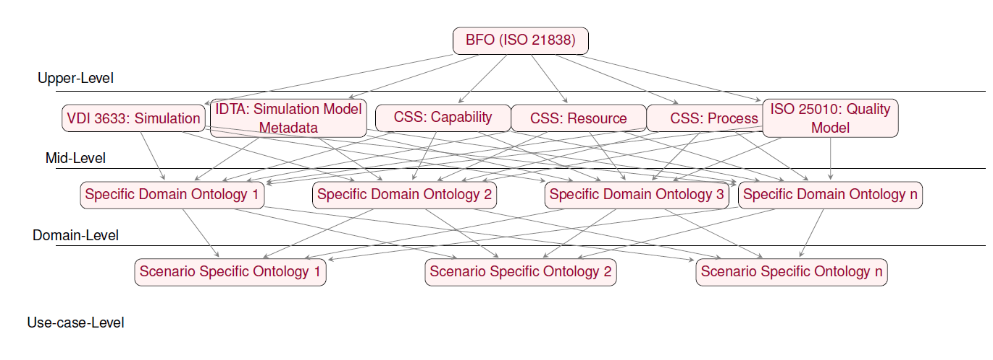
Ontological Framework for Capability-based Co-Simulation
Concept Diagram

Slide 6
Upper-Level Ontology
Concept Diagram
Integrated BFO (ISO21838) as the foundational semantic framework.
Leveraged established standards rather than developing new upper-level ontology from scratch.
Ensures semantic consistency and logical rigor across all ontology levels.
Key BFO Classes utilized – Function, Object, Process, Quality.

Slide 7
Mid-Level Ontology
Concept Diagram
Bridges domain-specific and upper-level abstractions in four-layer architecture.
Mapped to BFO categories for foundational consistency.
Integrates concepts from:
CSS ontology (Capability, Resource, Process)
VDI 3633 (Simulation)
IDTA SMT (Provision of Simulation Models)
ISO 25010 (Quality Attributes)
Core conceptual structure for capability-based co-simulation configuration.
Provides classes and properties for domain-level ontologies

Slide 8
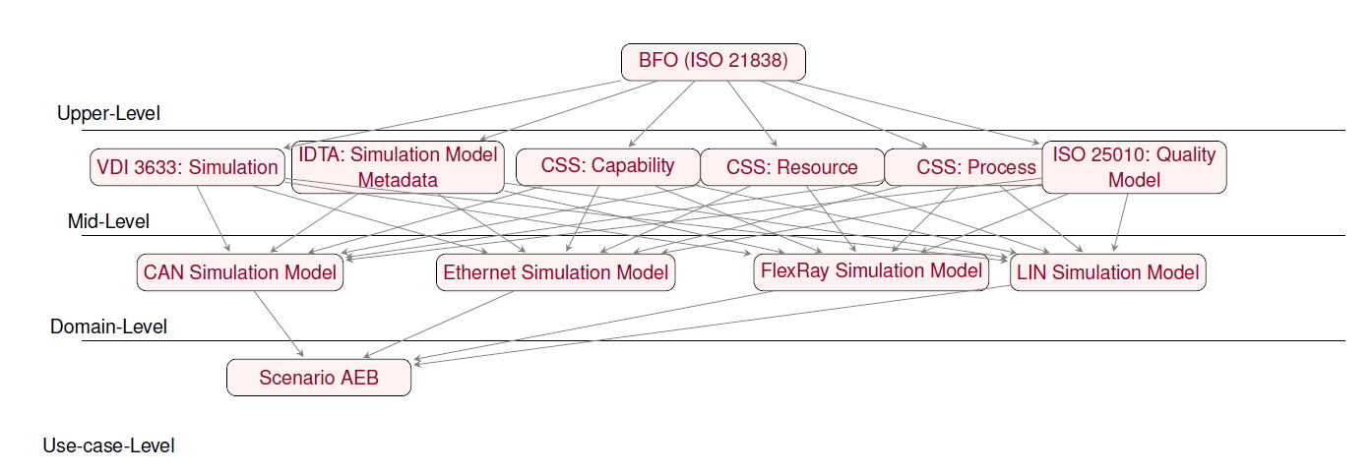
Ontology Architecture as the example of Fraunhofer IESE’s use case AEB
Implementation
Tools and technologies used:
Protégé: Primary ontology development tool with OWL 2 DL support for visual modeling and reasoner integration.
Pellet Reasoner: Selected for consistency checking, ontology classification, and complex inferencing.
Apache Jena Fuseki: SPARQL server for executing semantic queries and competency question validation.

Slide 9
Domain-Level Ontologies for Fraunhofer IESE
Implementation
Specializes mid-level structure for simulation models of communication network protocols
Built for 4 protocols: CAN, Ethernet, FlexRay, LIN based on Fraunhofer FERAL framework specifications.
Semantic alignment with IDTA SMT "Provision of Simulation Models"
Each represented as:
Simulation Model class
Related Resources (e.g., ECUs)
Capabilities (e.g., FaultInjection, MessageFrameTransmission)
Processes and Quality attributes
Encapsulated using OWL Classes, Object & Data Properties.
Performed Capability Check Evaluation for simulation models and resource identification.

Slide 10
Use-case-Level Ontology for Use-case AEB
Implementation
Real-World Simulation Scenario: Automated Emergency Braking (AEB)
Aligns with thesis focus on communication protocols in automotive context
Instantiates domain-level (CAN Bus) concepts to simulate the emergency braking scenario as it involves network of ECUs exchanging sensor/control data over CAN bus.
Maintains semantic consistency with mid- and domain-level ontologies.
Enables scenario-specific validation, reasoning, and traceability of simulation model configurations.
Performed Feasibility Check Evaluation for configuration verification of simulation model instances for required capabilities.

Slide 11
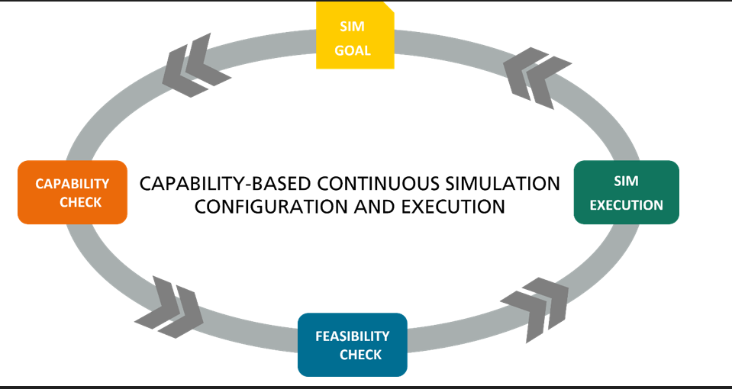
Capability-based Engineering Approach
Implementation
Image source: Based on Bock, J. et al. Capabilities, skills and services – CSS model extensions and engineering methodology. Technical report, Platform Industrie 4.0, 2023. Available at: https://www.plattform-i40.de/.

Slide 12
Evaluation
Objective: Assess ability of the ontology-based system to configure and validate the simulation models of network protocols for AEB in virtual testbeds.
Validation Method: Compared ontology-driven configuration to manual expert-built FERAL configuration.
Outcomes:
Ontology correctly identified models and associated capabilities fulfilling simulation goals.
Ontology-derived results matched expert-built FERAL configuration.
SPARQL queries effectively decomposed complex simulation requirements.
Significant reduction in manual effort and potential human errors.

Slide 13
Simulation Goals Definition
Evaluation
Both goals directly map to formal capabilities (FaultInjection, MessageFrameTransmission) defined in domain ontologies.
Simulation Goal 1:
Fault Injection: "Find the effect of network fault injection on emergency braking" - tests system robustness under failure conditions
Simulation Goal 2:
Message Frame Transmission: "Measure message frame transmission during emergency braking" - analyzes data integrity and timing between ECUs

Slide 14
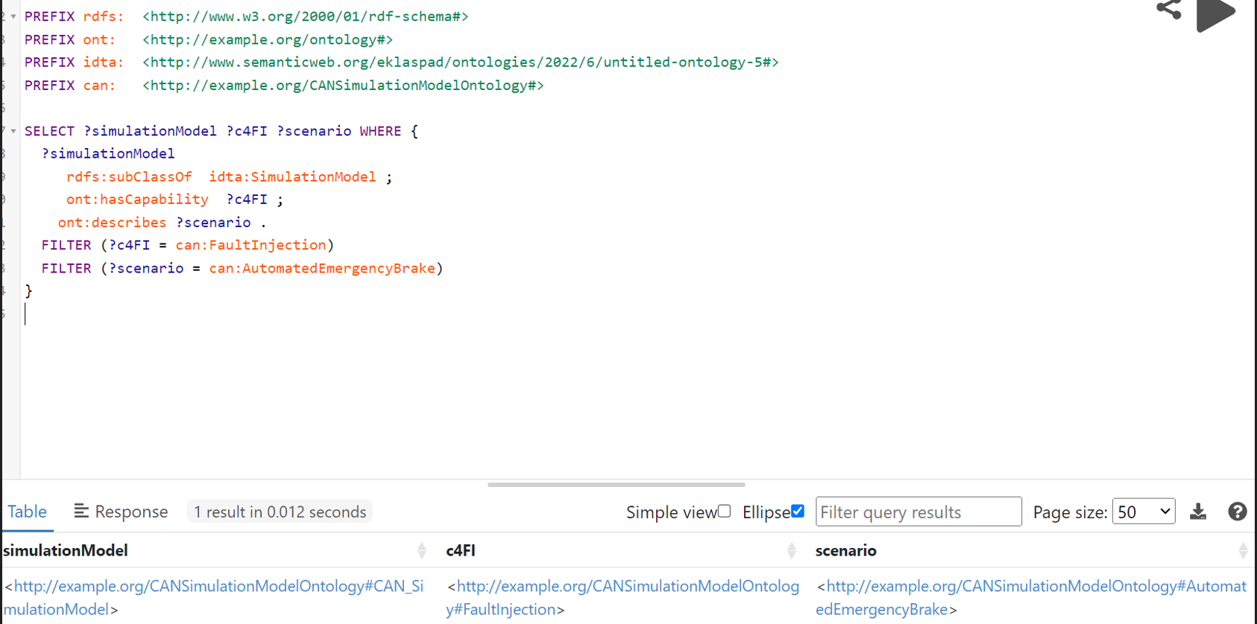
Example Query for Capability Check
Evaluation

Slide 15
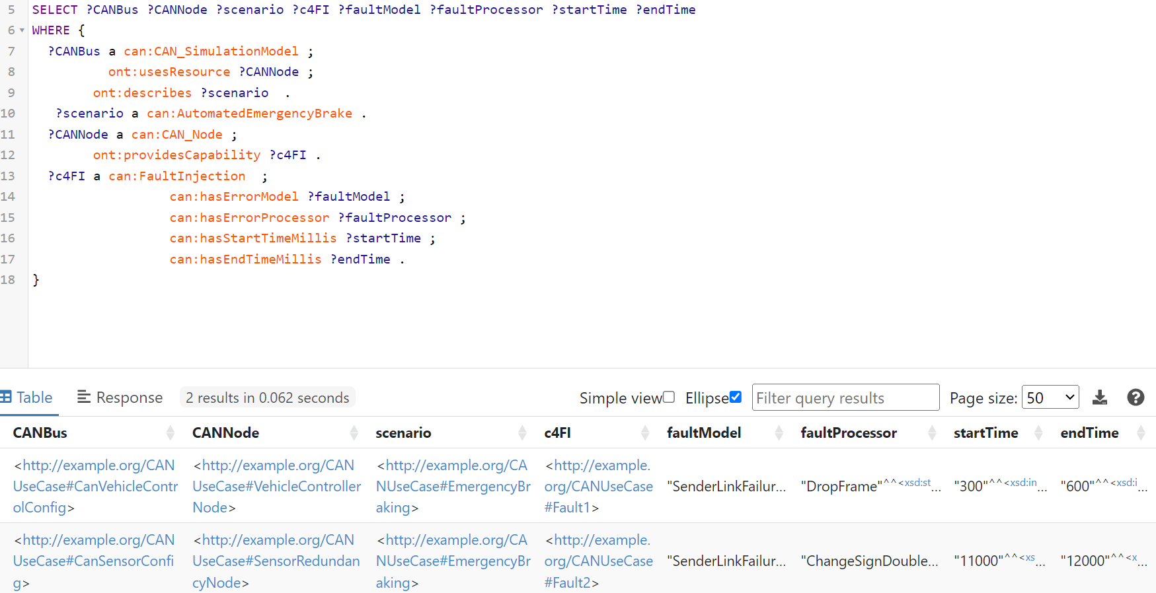
Example Query for Feasibility Check
Evaluation

Slide 16
Discussion
RQ1: How can a structured ontology architecture be developed to support capability-based co-simulation configuration?
Upper-level (BFO), Mid-level (CSS, VDI 3633, ISO 25010, IDTA SMT), Domain-level (protocol-specific), Use-case-level (scenario-specific)
RQ2: How can simulation models be represented into the ontology architecture to guide capability-based co-simulation configuration?
Models represented using IDTA SMT "Provision of Simulation Models" with protocol-specific information
RQ3: How can capabilities and quality attributes be formally incorporated to enable automated configuration?
CSS:Capability standard for defining capabilities
ISO 25010-based modeling for Quality attributes
RQ4: How can communication protocols at the domain level be semantically represented to ensure interoperability in co-simulation?
FERAL documentation semantics mapped to IDTA SMT standards
Detailed ontological representations for CAN, LIN, Ethernet, and FlexRay

Slide 17
Conclusion & Future Work
Developed a modular, four-layer ontology architecture for semantic co-simulation configuration.
Successfully aligned multiple industry standards (BFO, VDI 3633, CSS, IDTA SMT, ISO 25010).
Formalized communication protocols (CAN, LIN, Ethernet, FlexRay) using OWL + industrial ODPs.
Integrate with simulation execution platforms to complete the capability-based configuration cycle through automated execution.
Implement query-driven or rule-based mechanisms to automatically derive capabilities and simulation scenarios from simulation goals.
Introduce granular, reusable representations of simulation model quality attributes.

Slide 18
Thank you for your attention!
—

