Slide 1
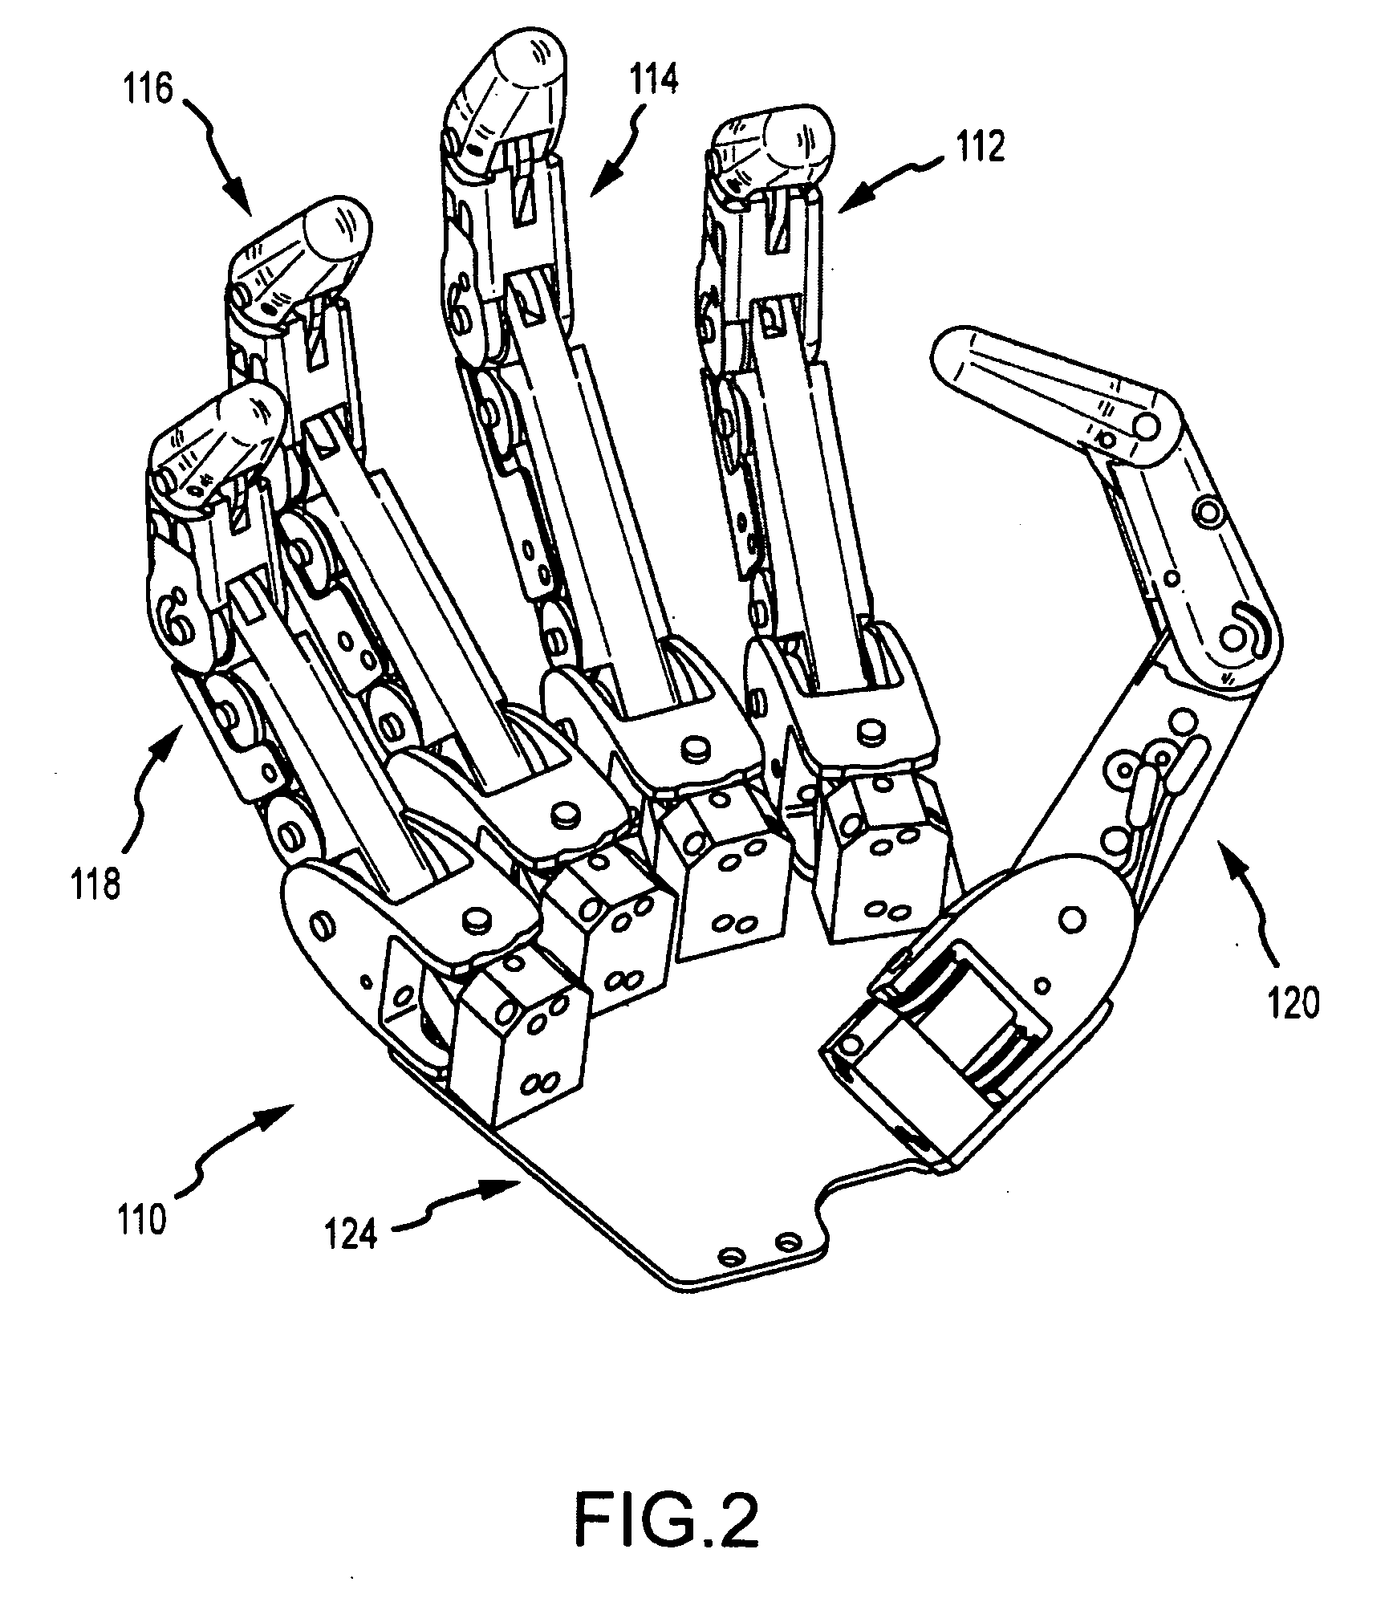

WIRELESS ROBOTIC ARM
TEAM MEMBERS:
GROUP 46
SHASHIKUMAR K 1PE14EC132
R S KARAN 1PE14EC103
KALAVATHI HK 1PE15EC411
ANUJA HALYAL 1PE14EC022
PROJECT GUIDE: Prof ANAND

Slide 2
OBJECTIVE
To make a wireless robotic arm that imitates a human hand.
To throw and catch a ball thrown vertically up.
To have the sense of touch to differentiate between a hard and a soft object.

Slide 3
BLOCK DIAGRAM
HAND GLOVE
ARDUINO
nRF24L01
ARDUINO
SERVO MOTORS
nRF24L01
Robotic arm
FORCE SENSOR
Solenoid

Slide 4
HARDWARE REQUIREMENTS

Slide 5
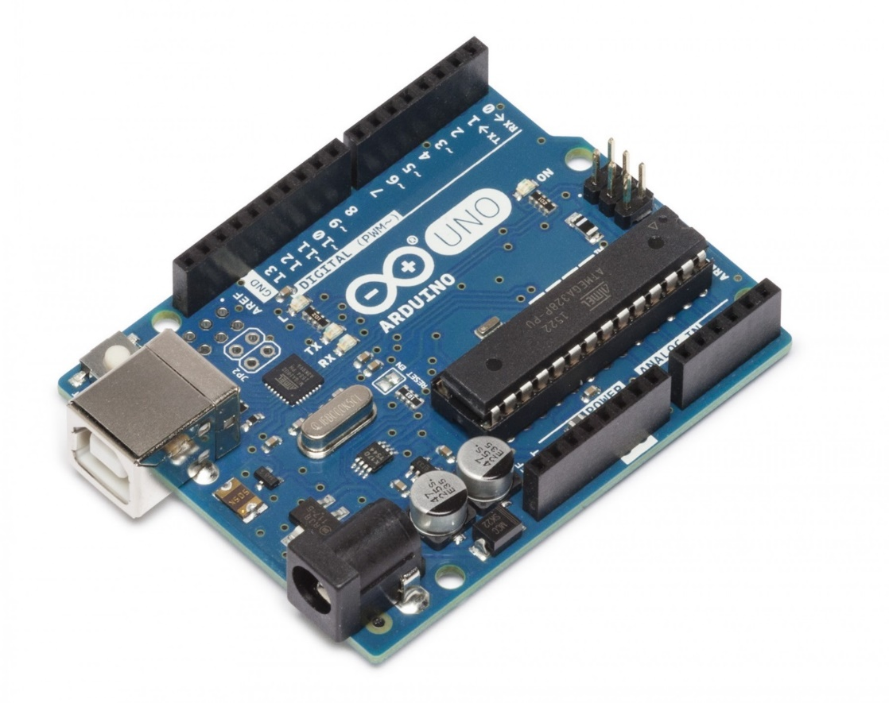
ARDUINO - UNO
Based on Atmega328
I/P voltage : 7-12V
14 Digital I/O pins( 6 as PWM outputs)
6 Analog inputs
Inbuilt 5V,3.3V voltage regulators
Inbuilt ADC with 10-bit resolution
32k FLASH MEMORY

Slide 6
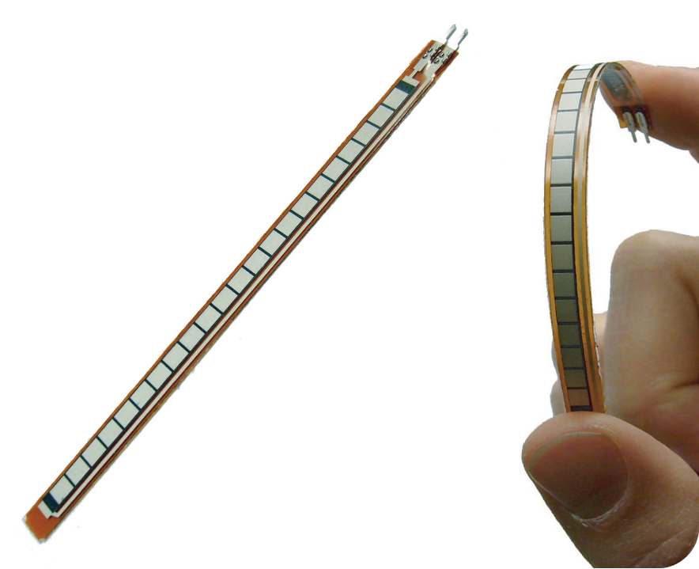
FLEX SENSORS
Work as voltage dividers
Resistance changes depending on the bend
Change in bend is proportional to the electrical resistance
Thin strips 1’’-5’’ long
Resistance Range:1.5K-40K ohms

Slide 7
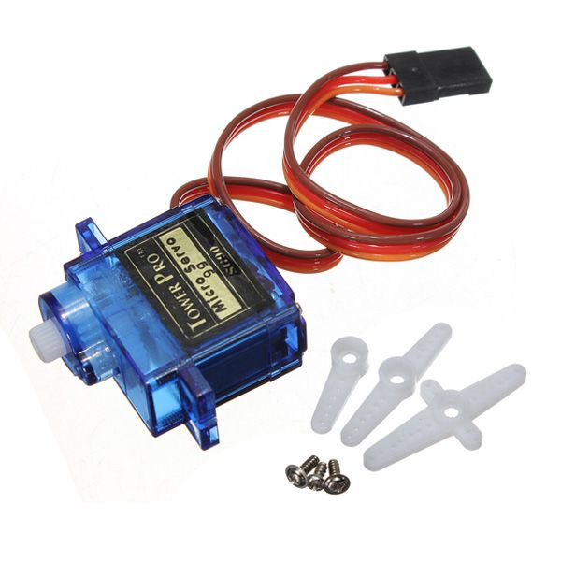
SERVO MOTORS
DC motor working with the principle of SERVOMECHANISM.
Tiny, light weight with high o/p power.
Rotates approx. 180°(90° each direction).
Torque – 2.5 kg/cm
Weight – 14.7 gms
Voltage – 4.8-6V
Servo motor SG90

Slide 8
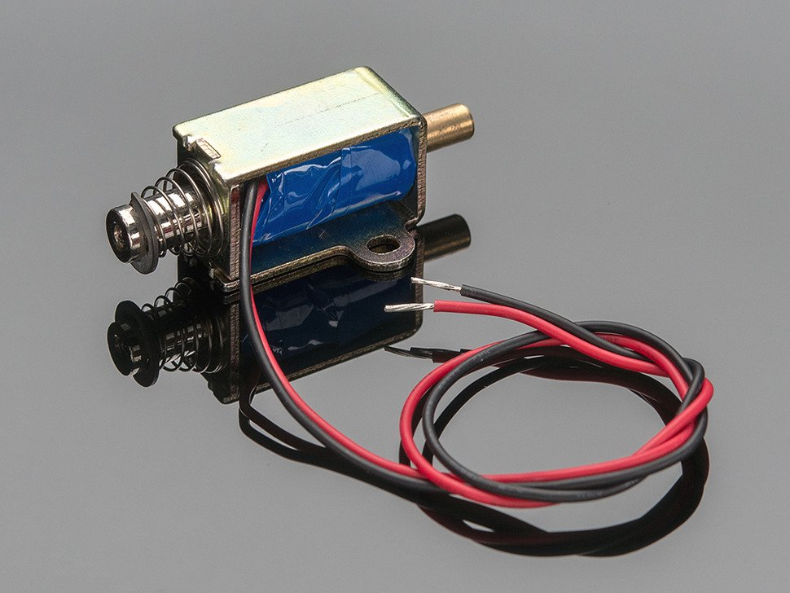
SOLENOID
Electromagnets made of coil of copper wire with armature in middle.
When coil is energized armature is pulled to centre of coil.
Armature with return spring.
30mm long body.
12V dc operation with 250mA current draw.
5 newton starting force(at 12V DC).
Small Push Pull Solenoid

Slide 9
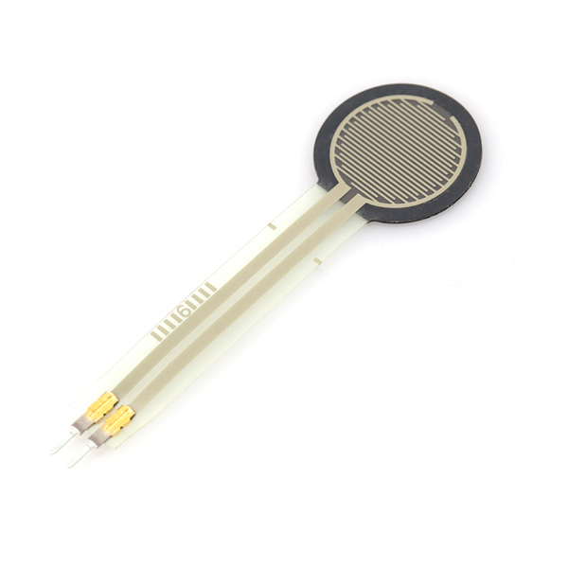
Force Sensor
The FSR will vary its resistance depending on how much pressure is being applied to the sensing area.
The harder the force, the lower the resistance.
This FSR can sense applied force anywhere in the range of 100g-10kg.
Sensing diameter: 0.5"
Force Sensitive Resistor

Slide 10
RESULTS

Slide 11
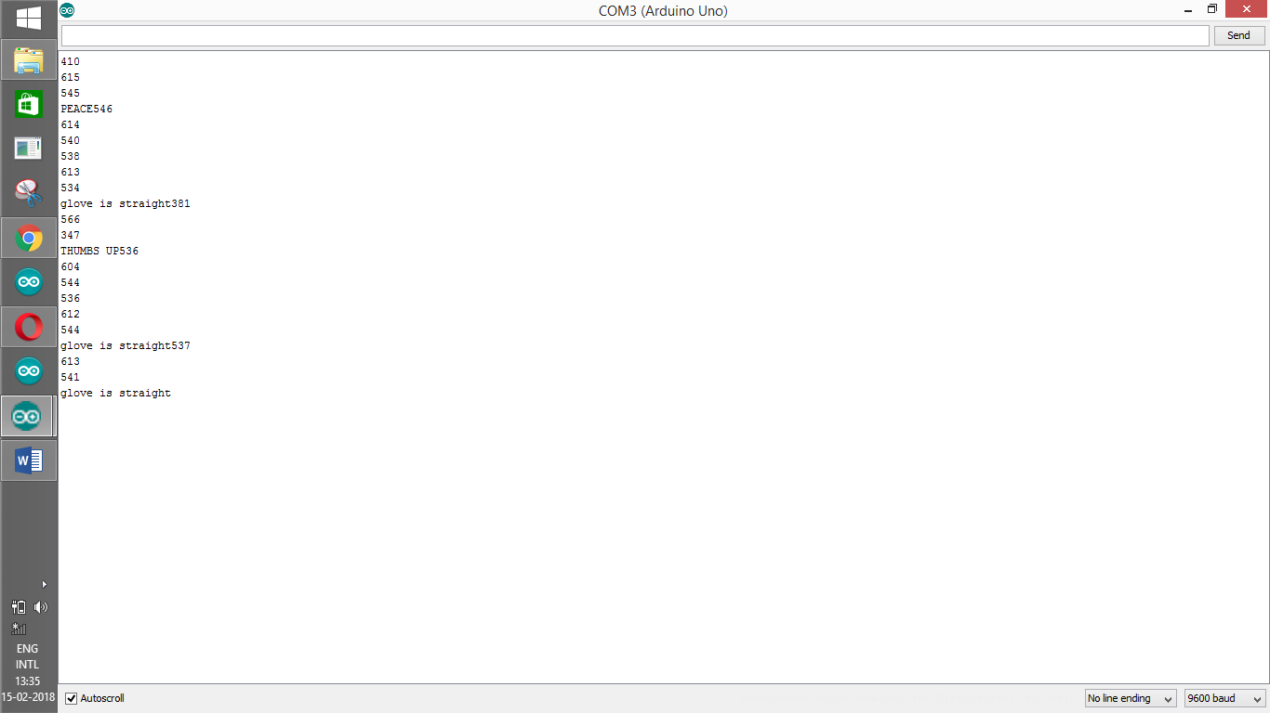
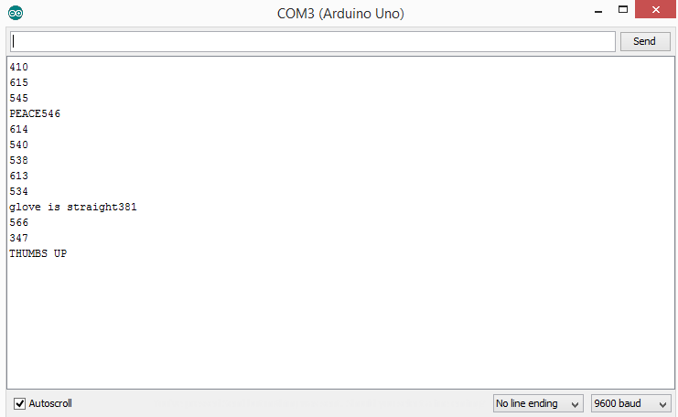

Slide 12
Gesture/Finger | Thumb(V) | Index(V) | Middle(V) | Ring(V)
Straight | 2.67 | 2.32 | 1.92 | 2.31
Claw | 2.74 | 2.97 | 2.06 | 2.97
Thumbs up | 2.64 | 3.28 | 2.14 | 3.14
Loose thumbs up | 2.63 | 3.07 | 2.07 | 2.95
Peace sign | 2.79 | 2.28 | 1.91 | 3.03

Slide 13
ESTIMATED COST

Slide 14
GLOVES
ROBOTIC ARM
SERVO MOTORS : 400Rs
Force Sensor : 500Rs
MICROCONTROLLER : 500-800Rs
nRF module : 200rs
Robotic hand material(foam and tubes):500
Solenoid: 500-800 Rs
FLEX SENSORS :600*4=2400Rs
MPU6050: 300Rs
MICROCONTROLLER : 500-800Rs
nRF module : 200Rs
Force Sensor :500Rs
Total Estimated Cost: 6500Rs

Slide 15
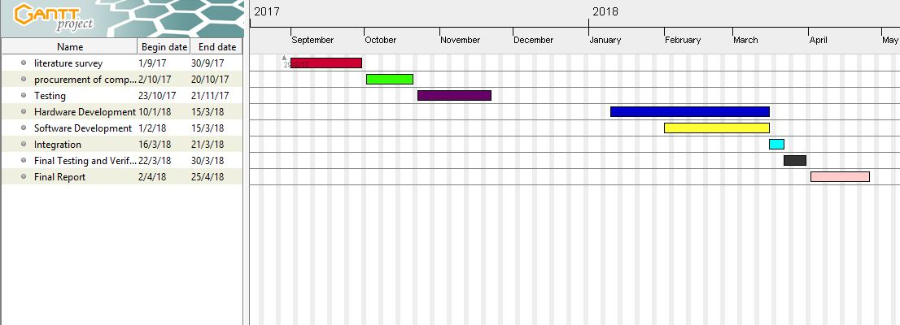
GANTT CHART

