Slide 1
Online Birth Certificate System Developed in PHP & MySQL

Slide 2
Abstract
Online Birth Certificate System maintains a good record of date of birth of people. This system helps admin to view data of date of birth of people who reside in country.
The main objective of “Online Birth Certificate System” project is to providing easier registration of date of birth and gets certificate of birth online which save lots of time.

Slide 3
Purpose
The purpose of developing birth certificate management system is to computerized the tradition way of birth registration. Another purpose for developing this application is to generate the report automatically.
Scope
Births registration plays a very important role in planning of various government schemes. All the important information like place of birth date, place of birth and vital particular at the time of Births are required in various places so this project helps to maintain all these records at one place which is useful for government as well as people.

Slide 4
Project Modules
In Online Birth Certificate System we use PHP and MySQL Database. This project has two module i.e. admin and user.
User
Admin

Slide 5
Admin Module
1. Home: In this section, admin can briefly view the total number of new application, total verified application and total rejected application.
2. Birth Application: In this section, admin view the application details and they have also right to change application status according to current status.
3. Reports: In this section admin can view the application details in a particular period.
4. Search: In this section, admin can search application with the help of customer application
Admin can also update his profile, change the password and recover the password.

Slide 6
User Module
1. Home Page: In this section, user can view welcome page of web application.
2. Birth Reg Form: In this section, user can fill the form of birth certificate and see the status of his/her application.
3. Certificate: In this section user can take print of verified certificate.
User can also download the certificate in PDF format.
User can also update his profile, change the password and recover the password.
User can also verify certificate without login.

Slide 7
Requirement Specification
Hardware Configuration:
Client Side
Server Side
RAM | 512 MB
Hard Disk | 10GB
Processor | 1.0 GHz
RAM | 1 GB
Hard Disk | 20GB
Processor | 2.0GHz

Slide 8
Continue.....
Software Requirement:
Client Side
Server Side
Web Browser | Google Chrome or any compatible browser
Operating System | Windows or any equivalent OS
Web Server | APACHE
Server side Language | PHP5.6 or above version
Database Server | MySQL
Web Browser | Google Chrome or any compatible browser
Operating System | Windows or any equivalent OS

Slide 9
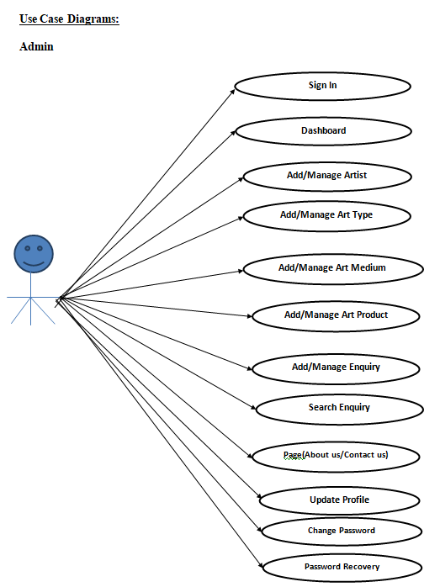
Use Case Diagram
Notes:
USECASE DIAGRAM: A Use case is a description of set of sequence of actions. Graphically it is rendered as an ellipse with solid line including only its name. Use case diagram is a behavioral diagram that shows a set of use cases and actors and their relationship. It is an association between the use cases and actors. An actor represents a real-world object. Primary Actor – Sender, Secondary Actor Receiver.

Slide 10
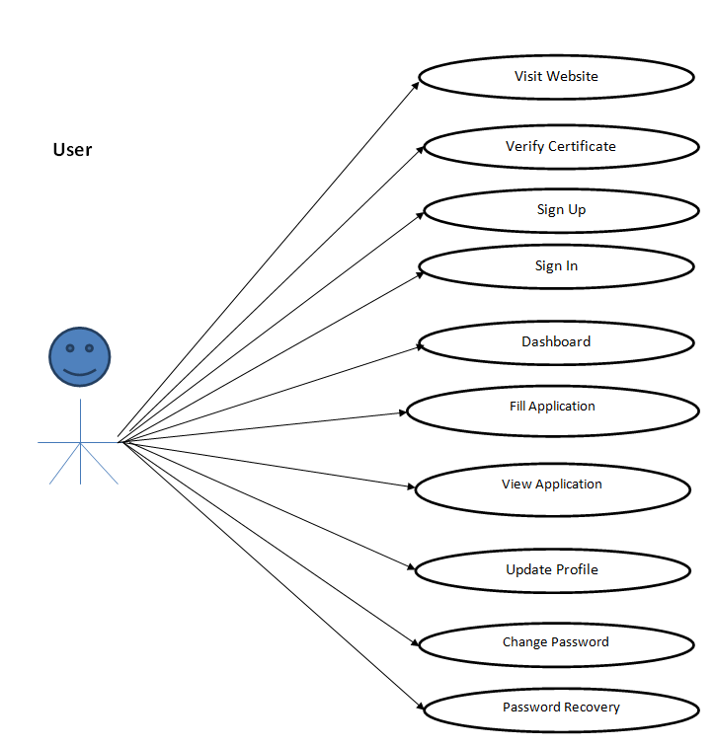
Continue…

Slide 11
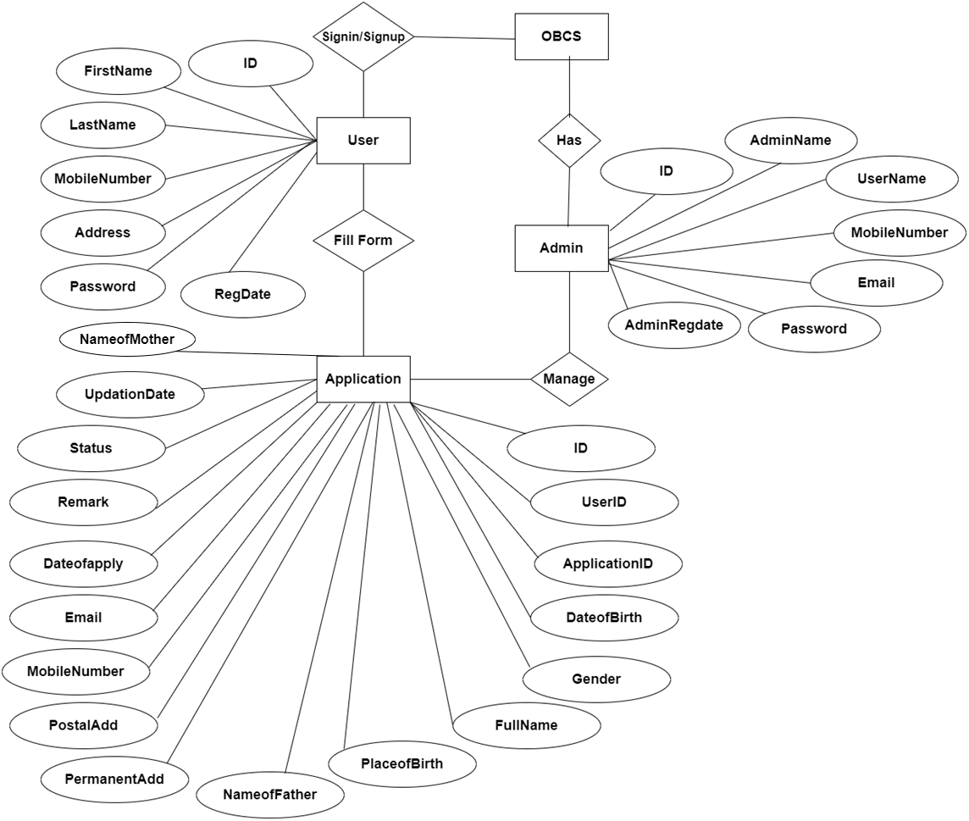
ER Diagram

Slide 12
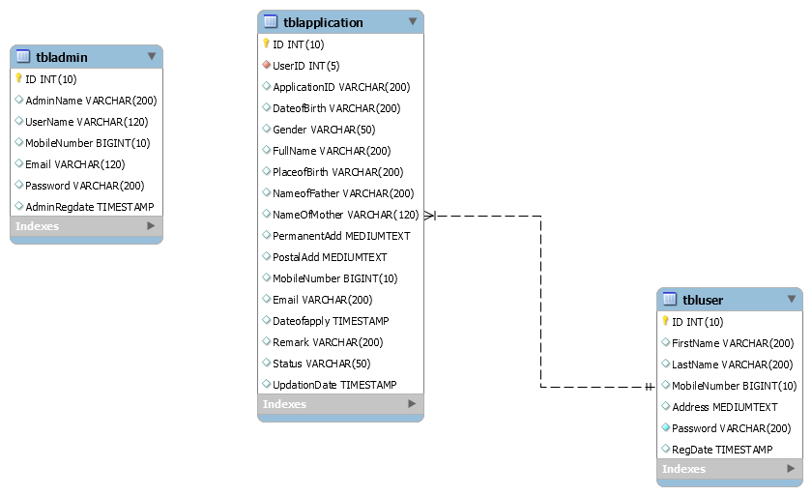
Class Diagram
Notes:
The class diagram shows a set of classes, interfaces, collaborations and their relationships.

Slide 13
Implementation and System Testing
After all phase have been perfectly done, the system will be implemented to the server and the system can be used.
System Testing
The goal of the system testing process was to determine all faults in our project .The program was subjected to a set of test inputs and many explanations were made and based on these explanations it will be decided whether the program behaves as expected or not. Our Project went through two levels of testing
Unit testing
Integration testing

Slide 14

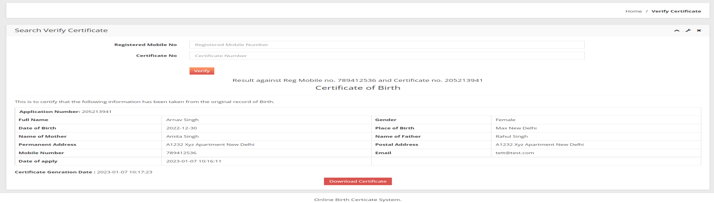
Project Screens

Slide 15

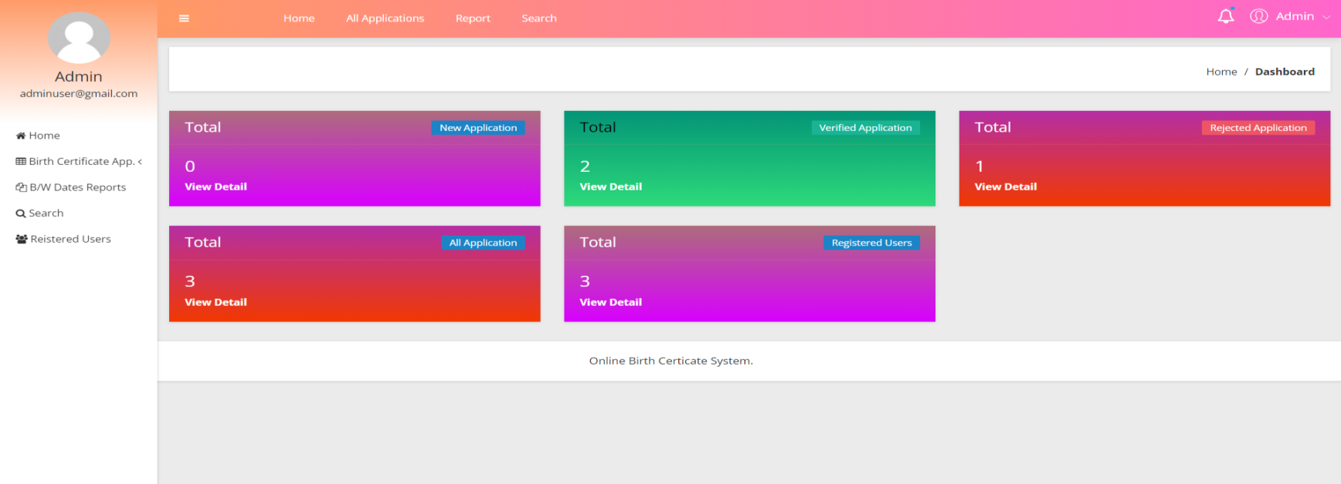

Slide 16
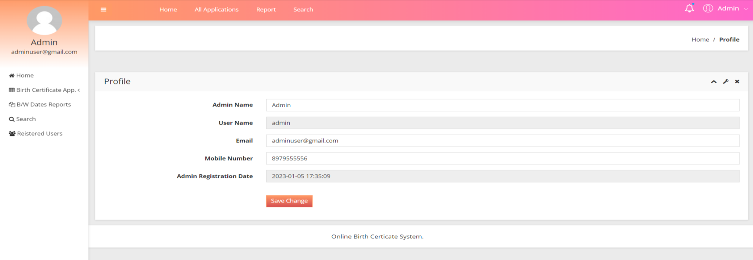
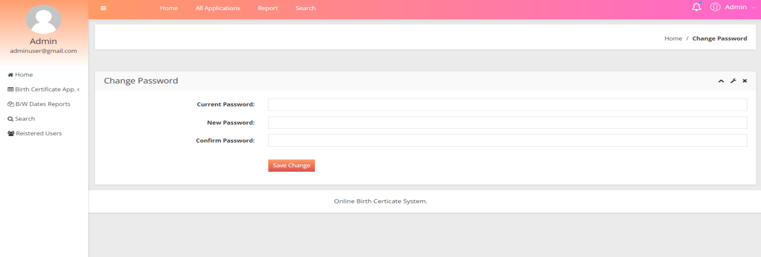

Slide 17
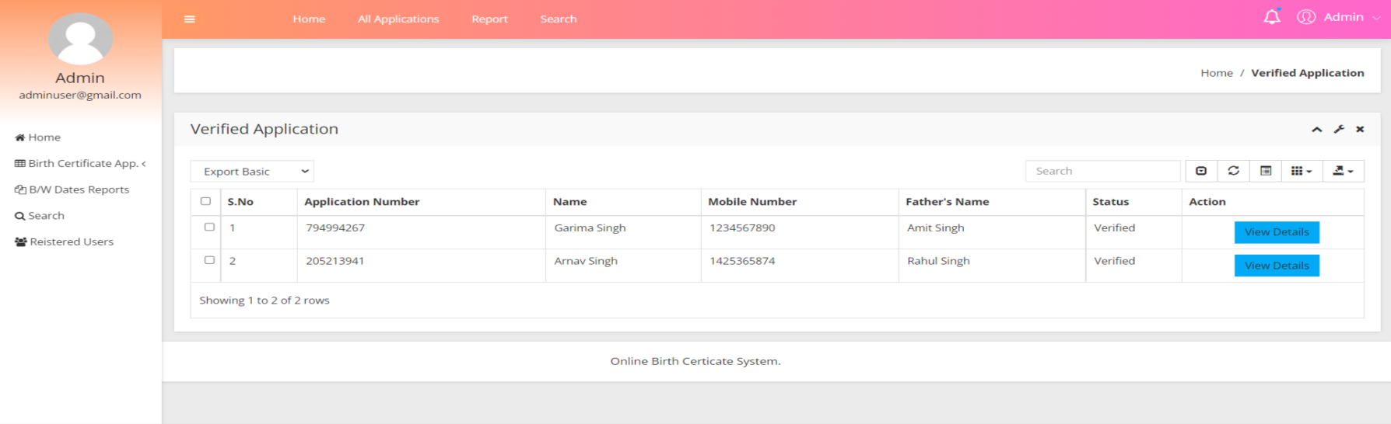
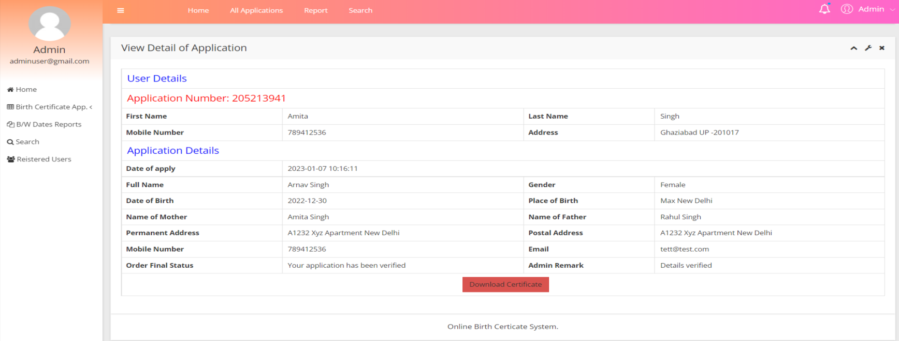

Slide 18
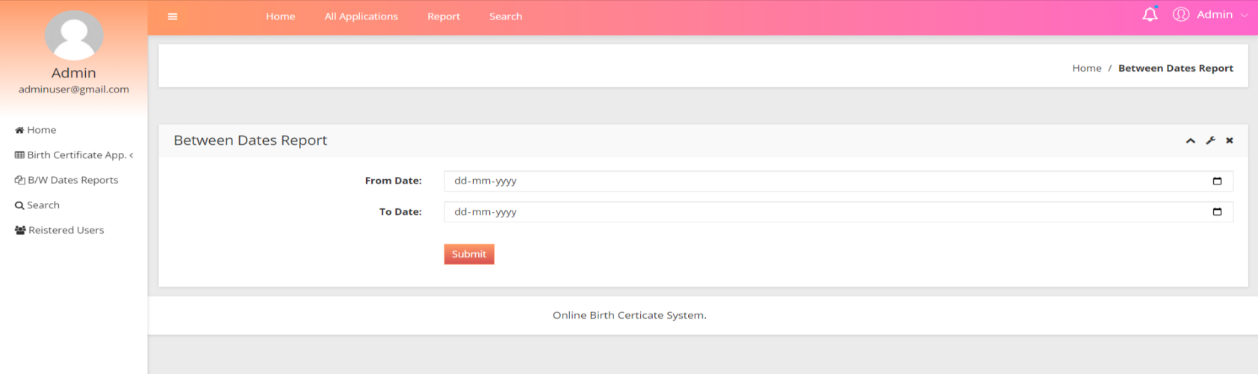
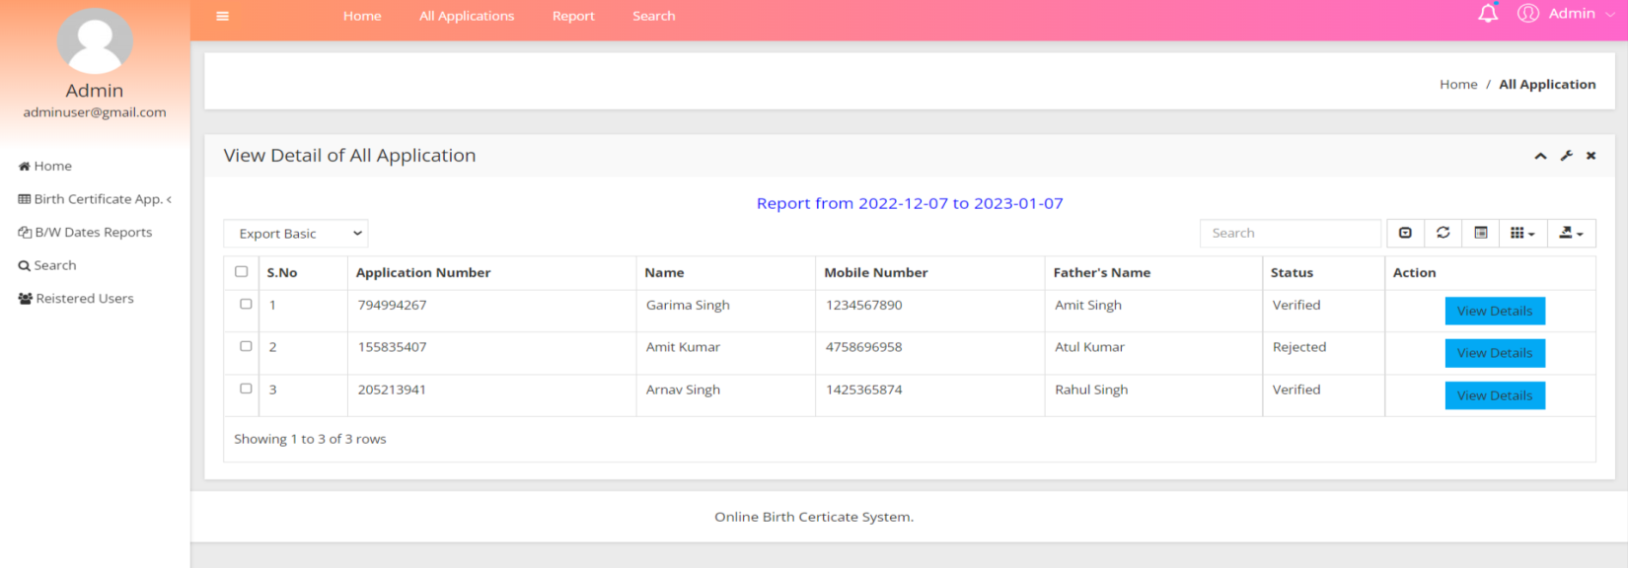

Slide 19
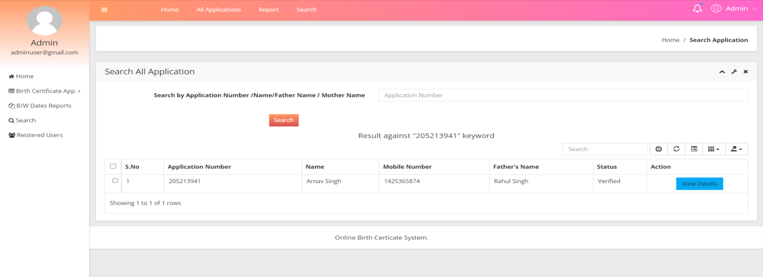
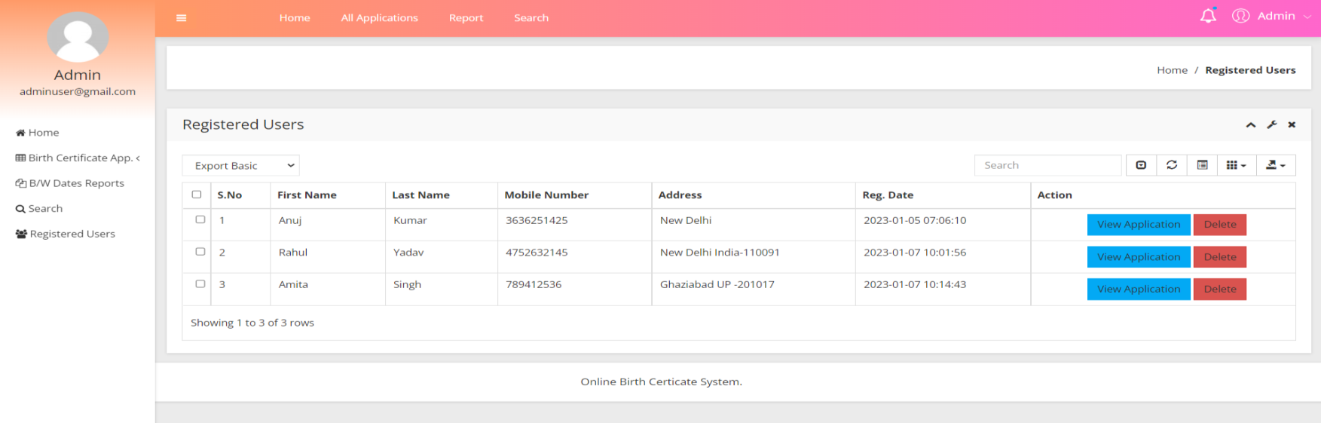

Slide 20

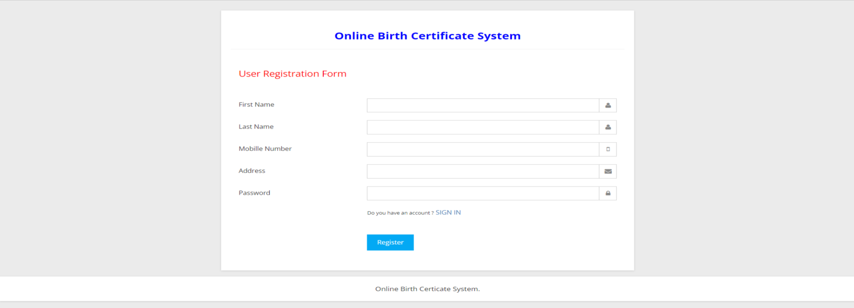

Slide 21

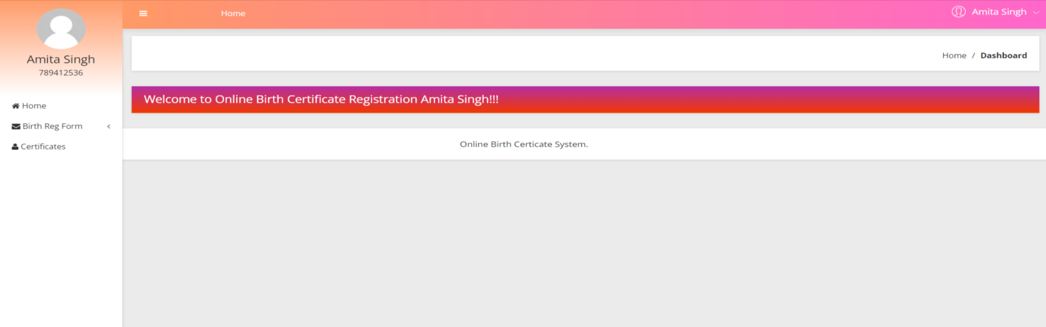

Slide 22
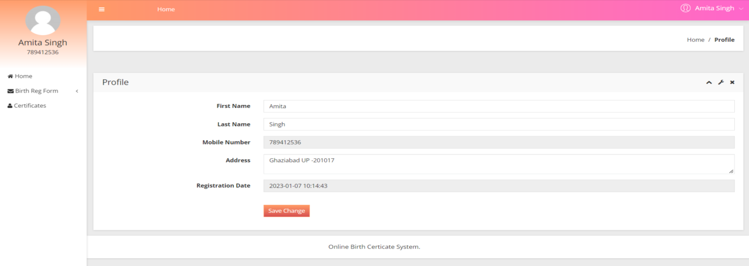
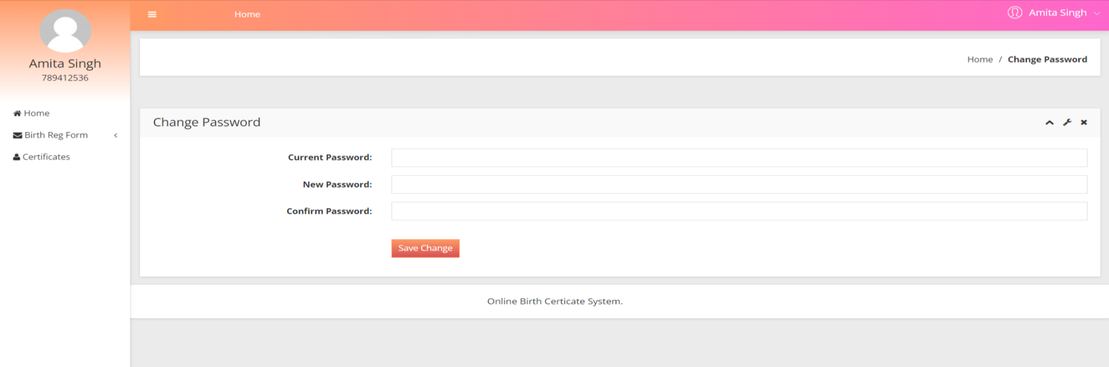

Slide 23
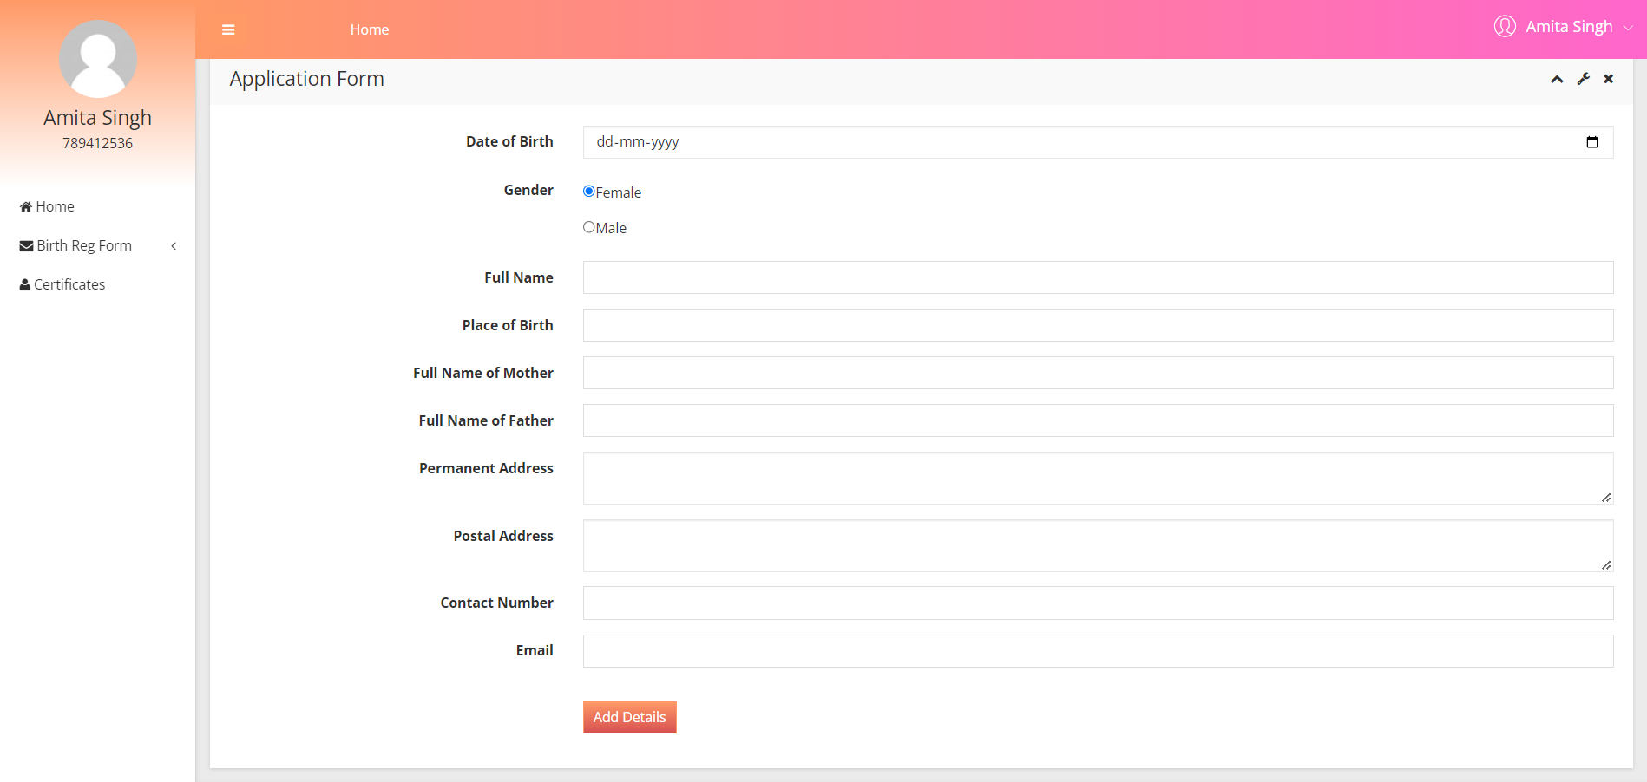
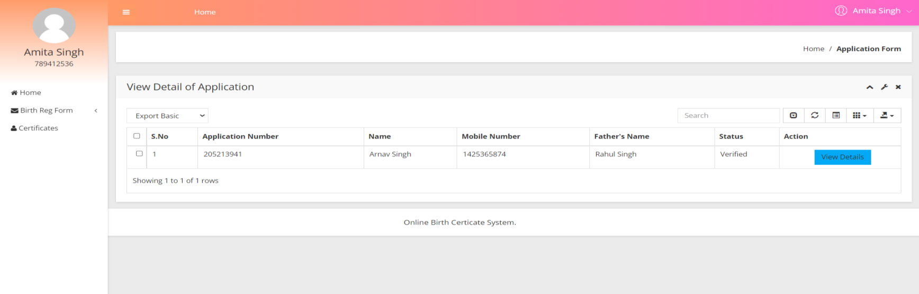

Slide 24
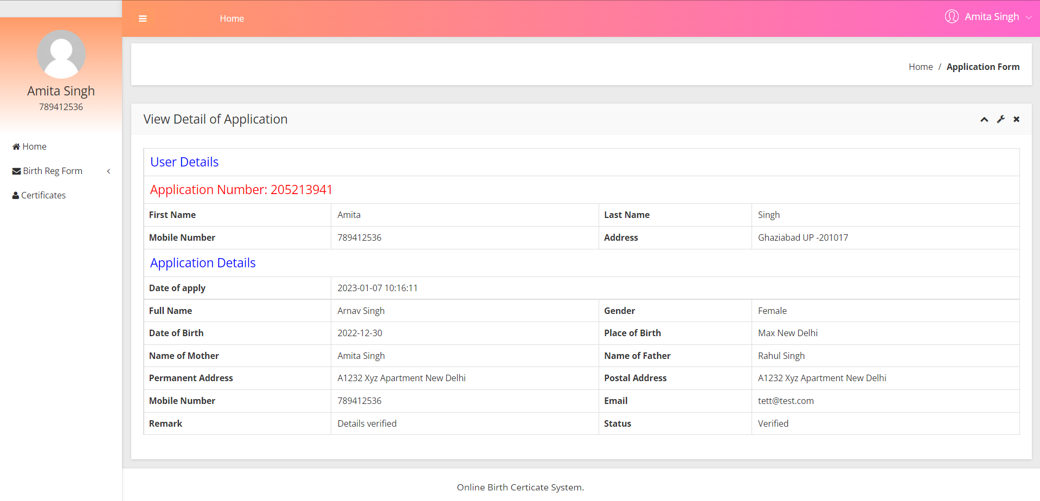
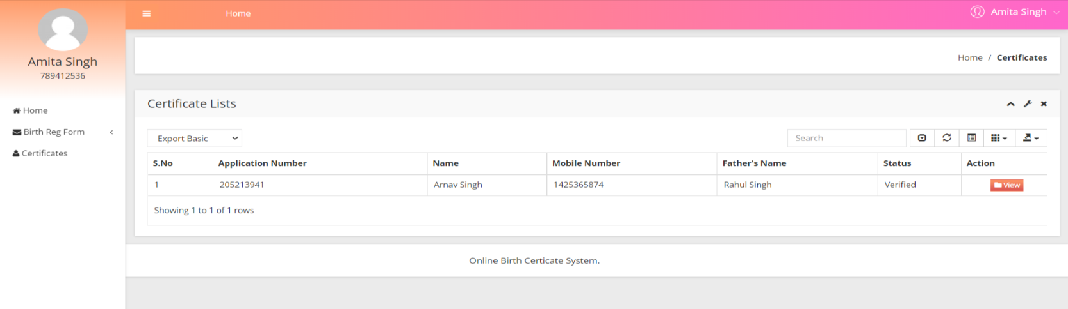

Slide 25
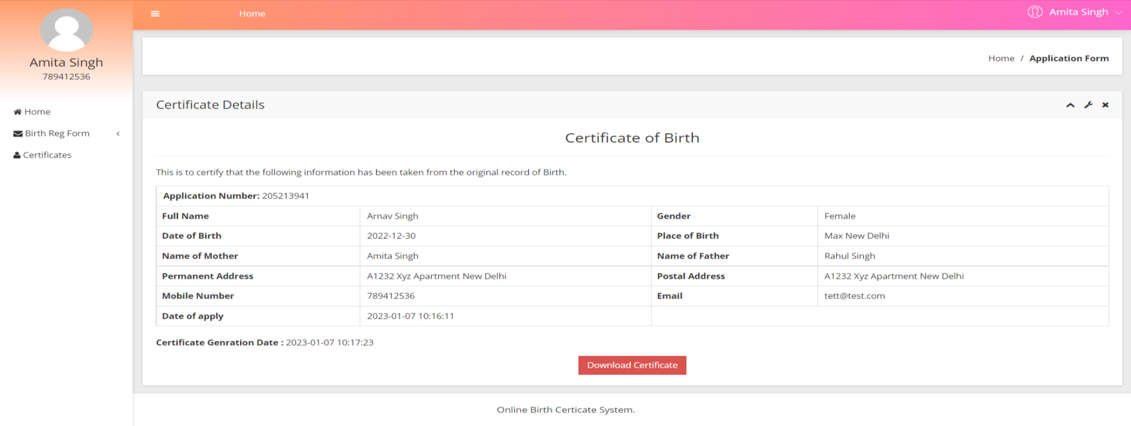

Slide 26
Conclusion
This Application provides a computerized version of Birth Certificate which helps admin to view data of date of birth of people who reside in country.
It makes entire process online and can generate reports. It has a facility of user’s login where user can fill the application details and send to admin.
The Application was designed in such a way that future changes can be done easily. The following conclusions can be deduced from the development of the project.
Automation of the entire system improves the productivity.
It provides a friendly graphical user interface which proves to be better when compared to the existing system.
It gives appropriate access to the authorized users depending on their permissions.
It effectively overcomes the delay in communications.
Updating of information becomes so easier.
System security, data security and reliability are the striking features.
The System has adequate scope for modification in future if it is necessary.

Slide 27
References
For PHP
https://www.w3schools.com/php/default.asp
https://www.sitepoint.com/php/
https://www.php.net/
For MySQL
https://www.mysql.com/
http://www.mysqltutorial.org
For XAMPP
https://www.apachefriends.org/download.html

Slide 28
Thank You

