Slide 1
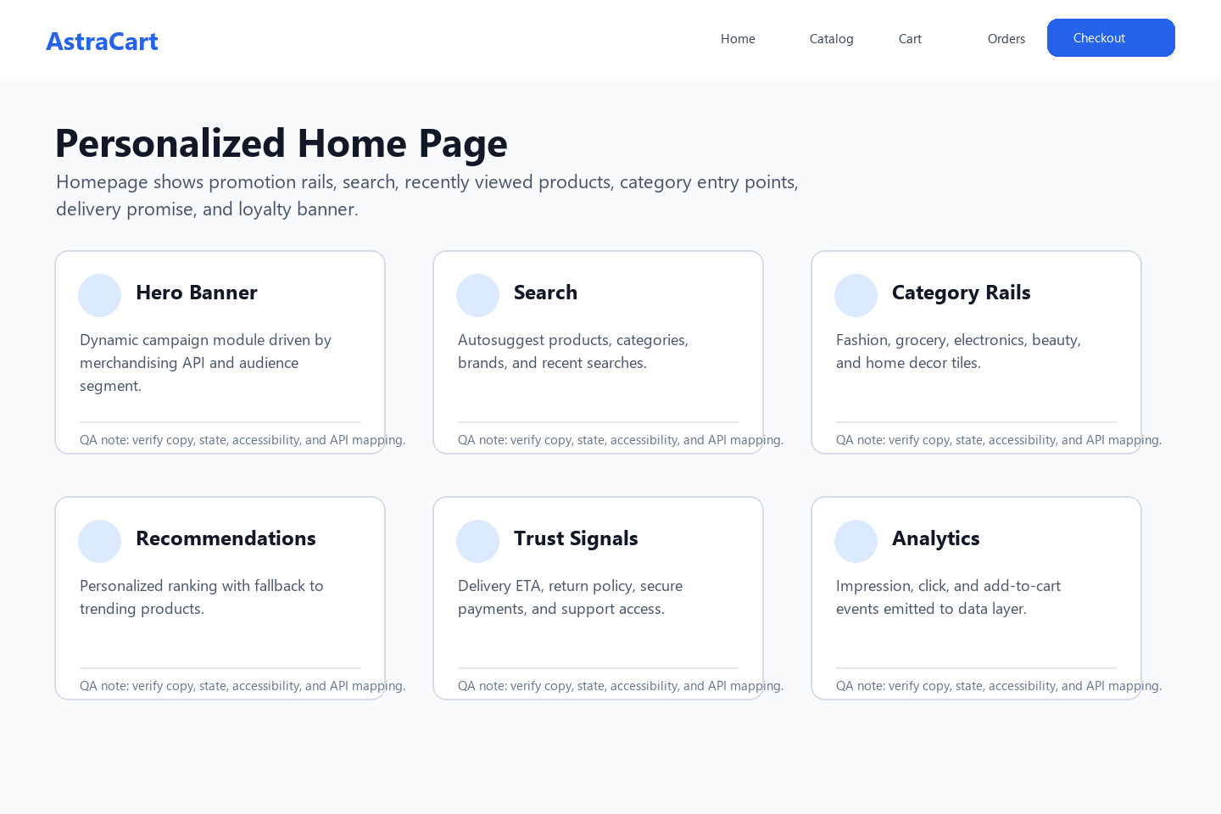
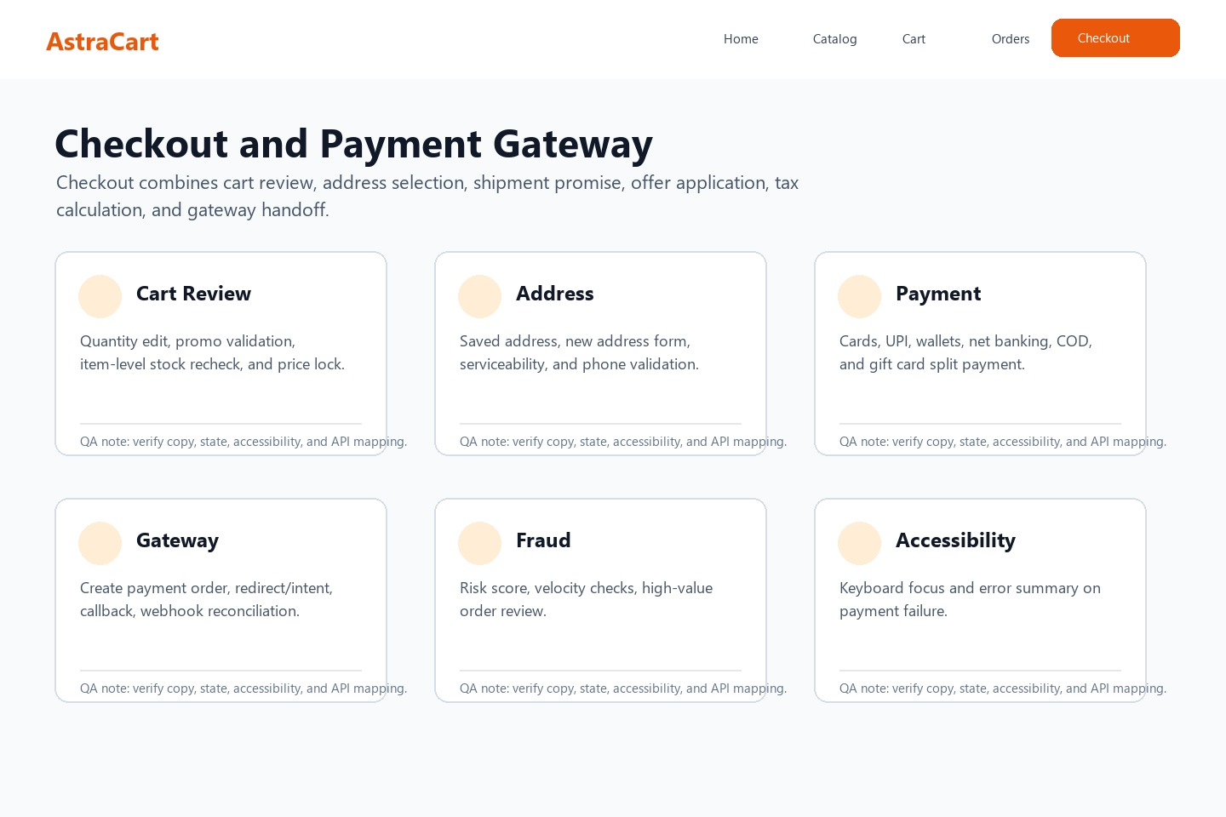
AstraCart Ecommerce Grooming Workshop
Scope review for registration, login, catalog, checkout, payment gateway, result pages, and order tracking.
Notes:
Speaker notes: Confirm whether guest checkout is part of MVP and identify payment gateway sandbox constraints before backlog generation.

Slide 2
Module Prioritization
Module | MVP | Business Risk | QA Focus | Notes
Registration/Login/Logout | Yes | High | Security + session | MFA prompt later
Forgot Password | Yes | High | Token expiry | Avoid enumeration
Home/Listing/PDP | Yes | Medium | Search + filters + variants | SEO state required
Checkout | Yes | High | Price/inventory lock | Quote expiry edge cases
Payment Gateway | Yes | Critical | Webhook reconciliation | Pending vs failed
Orders/Tracking | Yes | High | Timeline correctness | Refund visibility
Notes:
Speaker notes: Payment pending, duplicate callback, and gateway timeout should become explicit negative tests.

Slide 3
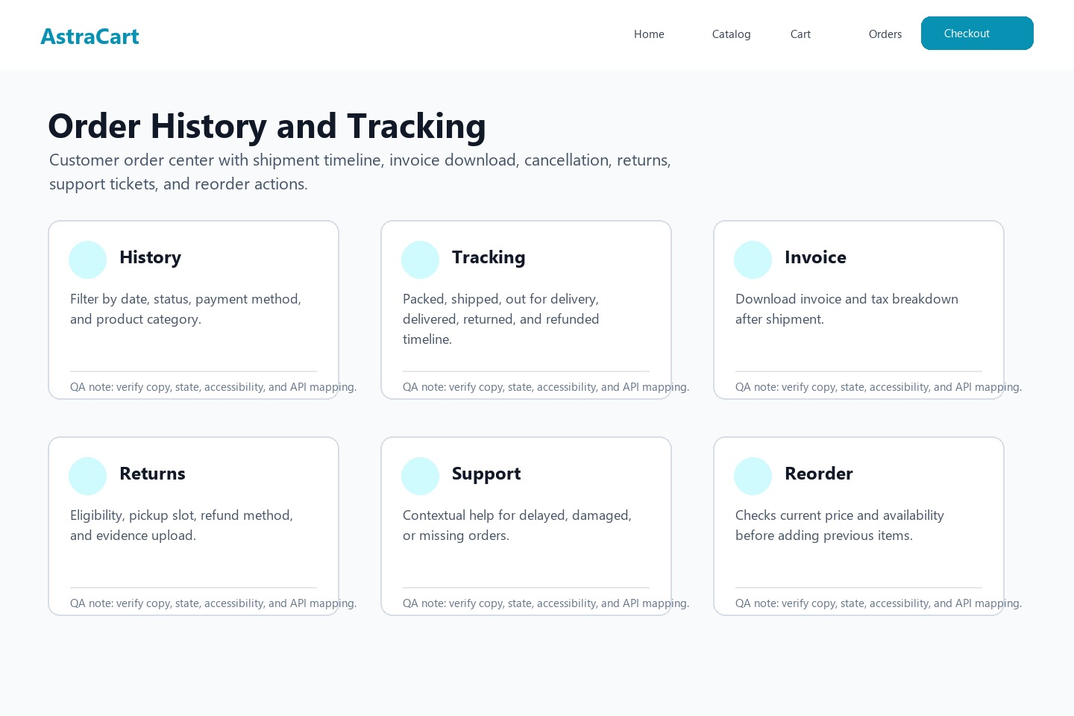
Checkout and Payment Flow
Cart
Quote
Gateway
Webhook
Order
Control points: quote id, payment order id, gateway callback id, order id, trace id, and reconciliation event id.
Notes:
Speaker notes: Ask engineering to expose payment event trail to support console and ensure success page is not final until webhook confirms.

Slide 4
Risks, Open Questions, and Test Hooks
Risk | Owner | Mitigation | Test Hook
Duplicate payment callback | Payments | Idempotency key | Replay webhook
Cart price changes during retry | Checkout | Quote expiry | Advance test clock
Password reset enumeration | Identity | Generic response | Unknown email test
PLP filter explosion | Catalog | Cache key control | High cardinality filters
Order tracking lag | OMS | Event SLA | Delayed shipment event
Reference: Payment gateway sandbox dashboard
Notes:
Speaker notes: Convert these risks into story acceptance criteria and automated API tests before SIT entry.

