Slide 1
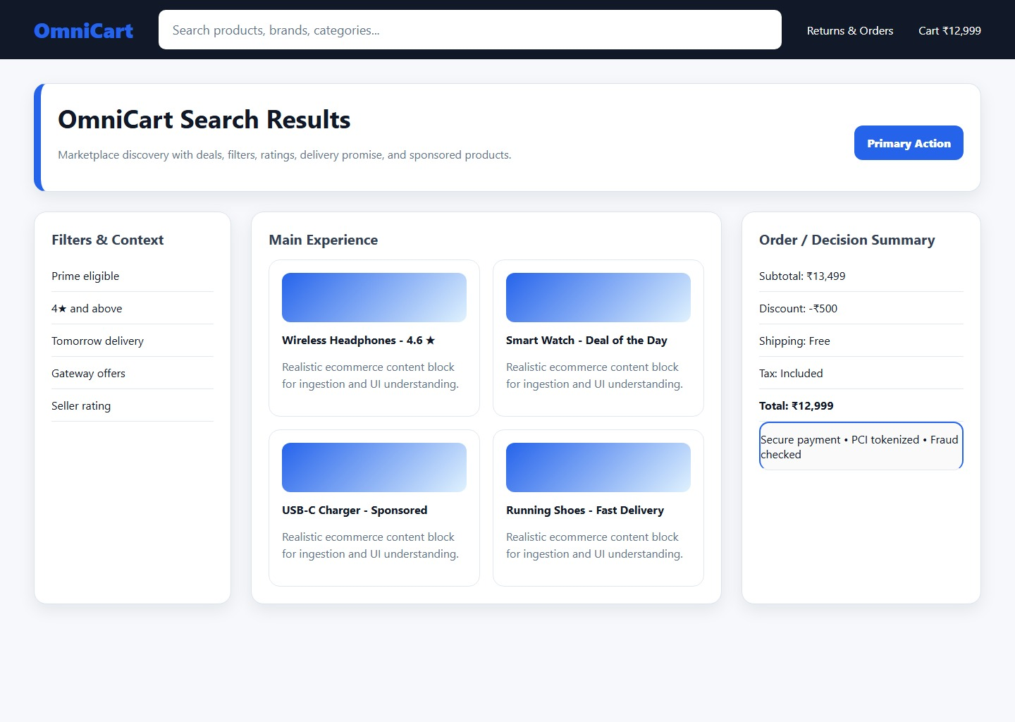
Payment Gateway Flow
Checkout validates fraud score before hitting the payment gateway.
Step | System | Outcome
1 | Risk Engine | Allow
2 | Gateway | Authorize
Route

