Slide 1
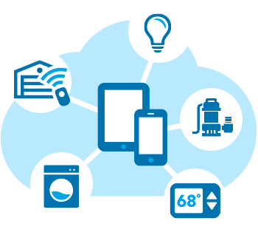
GrocMan - An IoT based grocery management system

Slide 2

ABSTRACT -
GrocMan - An IoT based grocery management system is a smart and new way of grocery shopping that acts as our helper and re-defines the approach towards grocery shopping.
Here we are going to measure the weight under the fixed value of frequency and according to that the order will be placed for shopping of that particular grocery list.
This system introduces us to the simple implementation and usable application with the low cost solution to the common man.

Slide 3

PROBLEM STATEMENT -
In this project, The system will continuously take the measurements of weight of different groceries using weight sensor as a input and system will gives the output as delivery of groceries if user wants to purchase.

Slide 4

INTRODUCTION
Grocery shopping these days has become a job. The client needs to continuously monitor groceries at home and also has the work of managing coupons, maintaining shopping lists, standing in restraint out queues, reading the fine print on food cans, and even needs to find out within which rack and row he or she may notice that item.
Most of the time we remain in wrong belief that we have enough grocery in our kitchen but we have to face empty bottles at the time of emergency when the requirement is must that gives us inconvenience.
And to avoid this, some time we buy more than enough grocery & store it at our home for many days, which is also an inconvenience can cause damage to grocery.
Both this situations are problems. System that can give continuous level measurement and can notify us about low level of content is required to avoid these problems.

Slide 5
Feasibility of Idea -
Specific : It automatically detects the level of groceries and if required place the order.
Measurable : Approach according to software development lifecycle.
Attainable : Define approach of the project.
Realistic : Skillset and resources required.
Timeline : It define timeline to completely the project.

Slide 6
Applicability of Solution -
Usability : Anyone can use this application especially working people are the target.
Scalability : It is scalable to Local and global market.
Economic Sustainability : It gives reasonable price and is every common man’s need.
Environmental Sustainability : It will help to reduce the wastage of groceries.

Slide 7

SURVEY & LIMITATION OF EXISTING SYSTEM
1. IoT based grocery management system - from researchgate
2. Smart Kitchen Automation and Grocery Management System using IoT from researchgate
LIMITATIONS :
Need of manual listing of grocery items.
No Android application used for automatic grocery cart .

Slide 8
OBJECTIVES -
Phase 1: Build smart container which can measure weight and it is connected to WIFI.
Phase 2: Store the status of grocery posted by container to the AWS cloud.
Phase 3: calculate the “out of stock value” and add those groceries to the cart.
Phase 4: Purchase the items added to the cart according to user’s approval

Slide 9
EXPECTED INPUT & OUTPUT -
Input: Update the grocery list if required & place the order.
Output: Delivery of the ordered groceries .

Slide 10

APPLICATIONS -
The responsive web online portal helps to identify inventory status of all the grocery items in the house at a glance
Order the required groceries on a click of a button from the comfort of your home.

Slide 11

REFERENCES -
Research Paper: ijret.esatjournals.org
Research Paper : https://www.researchgate.net/publication/311771245_IOT_based_grocery_management_system
Research Paper : semanticscholor.org

Slide 12
THANK YOU !

