Slide 1





Aliens In The Tidyverse
OCRUG 2019-11 Hackathon
Anuja
Dixit
Adwait
Toro
Ashish
Gupta
Mohan
Ganesan

Slide 2



PROBLEM STATEMENT
Based on various features, classifying whether a particular customer will subscribe to a term deposit or not.

Slide 3
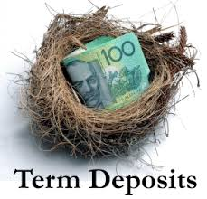
Depends on: -
1 – Age
2 – Balance
3 – Housing
4 – Contact
5 – Day
6 – Duration
7 – Campaign
8 – pdays
9 – previous
10 – Plus One hot encoding

Slide 4
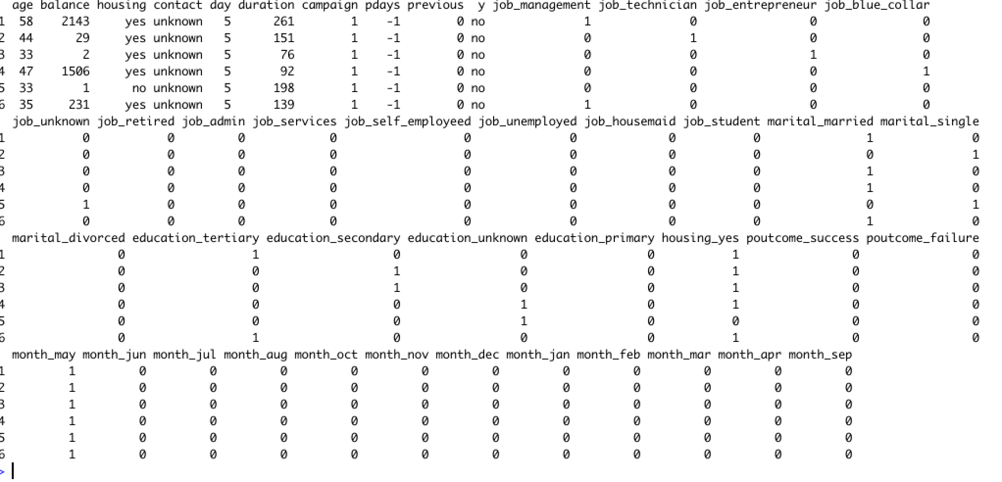

Slide 5

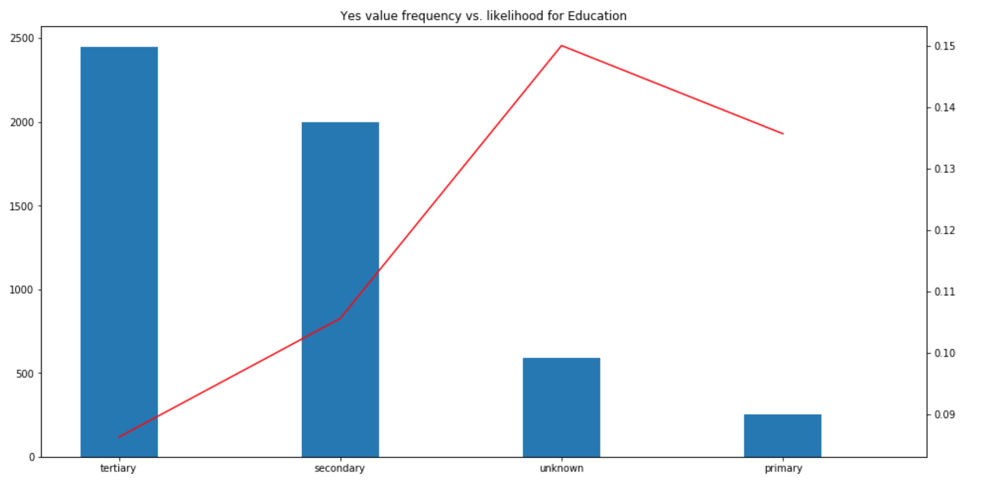
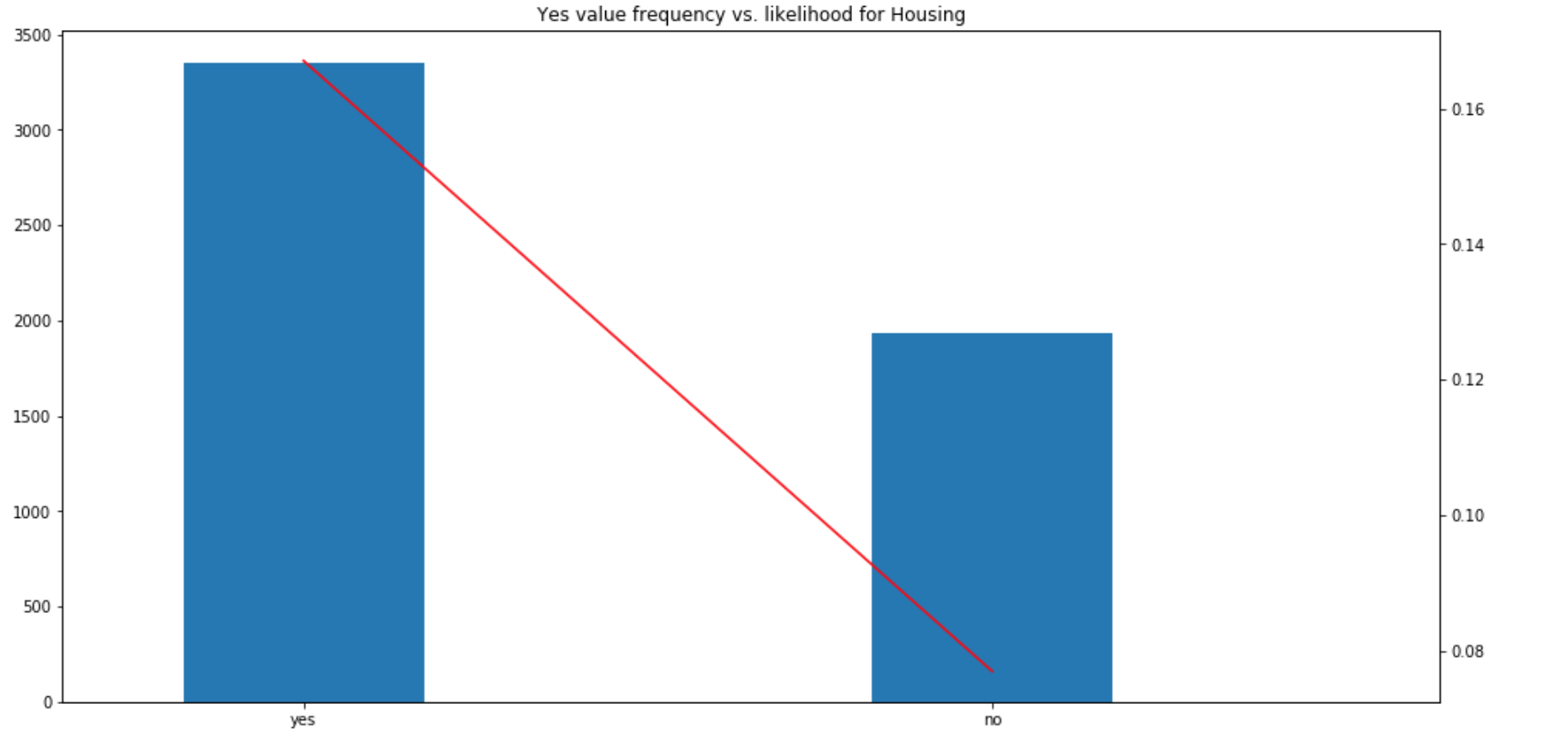
V
I
S
U
A
L
I
Z
A
T
I
O
N
S

Slide 6
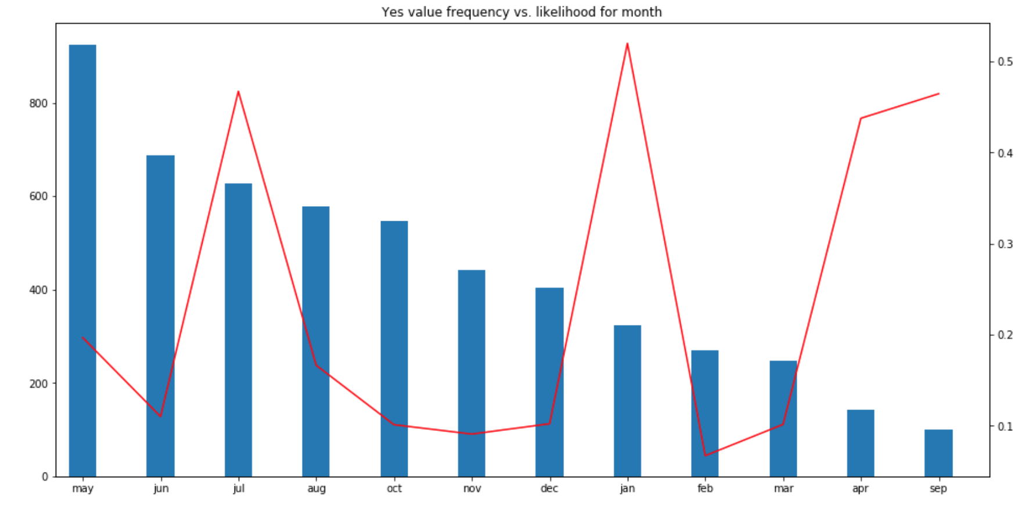
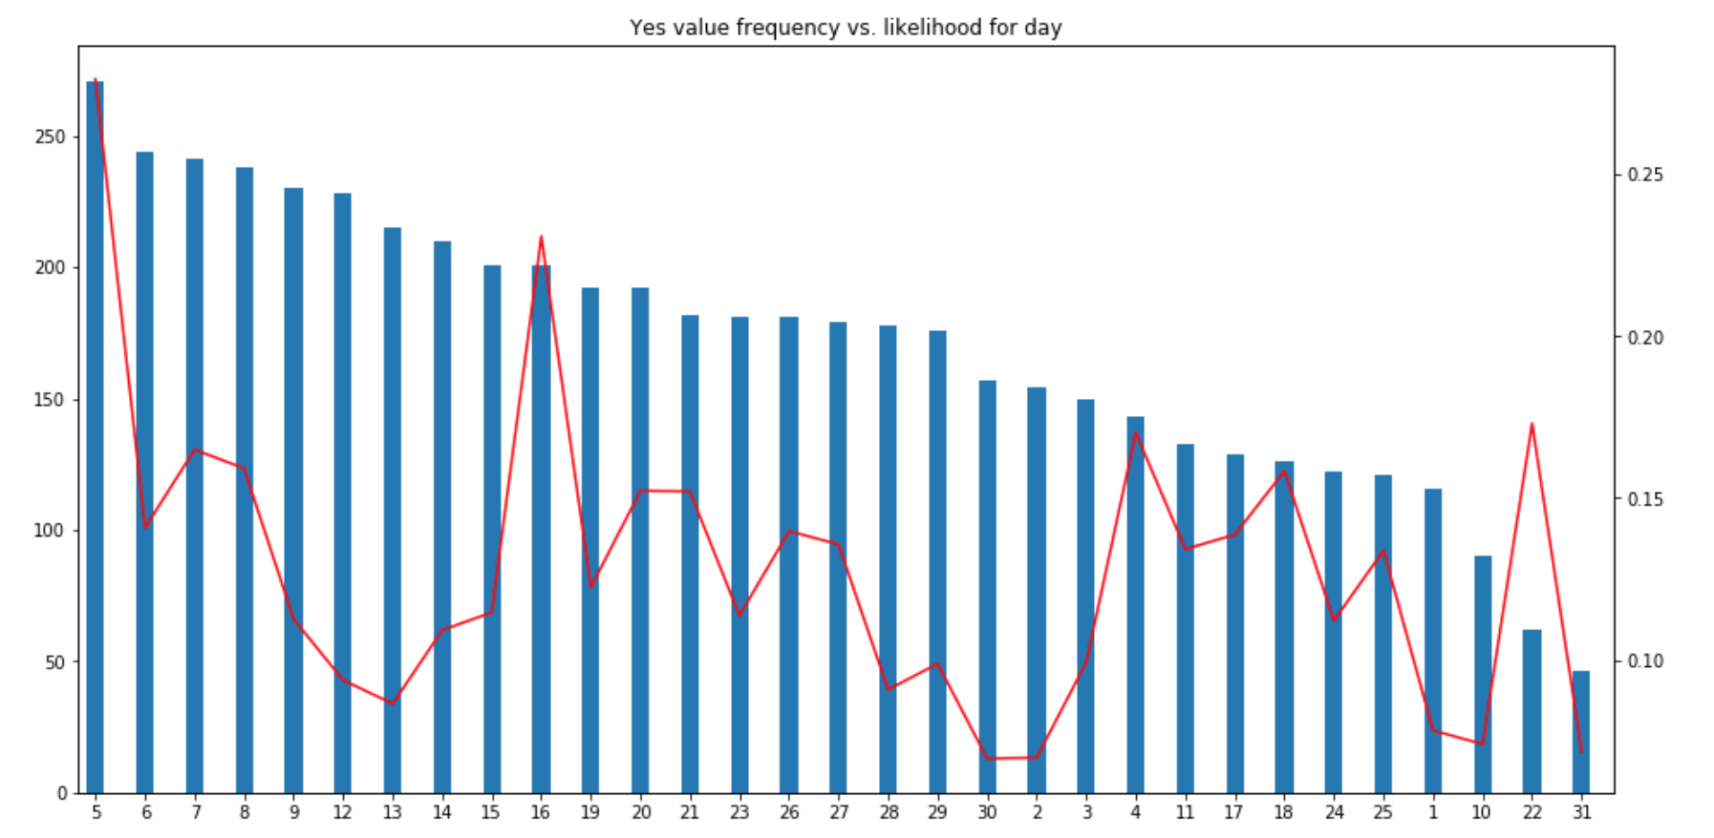

Slide 7
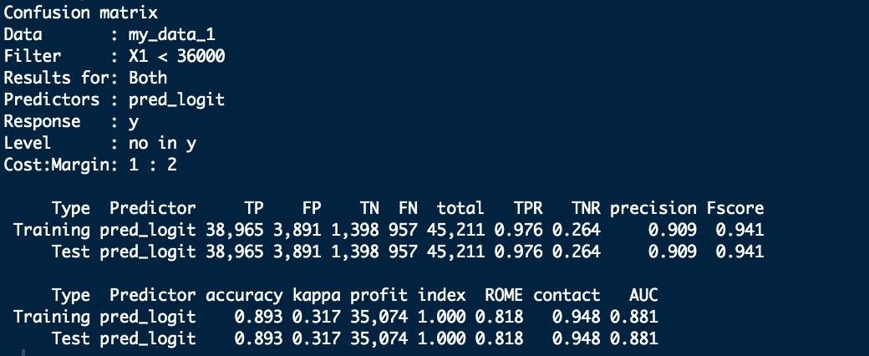
Logistic
Regression
Approach: -

Slide 8
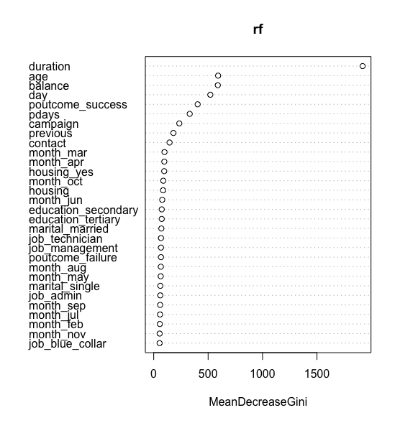

INFLUENCE OF VARIABLES

Slide 9
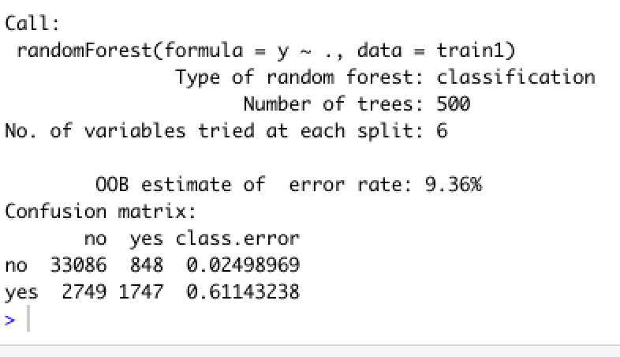
R
A
N
D
O
M
F
O
R
E
S
T

Slide 10
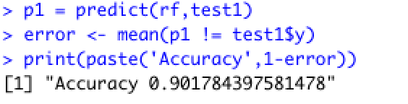
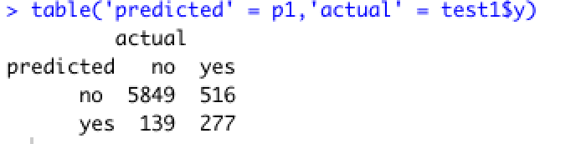
R
A
N
D
O
M
F
O
R
E
S
T

Slide 11
RECOMMENDATIONS
Negative balance, affirmative answer to term deposits – this should be addressed.
The likelihood of the customer to get converted decreases as the amount of customer interaction time engaged in a phone call increases – this should be addressed.
The age bin 56+ has a higher chance to agree for term deposits. Hence, following this strategy, same should be applied to the age group (21-35) which doesn’t agree for term deposits.

Slide 12
THANK YOU!

