Slide 1
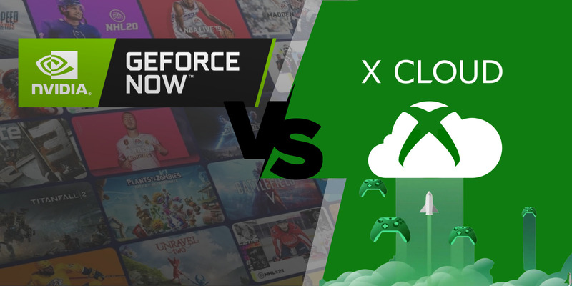
Group 6: Anuja Abhay Thakar, Shoaib Mohammed, Saloni Ghosh, Pranav Mody, Vishal Kumar

Slide 2

Introduction
Nvidia GeForce Now: Cloud Gaming platform that allows gamers to stream and play games they already own from various gaming consoles and PC gaming storefronts such as Steam, Epic Games store etc.
- Eliminates the need to repurchase games from cloud gaming service
- Better latency and resolution 1080p
- Provides atleast 3.5MB/s bandwidth
- Provides great quality on all platforms such as TV, PC, laptop, Mobile-phones and different browsers
Xbox Cloud Gaming: Microsoft’s cloud gaming platform that allows gamers to play games without installing or downloading them by using the extensive Xbox Game Pass library.
- Supports both Console and PC
- Less latency and resolution 480p
- Provides maximum upto 2.5 MB/s bandwidth
- Works better on smaller screens such as Mobile-phones or laptops and different browsers

Slide 3

Sources: NVIDIA GeForce YouTube Channel

Slide 4
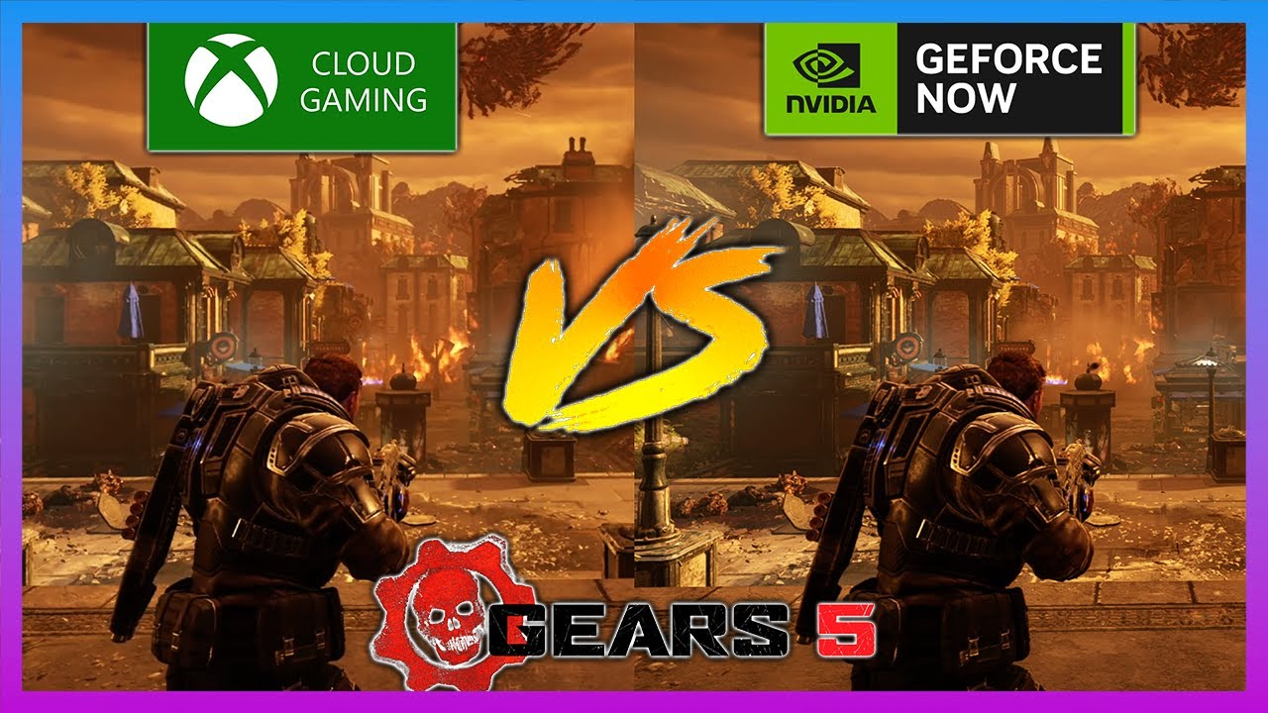
Source: Game Fusion YouTube Channel

Slide 5
Timing of Entry
Xbox Cloud Gaming (previously known as Project xCloud) officially launched in September 2020. It allows users to stream Xbox games to devices like phones and tablets. It is currently available in certain regions as part of an Xbox Game Pass Ultimate subscription.
NVIDIA GeForce Now officially launched in February 2020. It is NVIDIA's cloud gaming service that allows users to stream games they already own on platforms like Steam. It is currently available in North America and Europe.
Sources: Xbox Cloud Gaming – Wikipedia | GeForce Now - Wikipedia

Slide 6
Business Model and Organizational Structure of GeForce Now
Business Model | Organizational Structure
Subscription-Based Service: The monthly subscription price is $10. There is also an annual subscription option priced at $99.99. | GeForce NOW Alliance Program: NVIDIA has formed the GeForce NOW Alliance program to expand its reach globally. This program involves partnerships with global telecommunications providers
Game Ownership: GeForce Now allows users to play games they already own. This means that any game purchases made on personal store accounts will always stay with the user. | Data Centers: GeForce Now consists of a network of servers based in data centers in North America and Europe. NVIDIA has also announced plans to open additional data centers in Montreal, Canada, and Australia through their partnership with Pentanet.
Hardware Accessibility: Enables players with underpowered hardware to play the latest games at the highest graphics settings. This is possible because games streamed on GeForce Now are played over cloud servers equipped with NVIDIA’s high-end gaming GPUs. | Partnerships: NVIDIA has partnered with companies like Ampere Computing to extend its server platform to cloud gaming5. It also plans to deploy RTX cloud gaming servers in Japan and Korea through partnerships with Softbank and LG Uplus, respectively
Sources: GeForce NOW

Slide 7
Business model and Organization structure of Xbox Cloud Gaming
Business Model | Organizational Structure
Subscription-Based Service: The service is part of the Xbox Game Pass Ultimate, which typically costs $15 a month. | Gaming Ecosystem Organization (GEO): Microsoft formed its GEO in 2020, which looks after the needs of game creators across all of Microsoft’s software and services, including Xbox, Azure, and Microsoft 365
Cloud Gaming: The service operates by linking the device to a remote server in the cloud1. This allows users to play games on various devices, including Xbox consoles, Windows, Android, and iOS. | Data Centers: Xbox Cloud Gaming started off on Android only running off Xbox One S servers in Microsoft’s datacenters3. Since then, Cloud Gaming upgraded to Custom Xbox Series X servers, and launched on Windows PCs, Apple phones and tablets, Xbox One and Xbox Series S|X.
 | Global Reach: Xbox Cloud Gaming is available in 28 countries, such as Argentina, Australia, Austria, Brazil, Canada, Denmark, Finland, France, Japan, South Korea, Mexico, the Netherlands, Norway, Poland, Spain, Switzerland, the United Kingdom and the United States
Sources: Xbox Cloud Gaming's Growth and Evolution - Xbox Wire

Slide 8
Marketing Strategy
Marketing Strategy Aspect | Nvidia GeForce | Xbox Cloud Gaming
Target Audience and Segmentation | Primarily corporate firms and gamers. | Diverse audience, targeting teenagers to adults (20-45 years). Targets specific age groups and builds relationships with lifestyle and behaviour gamers.
Promotions | Occasionally offers promotions, especially during product launches or events, to stimulate sales. | Regularly employs promotions, discounts, and bundle offers, particularly during seasonal sales and events like Black Friday.
Loyalty Programs | No Loyalty Programs. | Offers a loyalty program with Xbox Live Gold, providing benefits like free games and exclusive discounts for subscribers.
Digital Marketing Strategy/Social Media | Unconventional campaigns, like the Crop Circle campaign, generate buzz and media attention. Actively engages with gaming influencers and content creators on platforms like Twitch and YouTube to promote Nvidia products and targeted ad campaigns. | Campaigns like Beyond Generations Campaign Engages with the gaming community through social media channels. Launches major campaigns for exclusive game releases and engages in collaborations.
Experiential Learning | GeForce Experience: Provides software that enhances gaming experiences on Nvidia GPUs, creating a positive and immersive experience for users. | PAX Australia Participation: Participates in events like PAX Australia, offering attendees an active brand experience to increase engagement.

Slide 9
Pricing Strategy
Pricing Strategy Aspect | Nvidia GeForce | Xbox Cloud Gaming
Product Pricing | Offers a range of GPUs with varying performance levels, targeting different market segments. Prices are often positioned at premium levels, reflecting high-performance and advanced technologies. | Xbox consoles are priced competitively to attract a broad consumer base. Xbox Game Pass subscription service offers various pricing tiers, providing flexibility to users.
Discounts | Occasionally offers discounts, especially during product launches or events, to stimulate sales and attract customers. | Xbox Live Gold subscription often includes free games and exclusive discounts.
Subscription & Freemium Models | Nvidia offers subscription services like GeForce Now. GeForce Now offers a freemium model, allowing users to access basic features for free and offering premium subscriptions for enhanced services. | Emphasizes subscription models such as Xbox Game Pass, providing access to a library of games for a monthly fee. Xbox Live Gold subscription for online multiplayer and additional perks.
Price Flexibility | Prices can be relatively inflexible due to the premium positioning of high-performance GPUs. | Xbox often adjusts console prices to remain competitive in the market. Regularly offers discounts on subscription services and game titles to encourage adoption.

Slide 10

PORTER’S FIVE FORCES FOR GLOBAL CLOUD GAMING MARKET
Threat of Potential Entrant
Bargaining Power of Supplier
Degree of Existing Rivalry
Bargaining Power of Buyer
Threat of Substitutes

Slide 11
PORTER’S FIVE FORCES FOR GLOBAL CLOUD GAMING MARKET
Bargaining Power of Suppliers | Suppliers in the cloud gaming market are few, and product dependence, availability of raw materials, and pricing give suppliers significant bargaining power. | High
Bargaining Power of Buyers | The initial cost of cloud gaming necessitates large capital investments | Low
Threat of New Entrants | Startups entering this market face high capital investment costs, labor costs, and must adhere to government regulations. | Low
Threat of Substitutes | There are alternative free gaming options available in the market. But the additional benefits offered by cloud gaming such as playing with less number of hardware are increasing the preference of the people towards cloud gaming. | Low
Competitive Rivalry in the Market | To stay ahead of the competition, companies in the global cloud gaming market are focusing on strategies such as business expansion, technological innovations, and product advancements. | Moderate
Sources: https://www.researchdive.com/press-release/cloud-gaming-market.html

Slide 12
Recommendation for companies
Xbox cloud gaming | Nvidia GeForce Now
Explore more pricings options: Xbox Game Pass Ultimate bundles 100+ games, multiplayer access, and cloud gaming for $15 per month Can have lesser price plan with limited options to attract more customers Bundled plans for different tenure | Games Purchasing GeForce NOW requires you to have the game bought in your library, where xcloud includes game library, therefore it is cheaper as it also comes with game-pass games This increases the overall price significantly
Better Hardware: Cloud gaming limited to 1080p at 60fps whereas GeForce Now supports 1440p at 120fps | Unavailability of big gaming companies Activision Blizzard, Capcom, Square-Enix, Warner Bros, etc are large companies with huge customer base that are not supported by GeForce
Freemium options: Microsoft could offer freemium options. Nvidia lets you create account for free and 1 hour session length of free game time | Library stability Sudden removals of titles like Cyberpunk 2077 shortly after launch upset subscribers. Nvidia needs better relationships with publishers.
Sources: https://www.cnet.com/tech/gaming/best-cloud-gaming-services/

Slide 13
Dominant Design After 5 years
Xbox Cloud Gaming
Microsoft's Unmatched Cloud Infrastructure
Larger Library of Games
Nvidia Geforce Now
Specialization in Cloud Gaming
Commitment to an Open Platform
Superior Graphics and Performance
Xbox Cloud Gaming, with its integration across Microsoft's gaming services and Azure cloud infrastructure, holds key advantages to dominate cloud gaming long-term.
However, GeForce NOW should remain a leading contender leveraging Nvidia's graphics engineering strengths and platform openness across various game stores.

Slide 14


