Slide 1
RISING STARS | EMPLOYEE ANALYTICS
›
›
›
›
›
›
›
Employee Analytics
& Data Warehouse System
A MySQL-backed application for employee records, project staffing, review events, and workforce analytics.
Project Team
Anuj Bankar
Sneha Garg
Harsh Nandal
WORKFORCE ANALYTICS
Notes:
Sources: supplied Rising Stars master prompt, supplied diagrams, repository README and application/SQL source. The diagrams are reproduced as supplied on the reference slides.

Slide 2
System at a Glance
Rising Stars connects day-to-day employee, project, assignment, and review workflows with a separate analytics warehouse. Operational changes are managed in MySQL OLTP; analytical history is organized in a star schema.
Seeded local demonstration data
Record type | Loaded rows
Employees | 100,000 (1 lakh)
Projects | 40
Assignments | 1,489
Review events | 3,000
These are generated demonstration records. They are not observed workforce facts or real dated source history.
Three design choices
Separate write and reporting workloads
Keep employee changes effective-dated
Make analysis traceable to review events
2 / 15
Notes:
Sources: supplied project master prompt; scripts/seed_sample_data.py; presentation sample volumes shown are 100,000 employees, 40 projects, 1,489 assignments, and 3,000 review events. Employee and activity data are synthetic demonstration records.

Slide 3
Application capabilities
The interface is organized around the records and decisions each user needs to manage.
Workspace | Purpose | Data and controls
Employees | Maintain employee records and review employment history. | Validation; department, role, level, and salary changes feed employee history.
Projects and assignments | Track project lifecycle and allocate employee capacity. | Dates and project statuses are validated; allocations use a 0-100% range.
Reviews | Create and browse performance review events. | Ratings and scores are checked; project and reviewer references are optional where allowed.
Warehouse and ETL | Prepare repeatable operational-to-analytics loads. | Staging batches, SQL procedures, surrogate keys, and employee SCD Type 2 history.
Analytics | Compare performance, attrition patterns, and delivery bottlenecks. | Year/department filters; ranking and descriptive analyses; interactive charts.
3 / 15
Notes:
Sources: app/pages/1_Employees.py, app/pages/2_Projects.py, app/pages/3_Reviews.py, app/pages/4_Dashboard.py, src/entities.py, src/managers.py, SQL DDL and the supplied master prompt.

Slide 4
Application and Data flow
Operational application
HR user
Streamlit interface
Python services
MySQL OLTP
Employee and review
work
→
Entry forms and
analytics views
→
Validation and
business rules
→
Core employee, project,
assignment and review data
Warehouse and analytics path
Source inputs
Staging
ETL procedures
OLAP
Analytics
IBM snapshot and
generated activity
→
Landing and
history tables
→
Validate, map keys,
apply SCD Type 2
→
Review fact and
dimensions
→
Metrics and interactive
Plotly dashboard
The ETL reads staged history and operational records. Transactional writes remain in OLTP; dashboard queries use the warehouse.
4 / 15
Notes:
Sources: supplied architecture diagrams; app/Workforce_Overview.py; app/pages; src/managers.py; src/db_manager.py; run_staging_load.py; scripts/seed_sample_data.py; sql/07_etl_olap.sql.

Slide 5
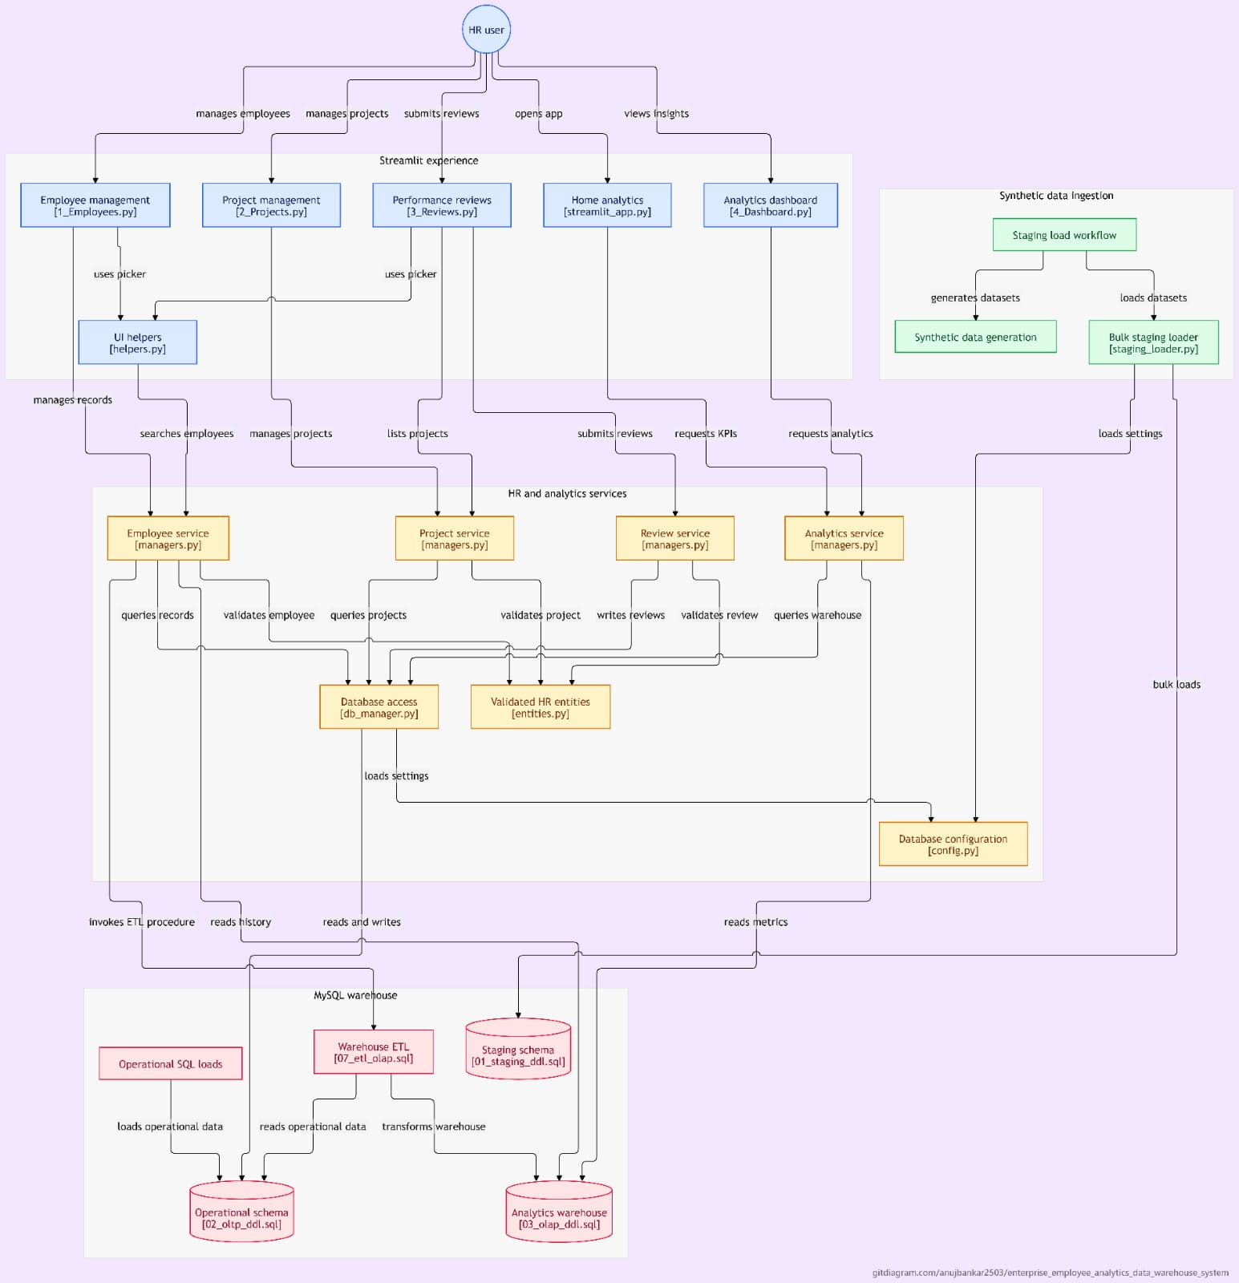
Architecture A | Application-to-Warehouse flow
1. HR-facing application
An HR user enters through employee management, project management, reviews, home analytics, or the dashboard. Employee and review pages share UI helpers for employee and project selectors.
2. Services and transactional data
Pages call employee, project/review, and analytics services in managers.py. Validated entities and the database access layer use centralized configuration. Operational records are stored in hr_oltp.
3. Ingestion and warehouse route
A separate staging runner creates and loads data into hr_staging. Operational and activity loads populate hr_oltp; warehouse ETL (07_etl_olap.sql) transforms source records into hr_dw. Analytics services query the warehouse.
5 / 15
Notes:
Diagram reading: HR user -> Streamlit pages and UI helpers -> domain services -> validated entities/database access. Separately, staging runner/data synthesizer -> hr_staging; operational/activity SQL loads -> hr_oltp; warehouse ETL -> hr_dw; analytics services query hr_dw. Source image embedded unchanged.

Slide 6
Architecture B | Application and Ingestion layers
Application and shared services
Employee, project, review, home, and dashboard pages call shared managers.py services. UI helpers supply selectors; validated entities hold the business rules. Database access and credentials are centralized through db_manager.py and config.py.
b. Two data paths
Application writes go through operational SQL into hr_oltp. A separate synthetic-data workflow generates and bulk-loads rows into hr_staging. The diagram keeps this batch ingestion path apart from user transactions.
c. Warehouse and reporting
Warehouse ETL reads staged and operational data to populate hr_dw; the analytics service reads warehouse metrics for the dashboard.
6 / 15
Notes:
Diagram reading: user-facing pages -> shared services/entities/database access. Synthetic generation -> staging load workflow -> hr_staging. Operational SQL loads -> hr_oltp. Warehouse ETL reads upstream data and populates hr_dw; analytics queries hr_dw. The original image is embedded unchanged.

Slide 7
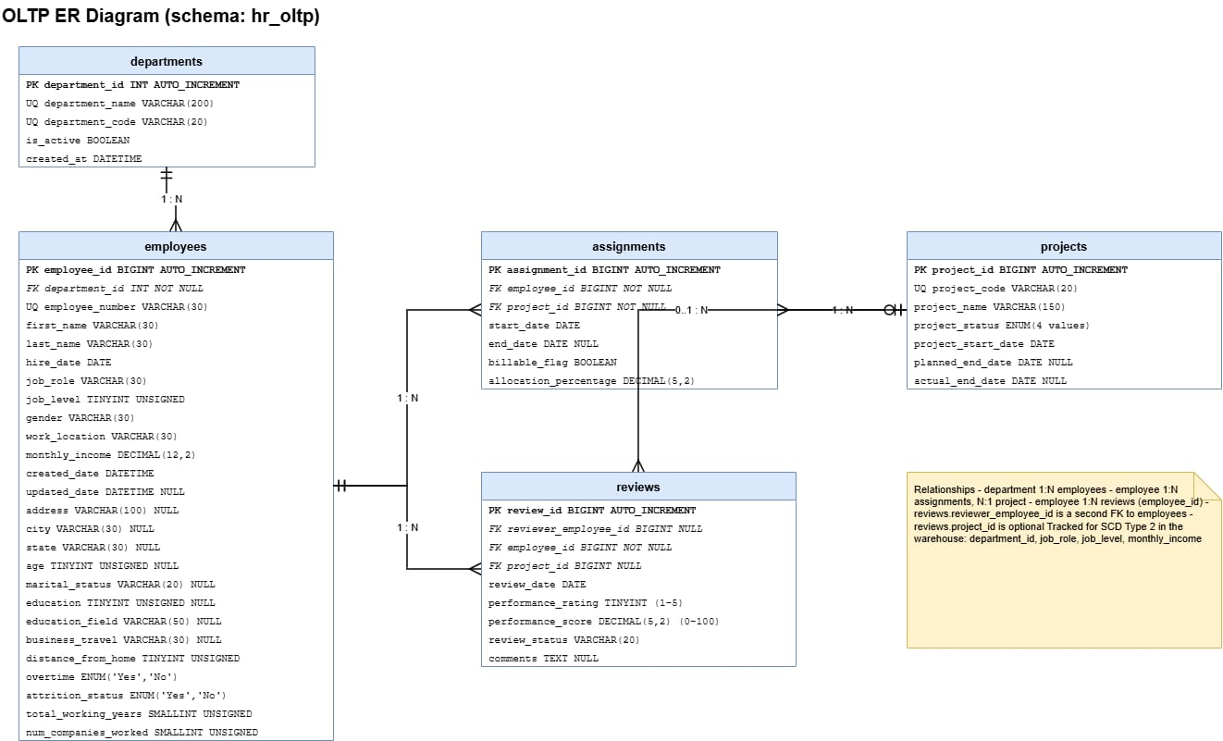
OLTP ERD | Operational Relationships
Department → employees (1:N)
Each employee references one department; a department can contain many employees.
Employee + project → assignments
Assignments link an employee to a project, turning the employee/project many-to-many relationship into two one-to-many relationships. Each row carries start/end dates, billability, and allocation percentage.
Employee → reviews; project is optional
review.employee_id identifies the employee being reviewed. reviewer_employee_id is a second employee foreign key for the reviewer; review.project_id may be null.
Key constraints
Allocation: 0–100%. Rating: 1–5. Score: optional, 0–100. Project status uses the listed lifecycle values.
7 / 15
Notes:
ERD relationships: departments 1:N employees; employees 1:N assignments; projects 1:N assignments; employees 1:N reviews as subject; employees can also appear as reviewer through reviewer_employee_id; review.project_id is optional. Assignment stores allocation and dates. The image is embedded unchanged.

Slide 8
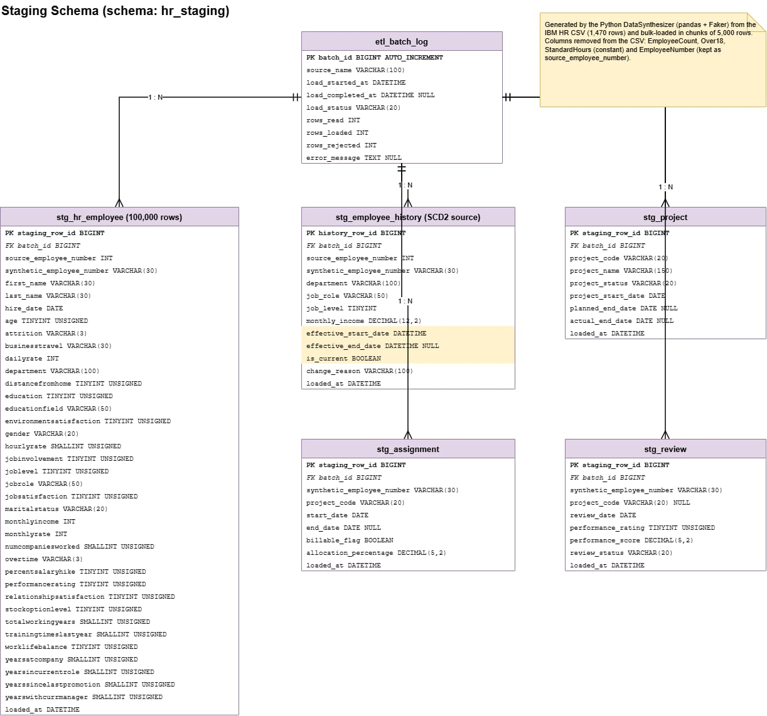
Staging schema | Batch lineage and Landing tables
Batch control
etl_batch_log records source, start/completion time, status, rows read/loaded/rejected, and error details. batch_id links staged records to the load that produced them.
Employee source and history
stg_hr_employee lands snapshot attributes. stg_employee_history stores department, role, level, income, effective start/end, current flag, and change reason for historical processing.
Application activity
stg_project, stg_assignment, and stg_review stage project and review activity before operational/warehouse loading. The diagram annotation identifies generated activity as synthetic sample data.
8 / 15
Notes:
Schema interpretation: ETL_BATCH_LOG is the batch parent; batch_id provides lineage for employee landing/history and staged project/assignment/review rows. HR snapshot fields and effective-dated employee changes are separate staging concerns. The diagram note describes Python/Pandas/Faker-generated sample records and omitted constant source columns. Image embedded unchanged.

Slide 9
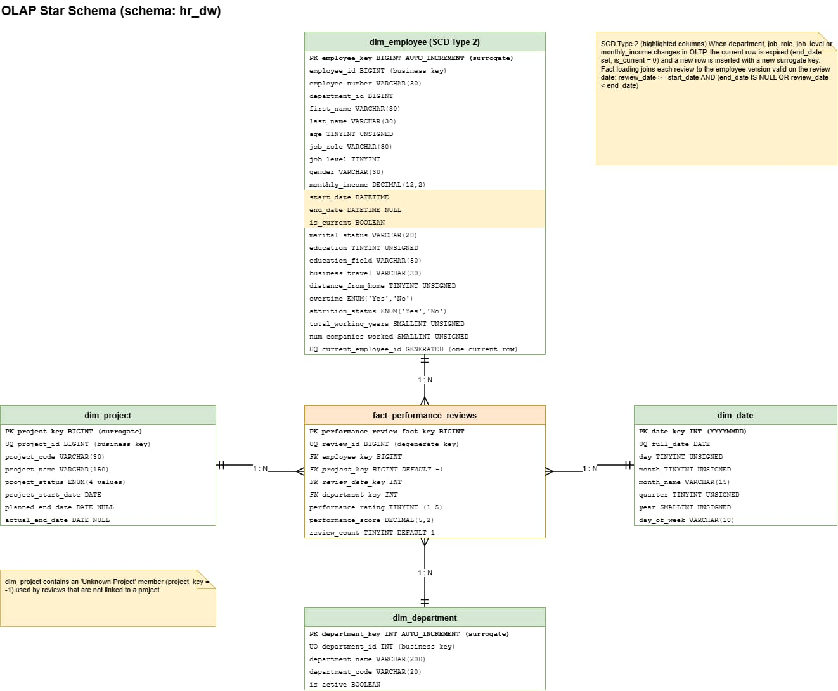
Star schema | Review fact and dimensions
Fact grain and measures
One row per review event. Stores review_id, rating, score, review_count, and dimension keys.
Four dimensions
Employee, department, project, and date each relate 1:N to the fact. Project key -1 is the unknown member for unlinked reviews.
Employee SCD Type 2
employee_key identifies each version; employee_id is the OLTP business key. Department, role, level, and monthly income are tracked. start_date/end_date/is_current delimit versions; review_date selects the valid row.
9 / 15
Notes:
Star-schema interpretation: fact_performance_reviews is at review-event grain with rating/score measures and dimension foreign keys. Each dimension has one-to-many fact relationships. dim_employee uses a surrogate employee_key plus the OLTP employee_id business key and Type 2 effective dating; dim_project includes an Unknown Project member for reviews with no project. Source image embedded unchanged.

Slide 10
ETL and Employee history
A repeatable warehouse load
Log batch
Validate rows
Reference dims
Employee SCD2
Review facts
Source, status,
row counts
→
Check and land
accepted data
→
Refresh keys and
descriptions
→
Expire changed
employee versions
→
Resolve valid
warehouse keys
SCD Type 2 rule
Step | Warehouse behavior
Detect change | Compare tracked department, role, job level, and monthly income.
Close old row | Set the current version's end date and is_current flag to false.
Insert version | Add a new row with a new surrogate key and current attributes.
Resolve review | Match start_date <= review_date and (end_date is null or review_date < end_date).
10 / 15
Notes:
Sources: sql/07_etl_olap.sql, src/db_manager.py, run_staging_load.py, and the supplied project master prompt. The procedure resolves reviews against the employee version valid on the event date.

Slide 11
Analytics and Interpretation
Interactive charts support inspection, comparison, and drill-down through hover details and chart controls.
Analysis | Question answered | Method and interpretation
Performance trend | How do average review scores change by year? | Annual averages and year-over-year change using LAG().
Top performers | Who ranks highest within each department? | SQL DENSE_RANK(); minimum review-event filter; score versus review coverage scatter.
Attrition patterns | How does recorded attrition vary across employee attributes? | Group comparisons of current employee labels; exploratory and not predictive.
Project delivery | Which active projects are past plan and where is capacity over 100%? | Days overdue and summed active assignment percentages.
Metric definitions
Headcount counts current employee dimension rows. Review score is a 0-100 average. Attrition rate is the share of current records marked Yes; it is not an individual risk prediction.
11 / 15
Notes:
Sources: src/managers.py and app/pages/4_Dashboard.py. Attrition comparisons are descriptive, not a validated predictive model. Review scores come from dated application review events, not the IBM snapshot's PerformanceRating field.

Slide 12
Demonstration data and Local controls
The local sample makes the application and analytics easier to explore end to end.
Demonstration records | Sample volume
Employees | 100,000 (1 lakh)
Projects | 40
Assignments | 1,489
Review events | 3,000
Interpretation and controls
- Generated employees and activity are demonstration records.
- The IBM HR file is a point-in-time snapshot; it does not contain real dated review events or employee change history.
- Attrition views describe labels and group patterns; they are not validated predictions.
- Local launch binds to 127.0.0.1. Keep credentials in app/.env and restrict access to the local development environment.
Prepared from the supplied project brief, diagrams, and repository implementation.
12 / 15
Notes:
Sources: scripts/seed_sample_data.py, app/.env.example, scripts/run_local.ps1, README.md, supplied master prompt and diagrams. Demo volumes are the last confirmed local seed counts; all such records are synthetic.

Slide 13
Scope and Limitations
What this local demo includes—and what its sample results cannot tell us.
Project scope | Limitations
Local app for employee, project, assignment, and review workflows. | Employee attributes are sampled; names and review and project activity are generated for demonstration.
MySQL stores operational records; staging and loading steps build the analytics warehouse. | The IBM HR file is a snapshot, not a complete dated history of reviews or employee changes.
Dashboard summarizes headcount, review scores, attrition labels, and project delivery. | Charts describe patterns, not causes or predictions; this demo is not for personnel decisions.
Use these sample metrics to explain the system, not to assess real employees.
13 / 15
Notes:
Scope: a local Streamlit workflow for employee, project, assignment, and review records; a MySQL operational database; staging and warehouse loading; and descriptive dashboard views. Limitations: employee attributes come from a point-in-time IBM HR sample, while names and review/project activity are generated for demonstration. The dashboard does not establish causes or predict individual outcomes, and the app does not provide sign-in or role-based access. Sources: project README.md, run_staging_load.py, src/etl/data_synthesizer.py, SQL ETL scripts, supplied master prompt, and supplied architecture and ER diagrams.

Slide 14
Conclusion
A local HR workflow can turn day-to-day records into clear reports.
Project result | What it means
One local HR workbench | Users can maintain employee records, projects, assignments, and reviews.
Connected data path | Records move from staging through MySQL operational tables into the reporting warehouse.
Reviews keep history in context | Each review is matched to the employee profile that was active on its review date.
The project demonstrates a complete local workflow. Real workforce conclusions need approved, dated HR data and measures agreed with HR.
14 / 15
Notes:
Conclusion: the project demonstrates a local end-to-end workflow from HR forms to operational storage, staging, the reporting warehouse, and descriptive analytics. Each review is linked to the employee dimension version valid on its review date. Real workforce conclusions require approved, dated HR history and measures agreed with HR. Sources: project README.md, run_staging_load.py, src/etl/data_synthesizer.py, SQL ETL scripts, supplied master prompt, and supplied architecture and ER diagrams.

Slide 15
RISING STARS
Thank You
Notes:
Closing slide.

