Slide 1
Approximation & Heuristic Approaches for the Travelling Salesperson Problem (TSP)
CS 512 – Final Project
Anuj Bohra – ab3414
Krisha Borana – kb1469

Slide 2
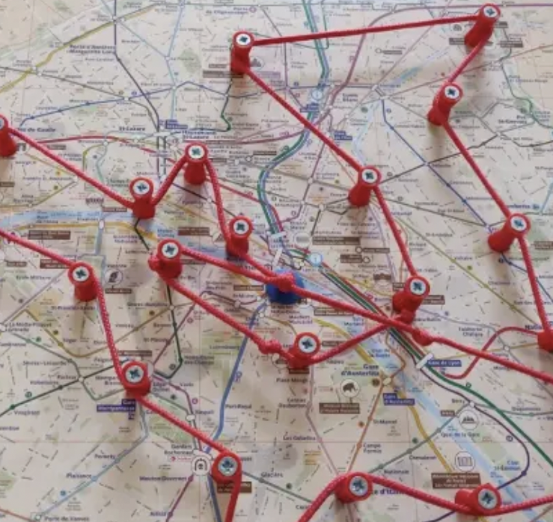
What is the TSP?
Given n cities and distances, find the shortest tour visiting each city once.
Must return to the starting city.
TSP is NP-hard; exact solutions scale factorially.
Used in routing, logistics, chip design, DNA sequencing.

Slide 3
Project Goals
Implement Brute Force, Nearest Neighbor, and 2-Opt.
Compare runtime, solution quality, approximation ratio.
Generate visualizations and performance plots.

Slide 4
Data Generation & Processing
Random (x, y) coordinates sampled in range [0, 100].
Euclidean distance matrix computed for all city pairs.
Small n = 6, 8, 10 used for optimal comparison.
Large n = 20, 50, 100, 200 for heuristics.

Slide 5
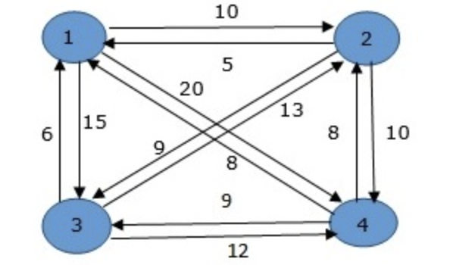
Brute Force (Exact Solver)
Enumerates all possible tours.
Computes guaranteed optimal solution.
Time complexity: O(n!).
Feasible only for n ≤ 10.

Slide 6

Nearest Neighbor Heuristic
Greedy: visit closest unvisited city at each step.
Computational complexity: O(n²).
Very fast but may produce suboptimal global structures.

Slide 7
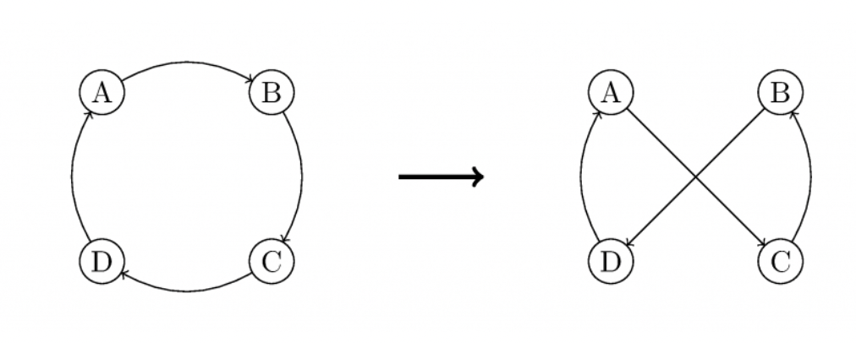
2-Opt Local Search
Improves an initial tour by reversing edge segments.
Removes crossings and reduces path length.
Time complexity: ~O(n³).
Produces high-quality tours at higher computation cost.

Slide 8
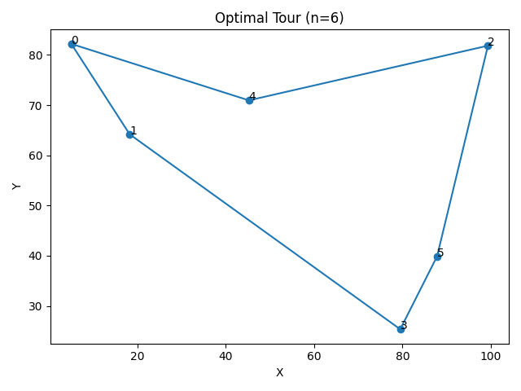
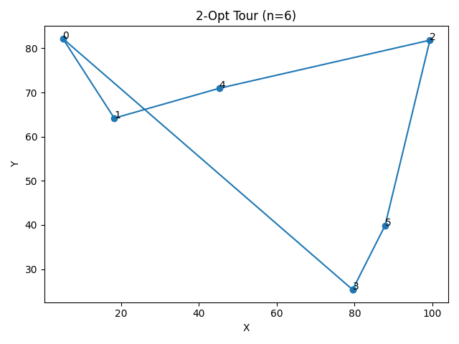
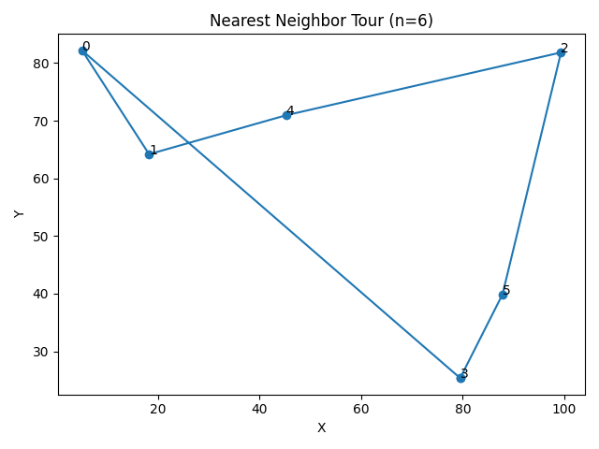
Example Tours (n = 6): Optimal, NN, 2-Opt
2-Opt improves the NN tour by removing edge crossings and reducing total distance.
Nearest Neighbor creates a quick but sometimes suboptimal path.
Shows how heuristics progress toward optimality on small instances.

Slide 9
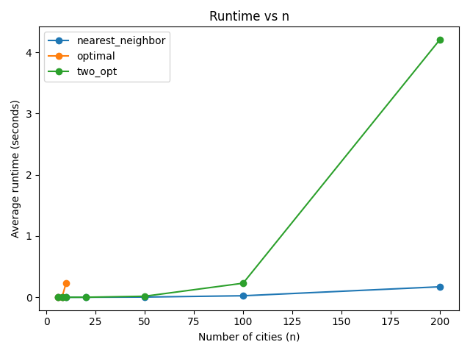
Runtime vs Number of Cities
Brute Force grows too quickly and becomes infeasible beyond small n.
Nearest Neighbor remains extremely fast even for large city counts.
2-Opt scales worse and becomes expensive for n ≥ 50 due to its cubic complexity.
Clear trade-off: NN offers speed, 2-Opt offers higher solution quality.

Slide 10
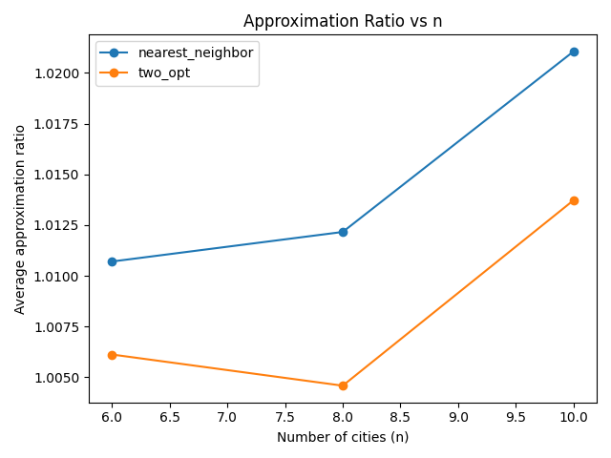
Approximation Ratio vs Number of Cities
Nearest Neighbor stays within 1–2% of the optimal solution.
2-Opt consistently improves the NN tour, reaching ~0.5–1.3% from optimal.
Both heuristics perform well on small Euclidean TSP instances.
2-Opt offers higher accuracy but requires more computation.

Slide 11
Key Findings
Brute Force is intractable beyond very small n.
Nearest Neighbor is extremely fast and scales well.
2-Opt significantly improves NN solutions.
Clear trade-off between runtime and solution quality.

Slide 12
Conclusion
Heuristics offer practical alternatives to exact algorithms.
2-Opt dramatically improves solution quality.
Framework can be extended with 3-Opt, SA, GA, Christofides.
TSP highlights the importance of approximation in NP-hard problems.

