Slide 1
SALES PERFORMANCE
Dashboard Summary
Data Analyst Internship – Task 4 | Power BI
An interactive view of sales, products, regions and sales representatives.
Prepared from the Sales Performance Dashboard created using sales_data.csv.
Power BI Desktop
Task 4 | Sales Performance Dashboard 1

Slide 2
1. Project Objective
Purpose and scope of the dashboard
Create an interactive dashboard that helps business stakeholders understand sales performance.
Summarize key measures such as total sales, quantity sold, transaction count, average sales and discount.
Compare performance across regions, product categories and sales representatives.
Use filters so users can explore the data by region, product, customer type and sales channel.
Task 4 | Sales Performance Dashboard 2

Slide 3
2. Key Performance Indicators (KPIs)
Values shown on the submitted dashboard
TOTAL SALES
TOTAL QUANTITY
TOTAL ORDERS*
5.02M
25K
1K
AVERAGE DISCOUNT
AVERAGE SALES
0.15
5.02K
*The dashboard's Total Orders card is based on the current dataset calculation; confirm whether each row represents one order before interpreting it as a unique order count.
Task 4 | Sales Performance Dashboard 3

Slide 4
3. Dashboard Visualizations
Charts included in the Power BI report
Monthly Sales Trend
Sales by Region
A line chart displays how sales change from January to December.
A horizontal bar chart compares sales across North, East, West and South.
Sales by Product Category
Sales by Sales Representative
A column chart compares Clothing, Furniture, Electronics and Food.
A horizontal bar chart compares sales generated by each representative.
Category Share
Together, these visuals make it easier to identify trends and compare performance.
A doughnut chart shows each product category's contribution to total sales.
Task 4 | Sales Performance Dashboard 4

Slide 5
4. Interactive Filters
Slicers available on the dashboard
Region – East, North, South and West.
Sales Representative – Alice, Bob, Charlie, David and Eve.
Customer Type – New and Returning.
Sales Channel – Online and Retail.
Product Category – Clothing, Electronics, Food and Furniture.
Selecting a slicer filters the dashboard visuals to show the selected segment.
Task 4 | Sales Performance Dashboard 5

Slide 6
5. Key Observations & Conclusion
Summary based on the dashboard
Total sales displayed are approximately 5.02 million, with about 25 thousand units sold.
North is the highest-sales region among the four regions shown.
Clothing is the highest-sales product category in the dashboard.
The monthly trend chart shows sales changing throughout the year, so users can compare stronger and weaker months.
The dashboard combines KPI cards, charts and slicers in one view to support quick business analysis.
Conclusion
The Power BI dashboard provides a clear and interactive summary of sales performance and helps users explore the data from different business perspectives.
Task 4 | Sales Performance Dashboard 6

Slide 7
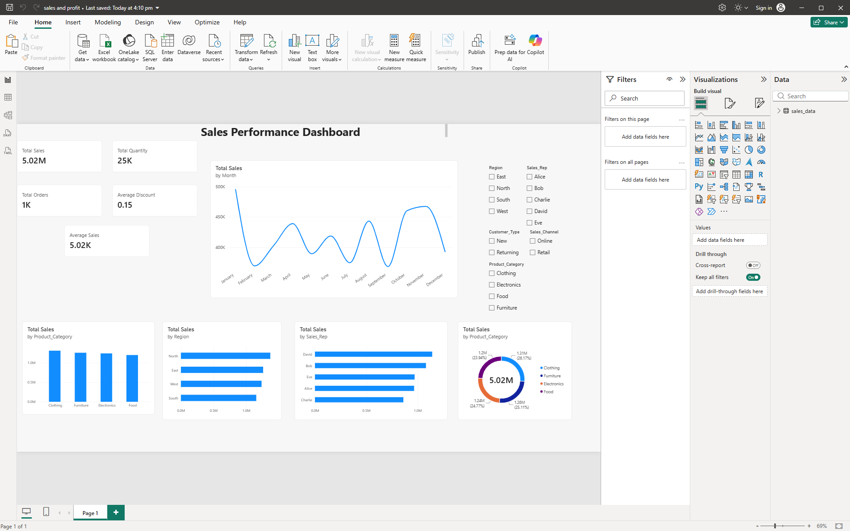
Dashboard Screenshot
Final Power BI dashboard submitted for Task 4
Task 4 | Sales Performance Dashboard 7

