Slide 1
RIDEEASE
A Ride-Hailing Web App with Real Road Routing & AI-Powered Chat Translation
SYSTEM ARCHITECTURE & SCALABILITY
Python · Flask · Leaflet.js · OSRM · Google Gemini API | Proposed cloud target: AWS
Academic Project — CIA-III, ECD223-3

Slide 2
THE PROBLEM
Two everyday frictions slow down short rides
1
Language barrier
2
Unclear, unfair fares
Riders and drivers often don't share a common language, which slows down coordinating pickup points and directions in the moment.
Riders want an accurate, upfront fare based on a real road route — not a straight-line estimate that ignores actual streets and turns.
Who RideEase is for
A
Riders
B
Drivers
C
Evaluators
Commuters booking short intra-city trips who want an accurate fare and may prefer a regional language.
Represented in this prototype by a simulated engine — a moving marker and preset translated replies.
Instructors and reviewers assessing the working demo, architecture, and scaling plan.
RideEase
02 / 15

Slide 3
TECHNOLOGY STACK
A lightweight, dependency-light build
Layer
Technology
Purpose
Frontend
HTML / CSS / JavaScript
Structure, styling, interactivity
Frontend
Leaflet.js
Interactive map, markers, route polyline
Backend
Python 3 + Flask
Web server and REST API (app.py)
Backend
python-dotenv
Loads GEMINI_API_KEY from a local .env file
Backend
google-genai SDK
Calls the Gemini API for translation, server-side
External API
OSRM
Free road-routing engine, no API key required
External API
Google Gemini API
Language detection and translation
Why these choices
Leaflet + OSRM — free, no key needed, returns real driving routes. Flask — lightweight for a handful of JSON endpoints. Gemini API — one prompt both detects language and translates.
RideEase
03 / 15

Slide 4
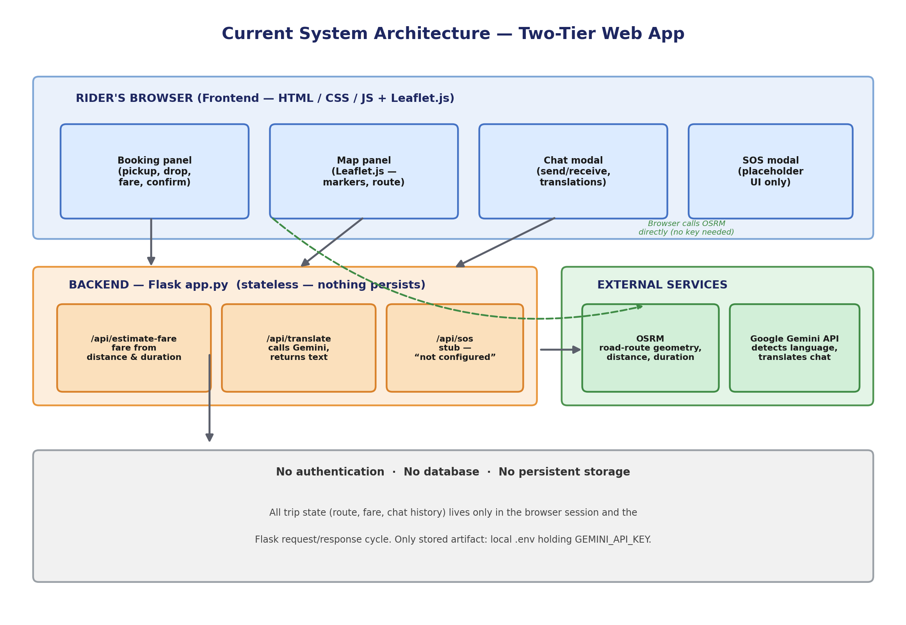
SYSTEM ARCHITECTURE
Current architecture — a simple two-tier web app
RideEase
04 / 15

Slide 5
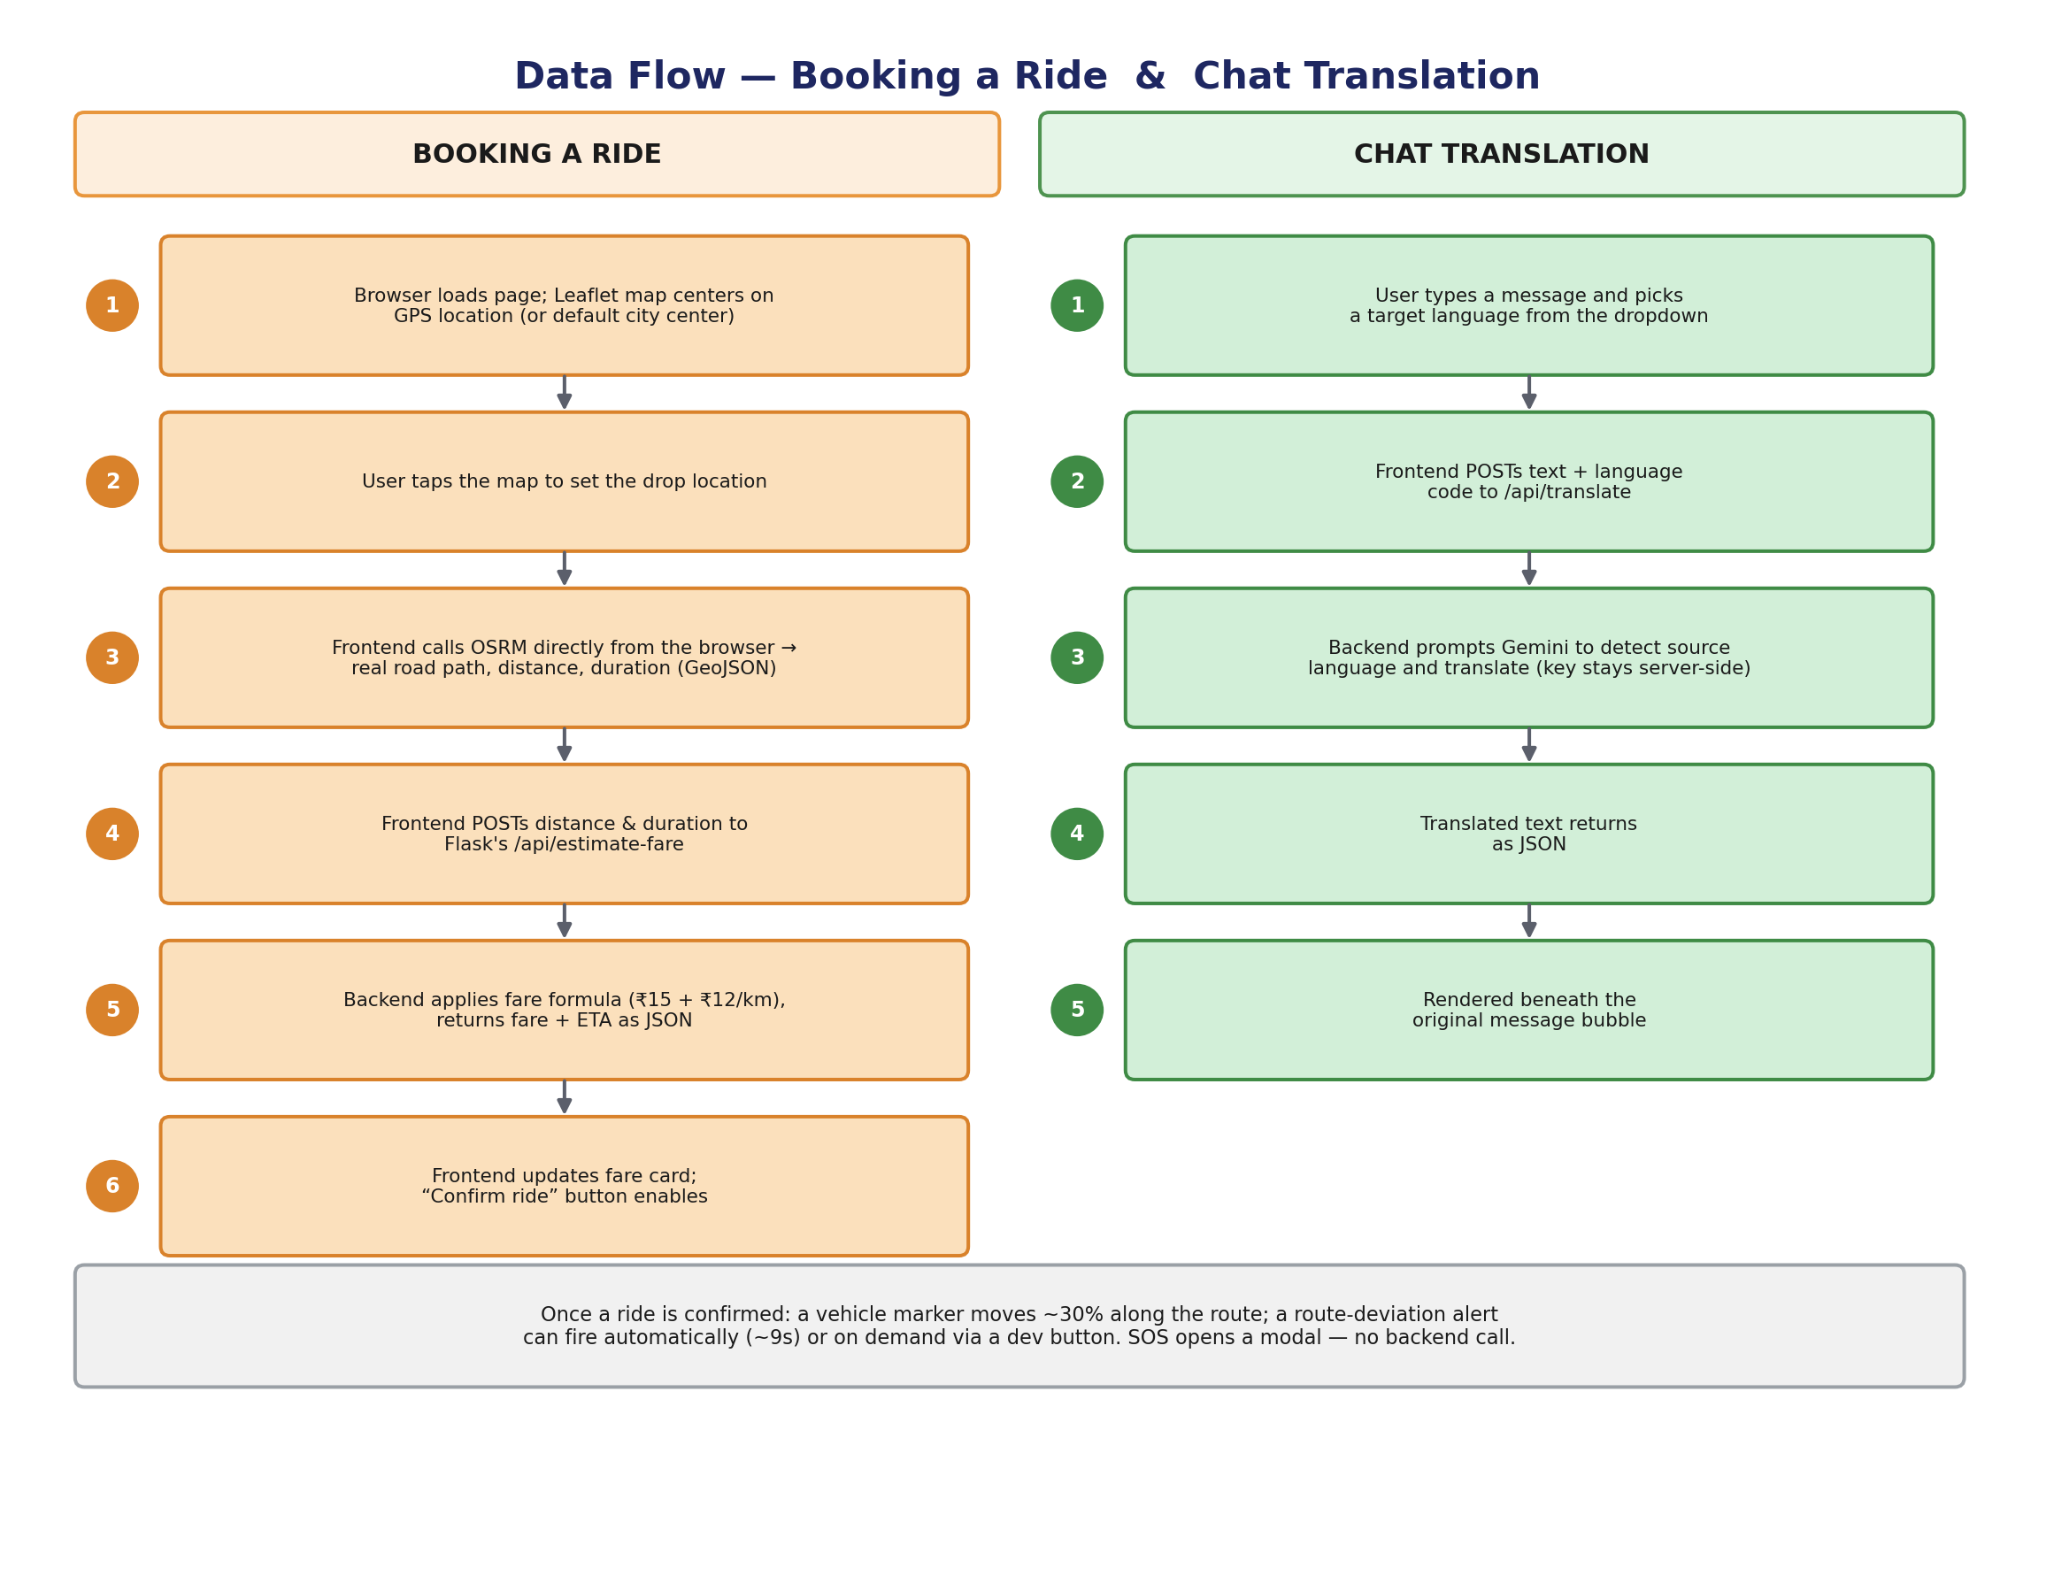
DATA FLOW
How a booking and a chat message move through the system
RideEase
05 / 15

Slide 6
TODAY'S DEPLOYMENT
Current hosting approach & known limitations
Hosting today
Known limitations
One Flask development-server process (python app.py)
No worker pool or process manager (Gunicorn/uWSGI)
Plain HTTP on localhost — no HTTPS, proxy, or CDN
No scaling — assumes a small classroom-demo audience
Gemini key read from a local .env file at startup
No persistence — a refresh or restart clears all state
Flat fare rate — no surge or traffic-based pricing
SOS does not place a real call or send an SMS
No authentication, accounts, or ride history
No database — no persistent storage at all
Driver chat replies are simulated, not live
No admin/manager role or dashboard
RideEase
06 / 15

Slide 7
PLATFORM CHOICE
Why AWS over Azure or Google Cloud
CHOSEN
Azure
Google Cloud
AWS
App Service/AKS, Azure SQL, Cosmos DB, Azure AD B2C map onto the same components
A reasonable choice for a team already standardised on Microsoft tooling
Cloud Run + Firestore enable a fast initial build
Firestore's document model fits the chat/GPS write pattern slightly less well than DynamoDB at 5M-user volumes
ECS Fargate + API Gateway + Lambda fit the containerised-API-plus-bursty-function pattern cleanly
DynamoDB is a strong match for the highest-write data: chat & GPS pings
Pay-per-use pricing keeps a low-traffic build inexpensive
RideEase
07 / 15

Slide 8
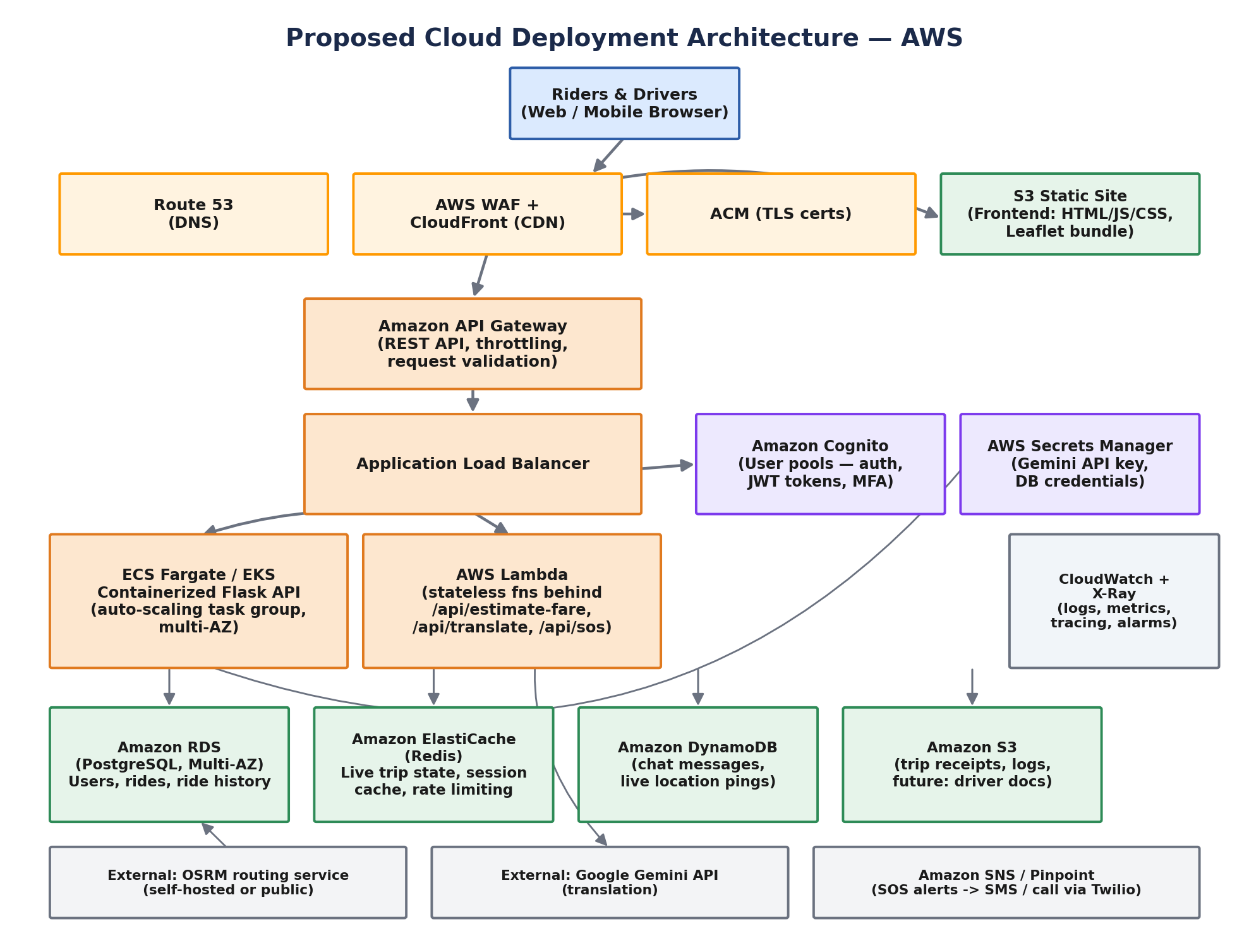
PROPOSED CLOUD ARCHITECTURE
Proposed AWS deployment architecture
RideEase
08 / 15

Slide 9
NETWORKING & SECURITY
How the AWS deployment protects the system
Networking components
Security components
VPC across 2–3 AZs — only the ALB/NAT sit in public subnets
Security groups scoped per tier, not by IP range
AWS WAF filters SQLi/XSS and rate-limits abusive clients
NAT Gateway lets private resources reach the internet outbound only
VPC Endpoints keep S3/Secrets Manager/DynamoDB traffic internal
IAM roles — least privilege, scoped per task/function
Encryption at rest (KMS) across RDS, DynamoDB, S3
TLS 1.2+ in transit; internal calls stay inside the VPC
MFA supported via Cognito user pools
Automated backups + point-in-time recovery; RPO ~minutes, RTO < 1 hr
RideEase
09 / 15

Slide 10
CLOUD SERVICE MAPPING
Business need → AWS service
Business Need
AWS Service
Business Need
AWS Service
Static frontend hosting
S3 + CloudFront
High-write chat/GPS data
Amazon DynamoDB
Backend API compute
ECS Fargate
Hot-path caching
Amazon ElastiCache (Redis)
Request distribution
Application Load Balancer
Object storage
Amazon S3
Public API surface
API Gateway
Secrets management
AWS Secrets Manager
Event-driven functions
AWS Lambda
Monitoring
CloudWatch + X-Ray
User authentication
Amazon Cognito
Notifications (SOS)
SNS / Pinpoint + Twilio
Relational data
Amazon RDS (PostgreSQL)
DNS & routing
Route 53
RideEase
10 / 15

Slide 11
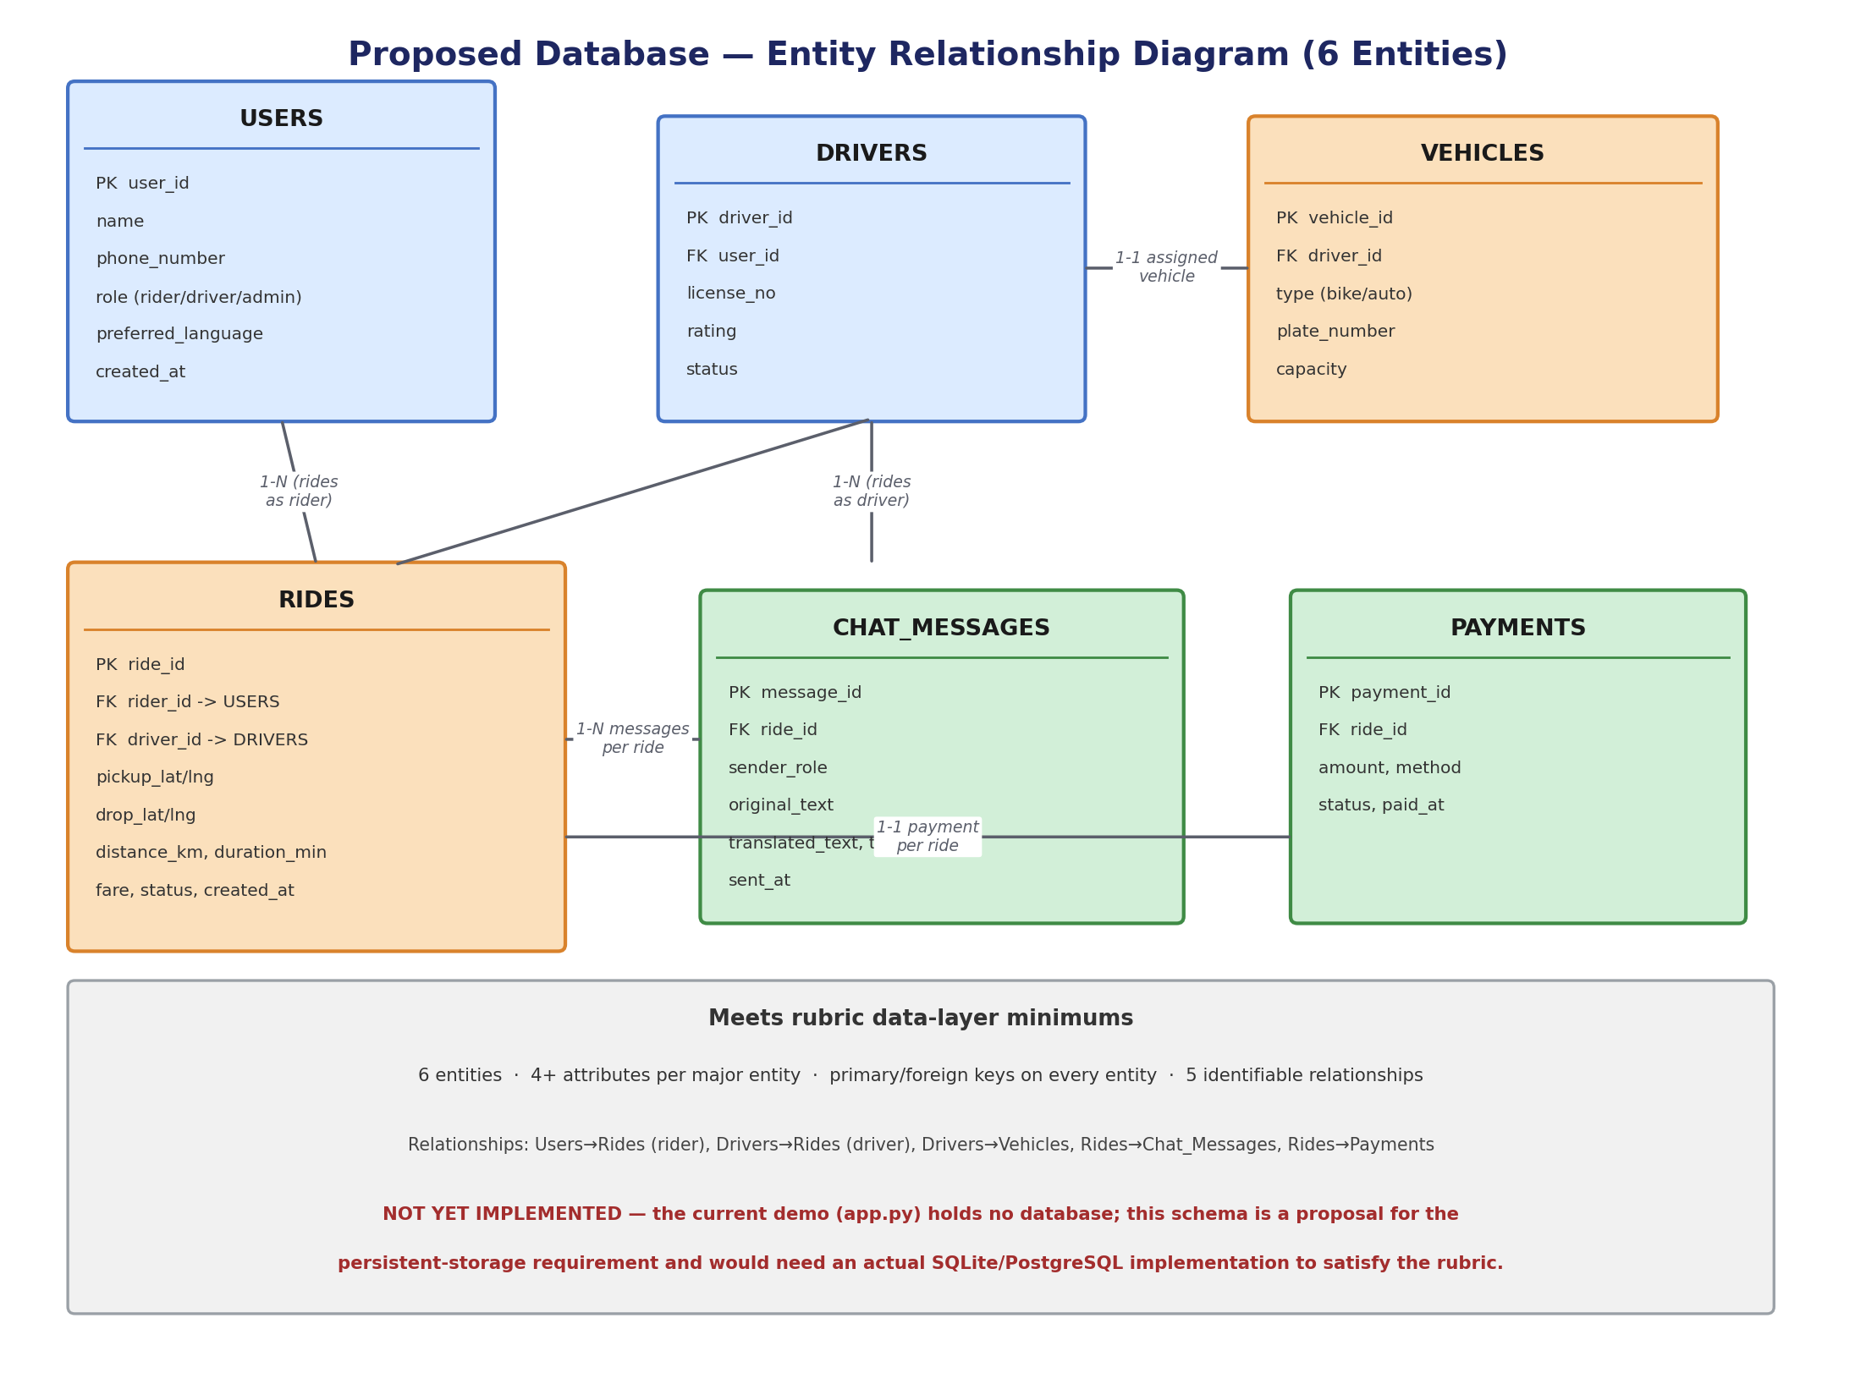
DATA LAYER
Proposed database schema (6 entities) — not yet built
RideEase
11 / 15

Slide 12
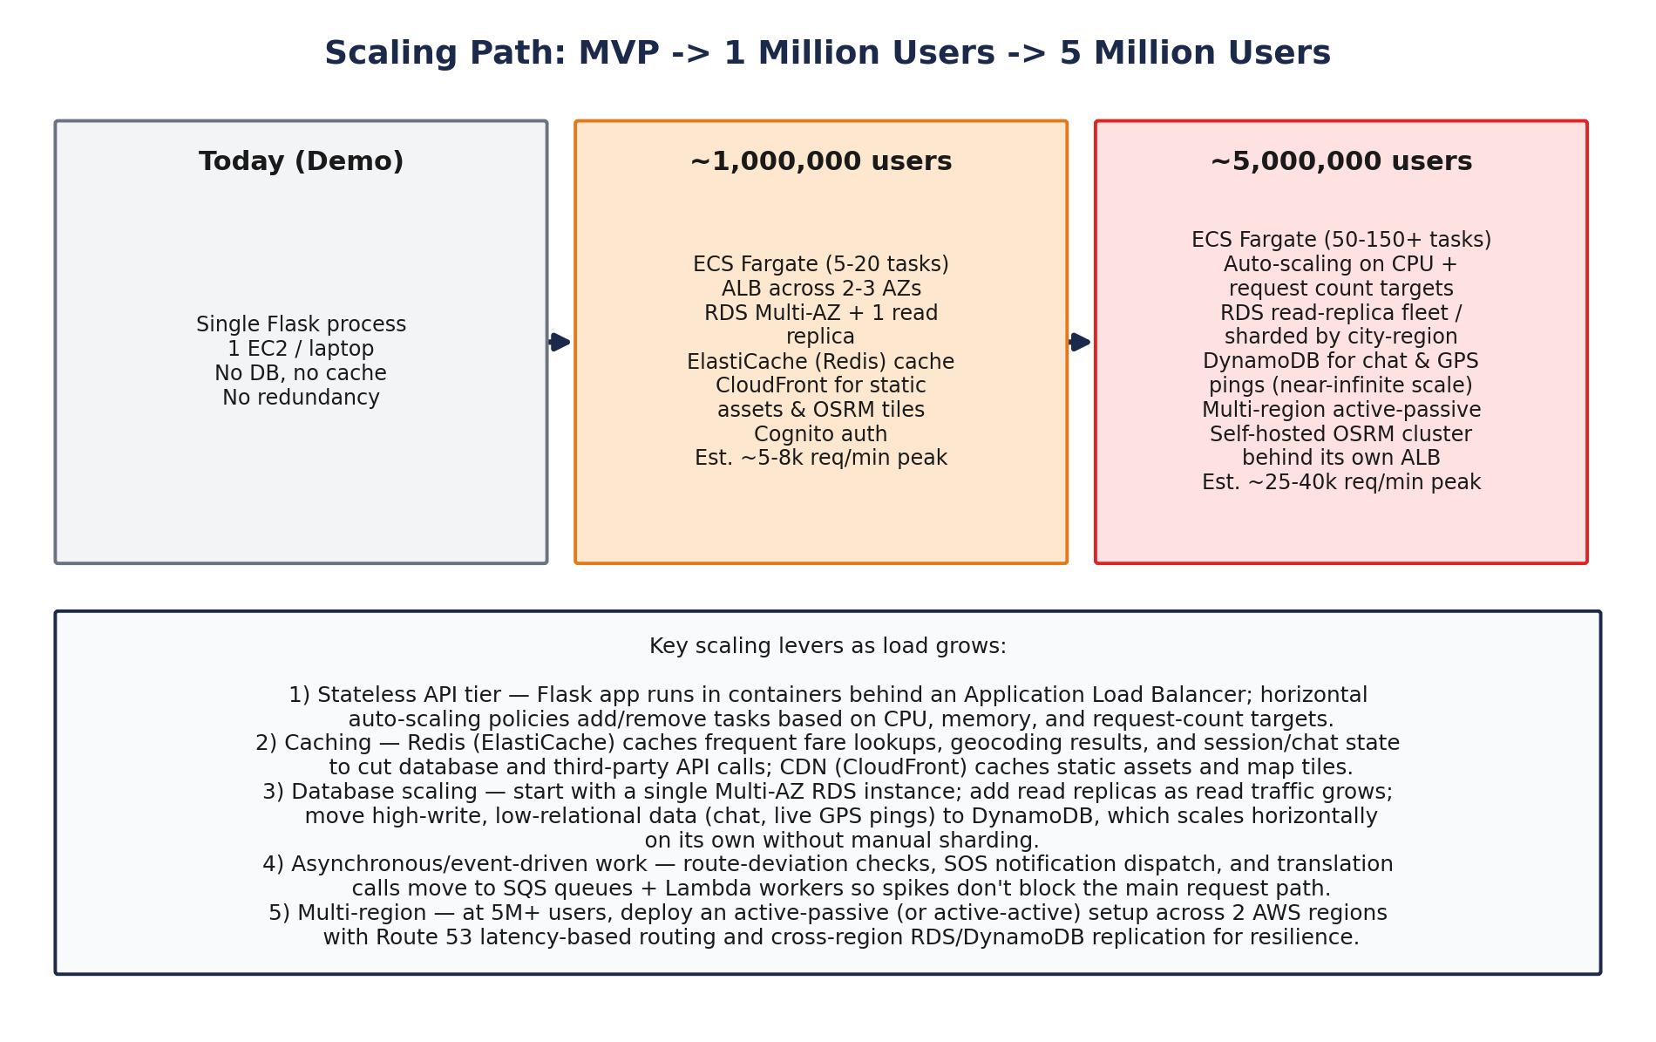
SCALABILITY ROADMAP
Scaling path: demo → 1 million → 5 million users
RideEase
12 / 15

Slide 13
QUANTITATIVE ANALYSIS
The numbers behind the scaling plan
30,518
500,000
≈ 41,667
projected users after 5 years
peak concurrent users at 5M registered
requests/second at peak, 5M-user stage
10,000 × (1.25)⁵ at 25%/yr growth
5,000,000 × 10% active-at-peak
500,000 active × 5 req/min ÷ 60
Every figure follows Formula → Values → Calculation → Result → Interpretation — full tables (growth over 5 years, concurrency at 4 milestones, req/min & req/sec at 4 traffic levels) are in docs/architecture.md §8.
RideEase
13 / 15

Slide 14
COST & THIRD-PARTY DEPENDENCIES
What it costs to run, and where the risk sits
Stage
Monthly Cost (USD)
Key Drivers
Demo / low traffic
$40 – $70 / mo
1–2 small Fargate tasks; db.t3.micro; minimal CDN/storage
~1,000,000 users
$900 – $1,800 / mo
5–20 autoscaled tasks; Multi-AZ RDS + 1 read replica
~5,000,000 users
$6,000 – $13,000 / mo
50–150+ tasks at peak; sharded DB; multi-region; self-hosted OSRM
Third-party dependency risk
OSRM and Gemini are both outside RideEase's control and can bottleneck before the app tier does
At 1M users: move off the free public OSRM endpoint; track Gemini quota with retry/backoff and fallbacks
At 5M users: self-host a regional OSRM cluster; add a backup translation provider; negotiate SLAs
RideEase
14 / 15

Slide 15
WHERE THIS GOES NEXT
Known limitations & future scope
Limitations today
Future scope
Flat fare rate; no surge/traffic pricing
SOS is UI-only — no real call/SMS
No auth, accounts, or ride history
No database — nothing persists
No admin/manager role or dashboard
Real SOS via Twilio/SNS with an emergency-contact flow
Cognito auth + RDS-backed ride history (schema in §11)
Admin/manager dashboard with live KPIs
Driver-matching + surge-pricing algorithm
Execute the AWS migration as usage grows toward 1M/5M
Thank you
RideEase
15 / 15

