Slide 1
RIDEEASE
A Cloud-Based Digital Business System for Ride-Hailing
Cloud System Architecture Report · CIA-III · AWS Deployment Design
Group Project · [Team Members / Roll Numbers] · [Course / Section]

Slide 2
01 · BUSINESS PROBLEM
The Problem RideEase Solves
Short intra-city trips in Indian cities face two everyday frictions: riders and drivers often don't share a language, and fare estimates rarely reflect the real road route.
₹15 + ₹12/km
Transparent, formula-based fare from real road distance
Riders — want an accurate, upfront fare and a route they can trust.
2 external APIs
Drivers — simulated in this prototype; represent a future driver-side app.
OSRM (routing) + Google Gemini (translation) — both free-tier
Evaluators — the immediate audience for this academic demonstration.
0 → 5M users
Designed with an explicit path from demo to production scale
2

Slide 3
01 · BUSINESS PROBLEM
Business Requirements
$
Accurate, upfront pricing
A
Cross-language communication
Fare based on real road distance before ride confirmation.
Riders and drivers coordinate without a shared language.
i
Trip transparency
!
A visible safety mechanism
Rider sees the planned route, ETA, and driver/vehicle details.
SOS reachable from the active-ride screen at all times.
₹
Low-cost demonstrability
↑
A scaling path
Runs end-to-end on free-tier services for academic evaluation.
Grows from single-instance demo to production without a redesign.
3

Slide 4
02 · PLATFORM SELECTION
Why AWS
All three major providers could host RideEase. AWS was selected for the strongest fit to this workload's shape: a containerized API with bursty, event-driven side-tasks.
SELECTED
ALTERNATIVE
ALTERNATIVE
AWS
Azure
Google Cloud
ECS Fargate + API Gateway + Lambda cover container + event-driven patterns natively
App Service / AKS, Azure SQL, Cosmos DB map onto the same components
Cloud Run + Firebase enable a faster initial build
DynamoDB fits high-write chat/GPS data with no manual sharding
Strong fit for teams standardized on Microsoft tooling
Firestore's document model fits chat data reasonably well
S3 + CloudFront pricing keeps low-traffic cost predictable while scaling to 5M users
Cosmos DB is a viable alternative to DynamoDB at this scale
Less mature fit for the highest write-volume GPS-ping workload
4

Slide 5
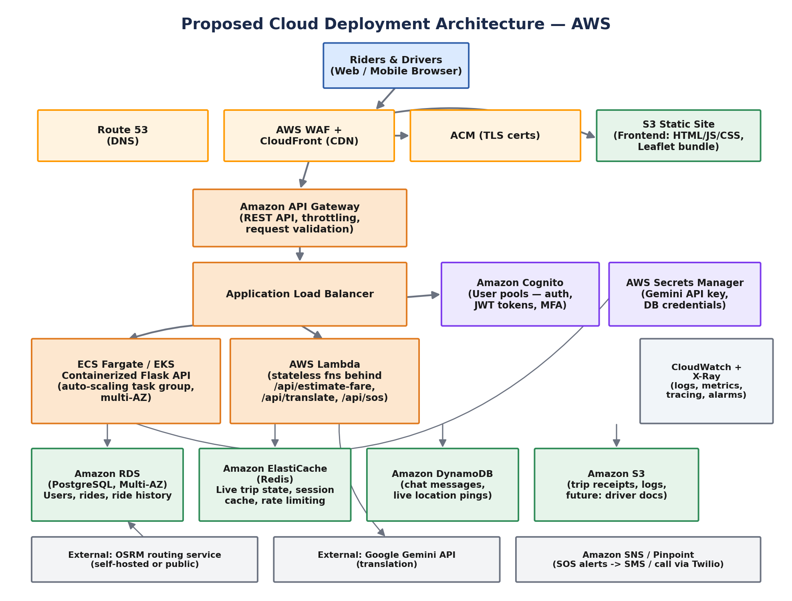
03 · SYSTEM ARCHITECTURE
Proposed AWS Deployment Architecture
Frontend layer (S3 + CloudFront) · Backend layer (API Gateway, ALB, Fargate, Lambda) · Database layer (RDS, DynamoDB, ElastiCache) · Security (Cognito, Secrets Manager)
5

Slide 6
03 · SYSTEM ARCHITECTURE
Networking Components
VPC
VPC Layout
SG
Security Groups
2-3 Availability Zones; public subnets hold only ALB/NAT, private subnets hold Fargate, RDS, DynamoDB endpoints, and cache — nothing stateful is internet-addressable.
Stateful virtual firewalls scoped per tier, each accepting traffic only from the specific security group one layer above it.
WAF
AWS WAF
NAT
NAT Gateway
Filters common web exploits (SQLi, XSS) and rate-limits abusive clients at CloudFront/ALB before they reach the app.
Lets private-subnet resources reach the internet for outbound calls (OSRM, Gemini) without being reachable from it.
6

Slide 7
04 · SECURITY
Security Components
IAM roles
Least-privilege roles per Fargate task and per Lambda — no broad shared role.
Encryption at rest
RDS, DynamoDB, and S3 use AWS-managed / KMS encryption for stored data.
Encryption in transit
TLS 1.2+ terminates at CloudFront/ALB; internal traffic stays inside the VPC.
Multi-factor auth
Cognito user pools support MFA (SMS / authenticator app) at sign-in.
Backup & DR
RDS point-in-time recovery, DynamoDB PITR, cross-region S3 replication — RPO ~minutes, RTO <1hr.
7

Slide 8
05 · SERVICE MAPPING
Cloud Service Mapping
Business Need | AWS Service | Purpose
Static frontend hosting | S3 + CloudFront | Global edge caching, HTTPS
Backend API compute | ECS Fargate | Containerized Flask app, no server mgmt
Request distribution | Application Load Balancer | Traffic distribution, health checks
Event-driven functions | AWS Lambda | Bursty translation/SOS workloads
User authentication | Amazon Cognito | Sign-up/sign-in, JWT, MFA
Relational data | Amazon RDS (PostgreSQL) | User profiles, ride records
High-write chat/GPS data | Amazon DynamoDB | Live chat, vehicle-position pings
Hot-path caching | ElastiCache (Redis) | Active trip state, fare lookups
Secrets management | AWS Secrets Manager | Gemini API key, DB credentials
Monitoring | CloudWatch + X-Ray | Logs, metrics, tracing
8

Slide 9
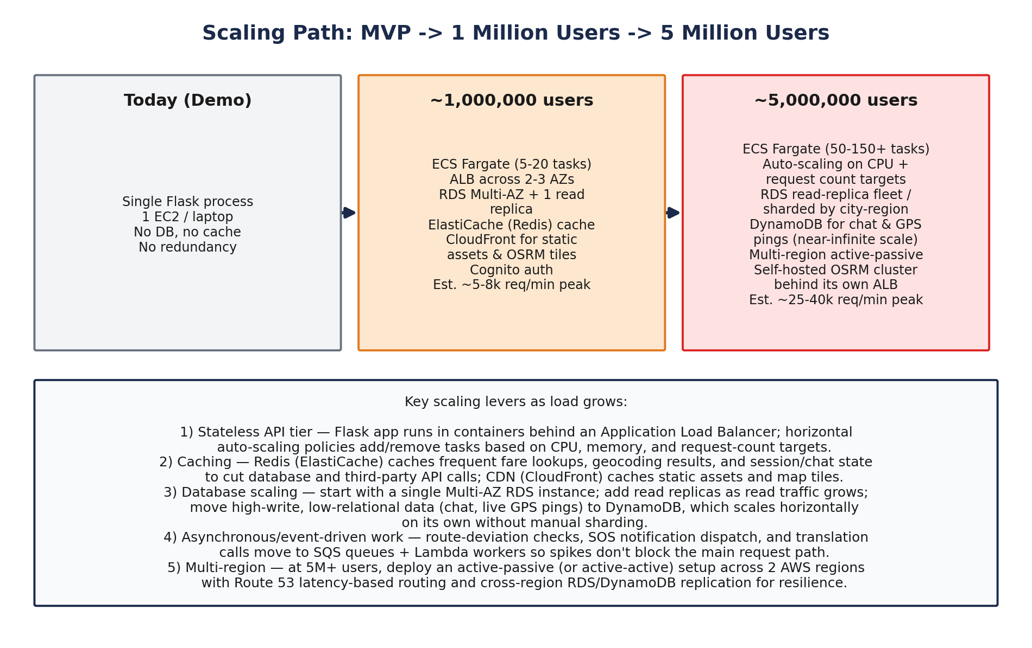
06 · SCALABILITY
Scaling to 1M and 5M Users
9

Slide 10
07 · COST
Estimated Monthly Infrastructure Cost
Demo / low traffic
~1M users
~5M users
$40-70
$900-1,800
$6,000-13,000
1-2 small Fargate tasks · db.t3.micro · minimal CDN
5-20 autoscaled tasks · Multi-AZ RDS + replica · Redis + CloudFront
50-150+ tasks at peak · RDS replica fleet · self-hosted OSRM cluster
Gemini API and OSRM are billed/used separately. Gemini's free tier covers low-volume academic use; a self-hosted OSRM cluster at 5M users adds ~$200-500/month, replacing the free public endpoint. Caching (ElastiCache, CloudFront) and on-demand DynamoDB throughput keep spend proportional to actual traffic.
10

Slide 11
08 · ROADMAP
Current Limitations & Future Scope
Known Limitations (Demo)
Future Scope (Production Path)
Flat per-km fare — no surge or traffic-based pricing
Real SOS via Amazon SNS/Pinpoint + Twilio calling/SMS
SOS does not place a real call or send an SMS yet
Cognito authentication + RDS-backed ride history
No user authentication or persistent ride history
Real-time driver GPS via WebSockets, stored in DynamoDB
No HTTPS, load balancing, or redundancy in the demo hosting
UPI/payment gateway integration; dynamic demand-based pricing
11

Slide 12
RideEase
A scalable, secure, cost-aware cloud architecture for a real ride-hailing problem — designed on AWS, built as a working demo.
Thank you · Questions welcome

