Slide 1
IP Analyzer
Anuj Tiwari

Slide 2
Outline
Introduction
Design
Database
Features
Summary
Demo
Further Research

Slide 3
Introduction
IP Analyzer is an information gathering tool.
Has features dedicated for firms.
Analyzes IP addresses/domains and provides following information:
  geo-location
  host reputation
  grey-list inspection
  Whois and Port Scanning
  User Reports
Motivation: No tool found which provides all these features.

Slide 4
Design
IP Analyzer is coded with Django as backend and Angular as frontend.
Multiple APIs are used for querying multiple databases across the world.
Why Django?
  High Security
  High Scalability
  Python-Based
  Why Angular?
    Well Structured
    High Flexibility
    Two-way Data Binding

Slide 5
Database
MongoDB is used for storing user credentials, logs and latest information of searched IP addresses/domains.
Why MongoDB?
  Highly Scalable
  Horizontal scaling features like replication and sharding
  Optimal Load Balancing

Slide 6
Features
IP Analyzer provides following features:
It has option to retrieve cached information from database.
Uses web tokens to prevent CSRF attacks.
Two-factor Authentication
  IP Geolocation
  Host reputation
  Grey List Inspection
  Port Scanning and Ping
  WHOIS
  DIG
  User Reports
  Abuse Score
  User Management

Slide 7
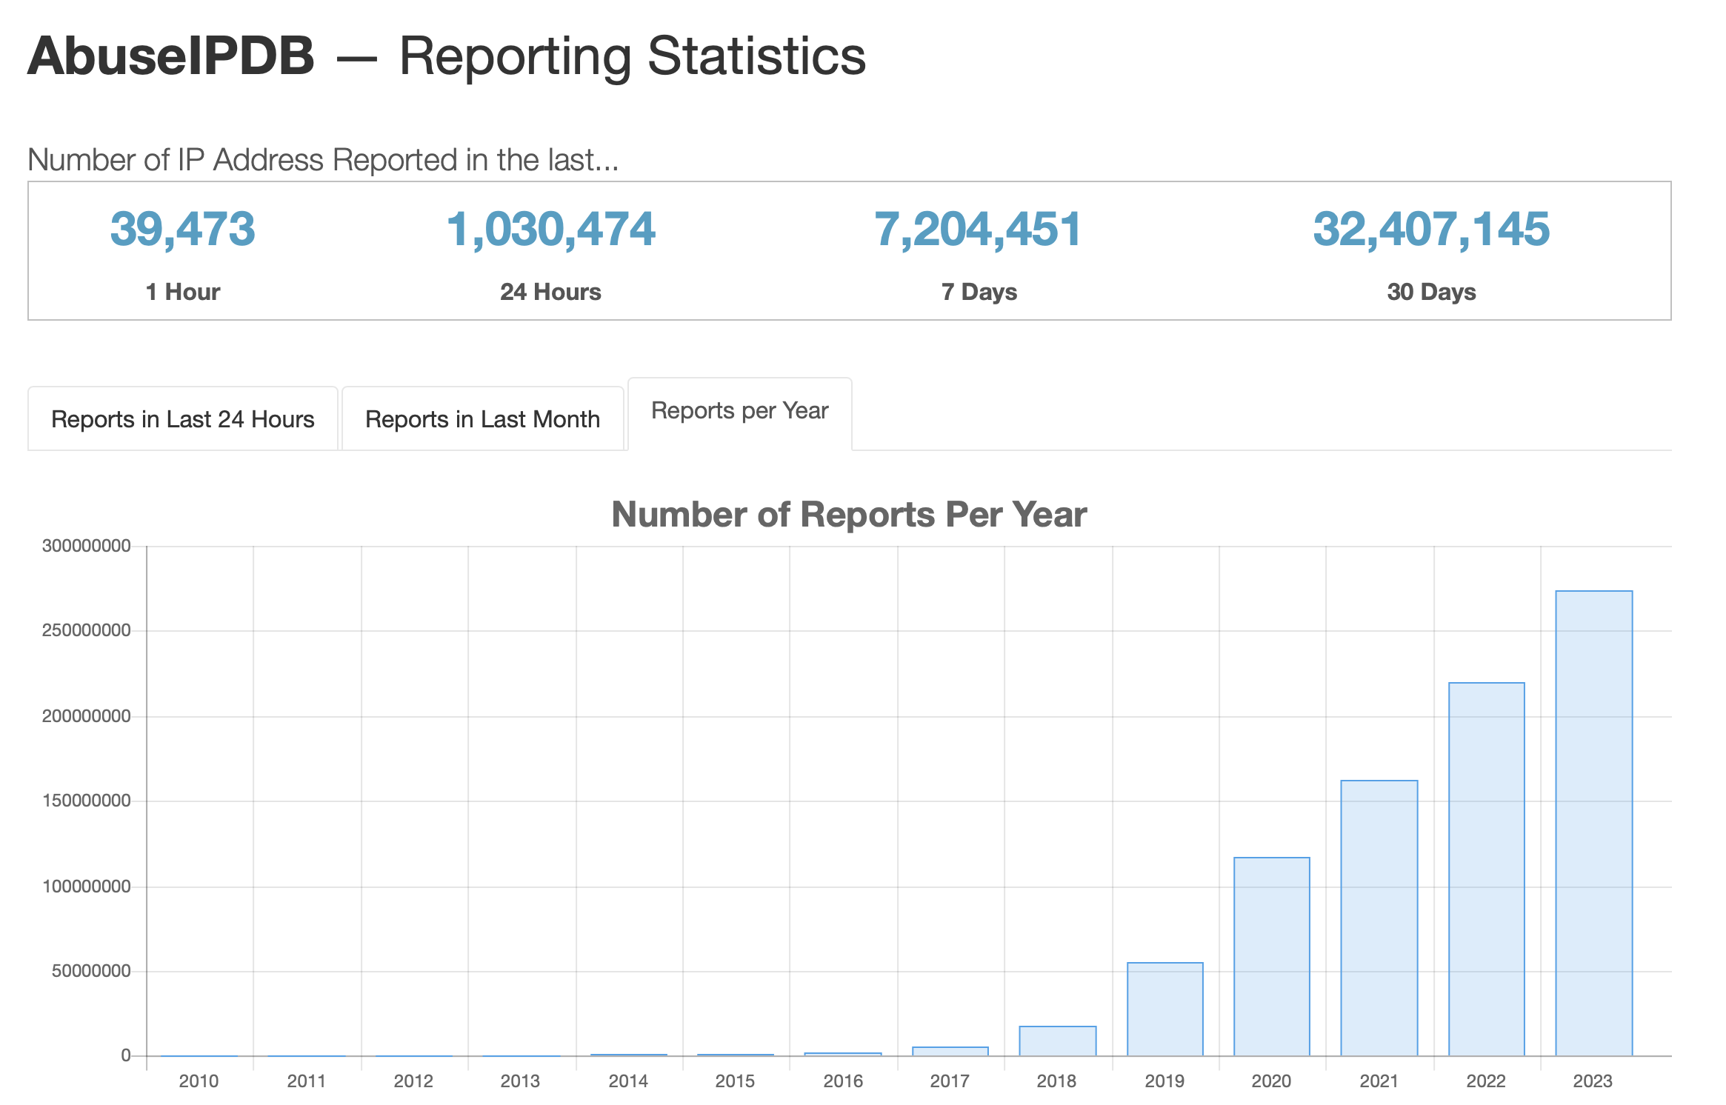
User Reports and Abuse Score
We use AbsueIPDB to retrieve user reports and abuse score.
Why AbuseIPDB?
  Independent Score
  Huge and frequently
  updated Database
  Weighted Score

Slide 8
Admin
Profile
Sign Out
Sign In
OTP
Home
Results
Resend OTP
WHOIS
DIG
Query
VPN
Abstract
Getipintel
Ipdetective
Ipgeolocation
Ipinfo
Ipqualityscore
Ipregistry
Proxycheck
Neutrino
Abuseip
Sign Up
OTP
Nmap
Resend OTP
API Calls

Slide 9
Summary
IP Analyzer analyzes IP addresses/domains and provides useful information.
Has security features like web tokens, 2FA along with scalable design
Has modular design
Accepted Publication: Cebajel Tanan, Sameer Kulkarni, Tamal Das, Manjesh Hanawal, “A Multi-Functional Web Tool for Comprehensive Threat Detection Through IP Address Analysis”, ICEI 2024.

Slide 10
Demo
Available at: https://ipanalyzer.in

Slide 11
Further Research
Develop an algorithm to find IP masked behind VPN or TOR network.
Add admin features to edit or add API keys for different APIs.
Handle querying to databases without using any third party APIs.

Slide 12
Thank you
Questions?

