Slide 1
NTT DATA GUIDEWIRE PRACTICE
GuidewireAI SDLC Test Accelerators
Seven AI modules for Guidewire InsuranceSuite — purpose, demo, examples & productionalisation
McKinsey-style client pack · July 2026 · Confidential

Slide 2
Seven AI accelerators compress manual work across the Guidewire testing lifecycle — from stories to triage
Executive Summary
GuidewireAI packages Claude-powered modules, bundled reference corpora (/katalon, GW standards), and per-project RAG into one web application.
THE CHALLENGE
OUR RESPONSE
Test design, UI automation, manual-to-auto conversion and triage consume 40–60% of sprint capacity
Inconsistent standards across delivery centres; UI regression rots with every customisation
AMS teams face 24/7 defect volume with limited L2/L3 capacity
7 AI modules: Plan → Build → Test → Release → Operate
Bundled reference material + per-project knowledge (RAG)
Katalon companion: 12 ready-to-run flows (PC · CC · BC · Jutro)
Indicative ROI: 30–70% effort reduction on targeted activities
7
12
5
RAG
AI accelerators
Katalon flows
SDLC phases
Per-project knowledge
GW SDLC Accelerator
Confidential
2

Slide 3
Each SDLC phase has a dedicated accelerator — a connected value chain from backlog to production
Lifecycle Architecture
PLAN
BUILD
TEST
RELEASE
OPERATE
Story Forge
Code Review
Test Strategist · Flow Automator · Test Migrator
Release Navigator
Defect Triage Agent
Accelerator | Phase | Primary testing value
Story Forge | Plan | Less effort per story
Code Review Copilot | Build | Fewer review cycles
Test Strategist | Test | Faster test-case design
Flow Automator | Test | Faster UI automation draft
Test Migrator | Test | Faster manual conversion
Release Navigator | Release | Less upgrade regression effort
Defect Triage Agent | Operate | Faster mean-time-to-triage
GW SDLC Accelerator
Confidential
3

Slide 4
01
The seven AI accelerators
Each slide: purpose · worked example · demo preview · productionalisation path

Slide 5
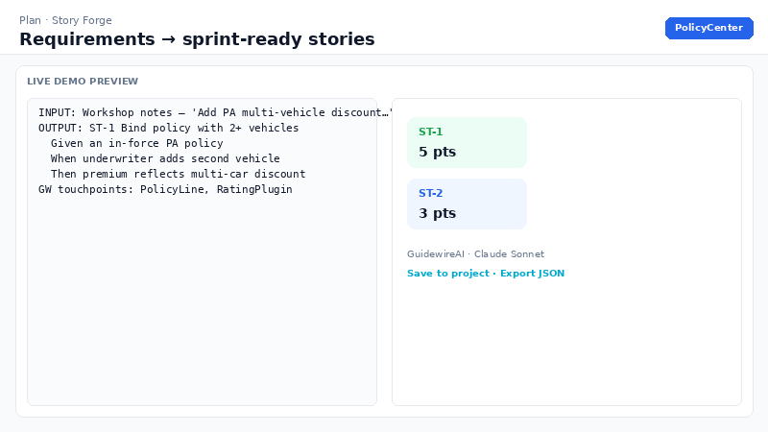
Story Forge converts raw requirements into sprint-ready, Guidewire-mapped user stories in minutes
Plan · Story Forge
Requirements in, sprint-ready stories out — Gherkin ACs, GW touchpoints and Fibonacci points pre-populated; fewer AC gaps reach SIT.
PURPOSE
LIVE DEMO
Eliminates the blank-page problem for BAs. Produces INVEST stories with negative-path ACs, mapped entities/PCF/plugins, and Jira-ready JSON.
EXAMPLE
Input: 'Apply multi-vehicle discount on mid-term PA change.' → Output: ST-1 with Given/When/Then, touchpoints (PolicyLine, RatingPlugin), 5 pts, open question on eligibility.
PRODUCTIONALISE
Pilot on live backlog grooming; map JSON → Jira/ADO fields
Load client story standards into Project knowledge (RAG)
Add SSO + tenant scoping before production client data
40–60%
Less effort per story
GW SDLC Accelerator
Confidential
4

Slide 6
Code Review Copilot delivers principal-level Guidewire review on every commit — catching defects at desk-check cost
Build · Code Review Copilot
Defects caught at review cost ~10× less than at UAT — zero senior reviewer calendar time; bundled GW Cloud standards per profile.
PURPOSE
LIVE DEMO
Reviews Gosu, PCF, integration, GX and batch code. Severity findings (critical→info), upgrade-safety flags, code-health score, optional Sonar merge.
EXAMPLE
Input: Gosu with gw.transaction in PCF onClick → Output: critical (UI-layer transaction), major (query in loop), score 62, concrete fix naming GW construct.
PRODUCTIONALISE
Pre-PR gate in CI pipeline; persist findings as artifacts
Index client coding standards into Project knowledge
Golden eval set in CI on prompt/model changes
30%
Fewer review cycles
GW SDLC Accelerator
Confidential
5

Slide 7
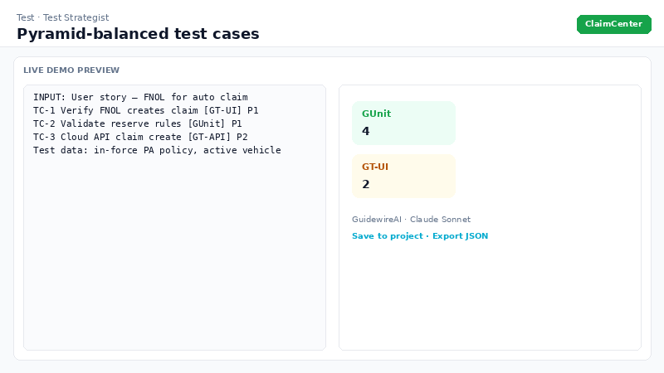
Test Strategist enforces pyramid discipline — assigning GUnit, GT-API, GT-UI or Manual per case
Test · Test Strategist
Test design keeps pace with development — harness selection enforced, test data staged upfront, full AC traceability.
PURPOSE
LIVE DEMO
Derives executable cases from stories, code or defects. Maintains pyramid health; lists preconditions and data to stage before execution.
EXAMPLE
Input: FNOL user story + ACs → Output: TC-1 GT-UI journey, TC-2 GUnit reserve rules, TC-3 GT-API claim create; data: in-force PA policy, vehicle VIN.
PRODUCTIONALISE
Webhook from ALM to auto-feed sprint stories
Export to Zephyr/qTest via CSV transform
Pair GT-UI cases with Flow Automator scripts
50%
Faster test-case design
GW SDLC Accelerator
Confidential
6

Slide 8
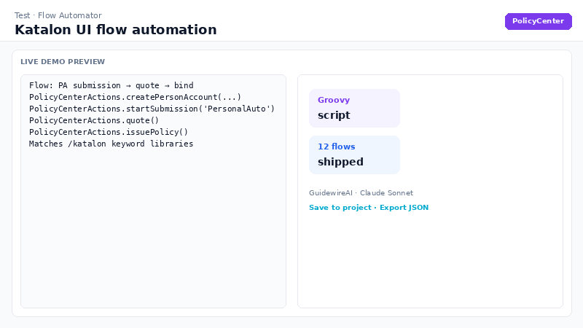
Flow Automator scaffolds keyword-driven Katalon UI automation for common Guidewire journeys in minutes, not days
Test · Flow Automator
Regression UI packs in minutes — real /katalon @Keyword signatures injected into prompts, not guessed method names.
PURPOSE
LIVE DEMO
Generates Katalon Groovy for PC/CC/BC/Jutro flows (submission→bind, FNOL, billing, quote-and-buy). Matches bundled keyword libraries.
EXAMPLE
Input: PC — 'PA submission → quote → bind' → Output: Groovy calling createPersonAccount, startSubmission, quote, issuePolicy + prerequisites list.
PRODUCTIONALISE
Open /katalon in Katalon Studio; adapt locators per env
Run katalonc headless in CI with profile secrets
Regenerate after PCF customisation via Flow Automator
60%+
Faster UI automation draft
GW SDLC Accelerator
Confidential
7

Slide 9
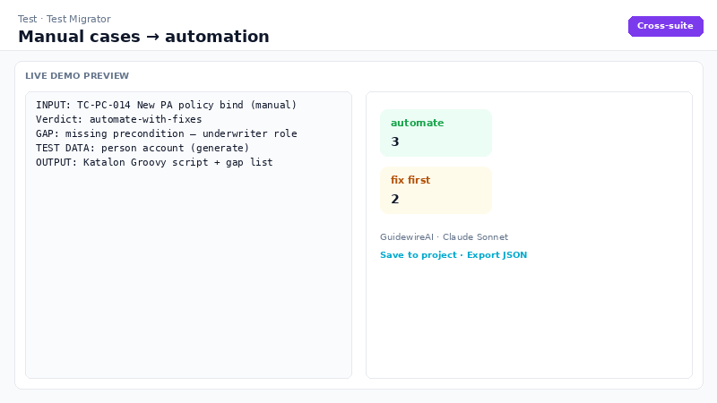
Test Migrator converts legacy manual regression packs into runnable automation — with honest gap analysis per case
Test · Test Migrator
Manual pack → automation drafts in minutes — per-case verdict (automate / fix-then-automate / keep manual) plus test-data manifest.
PURPOSE
LIVE DEMO
Ingests Excel/Zephyr/qTest cases (single or bulk). Converts to Katalon, GT, Playwright, Selenium or Cucumber; surfaces blocking gaps.
EXAMPLE
Input: TC-PC-014 manual bind from Excel → Output: Katalon script, verdict automate-with-fixes, gap (missing underwriter role), data: person account (generate).
PRODUCTIONALISE
Batch-convert client UAT pack in pilot weeks 2–4
Remediate gaps before promoting scripts to CI
Wire Katalon output into /katalon regression suite
70%+
Faster manual conversion
GW SDLC Accelerator
Confidential
8

Slide 10
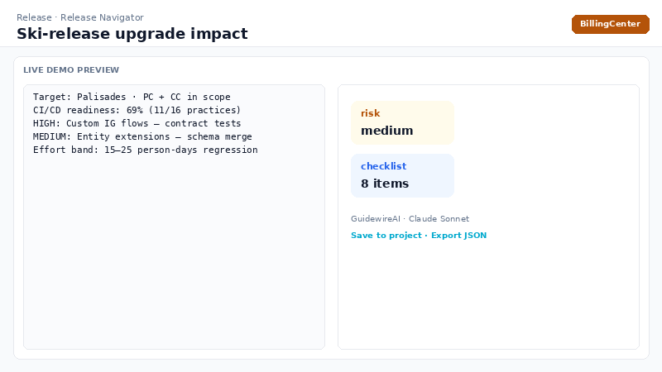
Release Navigator reveals what the next ski release does to your customisations — before it lands
Release · Release Navigator
Upgrade planning from evidence, not guesswork — CI/CD maturity score + per-area impact, remediation and regression focus.
PURPOSE
LIVE DEMO
16-practice readiness self-check plus AI impact analysis of customisation inventory vs target ski release; effort band and pre-upgrade checklist.
EXAMPLE
Input: Palisades, PC+CC, inventory (IG, entity extensions, PCF) → Output: medium risk, high IG impact, 8-step checklist, targeted regression list.
PRODUCTIONALISE
Maintain inventory in Project knowledge; re-run each ski release
Attach official GW release notes to RAG corpus
Feed regression focus into Test Strategist + Katalon
20–30%
Less upgrade regression effort
GW SDLC Accelerator
Confidential
9

Slide 11
Defect Triage Agent runs a four-agent pipeline with self-correction — L2/L3 triage in minutes, 24/7
Operate · Defect Triage Agent
The flagship agentic module — confidence-gated loop (max 2 passes) with live timeline; ideal for client showcases.
PURPOSE
LIVE DEMO
Intake → Investigator → Router (loops if confidence < 65%) → Fix Planner. Datadog log integration; bulk triage up to 5 errors.
EXAMPLE
Input: Payment posting failure + Datadog logs → Output: P2 Billing, 72% confidence hypothesis, workaround, permanent fix, regression cases.
PRODUCTIONALISE
Connect DD_API_KEY for live log evidence
Index client runbooks in Project knowledge
Push case file JSON to ServiceNow / Jira enrichment
35–50%
Faster mean-time-to-triage
GW SDLC Accelerator
Confidential
10

Slide 12
02
Productionalise the suite
From internal demo to client-ready, governed enterprise service

Slide 13
A four-phase roadmap moves GuidewireAI from demo to enterprise scale without re-architecting
Productionalisation Roadmap
Phase 0 works today on Vercel + Anthropic + Neon. Phases 1–3 close auth, tenancy, CI evals and Katalon automation gates.
Phase | Goal | Key work
0 — Now | Internal / client demo | Vercel deploy; bundled reference + RAG; /katalon open in Studio
1 — Pilot | Named users, safe pilot | SSO, rate limits, input validation, DB migrations, CI build gate
2 — Client-ready | Multi-tenant, governed | Row-level tenancy, audit log, prompt evals in CI, Katalon in CI (KRE)
3 — Enterprise | Supportable product | Token budgets, schema-validated outputs, TestOps, API-driven test data
GW SDLC Accelerator
Confidential
11

Slide 14
Katalon Flow Automation ships 12 ready-to-run flows — the execution layer behind Flow Automator
Companion Asset · /katalon
AI generates scripts; Katalon runs them. Keyword libraries centralise locators — one fix per customised screen.
Product | Flows
PolicyCenter | Submission→bind · Change · Cancel · Renewal
ClaimCenter | FNOL · Reserve+payment · Close
BillingCenter | Payment · Invoices · Disbursement
Jutro | Quote-and-buy · Self-service FNOL
Productionalise: katalonc headless in CI
Secret-injected profiles (default.glbl, qa.glbl)
Flow Automator injects real Groovy signatures from /katalon
GW SDLC Accelerator
Confidential
12

Slide 15
Serverless architecture keeps secrets server-side; bundled corpora and RAG enrich every accelerator run
Technical Architecture
React SPA → Vercel /api/chat (Edge) + /api/knowledge + /api/projects
Claude Sonnet 4.6 — prompt caching on reference material
Global corpora: /katalon, /reference (GW standards, ski releases)
Per-project RAG: chunk → embed → retrieve top-8 chunks
Neon Postgres: projects, artifacts, knowledge_docs/chunks
Optional pgvector + Voyage/OpenAI embeddings at scale
ANTHROPIC_API_KEY — server-side only
DATABASE_URL — Neon pooled connection
VOYAGE_API_KEY — production RAG embeddings (optional)
DD_API_KEY — Defect Triage Datadog integration
GW SDLC Accelerator
Confidential
13

Slide 16
Indicative ROI: 30–70% effort reduction concentrated at highest-volume manual activities
Value at a Glance
Accelerator | Phase | ROI | Productionalise first step
Story Forge | Plan | 40–60% Less effort per story | Pilot on live backlog grooming; map JSON → Jira/ADO fields
Code Review Copilot | Build | 30% Fewer review cycles | Pre-PR gate in CI pipeline; persist findings as artifacts
Test Strategist | Test | 50% Faster test-case design | Webhook from ALM to auto-feed sprint stories
Flow Automator | Test | 60%+ Faster UI automation draft | Open /katalon in Katalon Studio; adapt locators per env
Test Migrator | Test | 70%+ Faster manual conversion | Batch-convert client UAT pack in pilot weeks 2–4
Release Navigator | Release | 20–30% Less upgrade regression effort | Maintain inventory in Project knowledge; re-run each ski release
Defect Triage Agent | Operate | 35–50% Faster mean-time-to-triage | Connect DD_API_KEY for live log evidence
GW SDLC Accelerator
Confidential
14

Slide 17
Phased adoption moves teams from showcase to embedded workflow in four steps
Recommended Adoption Path
1
Week 1 — Discover & demo
Lead with Defect Triage + Flow Automator + Katalon hands-on.
2
Weeks 2–4 — Pilot on live data
Story Forge grooming, Code Review on real Gosu, Test Migrator on 10–20 cases.
3
Month 2+ — Embed
Jira/ADO export, Katalon in CI, Code Review as pre-PR gate, Project knowledge populated.
4
Ongoing — Measure
Track ROI per module; extend /katalon libraries and RAG corpus per client.
GW SDLC Accelerator
Confidential
15

Slide 18
NEXT STEPS
Deploy. Demo. Deliver.
Deploy to Vercel — Anthropic + Neon + optional Voyage for RAG embeddings
Schedule client showcase: Defect Triage + Flow Automator + Katalon live
Pilot weeks 2–4 on live client data; measure ROI per module
Harden: SSO, rate limits, CI evals — see productionalisation roadmap
NTT DATA Guidewire Practice · GuidewireAI · gw-sdlc-accelerator

