Slide 2
Agenda

Slide 3
Executive summary
Seven AI accelerators compress manual work across the Guidewire testing lifecycle
The challenge
Test design, UI automation, manual-to-auto conversion and defect triage consume 40–60% of sprint capacity
Inconsistent standards across delivery centres and geographies
UI regression rots with every customisation and ski release
Our response
7 Claude-powered modules mapped Plan → Build → Test → Release → Operate
Bundled reference material (/katalon, GW standards, ski-release themes)
Per-project RAG over client standards and saved artifacts
Katalon companion: 12 ready-to-run flows across PC · CC · BC · Jutro

Slide 4
The seven AI accelerators

Slide 5
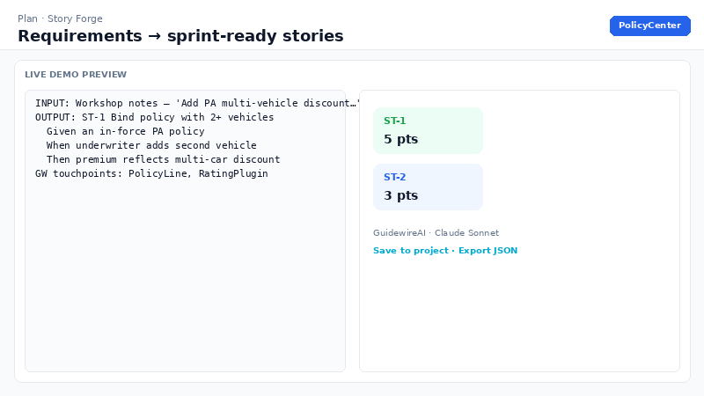
Story Forge — Plan
Requirements in, sprint-ready Guidewire stories out
Purpose
Eliminates the blank-page problem for BAs and product owners. Converts raw requirements into INVEST-compliant user stories with Gherkin acceptance criteria, mapped Guidewire touchpoints, Fibonacci estimates and explicit dependencies.
Example
Input: Workshop notes — 'Underwriter must apply multi-vehicle discount on mid-term change.'
Output: ST-1 with Given/When/Then ACs, touchpoints (PolicyLine, RatingPlugin), 5 story points, open question on discount eligibility rules.
Key capabilities
Negative-path ACs generated by default
JSON export ready for Jira / Azure DevOps
Per-project RAG over client standards
Productionalise
Pilot on live backlog grooming; map JSON fields to Jira
Add client story templates to Project knowledge (RAG)
Gate with auth + tenant scoping before client data
Indicative ROI
40–60% less effort per story

Slide 6
Code Review Copilot — Build
Principal-level Guidewire review on every commit-sized chunk
Purpose
Catches defects at desk-check cost — not SIT cost. Reviews Gosu, PCF, integration, GX and batch code against bundled GW Cloud standards with severity-calibrated findings and upgrade-safety flags.
Example
Input: 40-line Gosu enhancement with gw.transaction inside a PCF handler.
Output: critical finding (UI-layer transaction), major (query in loop), score 62, quick wins ranked; optional merge with SonarQube report.
Key capabilities
Profiles: Standards · Performance · Upgrade · Security
Bundled GW Cloud standards injected per profile
External static-analysis merge (Sonar, ESLint, Checkstyle)
Productionalise
Pre-PR gate in CI; store findings as project artifacts
Index client coding standards into Project knowledge
Add schema validation + golden eval set on prompt changes
Indicative ROI
30% fewer human review cycles

Slide 7
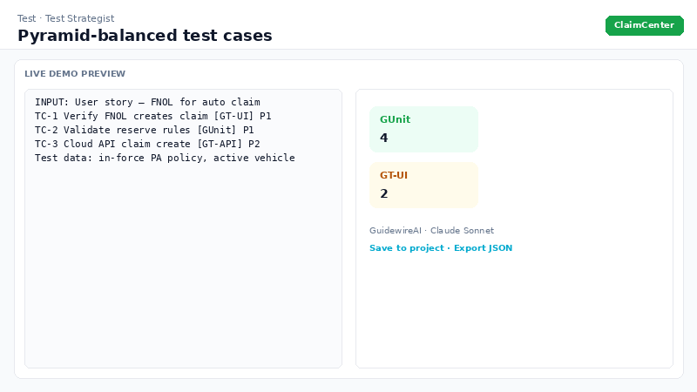
Test Strategist — Test
Pyramid-balanced coverage — harness chosen per case
Purpose
Keeps test design pace with development. Derives executable cases from stories, code or defects; assigns GUnit, GT-API, GT-UI or Manual per case and lists test data to stage before execution.
Example
Input: FNOL user story with acceptance criteria.
Output: TC-1 GT-UI journey, TC-2 GUnit reserve rules, TC-3 GT-API claim create; test data manifest (in-force policy, vehicle VIN).
Key capabilities
Enforces test pyramid discipline
Traceability: each case names the AC it covers
Automation notes per harness
Productionalise
Feed sprint stories automatically from ALM webhook
Export cases to Zephyr/qTest CSV transform
Combine with Flow Automator for GT-UI cases
Indicative ROI
50% faster test-case design

Slide 8
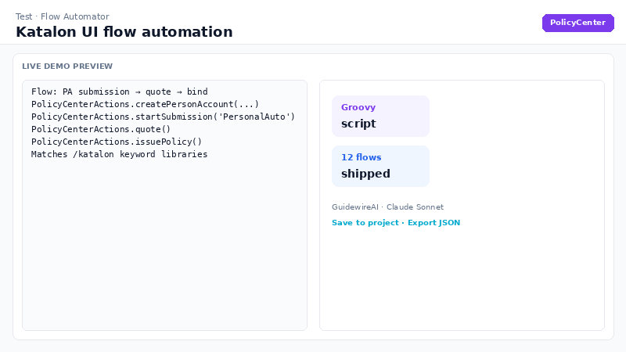
Flow Automator — Test
Common Guidewire flows scripted in Katalon — PC, CC, BC & Jutro
Purpose
Scaffolds keyword-driven Katalon UI automation for everyday regression journeys. Generated scripts match the bundled /katalon accelerator — real @Keyword signatures injected from the repo, not invented method names.
Example
Input: PolicyCenter — 'New PA submission → quote → bind'.
Output: Runnable Groovy test case calling PolicyCenterActions.createPersonAccount, startSubmission, quote, issuePolicy; prerequisites and keyword additions listed.
Key capabilities
12 ready-to-run flows in /katalon companion project
Defensive OOTB / data-test locators
Product-specific keyword libraries bundled into prompt
Productionalise
Open /katalon in Katalon Studio; adapt locators per client env
Run headless via katalonc in CI with profile secrets
Regenerate scripts after screen customisation via Flow Automator
Indicative ROI
60%+ faster first-draft UI automation

Slide 9
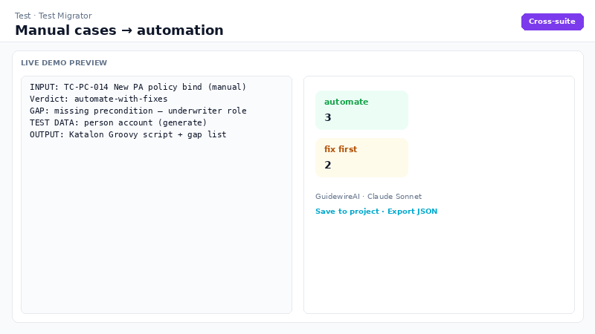
Test Migrator — Test
Manual test cases in, automated scripts out — gaps flagged
Purpose
Converts legacy manual regression packs (Excel, Zephyr, qTest) into runnable automation across five frameworks. Per case: honest verdict, gap analysis and test-data manifest — not just a script.
Example
Input: TC-PC-014 manual bind scenario pasted from Excel.
Output: Katalon Groovy script, verdict automate-with-fixes, gap (missing underwriter precondition), test data (person account — generate).
Key capabilities
Frameworks: Katalon · GT · Playwright · Selenium · Cucumber
Pipeline: split → convert per case → synthesise suite
Katalon output aligned to /katalon libraries
Productionalise
Batch-convert client UAT pack in pilot week 2–4
Fix gaps in manual cases before CI promotion
Wire converted Katalon scripts into regression suite
Indicative ROI
70%+ faster manual-to-automation conversion

Slide 10
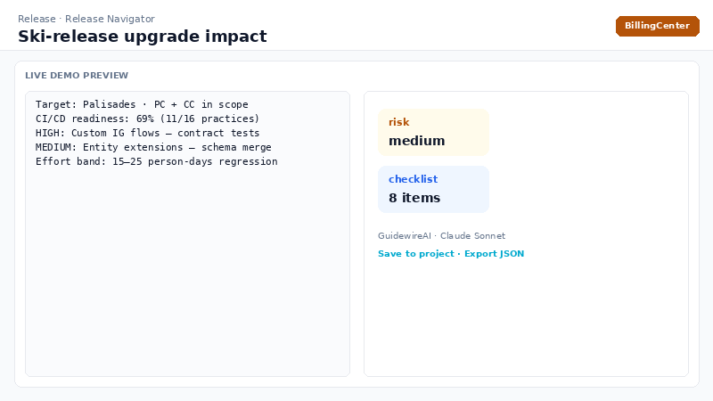
Release Navigator — Release
Know what the next ski release does to you before it lands
Purpose
Combines CI/CD maturity self-check (16 practices) with AI impact analysis of customisation inventory vs target ski release — per-area risk, remediation, regression focus and effort band.
Example
Input: Palisades target, PC+CC, inventory (IG flows, entity extensions, PCF overrides).
Output: medium overall risk, high-impact IG area, pre-upgrade checklist, 20–30% regression effort reduction via targeted test focus.
Key capabilities
Bundled ski-release upgrade themes per target release
Live CI/CD readiness scoring in UI
Per-area regression focus for test planning
Productionalise
Maintain living customisation inventory in Project knowledge
Re-run per ski release; attach official GW release notes to RAG
Feed regression focus into Test Strategist / Katalon suite
Indicative ROI
20–30% less upgrade regression effort

Slide 11
Defect Triage Agent — Operate
Four agents work the case — loop back when confidence is low
Purpose
Agentic L2/L3 triage in minutes, 24/7. Intake → Investigator → Router (self-corrects if confidence < 65%, max 2 loops) → Fix Planner. Live timeline shows every handoff.
Example
Input: Production defect — payment posting failure + Datadog log export.
Output: P2 routed to Billing, top hypothesis 72% confidence, workaround, permanent fix in BC payment plugin, regression GT-API cases listed.
Key capabilities
Multi-agent pipeline with confidence-gated loop
Datadog live log query + bulk triage (max 5 errors)
Full case file JSON saved to project
Productionalise
Connect Datadog (DD_API_KEY) for live evidence
Index client runbooks in Project knowledge
Integrate output with ServiceNow / Jira ticket enrichment
Indicative ROI
35–50% faster mean-time-to-triage

Slide 12
Productionalise the suite

Slide 13
Companion asset — Katalon Flow Automation
Physical execution layer behind Flow Automator and Test Migrator (Katalon framework)
What ships in /katalon
12 flows: PC01–PC04 · CC01–CC03 · BC01–BC03 · JU01–JU02
Keyword libraries: PolicyCenterActions, ClaimCenterActions, BillingCenterActions, JutroActions
Shared: GuidewireUI · LoginActions · TestData
Productionalise
Open GuidewireFlowAutomation.prj in Katalon Studio 8.x+
Swap URLs/credentials via execution profiles (default.glbl, qa.glbl)
Run headless: katalonc in CI with Runtime Engine + secret-injected profiles
Adapt locators in one keyword library per product when screens are customised

Slide 14
Productionalisation roadmap
From internal demo to client-ready, governed service
Phase 0 — Now (demo)
Vercel + Anthropic + Neon; bundled reference material + RAG
No auth; auto-schema; suitable for showcases and pilots
Phase 1 — Pilot hardening
SSO / edge auth, rate limits, input validation, structured logging
Versioned DB migrations; branch protection + CI build
Phase 2 — Client-ready
Multi-tenant row scoping, audit log, data classification
Prompt evals in CI; Katalon in CI with KRE
VOYAGE_API_KEY for production-grade RAG embeddings
Phase 3 — Enterprise scale
SLOs, token budgets, schema-validated outputs
Katalon TestOps, grid parallelism, API-driven test data seeding

Slide 15
Recommended adoption path

