Slide 1
INVESTIGATE WORLD UNIVERSITY RANKINGS
Anuj Patel 0875202

Slide 2
Introduction
Information about the datasets
Observations and Key findings

Slide 3
Introduction
Ranking universities is a difficult, political, and controversial practice. There are hundreds of different national and international university ranking systems, many of which disagree with each other. This Kaggle dataset contains three global university rankings from very different places.

Slide 4
Information about the datasets
In this project I have used mainly three datasets.
1. timesData
2. shanghaiData
3. cwurData
The Times Higher Education World University Ranking is widely regarded as one of the most influential and widely observed university measures. Founded in the United Kingdom in 2010, it has been criticized for its commercialization and for undermining non-English- instructing institutions.

Slide 5
Information about the datasets
The Academic Ranking of World Universities, also known as the Shanghai Ranking, is an equally influential ranking. It was founded in China in 2003 and has been criticized for focusing on raw research power and for undermining humanities and quality of instruction.
The Center for World University Rankings, is a less well known listing that comes from Saudi Arabia, it was founded in 2012.

Slide 6
Observation:-1
For this observation have used the cwurData.csv data file. The file contains the data from 2012 to 2015. I wanted to get the following results. Similarly you can get the result by just changing the year to 2015 for latest ranking.
1. In 2012, which Canadian universities are in the list?
2. In 2012, which US universities are in the list?
3. In 2013, which Canadian universities are in the list?
4. In 2013, which US universities are in the list?

Slide 7
code
library(tidyverse)
data<-read.csv("cwurData.csv" )
data
#for canadian Universities
data_canada<- filter(data, country=="Canada")
#for US universities
data_usa<- filter(data, country=="USA")
#for canadian Universities
a1<-filter(data_canada, year=="2012")
a1<- select(a1, world_rank,national_rank,institution)
a1
b1<-filter(data_usa, year=="2012")
b1<- select(b1, world_rank,national_rank,institution)
b1

Slide 8
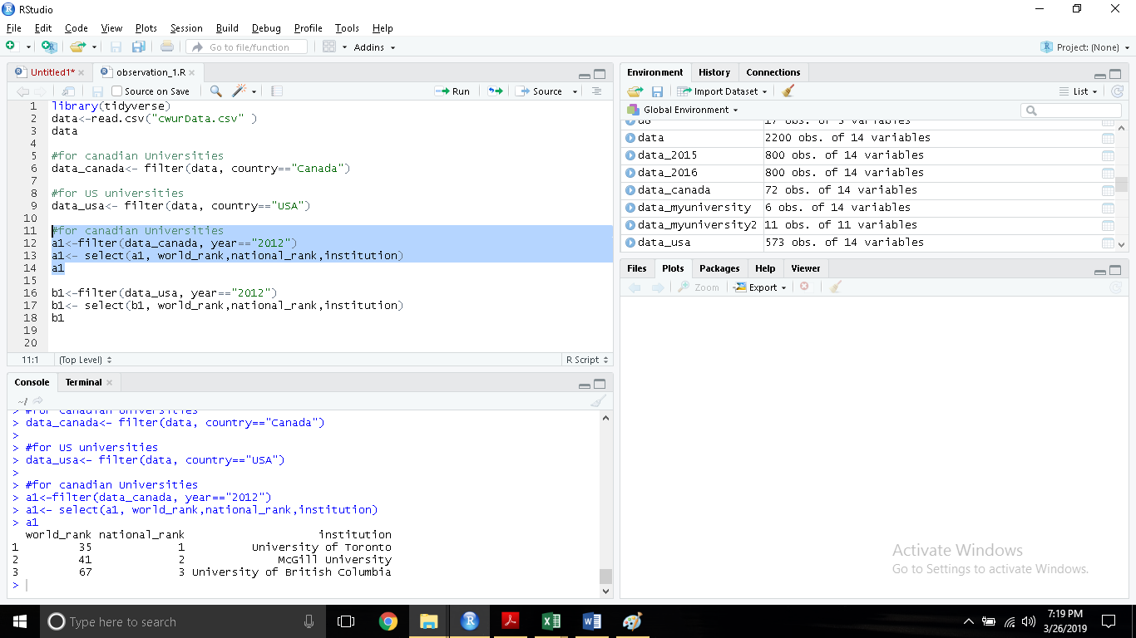
1

Slide 9
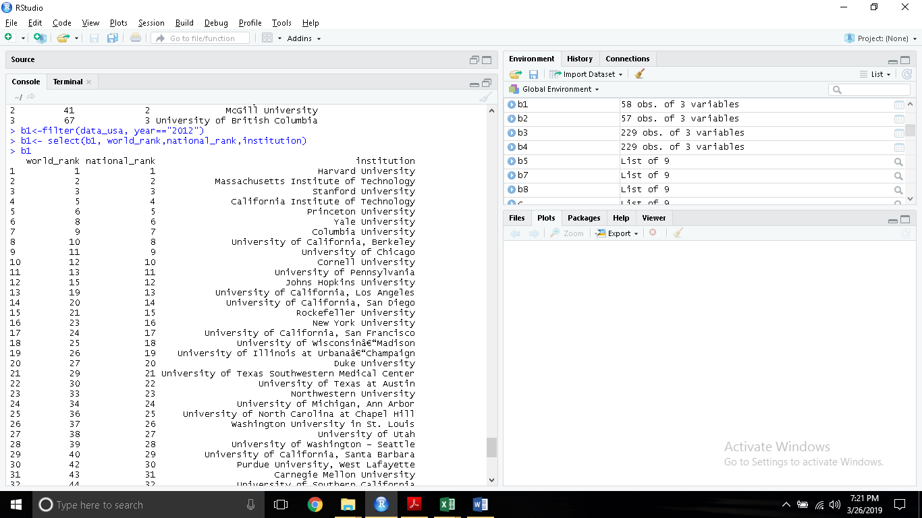
2

Slide 10
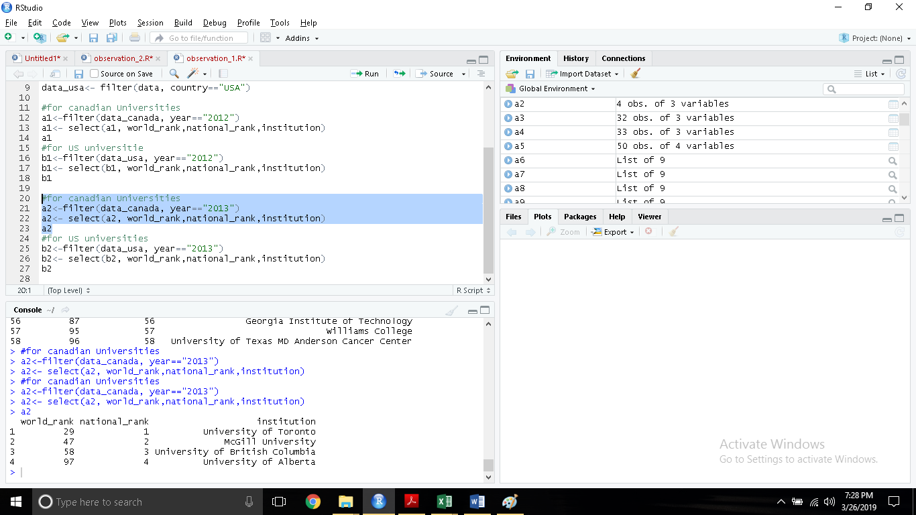
3

Slide 11
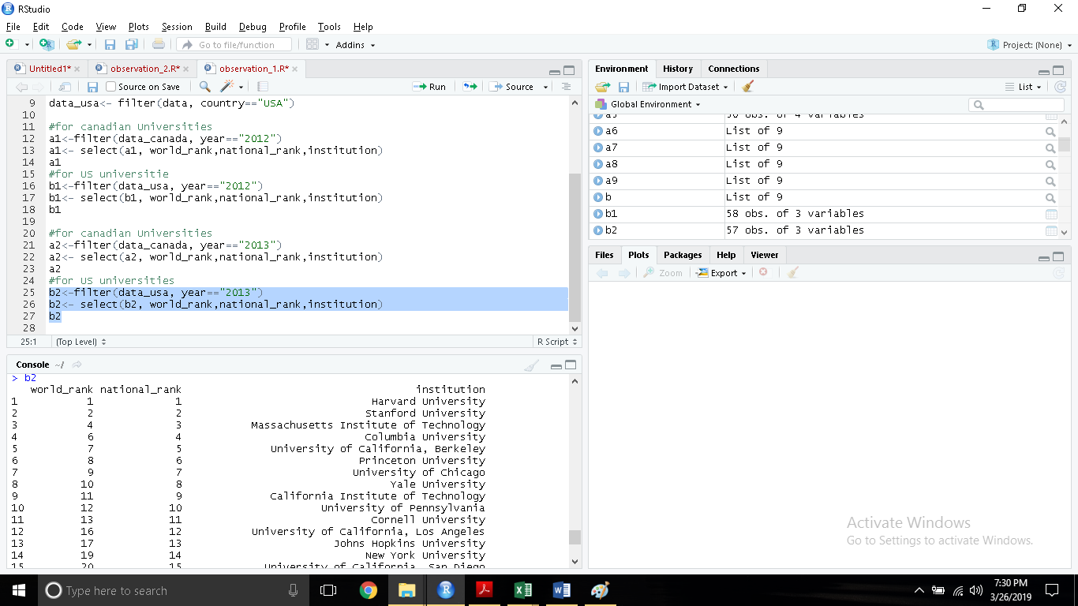
4

Slide 12
Observation:- 2
For this observation have used the cwurData.csv data file. The file contains the data from 2012 to 2015. I wanted to get the following results.
5.Which are the latest top50 Universities in the world?
6.Which are the latest top10 Universities in Canada?
7.Which are the latest top10 Universities in US?
8.Which is the best country for study? (Which country has the highest number of universities in top50)

Slide 13
code
library(tidyverse)
data<-read.csv("cwurData.csv" )
data
#for latest ranking
data_2015<- filter(data, year=="2015")
data_2015<-data_2015[1:50,]
data_2015
#for canadian Universities
a4<-filter(data_canada, year=="2015")
a4<- select(a4, world_rank,national_rank,institution)
a4
c4<- select(a4,national_rank,world_rank,institution)
c4[1:10,]

Slide 14
#for US universities
b4<-filter(data_usa, year=="2014")
b4<- select(b4, world_rank,national_rank,institution)
b4
d4<- select(b4,national_rank,world_rank,institution)
d4[1:10,]
#for latest ranking
e4<- ggplot(data_2015,aes(country,fill=country)) +geom_bar()+ggtitle("Top 50 by Center for World University Rankings")
e4
f4<-select(data_2015,world_rank,institution,country)
f4[1:10,]
g4<-data_2015%>%group_by(country)%>%summarise(count=n())
g4

Slide 15
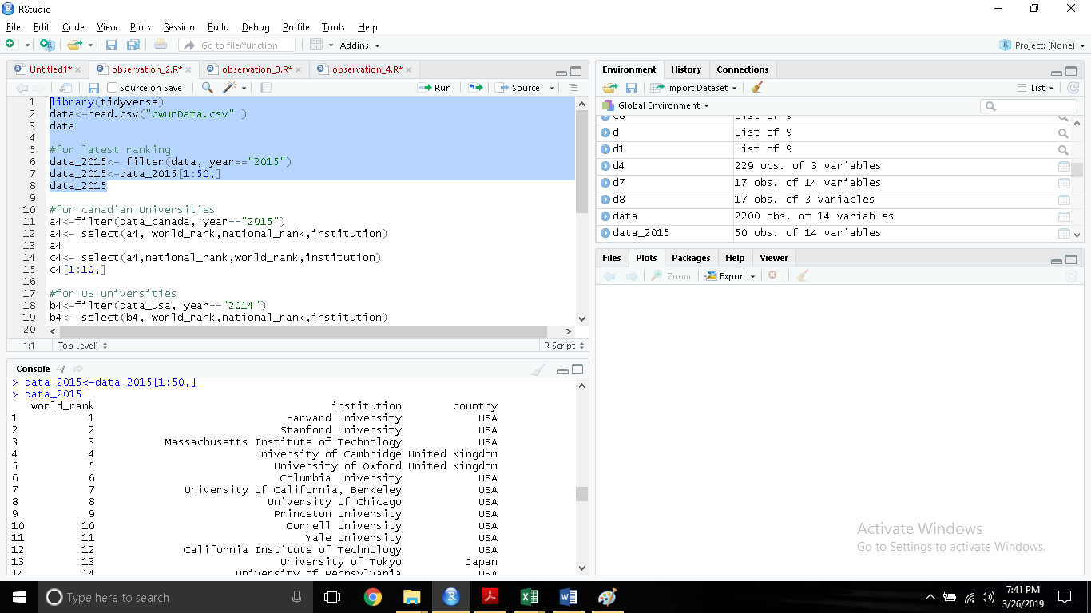
5

Slide 16
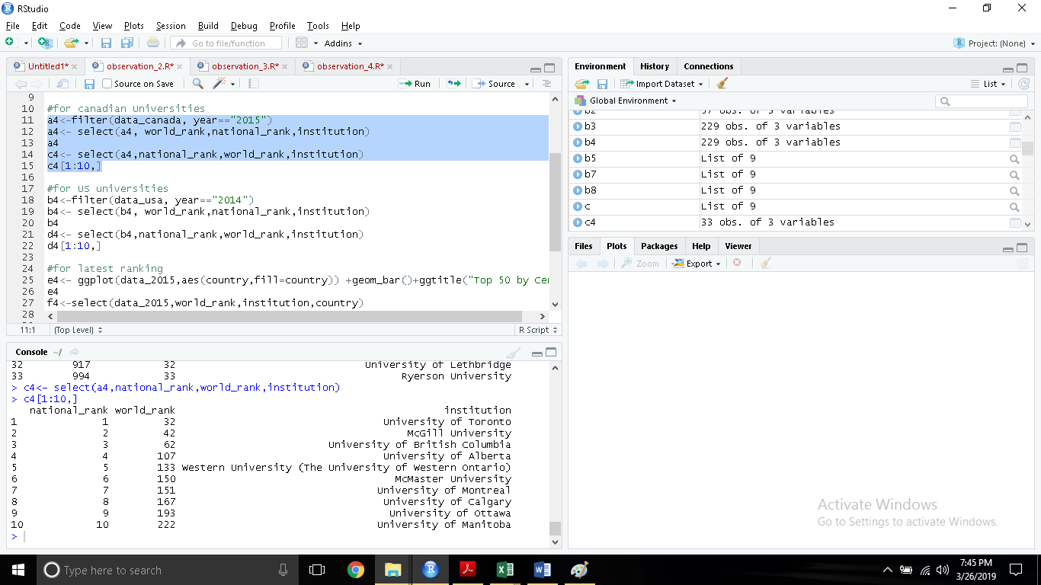
6

Slide 17
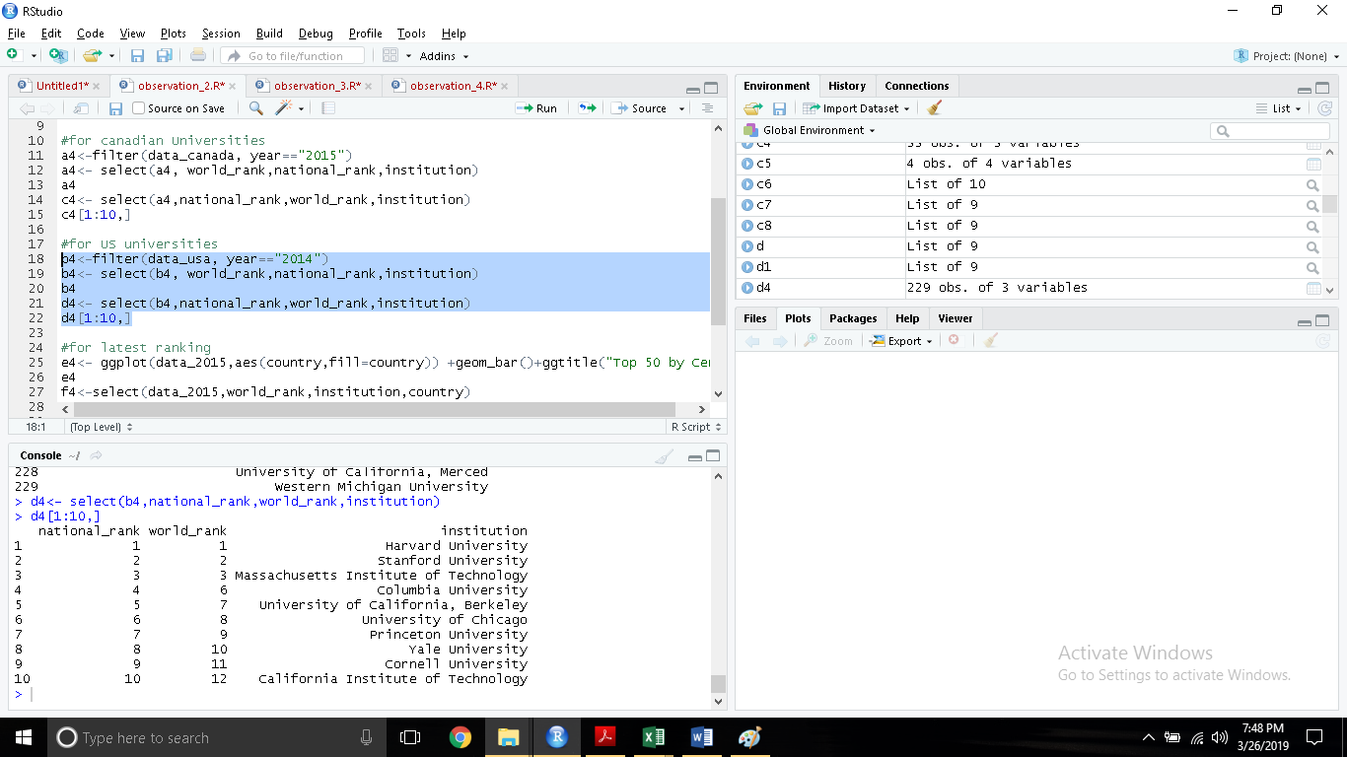
7

Slide 18
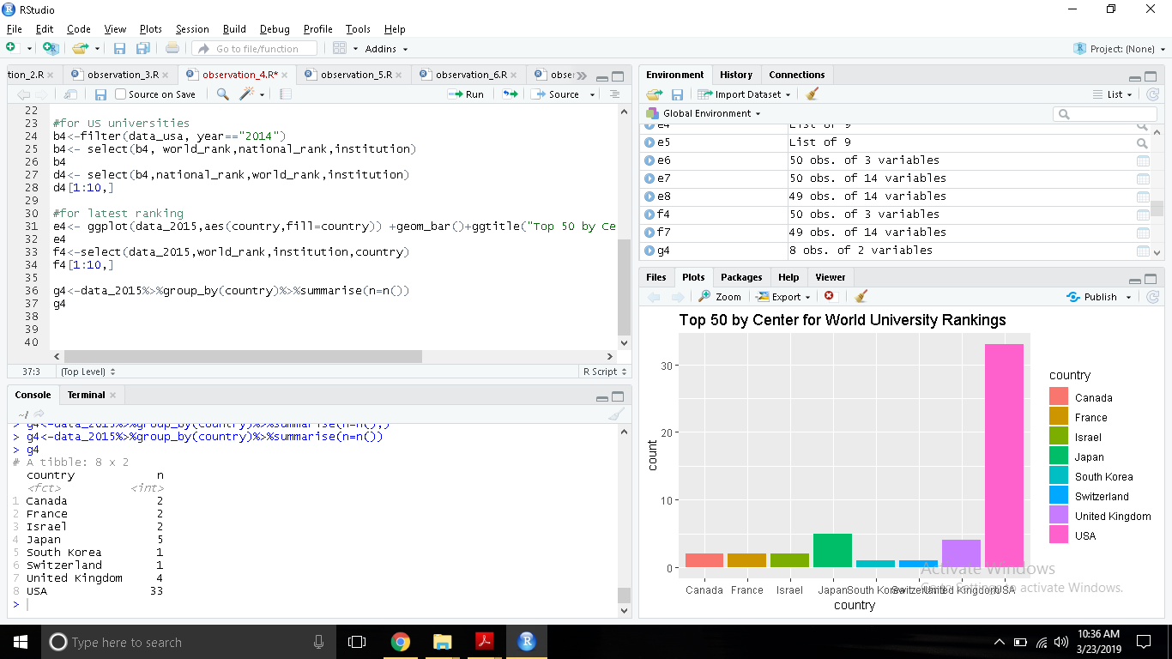
8

Slide 19
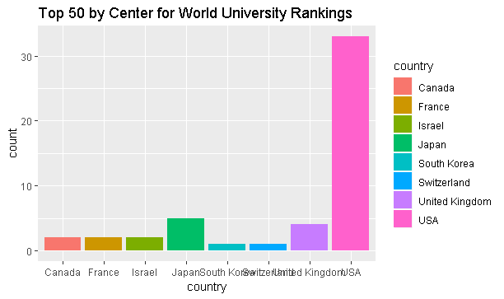
8

Slide 20
Key finding of observation 2
From the above observations it can be said that USA is the best country for study as almost 70% universities in top50 are in USA. USA is a clear winner.
As the most of the top ranked universities are in USA, it can be predicted that USA is a most preferable place for study.

Slide 21
Observation:-3
For this exercise I have used the cwurData.csv data file. The file contains the data from 2012 to 2015. I wanted to get the following results.
9. Find out the density of the values of score.
10. Visualize the relationship between score and world_rank.
11. Smooth the curve and separate the results by year.

Slide 22
code
library(tidyverse)
library(ggplot2)
data<-read.csv("cwurData.csv" )
data_2015<-filter(data, year==2015)
d1<- ggplot(data,aes(score,..density..))+geom_histogram(color="white", fill="black")+geom_density()+ggtitle("cwur score's density")
d1
d2<- ggplot(data_2015,aes(score,..density..))+geom_histogram(color="white", fill="black")+geom_density()+ggtitle("cwur score's density of 2015")
d2
a<-ggplot(data,aes(world_rank,score,color=year))+geom_point()
a
b<-a+facet_grid(year~.)+geom_smooth()
b
c<-a+facet_grid(.~year)+geom_smooth()
c
d<-a+facet_wrap(.~year)+geom_smooth()
d

Slide 23
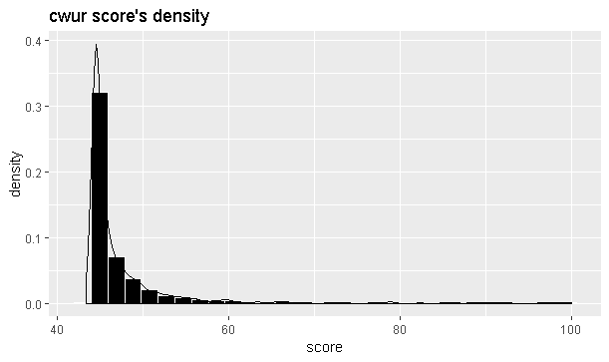
9

Slide 24
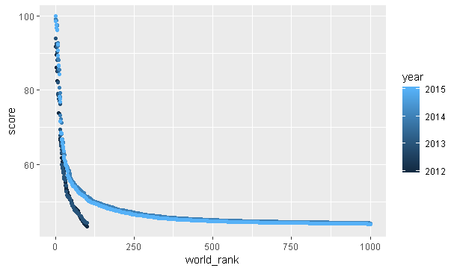
10

Slide 25
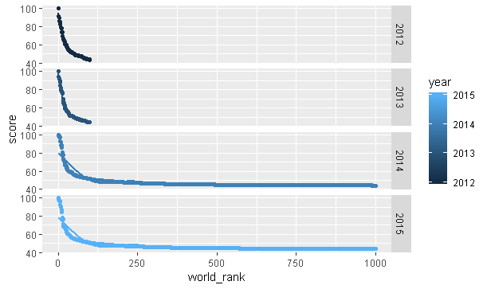
11

Slide 26
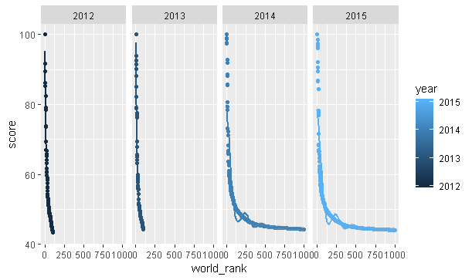
11

Slide 27
Key finding of observation 3
There is a direct relationship between score and world ranking. The higher overall score results in a higher world ranking.
The density between 40 to 60 are much higher than other values of score.

Slide 28
Observation:- 4
For this observation I have used the cwurData.csv data file. The file contains the data from 2012 to 2015. I wanted to get the following results.
12. List the top50 universities by quality of education all over the globe.
13. Visualize Quality of education ranking VS overall ranking of top50 by CSWU

Slide 29
code
library(tidyverse)
library(ggplot2)
library(forecast)
data<-read.csv("cwurData.csv" )
data_myuniversity<- filter(data, institution=="University of Toronto")
a5<-filter(data, year=="2015")
a5<-a5[1:50,]
a5<-a5[order(a5$quality_of_education),]
rownames(a5) <- 1:nrow(a5)
a5<-select(a5,quality_of_education,world_rank,institution,country)
a5
b5<-ggplot(a5,aes(quality_of_education,world_rank,color=country))+geom_point()+ggtitle("Quality of education ranking VS overall ranking by CSWU")
b5

Slide 30
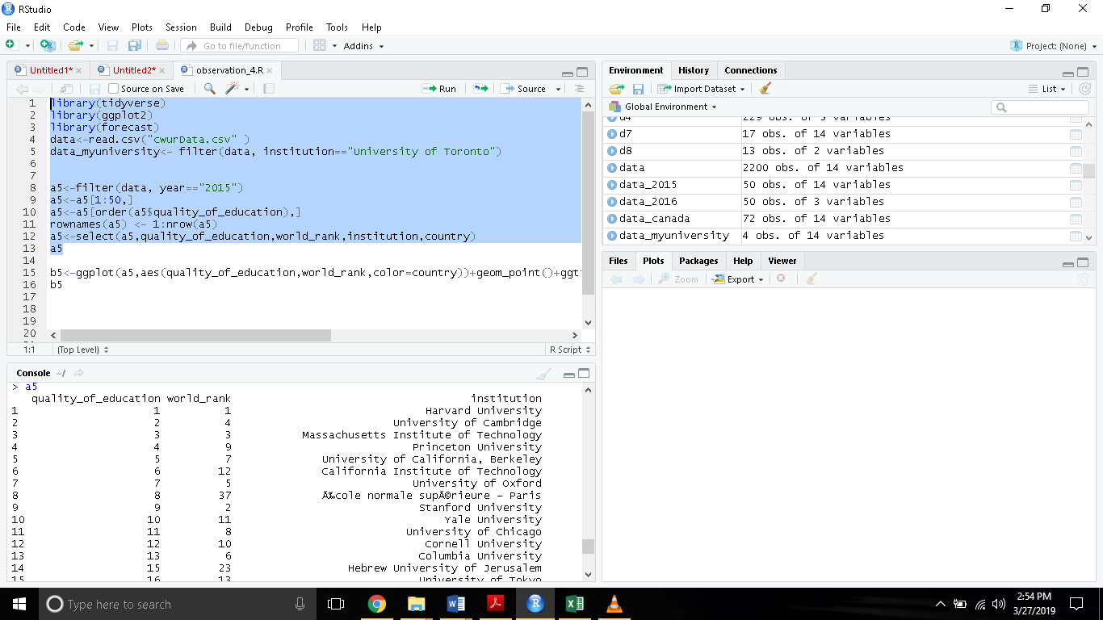
12

Slide 31
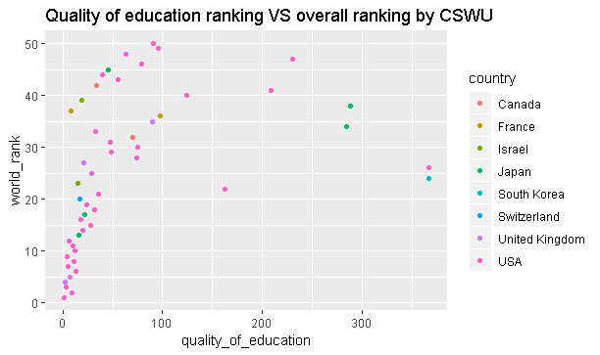
13

Slide 32
Key findings of observation 4
In terms of quality of education as well as overall ranking Harvard is number one university.
The universities of the USA provide best quality of education, the second country in terms of quality of education is Switzerland. Then next to it is Japan and then Canada.

Slide 33
Observation:- 5
For this observation I have used the cwurData.csv data file. The file contains the data from 2012 to 2015. I wanted to get the following results. I choose University of Toronto as my university.
14. Visualize the ranking of my university over the time.
15. Try to predict the rank of my university (University of Toronto) in upcoming years.
16. Try to smooth the curve and predict by using ggplot2 library.

Slide 34
code
library(tidyverse)
library(ggplot2)
library(forecast)
data<-read.csv("cwurData.csv" )
data_myuniversity<- filter(data, university_name=="University of Toronto")
data_myuniversity
#my university
c5<-select(data_myuniversity,world_rank,institution,country,year)
c5
Rank_cswur<-ts(c5$world_rank,start=c(2012))
Rank_cswur
plot(Rank_cswur,main="cwur Ranking of Univerisy of toronto over the time")

Slide 35
c6<-forecast(c5,h=5)
plot(c6, main="cwur Ranking of Univerisy of toronto over the time")
model<-lm(world_rank~year, data=c5)
pred<-predict(model, interval="prediction")
c7<-cbind(c5,pred)
c7
c8 <- ggplot(c7, aes(year, world_rank)) +
geom_point() +
stat_smooth(method = lm)
c8
c8 + geom_line(aes(y = lwr), color = "red", linetype = "dashed")+
geom_line(aes(y = upr), color = "red", linetype = "dashed")

Slide 36
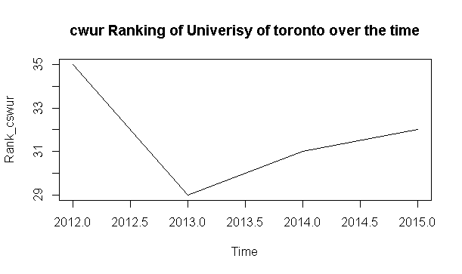
14

Slide 37
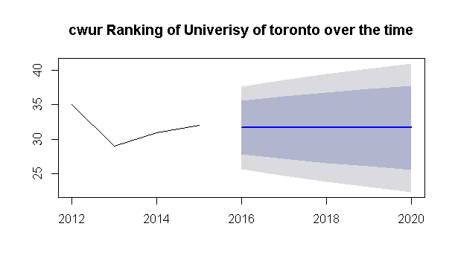
15

Slide 38
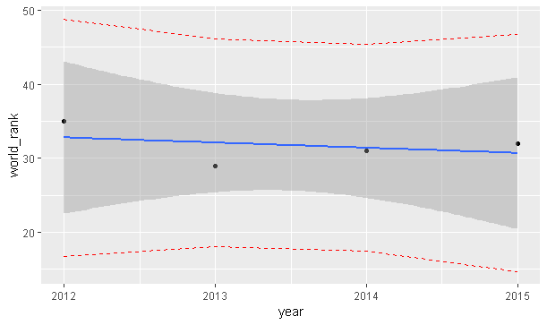
16

Slide 39
Key findings of observation 5
Between the time span from 2012 to 2015 the world ranking of university Toronto is increased from 35 to 32.
From the past observations we can predict than the ranking of the university of Toronto is most likely to between 23 to 43.
The redline in the graph 16 indicates the border. Outside of this border the ranking is less likely to go in future.

Slide 40
Observation:- 6
For this exercise I have used the timesData.csv data file. The file contains the data from 2011 to 2016. I wanted to get the following results. I choose University of Toronto as my university.
17.List recent top 50 universities all over the globe
18.Ranking of Univerisy of toronto over the time

Slide 41
Code
library(tidyverse)
library(ggplot2)
library(forecast)
data<-read.csv("timesData.csv", stringsAsFactors = FALSE )
data_myuniversity<- filter(data, university_name=="University of Toronto")
data_myuniversity
#List recent top 50 universities all over the globe
data_2016<- filter(data,year=="2016")
data_2016<-data_2016[1:50,]
data_2016<-select(data_2016,world_rank,university_name,country)
data_2016
#timeseries
a10<- select(data_myuniversity,world_rank,university_name,country,year)
a10
Rank_time<-ts(a10$world_rank,start=c(2011))
Rank_time
plot.ts(Rank_time,main="Time Ranking of Univerisy of toronto over the time")

Slide 42
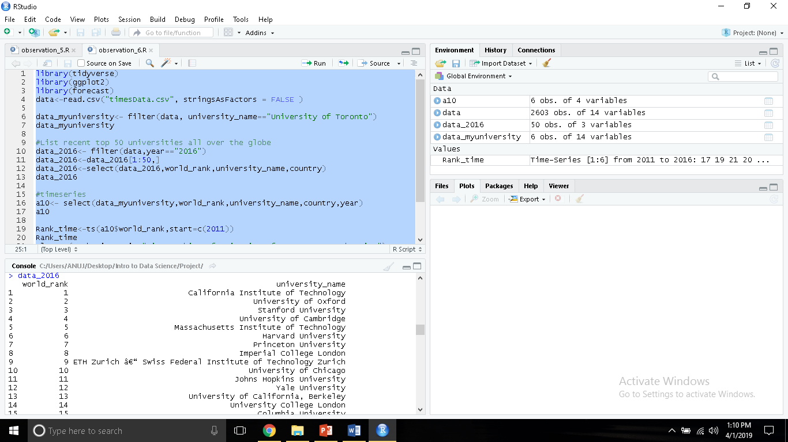
17

Slide 43
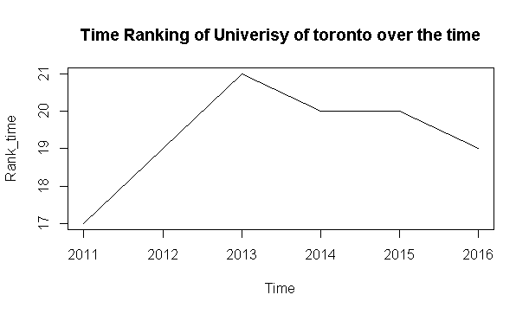
18

Slide 44
Observation:- 7
For this exercise I have used the timesData.csv data file. The file contains the data from 2011 to 2016. I wanted to get the following results. I choose University of Toronto as my university.
19. Find the recent Top ranked universities with highest international students
20. Visualize the Countries having top 10 universities.
21. Visualize the research score vs teaching score.
22. Find the recent top ranked universities in INDIA

Slide 45
Code
library(tidyverse)
library(ggplot2)
library(forecast)
data<-read.csv("timesData.csv" )
data_2016<-filter(data, year=="2016")
top_50<-data_2016[1:50,]
top_10<-data_2016[1:10,]
#Top universities with highest international students
e7<-top_50
e7
f7<-e7[order(e7$international_students, decreasing = TRUE),]
f7<-f7[2:50,]
rownames(f7)<- NULL
g7<-select(f7,world_rank,university_name,country,international_students)
g7

Slide 46
#Countries having top 10 universities.
b7<-ggplot(top_10,aes(country,fill=country)) +geom_bar()+ggtitle("Time Ranking")
b7
#reseach vs teaching
c7<-ggplot(top_50,aes(teaching,research,color=country))+geom_point()+ggtitle("Time Ranking")
c7
#recent top ranked universities in Indiad7<- filter(data_2016, country=="India")
d8<-select(d7,world_rank,university_name,country)
d8

Slide 47
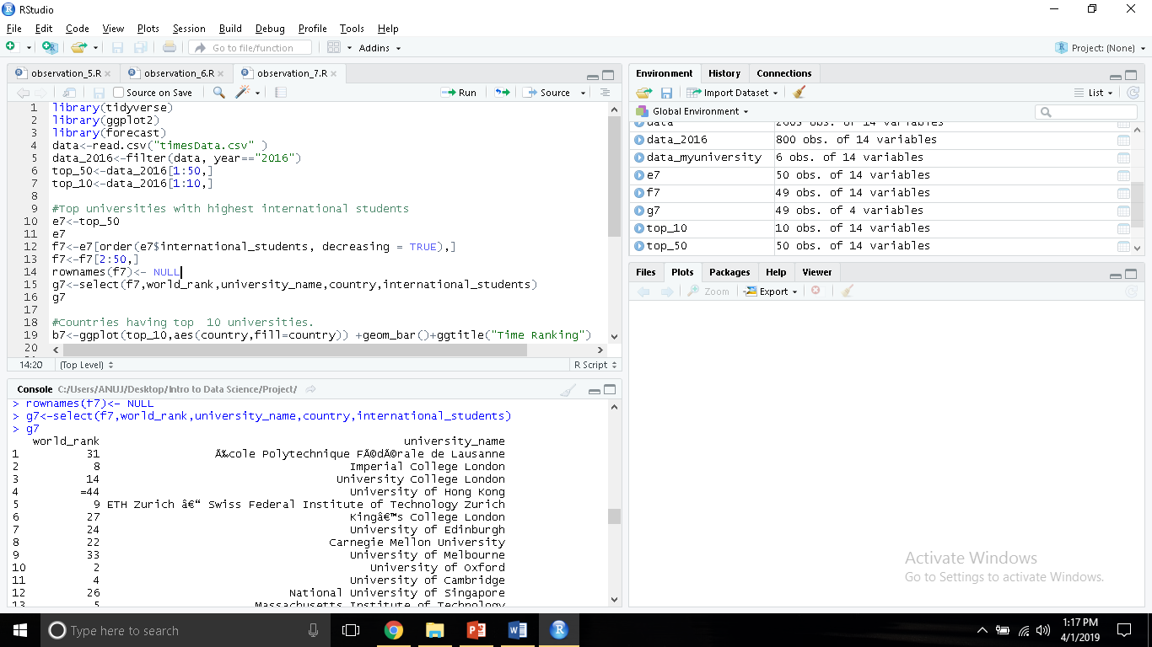
19

Slide 48
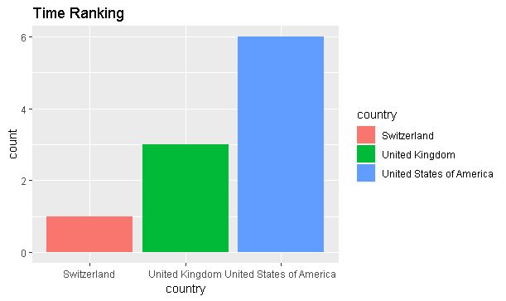
20

Slide 49
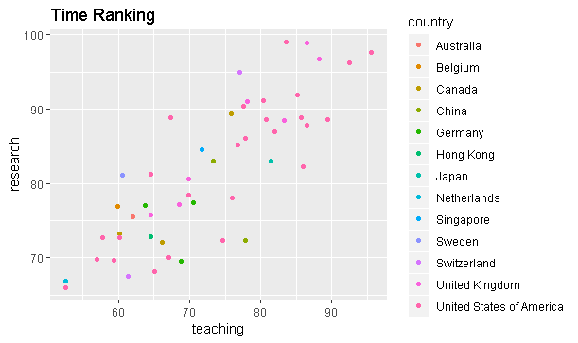
21

Slide 50
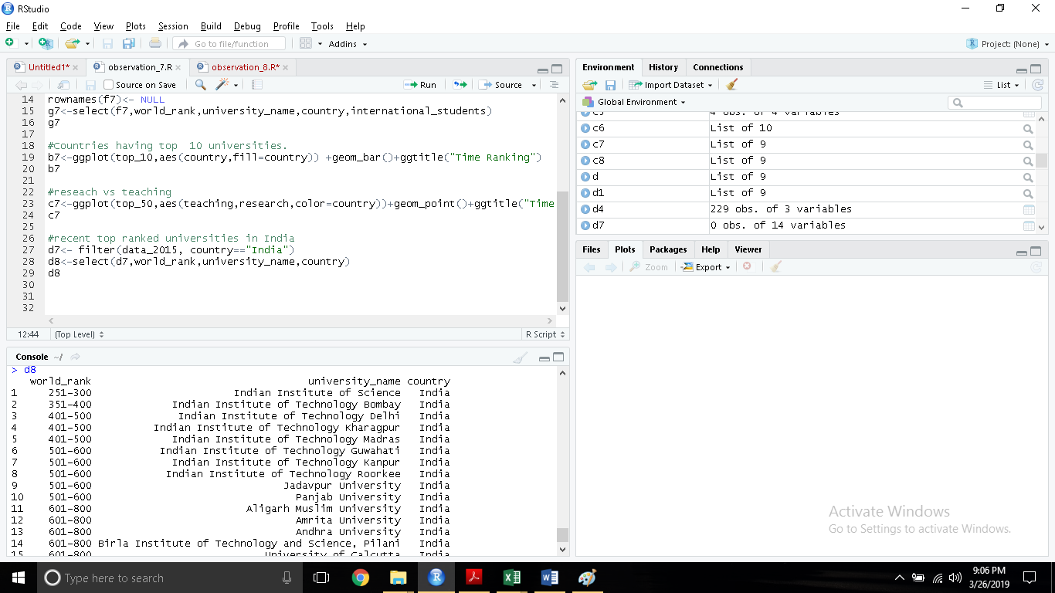
22

Slide 51
Key findings of observation 7
I got the list of the top ranked universities with highest international students. This list can help those international students who are planning to peruse the education in foreign country as these top ranked universities have many students.
Out of top 10 universities 6 universities are located in USA.
I also found the list of top ranked Indian universities .

Slide 52
Observation:- 8
For this exercise I have used the timesData.csv and shanghaiData.csv data files. I tried to find out the top raked universities considering both files.
23. Get the output of both ranking of each universities in one data frame.
24. Visualize both Time ranking and Shanghai ranking of each university.(Time ranking on X axis and Shanghai ranking on Y axis).
25. Find out the best country for education according to Time ranking.
26. Visualize your above result.

Slide 53
Code
library(tidyverse)
library(ggplot2)
library(dplyr)
datatime<-read.csv("timesData.csv" )
datashanghai<-read.csv("shanghaiData.csv")
datatime_2015<-filter(datatime, year=="2015")
datashanghai_2015<-filter(datashanghai, year=="2015")
shan_time_data<-dplyr::inner_join(datatime_2015,datashanghai_2015,by="university_name")
shan_time_data
shan_time_data<- select(shan_time_data,world_rank.x,world_rank.y,university_name,country)
shan_time_data
names(shan_time_data)[1:2]<-c("Time_world_ranking", "Shanghai_world_ranking")
head(shan_time_data)

Slide 54
top_20<-shan_time_data[1:20,]
top_20
a8<-ggplot(top_20,aes(Time_world_ranking,Shanghai_world_ranking,color=university_name))+geom_point()
a8
top_10<-shan_time_data[1:10,]
top_10
b8<-ggplot(top_10,aes(Time_world_ranking,Shanghai_world_ranking,color=university_name))+geom_point()
b8
#Time
top_50_t<-datatime[1:50,]
c8<-ggplot(top_50_t,aes(country,fill=country))+geom_bar()+ggtitle("Time ranking")
c8
d8<-top_50_t%>%group_by(country)%>%summarise(count=n())
d8<- d8[order(-count),]
d8

Slide 55
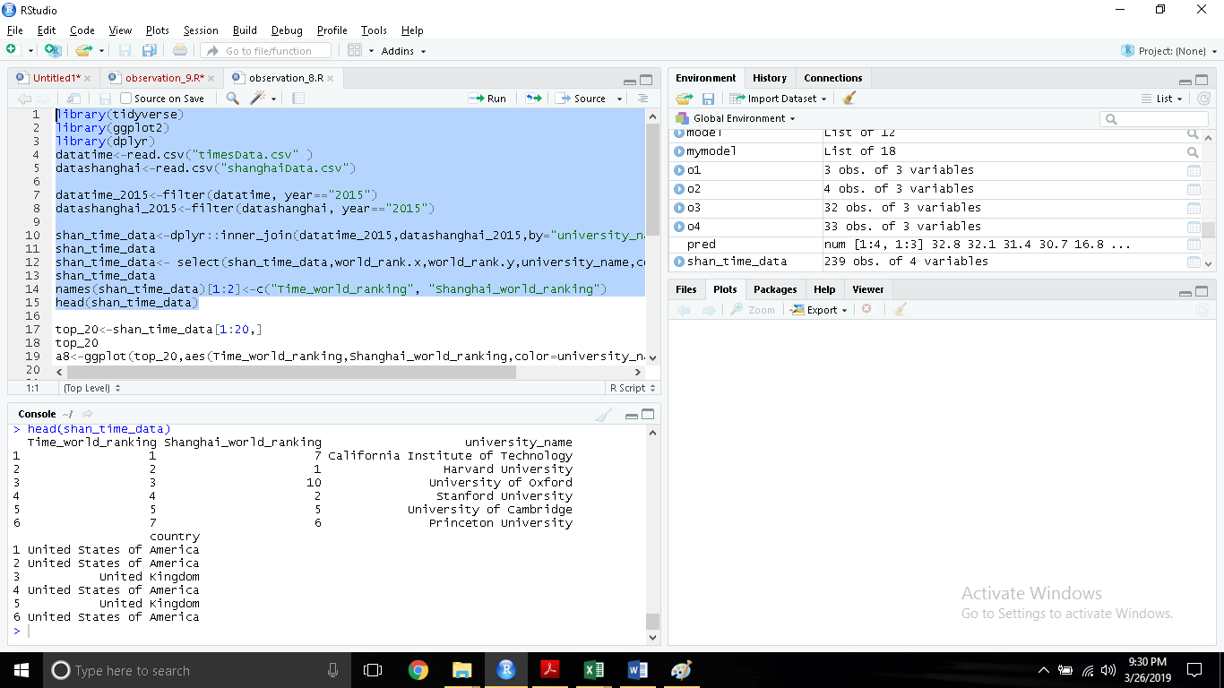
23

Slide 56
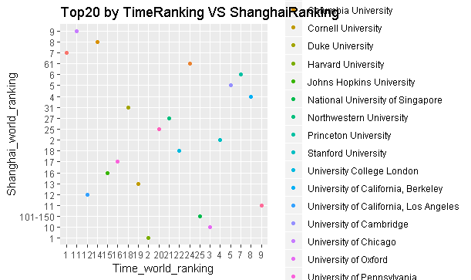
24

Slide 57
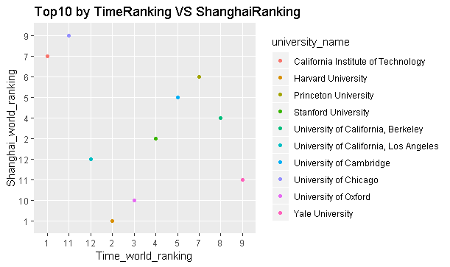
24

Slide 58
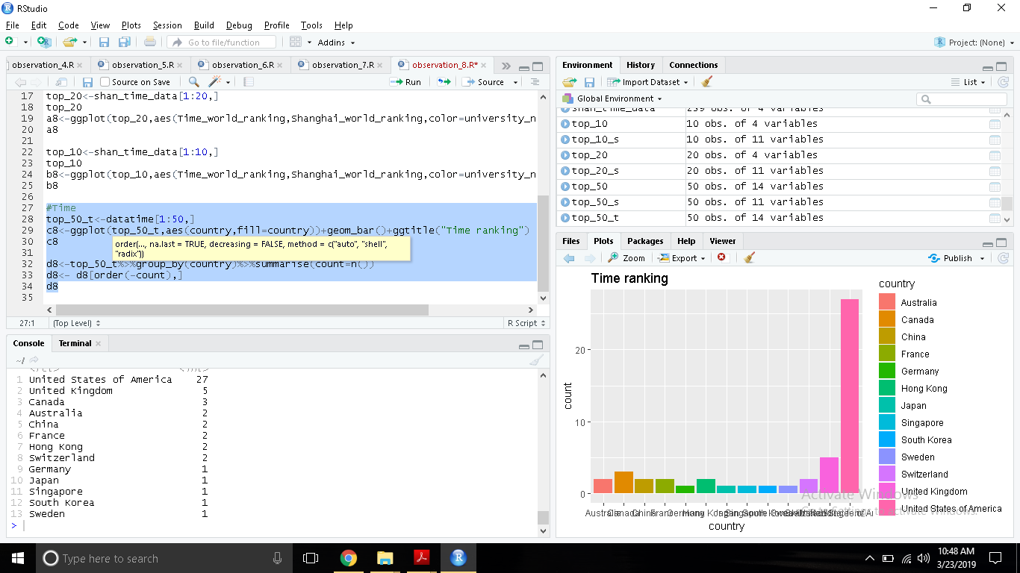
26

Slide 59
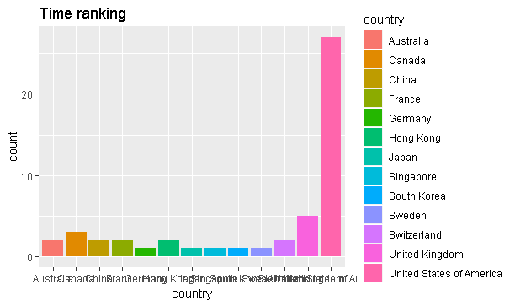
26

Slide 60
Key findings of observation 8
Here I compared two ranking systems. Times vs Shanghai. From the graph and result one can check the ranking of the universities by both systems.
From the above observations it can be said that USA is the best country for study as almost 54% universities in top50 are in USA. USA is a clear winner.

Slide 61
Thank you

