Slide 1
SMS Classifier : Ham or Spam
Anuj Kawane
Abhishek Ranjan

Slide 2
Background and Motivation
Human Attention
SPAM messages requires unnecessary human intervention.
Roaming Cost
Most of the cellular plan charges to receive SMS while in roaming. Lots of SPAM messages can lead to hefty bills.
Phishing Attacks
SMS based Phishing is where user receives malicious link via SMS and asks user to visit that link and steals sensitive information from user’s mobile device. Classifier can protect user from these messages by classifying these SMS as spam.
Notes:
You have to pay for receiving a SMS and while in roaming, you pay for all SMS that you get, so it can be very expensive even to get these SMS spams.

Slide 3
Project Objective
Build a classifier using ML model to detect spam messages.
The purpose of this project is to apply various machine learning algorithms to the problem of SMS spam classification, compare their performance to gain insight about these methods that can accurately filter spams.

Slide 4
Tasks
A dataset of real SMS Spams from UCI Machine Learning repository is used
Performed preprocessing of text using various NLP techniques.
Trained various machine learning algorithms on the chosen dataset.
The results are compared and the best algorithm for spam filtering for text messaging is introduced.

Slide 5
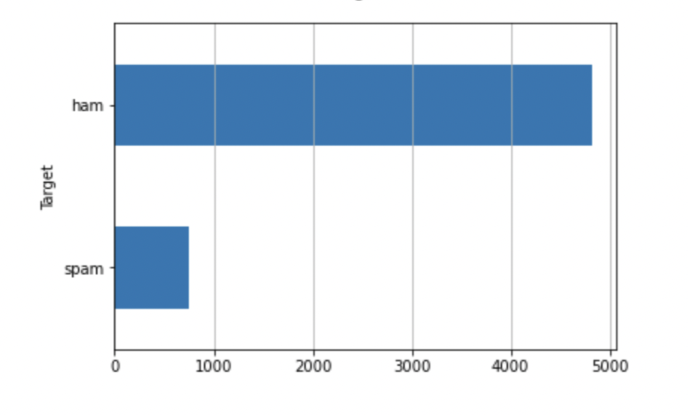
Dataset
Dataset consists of two columns :
1. Text (SMS)
2. Ground Truth(Spam or Ham)
Source: UCI Machine Learning Repository: SMS Spam Collection Data Set

Slide 6
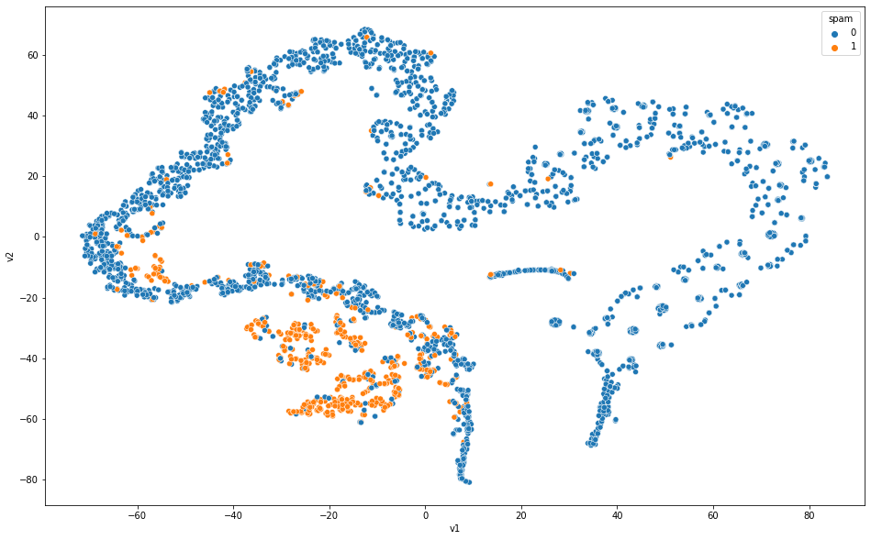
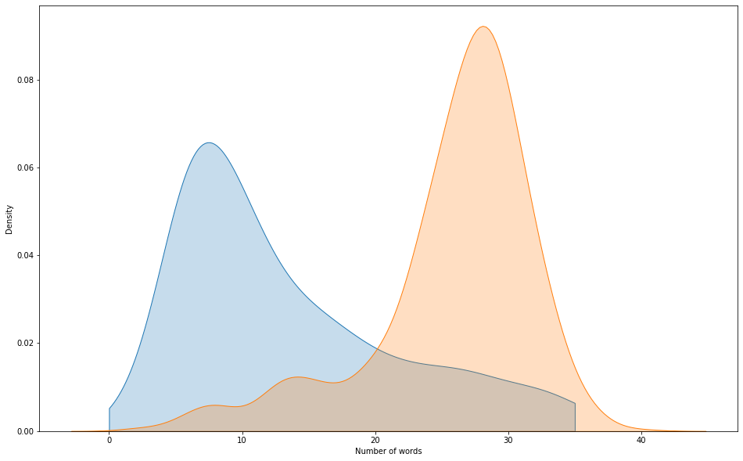
Dataset - Exploratory Data Analysis
Plot 1. After BERT embeddings, Spam messages are generally clustered together
Plot 2. Spam messages has more words than Ham messages.(Spam messages averages around 30 words while ham messages has 10 words)

Slide 7
Methodology
Text Preprocessing:
Original message : Ok lar... Joking wif u oni…
Replacing all non-alphabetic characters with a space :
Ok lar Joking wif u oni
Convert all words to lowercase :
ok lar joking wif u oni
Tokenize text :
['ok', 'lar', 'joking', 'wif', 'u', 'oni']
Remove stopwords like ['i', 'me', 'my', 'myself', 'we', 'our', 'ours', 'yourselves']:
['ok', 'lar', 'joking', 'wif', 'u', 'oni']
Lemmatize each word :
['ok', 'lar', 'joke', 'wif', 'u', 'oni']

Slide 8
Methodology
2. Encode Text data with Bag-of-Words model (with Tf-Idf )
** Tf-Idf builds a vocabulary from a corpus of documents and counts how many times the words appear in each document.
3. Label encoding to 0/1 where 1 represents spam 0 represent ham.

Slide 9
Methodology
Machine Learning Models Trained
NaiveBayes
RandomForest
KNeighbours
SVC
Logistic Regression
DecisionTreeMaxDepth2
Decision Tree
XGBoost
Neural Network

Slide 10
Experiment Setting
Training/testing Dataset
Apportion the data into training and test sets, with an 75-25 split
Evaluation Metrics
k- fold cross validation where k = 10
confusion matrix and associated
Accuracy, Precision, Recall
ROC curve
F1 score
Accuracy on Training set
Accuracy on Test set

Slide 11
Experiment Setting
Baseline Methods
We used old fashioned Bag-of-Words (with Tf-Idf ) as a baseline method to encode text data and trained the model using:
NaiveBayes
RandomForest
KNeighbours
SVC
Logistic Regression
DecisionTreeMaxDepth2
Decision Tree
XGBoost
Neural Network

Slide 12
Numerical Results
Cross Validation mean Score
NaiveBayes : 0.966497
RandomForest : 0.976786
KNeighbours : 0.911942
SVC : 0.975829
Logistic Regression : 0.960514
DecisionTreeMaxDepth2 : 0.916009
Decision Tree : 0.959799
XGBoost : 0.977265

Slide 13
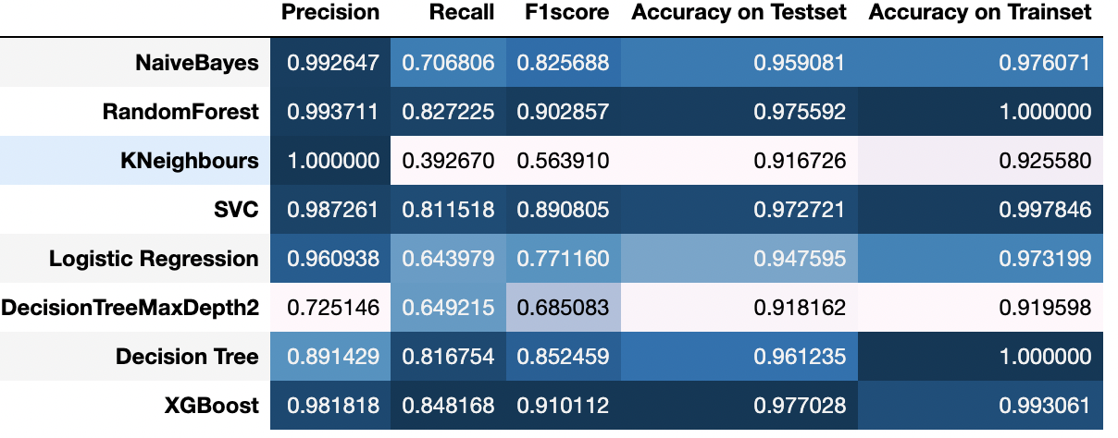
Numerical Results
Testing Result

Slide 14
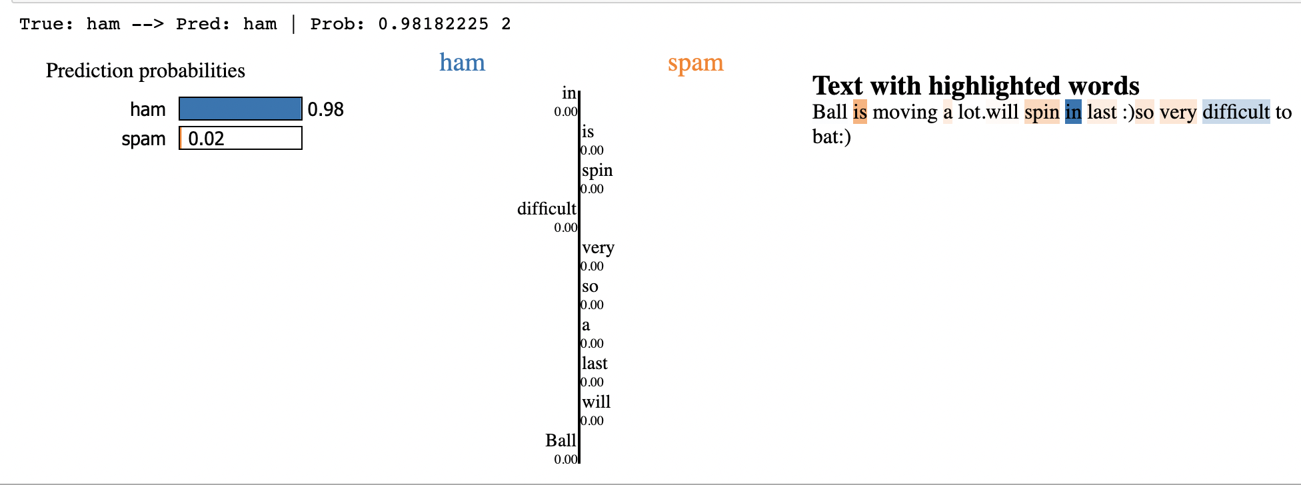
Qualitative Results
Success Sample

Slide 15
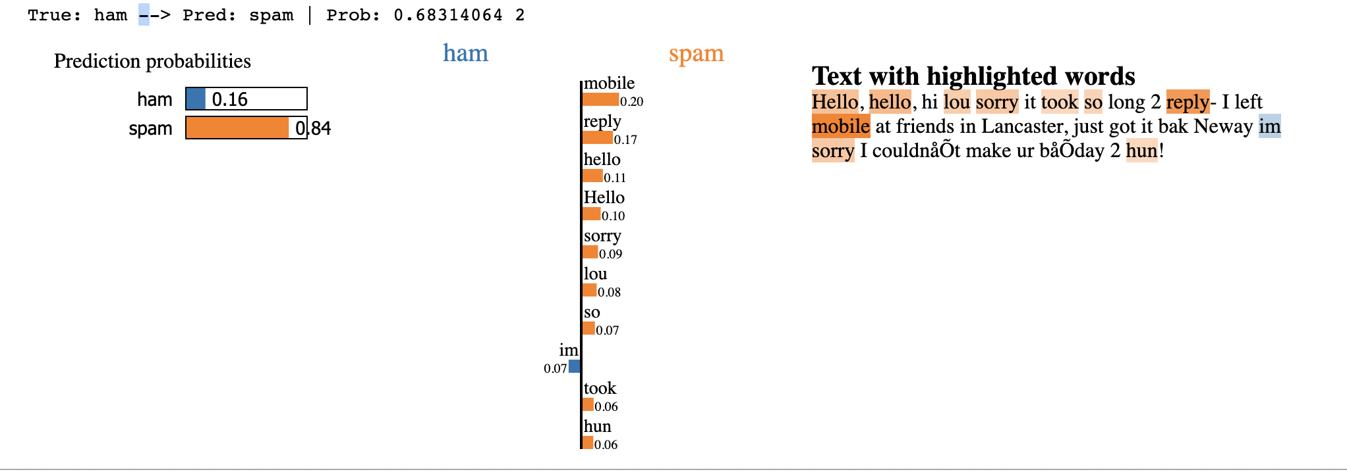
Qualitative Results
Failure Sample
Notes:
sdjhbasdjhbshdbdasjhsbddjbhbsdk

Slide 16
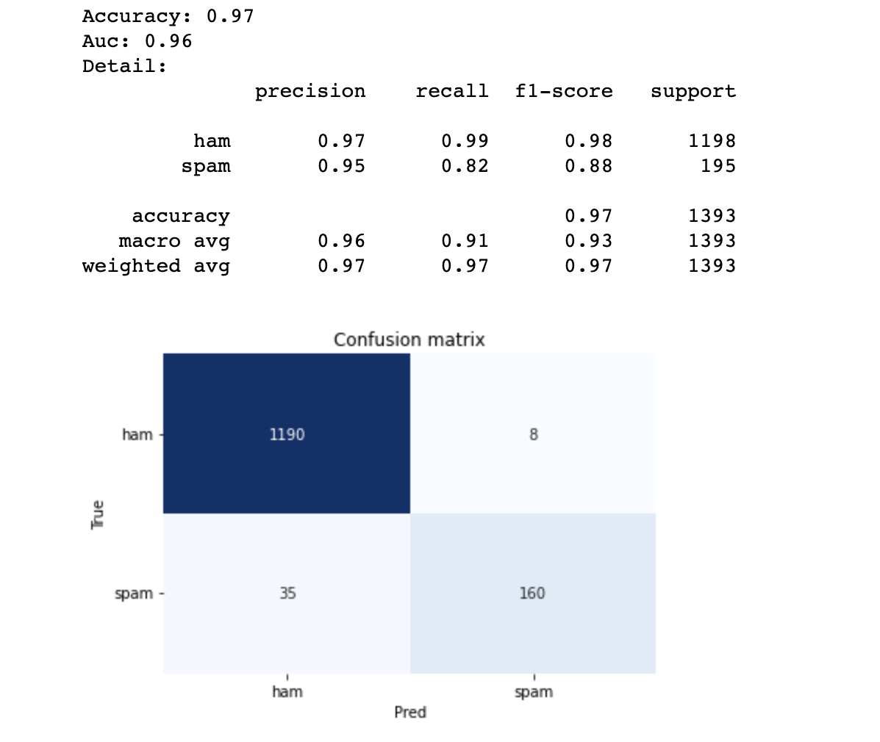
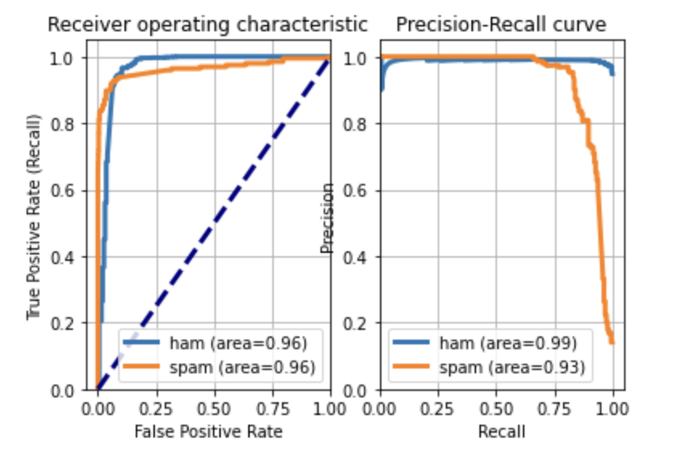
Conclusion
We found that RandomForest, SVC and XGBoost are among the best classifier for SMS spam detection.
For XGBoost(best validation score), below are the summary of the result:

Slide 17
Conclusion
We observed that the recall for spam is particularly low at 82%.
Some of the keyword like ‘hello’, ‘reply’, ‘mobile’ is associated heavily with SPAM so, if we find this keyword in the ham message, it is most likely to be classified under SPAM. So, we need some more sophisticated way to encode messages.
We plan to test the famous Word Embedding (with Word2Vec), and the cutting edge Language models (with BERT) that may further improve the performance .
We also plan to resample the dataset to reduce the imbalance ratio.

