Slide 1
Amazon Web Services
CSE 490H
This presentation incorporates content licensed under the Creative Commons Attribution 2.5 License.

Slide 2
Overview
Questions about Project 3?
EC2
S3
Putting them together

Slide 3
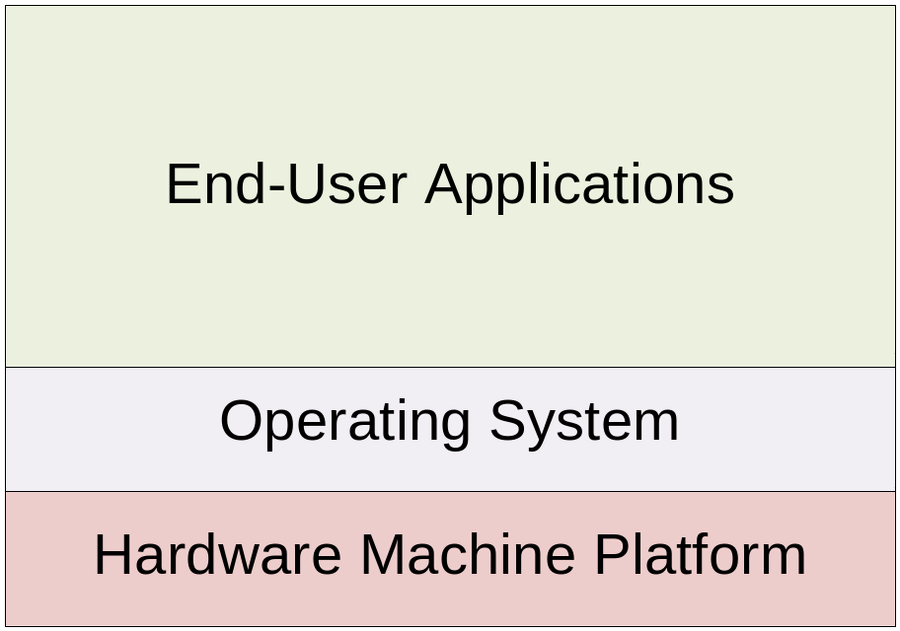
Brief Virtualization Review

Slide 4
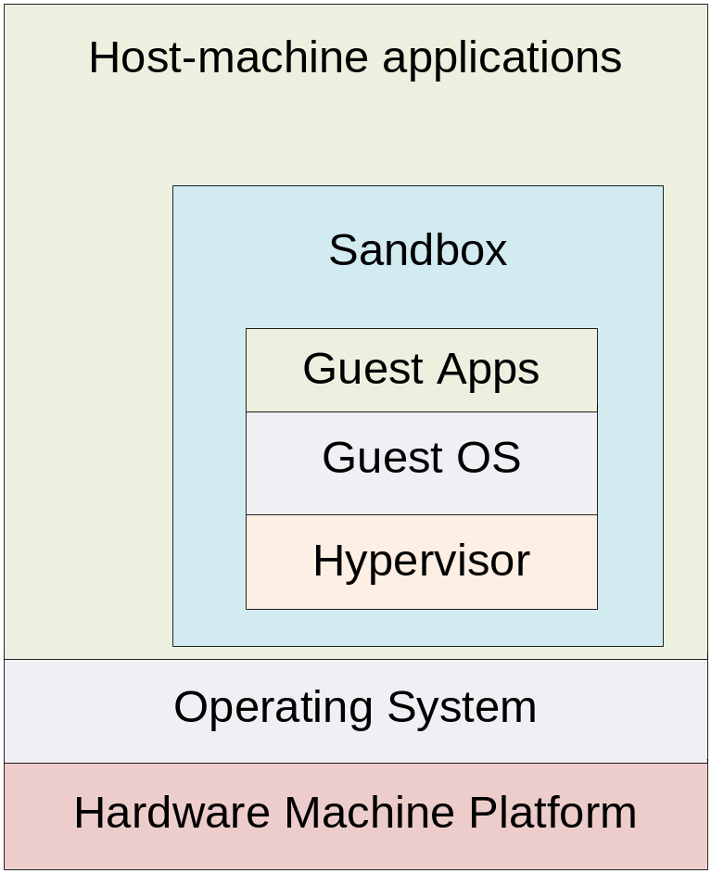
Host and Guest Systems

Slide 5
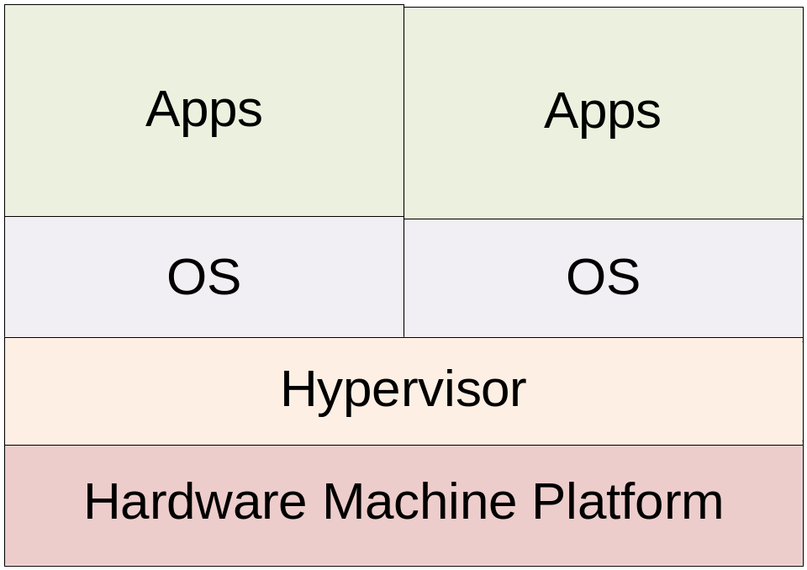
Fully Virtualized Machine

Slide 6
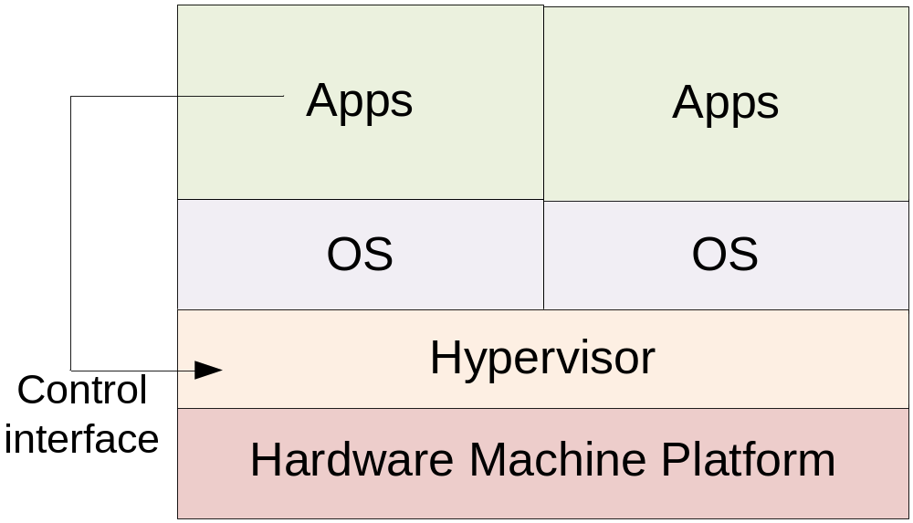
Interacting with the Hypervisor

Slide 7
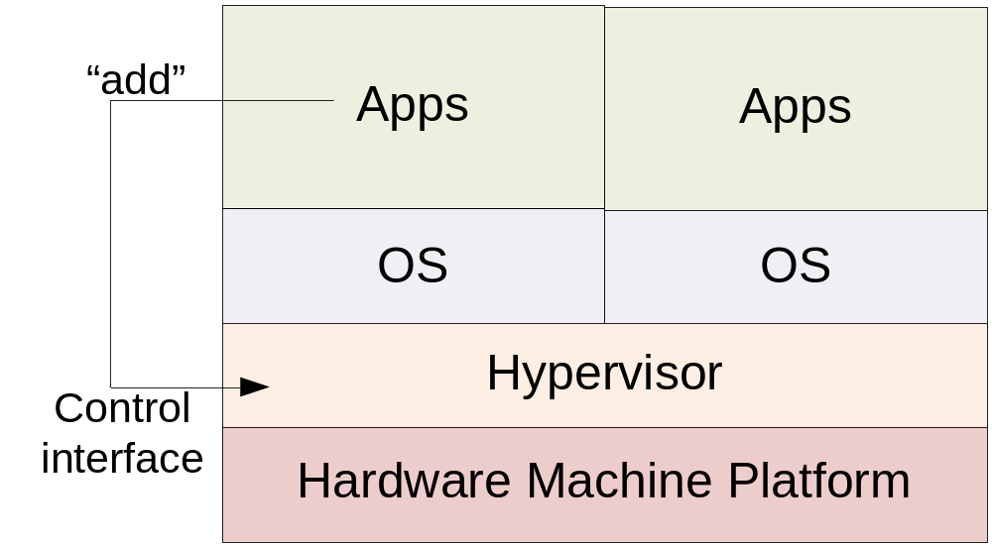
“add machine”

Slide 8
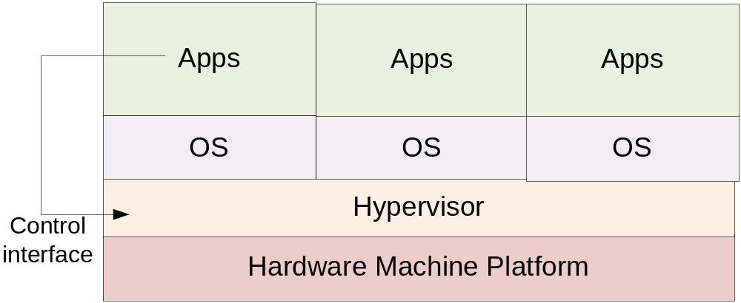
New machine added

Slide 9
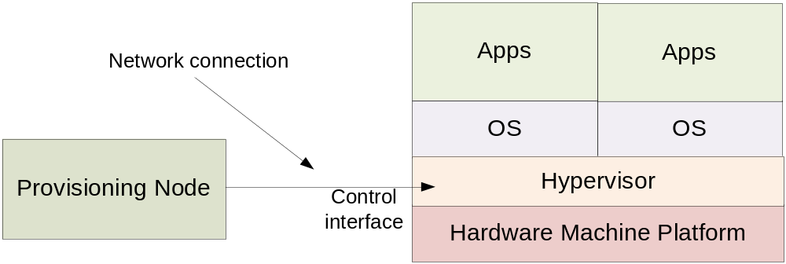
Managing Large Deployments

Slide 10
How Web Servers Work
Interacting with a web servers has three stages
  Request – A URL (and some data) is sent to the server
  Handler – Some logic looks at the request
  Response – Some data is sent back to the user

Slide 11
Serving a Web Page
Request: “GET /index.html”
Handler: The server itself reads the $wwwroot/index.html file
Response: The contents of the file are sent back to the user

Slide 12
Web Applications
Request: “GET /buyItem.php?itemId=414&customerId=2000”
Handler: The server invokes the buyItem.php script and runs the code
Response: Whatever output is sent back from the script gets sent back to the end user’s web browser

Slide 13
CGI Scripts
This sort of “Web page that does something” is referred to as CGI (the Common Gateway Interface)
Typically a script that takes in parameters, does some processing, and returns a new web page to view in your browser

Slide 14
REST Interfaces
… Buy why the focus on “pages?”
Request: “GET /launchMissiles.exe?authCode=12345”
Handler: launchMissiles program works
Response: “Boom!”
…This is a “web service”

Slide 15
REST Interfaces
Well-defined “URLs” perform operations
Web server is connected to programs specific to each of those operations
Typically work with XML-formatted data
Designed for connections to be self-contained and non-persistent

Slide 16
Web without the Web Browser
Any application can send/receive data with the HTTP protocol
Requests can be sent by command-line utilities, other GUI apps, etc
They then parse the XML response, display data as is appropriate

Slide 17
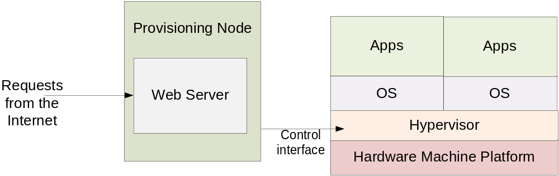
Put them together…

Slide 18
EC2 Terminology
Instance – A virtual machine
Image, AMI – The initial state for a VM
Security Group – A set of instances with shared firewall settings

Slide 19
Launching Instances
ec2-run-instances
  Requires AMI id (e.g., ami-1a2b3c4d)
  User key, security group, instance type, count
Doesn’t run immediately – instances start in “pending” state; later transition to “running”

Slide 20
Where’s my instance?
ec2-describe-instances
RESERVATION r-b27edbdb 726089167552 tom
INSTANCE i-90a413f9 ami-4715f12e
ec2-67-202-10-48.compute-1.amazonaws.com
ip-10-251-22-143.ec2.internal
running tom 0 m1.large
2008-11-11T17:23:39+0000
us-east-1c aki-b51cf9dc ari-b31cf9da

Slide 21
Firewall rules
ec2-describe-group (groupname)
GROUP 726089167552 aaron aaron
PERMISSION 726089167552 aaron ALLOWS
tcp 22 22 FROM CIDR 0.0.0.0/0
PERMISSION 726089167552 aaron ALLOWS
tcp 80 80 FROM CIDR 0.0.0.0/0
Create a group with ec2-add-group
Control permissions with ec2-(de)authorize

Slide 22
A new instance, a blank slate
How do you log in to an instance?
How does an instance know what it should do?
  Per-instance metadata

Slide 23
ssh keypairs
ssh lets you log in to a remote machine with a username
  Authentication can be done by password
  Also can be done with public/private keys
EC2 will let you register a key pair in db
  Injects public key into instance on boot
  You have the private key, you can log in

Slide 24
Shutting down instances
ec2-terminate-instance (instance id)
Terminates a running instance
Use ec2-describe-instances to get the instance id (i-XXXXXXXX)

Slide 25
Using Instance Metadata
You can create an AMI to do anything you want
Very specific AMI may already have full application stack already loaded
More generic AMI may run a bootstrap script
  Can download more programs, data from another source

Slide 26
S3 – The Simple Storage Service
S3 is an infinitely-large, web-accessible storage service
Data is stored in “buckets” as (key, value) pairs
  Effectively (server, filename) → file mapping

Slide 27
S3 has a REST API too
PUT request to a URL with data uploads the data as the value bound to the key specified by the URL
GET request to the URL retrieves the value (file) or “404 Not Found”

Slide 28
S3 Buckets
Names must be globally unique
  (Since they are addressable as DNS entries)
Can hold an unlimited number of keys
Each key can have up to 5 GB of value

Slide 29
Starting a Server
ec2-run-instances can specify metadata
A new server is provisioned and boots
Boot process runs a script that reads metadata
  This specifies location of another program
  Retrieves the program, runs it
  Retrieves data, starts more services, etc…

Slide 30
Project 4 And You
Project 3 will provide you with map tiles and an index from (address → lat, lon)
In project 4, you will:
  Upload this into S3
  Write a web server handler applet to do address lookups
  Write the bootstrap scripts to retrieve data from S3 into your instance and launch your server

Slide 31
More Web Services
Simple Queue Service (SQS)
  Reliable producer—consumer queues that hold millions of queue entries, with hundreds of servers connecting…
Simple Database Service (SDB)
  A lot like BigTable

Slide 32
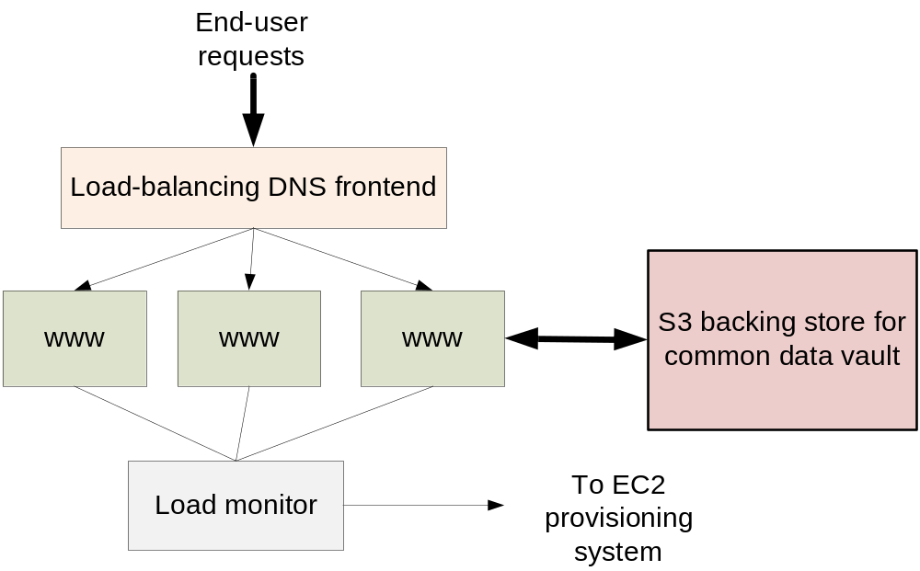
Self-Scaling Applications

Slide 33
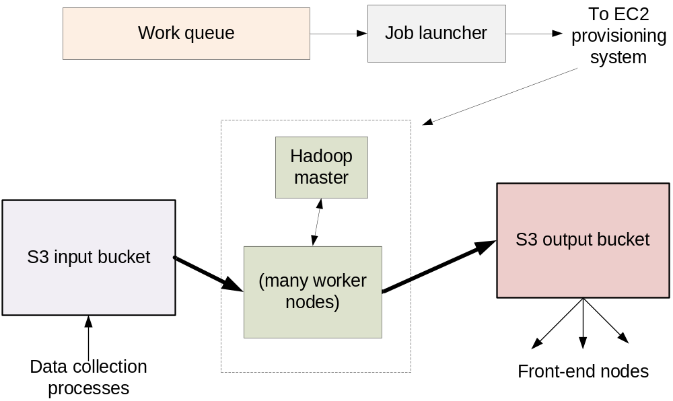
Self-Scaling Backends

Slide 34
GrepTheWeb
Large web crawl data is stored in S3
Users can submit regular expression to the GTW program
  GTW uses Hadoop to search for data
  Puts your results in an output bucket and notifies you when it’s ready

Slide 35
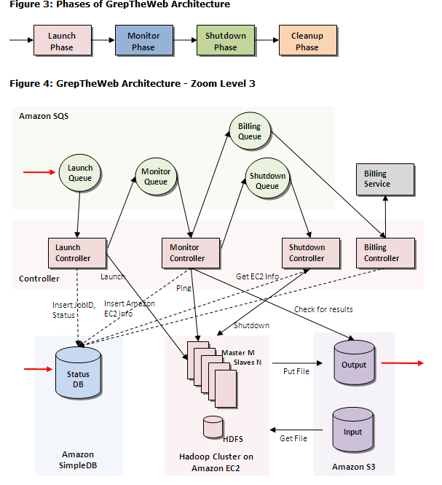

Slide 36
Conclusions
Web Services make for clean couplings between systems
Hardware as a Service (EC2/S3) allows applications to use physical resources dynamically
The two put together allow for very scalable application design

