Slide 1
Amazon Web Services
Maneesh mohanavilasam

Slide 2
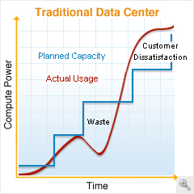
OLD IS GOLD?...NOT
Predicting peaks
Developing partnerships
Buying and maintaining hardware
Upgrading hardware
More time running a data center than developing a product

Slide 3
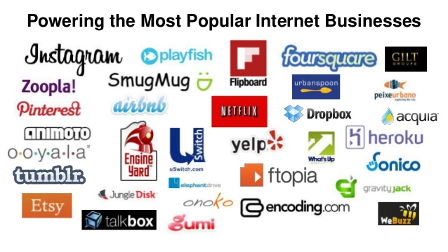

SO WHY AWS?
Secure
RELIABLE
In-expensive
ELASTIC
Completely Controlled
Flexible

Slide 4
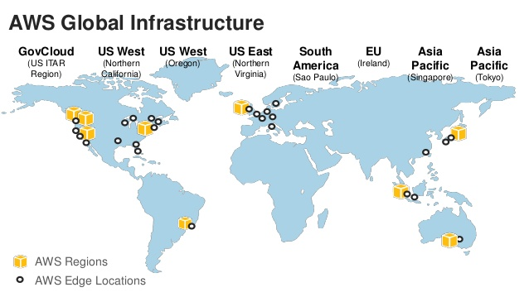
A STRONG BASE TO BULD ON
Global Infrastructure is divided into:
Regions
Availability Zones
Edge locations

Slide 5
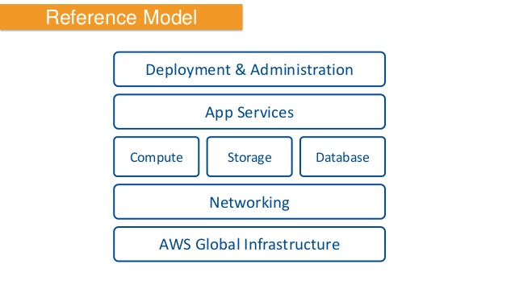
CONNECTIONS TO THE CLOUD
Direct Connect
VPN Connection
Virtual Private Cloud
Route 53

Slide 6
UNLIMITED COMPUTATIONAL POWER
Elastic Cloud Compute (EC2)
Reserved Instance
Spot Instance
Auto Scaling based on triggers
Elastic Load Balancing

Slide 7
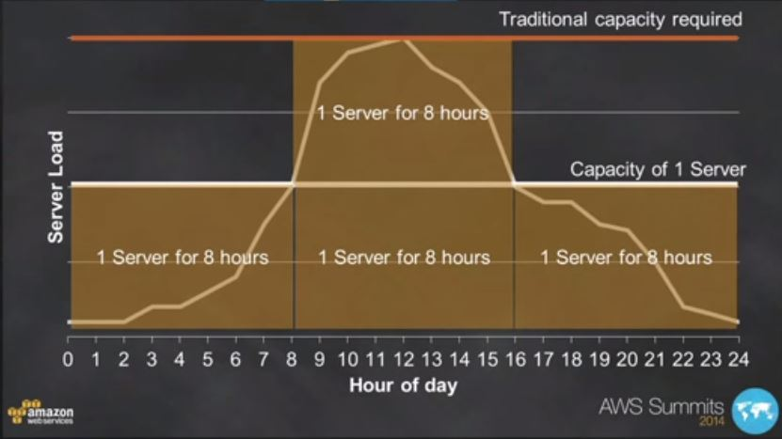
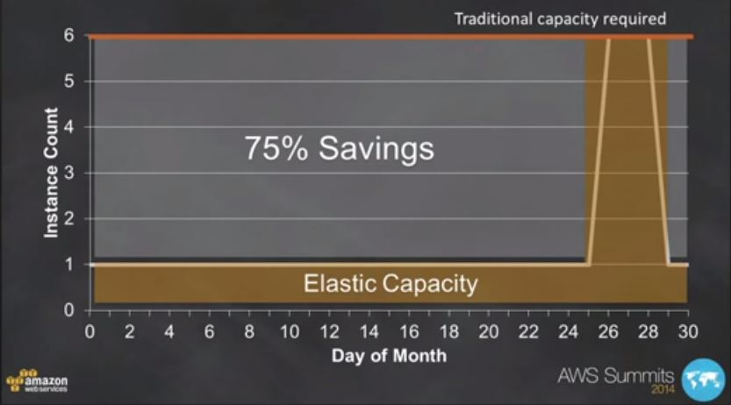
GRAPHS ARE SO COOL

Slide 8
A SAFE HAVEN FOR DATA
Simple Storage Service (S3)
Object Storage
Copies of data multiple times across multiple location
Complimented by Glacier that is used to archive data

Slide 9
DATAMANAGEMENT OUTSORCED
Relational databases like Oracle, SQL server…
Non relational databases- Dynamo DB is a NOSQL database..
all clustering and partitioning handled by amazon

Slide 10
AND THEN THERE WAS MORE
Simple Workflow
Reliably coordinate processing steps applications, connect AWS to Non AWS
Elastic MapReduce
Managed and elastic Hadoop.
Integrates with S3 and DynamoDB
Leverage Hive & Pig analytics scripts

Slide 11
Deployment & Administration
Elastic Bean Stalk
One click deployment from Eclipse, Visual Studio..
Rapid deployment of applications
All AWS resources automatically created

Slide 12

That’s all folks

