Slide 1
NNMF/NMF

Slide 2

Introduction
Matrix in mathematics and components
Basic matrix operations
Matrix Factorization
Finding 2 smaller matrices with k-dimensional features
P & Q are of n x k and m x k such that product approximates R

Slide 3
Factored Matrices
P
Features matrix
Row for feature, column for column in R
Q
weights matrix
Column for feature, row for row in R
Dot product, to find sum of latent features by weights for each element

Slide 4
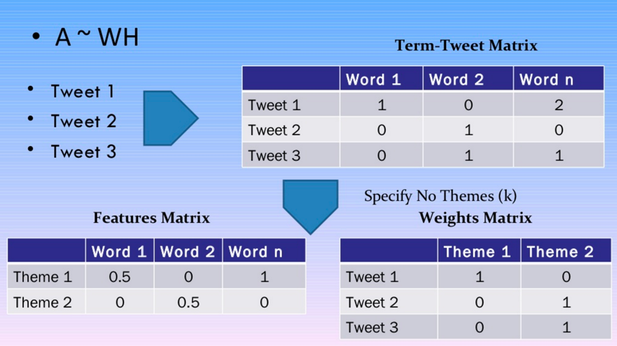

Slide 5
Non-negative
Returns non negative features and weights values
Clustering
Closely related to Supervised and Unsupervised, but closely to other clustering

Slide 6
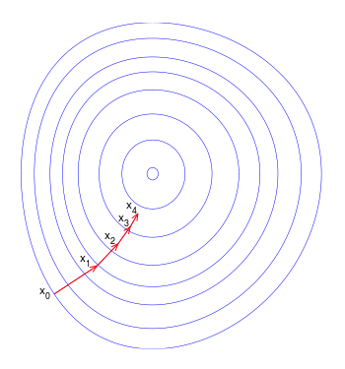
Gradient Descent
Attempts to minimize error
Calculate error using squared error(actual-predicted)²
Calculate gradient to figure out which direction to go to minimize error.
Repeat step till there is no more error

Slide 7
Algorithm
Initialize P & Q with random small numbers
loop until max_steps:
loop row, col in R:
If R[row][col] > 0:
Compute error of element
Compute gradient from error
Update P & Q with new entry
Compute total error
If error < threshold:
break
return P, Q^{T}

Slide 8

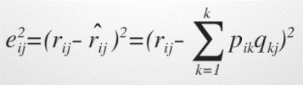
Computation
Compute predicted element(dot product of row & col in P & Q)
^{Compute squared error}
Find gradient by taking differential of error for each element
Update each element in P & Q using learning rate α. Α is usually small, because step size is too large, we can miss minimum.
Converge once sum of errors reaches threshold.

Slide 9
Useful
Ambiguous attributes or weak predictability
^{Text mining}
Image analysis and Computer Vision
^{Social Network}

Slide 10
LDA vs NNMF
Similarity | Difference
Both return documents that belong to topic and words belonging to topic | Differing mathematical underpinning
Take bag of words matrix as input | LDA is based on probabilistic graphical modeling while NMF is based on linear algebra

