Slide 1


“Clouds over Cloud Computing”

Slide 2

Afnan Pathan
Anuj Khasgiwala
Computer Science Engineering
Medi-Caps Institute of Technology and Management, Indore.

Slide 3

Introduction
What is Cloud Computing?
“ Efficient resource utilization”
“ Pay as you go”
“ Service != Product”
???? What does it Comprises ?????

Slide 4
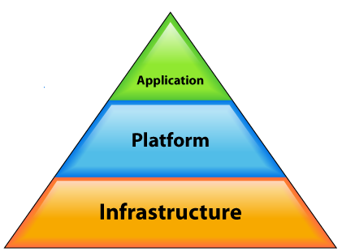





End Customers Developers System Admins

Slide 5
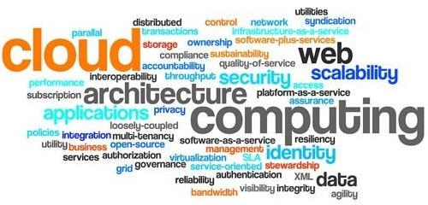
Benefits of Cloud Computing
Minimized Capital expenditure
Location and Device independence
Utilization and efficiency improvement
Very high Scalability
High Computing power
Notes:
Clouds over Cloud Computing

Slide 6

Purpose
Security concerns arising because both customer data and program are residing in Provider Premises.
Security is always a major concern in Open System Architectures
Notes:
Clouds over Cloud Computing

Slide 7
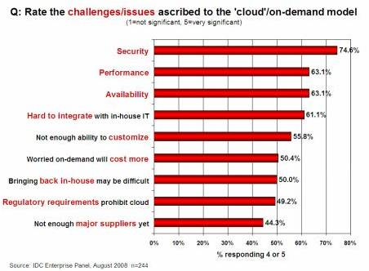

Slide 8
Dangers
Disrupts Services.
Theft of Information.
Loss of Privacy.
Damage information.
Vulnerabilities
Hostile Program.
Hostile people giving instructions to good programs.
Bad guys corrupting or eavesdropping on communications

Slide 9
Scope
Common Security Requirements
Confidentiality
Integrity
Availability
Notes:
Confidentiality:
Ensuring that information is not disclosed to unauthorized person.
Integrity:
Ensure that information hold by system is proper representation of information intended and has not been modified by unauthorized person.
Availability:
Ensuring that information processing resources are not made unavailable by malicious actions.
Clouds over Cloud Computing

Slide 10
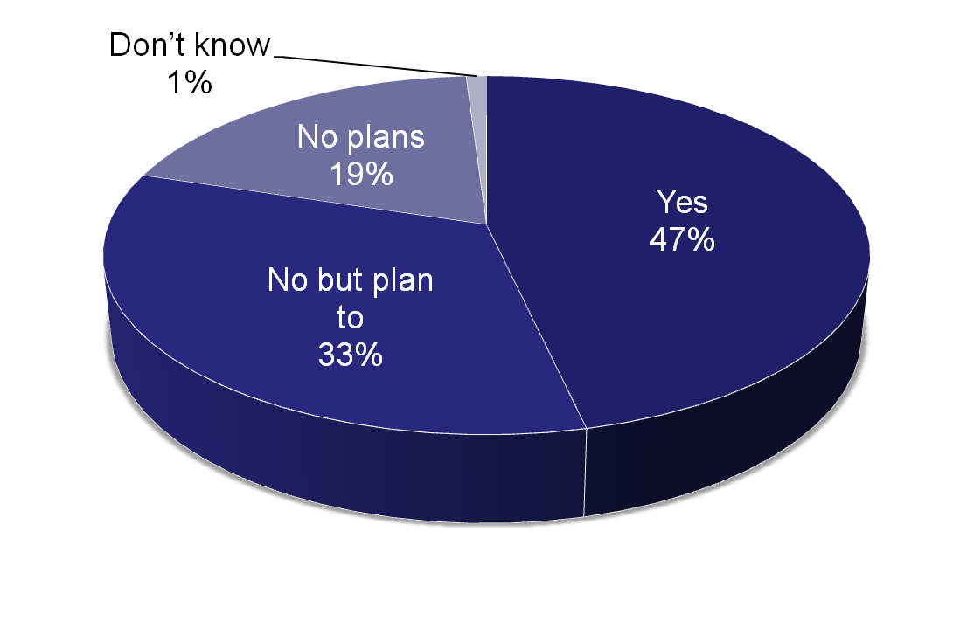
Reality
Organizations running applications in production on virtual infrastructure:
Enterprise Strategy Group, 2010 (N = 365 companies)

Slide 11
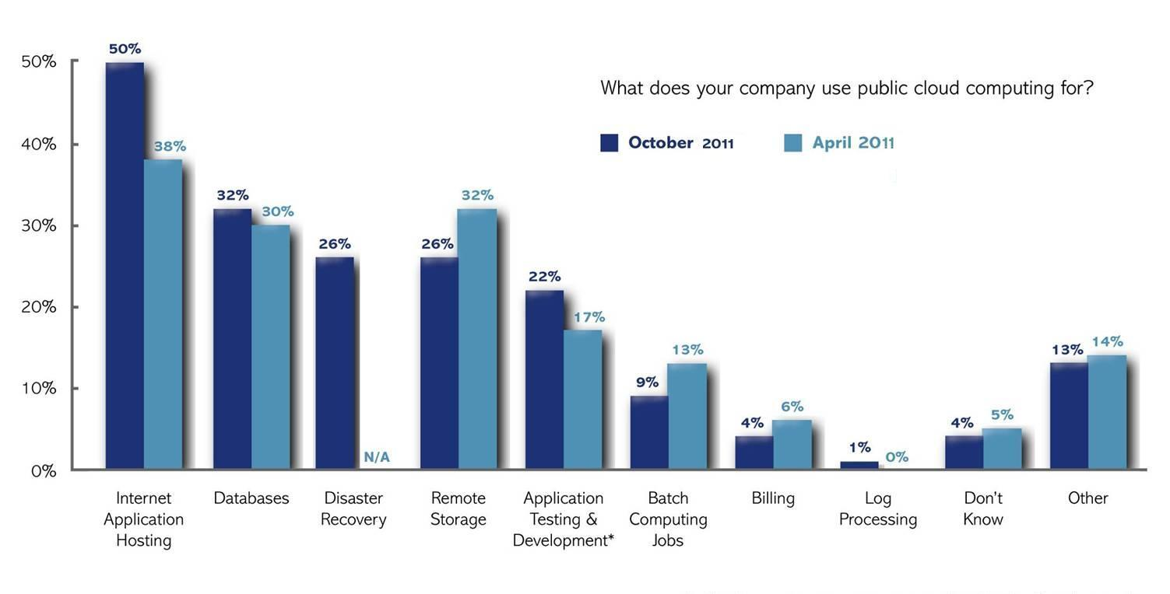

Slide 12
Hardware Specification
3 Computers with following configuration:
1G RAM
40 MB disk space
Notes:
CloudSim goal is to provide a generalized and extensible simulation framework that enables modeling, simulation, and experimentation of emerging Cloud computing infrastructures and application services, allowing its users to focus on specific system design issues that they want to investigate, without getting concerned about the low level details related to Cloud-based infrastructures and services.
support for modeling and simulation of large scale Cloud computing data centers
support for modeling and simulation of virtualized server hosts, with customizable policies for provisioning host resources to virtual machines
support for modeling and simulation of energy-aware computational resources
support for modeling and simulation of federated clouds
support for dynamic insertion of simulation elements, stop and resume of simulation
Eucalyptus is a software platform for the implementation of private cloud computing on computer clusters. There is an open-core enterprise edition and an open-source edition.
Eucalyptus implements IaaS (Infrastructure as a Service) style private and hybrid clouds.
Clouds over Cloud Computing

Slide 13
Software Specification
Aneka 2.0
. Net Framework 2.5+
Net Beans 6.0 +
Apache Tomacat Web Server
Notes:
CloudSim goal is to provide a generalized and extensible simulation framework that enables modeling, simulation, and experimentation of emerging Cloud computing infrastructures and application services, allowing its users to focus on specific system design issues that they want to investigate, without getting concerned about the low level details related to Cloud-based infrastructures and services.
support for modeling and simulation of large scale Cloud computing data centers
support for modeling and simulation of virtualized server hosts, with customizable policies for provisioning host resources to virtual machines
support for modeling and simulation of energy-aware computational resources
support for modeling and simulation of federated clouds
support for dynamic insertion of simulation elements, stop and resume of simulation
Eucalyptus is a software platform for the implementation of private cloud computing on computer clusters. There is an open-core enterprise edition and an open-source edition.
Eucalyptus implements IaaS (Infrastructure as a Service) style private and hybrid clouds.
Clouds over Cloud Computing

Slide 14
Issue
Security Issues
Cloud Providers
Customers

Slide 15
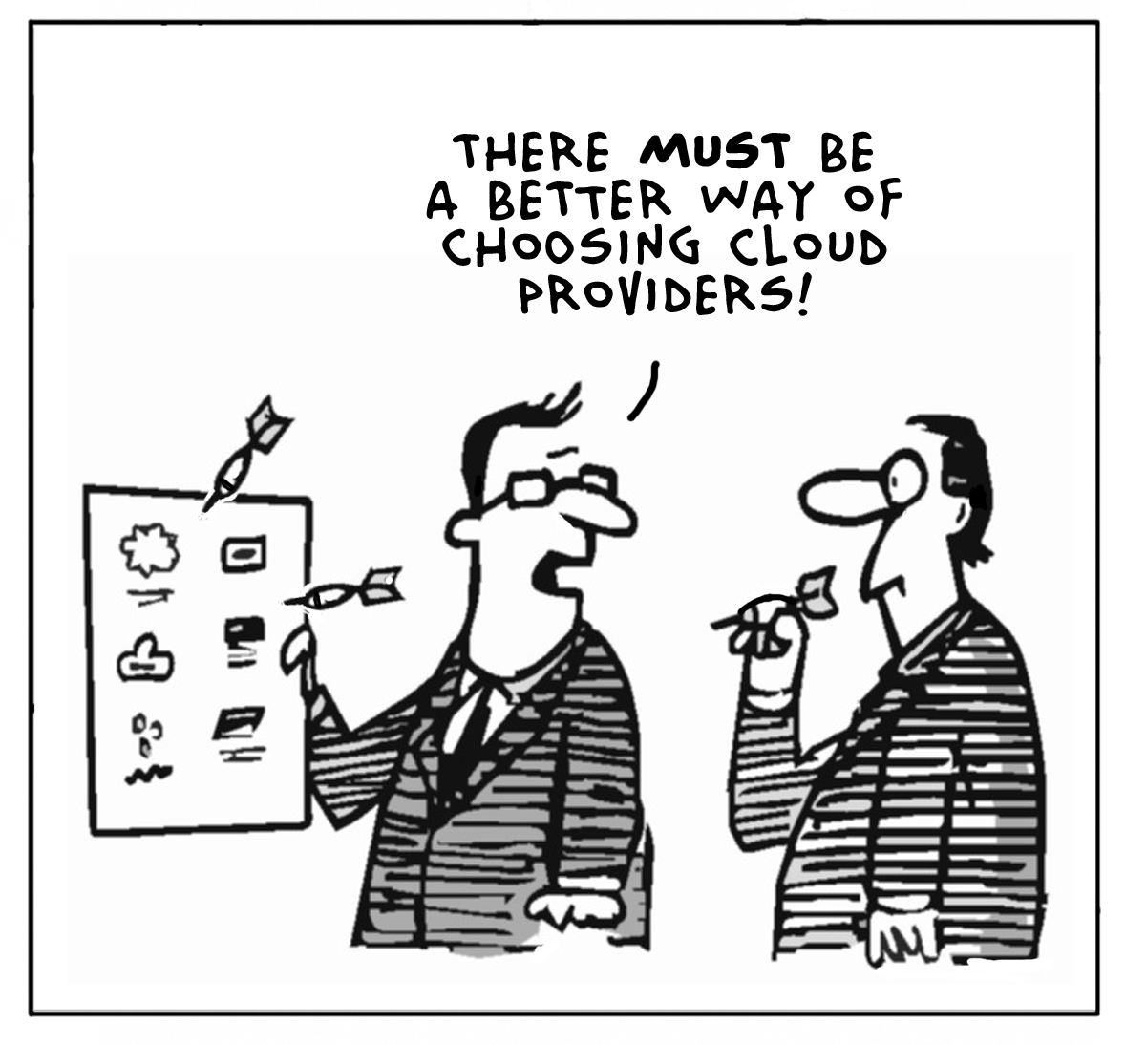

Slide 16
Customer Aspects
1. Privileged user access
2. Regulatory compliance : vendor is → external audits and security certifications
3. Data location
Data segregation: make sure that encryption is available at all stages
Recovery
Investigative Support: inquire whether a vendor has the ability to investigate any inappropriate or illegal activity
Long-term viability:

Slide 17
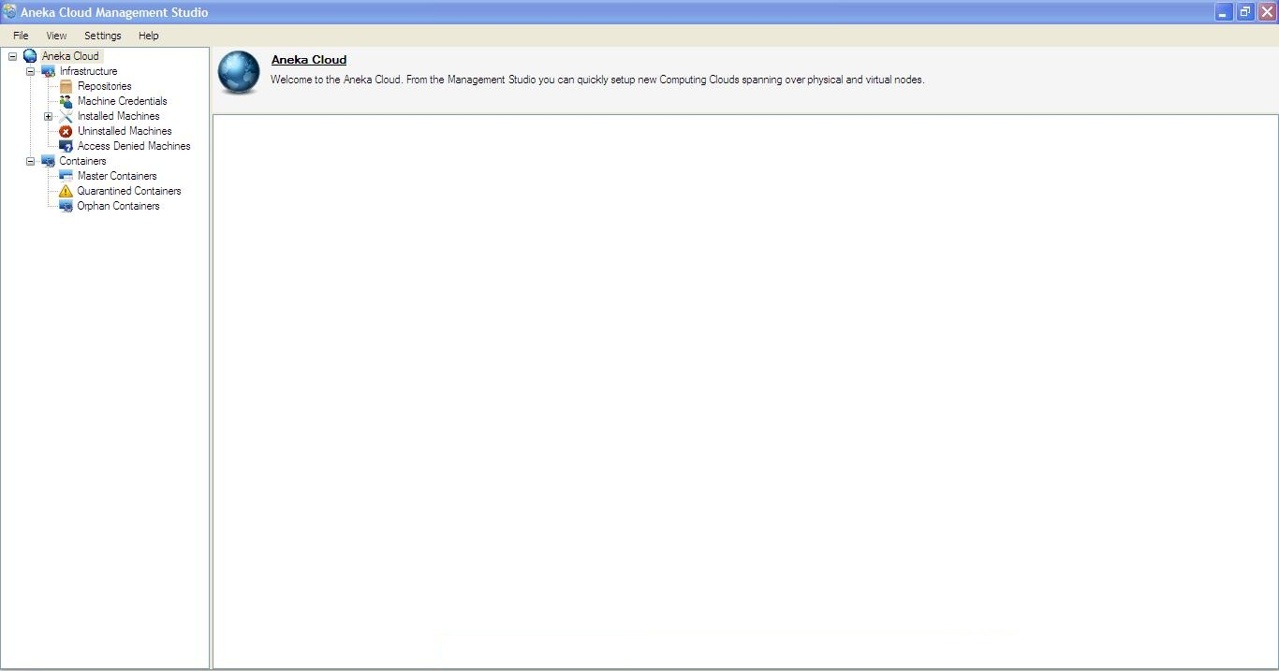

Slide 18
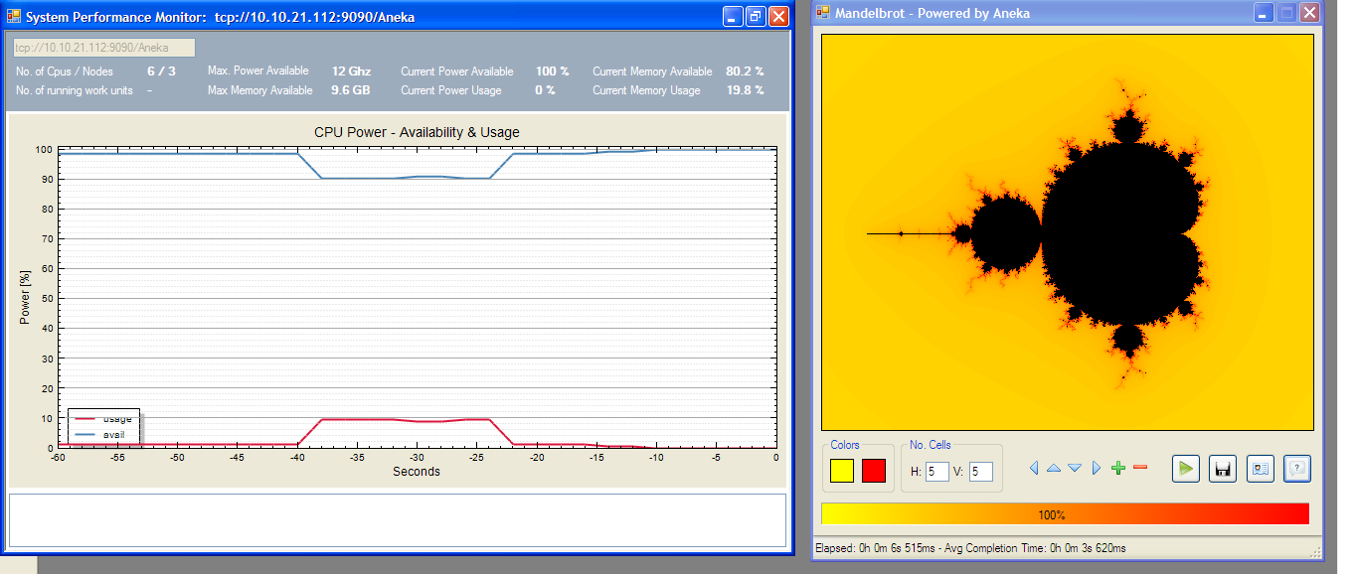

Slide 19
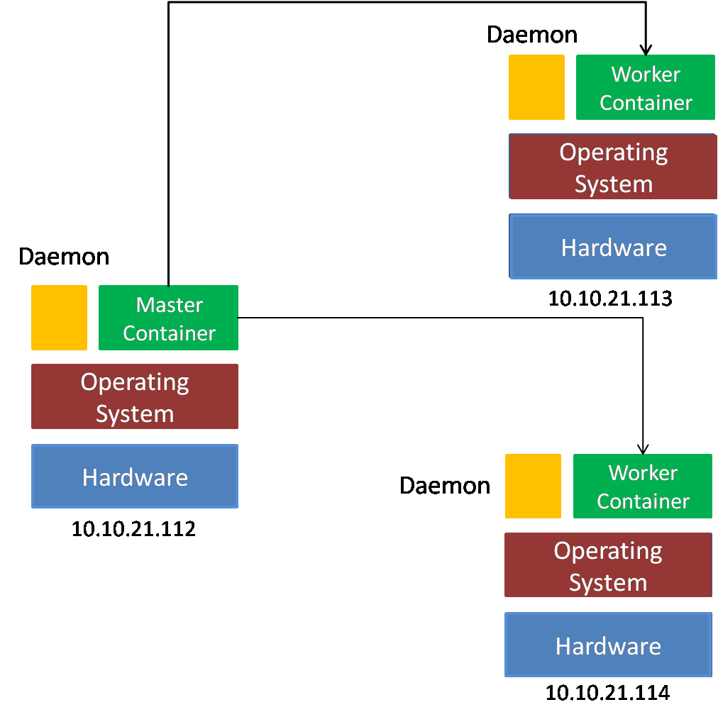
Architecture

Slide 20
Performance Results
No of CPU/Nodes: 6/3
Max. Available Power: 12 Ghz
Max memory available: 9.6 GB
Max Storage: 894.27 GB
 | Power Available(%) | Power Usage(%)
1 application | 85.7 | 14.3
2 applications | 80.3 | 19.7
3 applications | 74 | 26

Slide 21
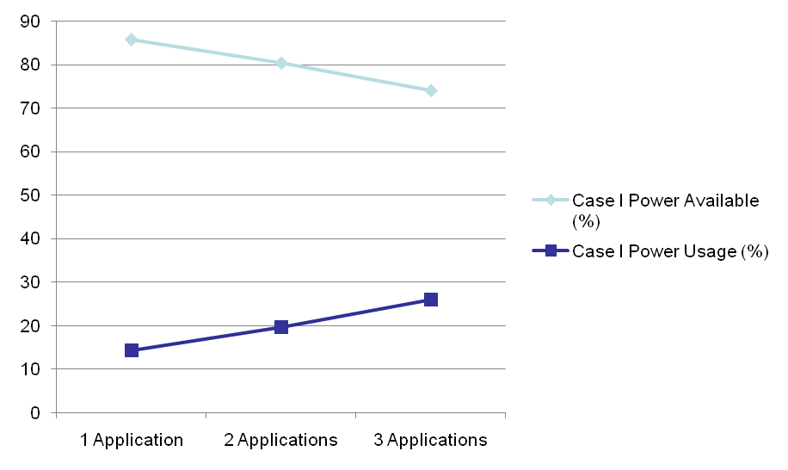
Performance Results
No of CPU/Nodes: 6/3
Max. Available Power: 12 Ghz
Max memory available: 9.6 GB
Max Storage: 894.27 GB

Slide 22
Performance Results
No of CPU/Nodes: 4/2
Max. Available Power: 8 Ghz
Max memory available: 6.4 GB
Max Storage: 596.18 GB
 | Power Available(%) | Power Usage(%)
1 application | 83.3 | 16.7
2 applications | 79.6 | 20.4
3 applications | 71.4 | 28.6

Slide 23
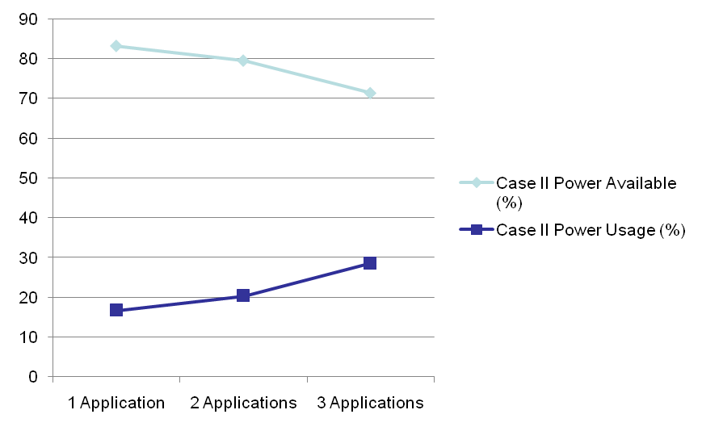
Performance Results
No of CPU/Nodes: 4/2
Max. Available Power: 8 Ghz
Max memory available: 6.4 GB
Max Storage: 596.18 GB

Slide 24
Performance Results
No of CPU/Nodes: 2/1
Max. Available Power: 4 Ghz
Max memory available: 3.2 GB
Max Storage: 298 GB
 | Power Available(%) | Power Usage(%)
1 application | 82.2 | 17.8
2 applications | 79.3 | 20.7
3 applications | 70.5 | 20.7

Slide 25
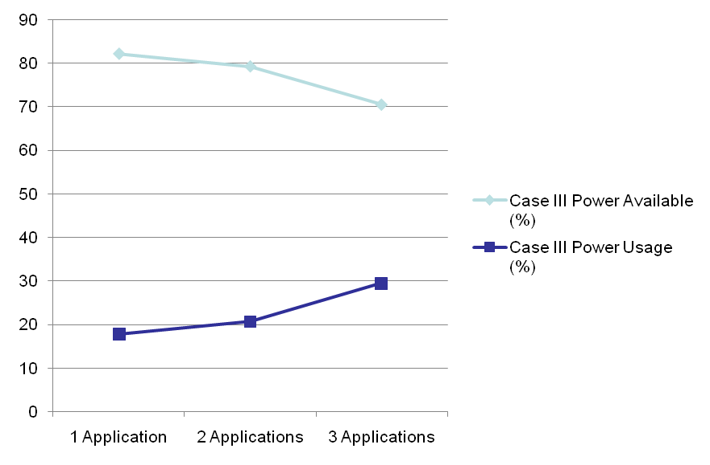
Performance Results
No of CPU/Nodes: 2/1
Max. Available Power: 4 Ghz
Max memory available: 3.2 GB
Max Storage: 298 GB

Slide 26

A proposed Solution
Multiple Encryption
CryptoSteg= Encryption + Stegnography
Combination of Keys
Protocol

Slide 27
A proposed Solution
Ceaser Cipher
x:=character read from the file
n:=is the number by which character is shifted
t:=times encryotion takes place
//Encryption
for(int i=1;i<=t;i++) {
if (character is in alphabet)
E(x)=x+n mod 26
else if(character is a number)
E(x)=x+n mod 10
else if(special character)
E(x)=x
}
Time Complexity: t+3

Slide 28
A proposed Solution
//Drecryption
for(int i=1;i<=t;i++) {
if (character is in alphabet)
D(x)=x-n mod 26
else if(character is a number)
D(x)=x-n mod 10
else if(special character)
D(x)=x
}
Time Complexity: t+3

Slide 29
Future Scope
As the development of Cloud Computing is increasing, security has became a top priority.

Slide 30
References
Research Papers
[1] Introduction to Cloud Computing ThinkGrid
[2] Traian Andrei, Cloud Computing Challenges and Related Security Issues
[3] Wayne Jansen, Timothy Grance, Security and Privacy in Public Cloud Computing
Websites
[1] www.manjrasoft.com
[2] http://blogs.zdnet.com/Hinchcliffe
[3] http://en.wikipedia.org/wiki/Cloud_computing_security
[4] https://wiki.cloudsecurityalliance.org/guidance/index.php/Cloud_Computing_Architectural_Framework
[5] http://cloudsecurity.org/resources.html

Slide 31
Queries

Slide 32
Thank You

