Slide 1
Gender, Accent & Age Recognizer From Audio
By:
Anuj Khasgiwala, Bhagyashree Mandora

Slide 2
Problem Statement
In this project, we are creating an intelligent tool which would be able to predict characteristics of a person so that appropriate business decisions can be made using voice. We are focusing on gender, accent and age characteristics. This can be achieved by processing the sound waves from the wav file.

Slide 3
Tools
Toolkit
Pandas, NumPy – These python libraries are used for data handling and processing
PyAudioAnalysis, SciPy, SciPy.io.wavfile – These python libraries is used to process the sound files given as an input.
Method:
SVM, Random Forest, XGBoost - for getting preliminary results for predicting gender

Slide 4
Progress
Successful prediction of gender using the available training data set
Extraction of MFCC from sound file.
Notes:
MFCC - Mel Frequency Cepstral Coefficients form a cepstral representation where the frequency bands are not linear but distributed according to the mel-scale. This value is used for calculating different frequencies which are used for predictions.

Slide 5
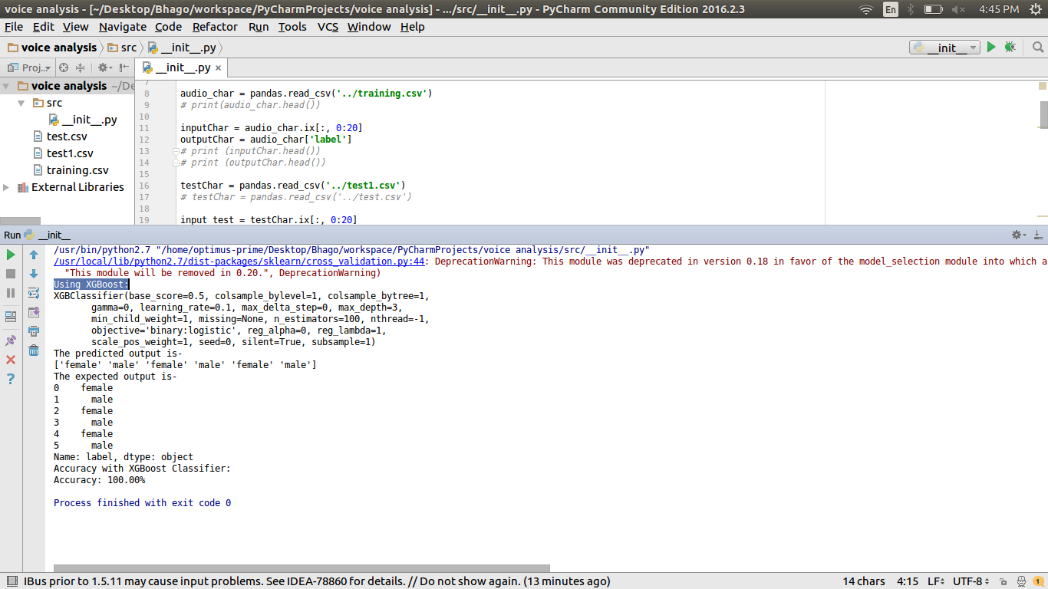
Progress contd.
Notes:
MFCC - Mel Frequency Cepstral Coefficients form a cepstral representation where the frequency bands are not linear but distributed according to the mel-scale. This value is used for calculating different frequencies which are used for predictions.

Slide 6
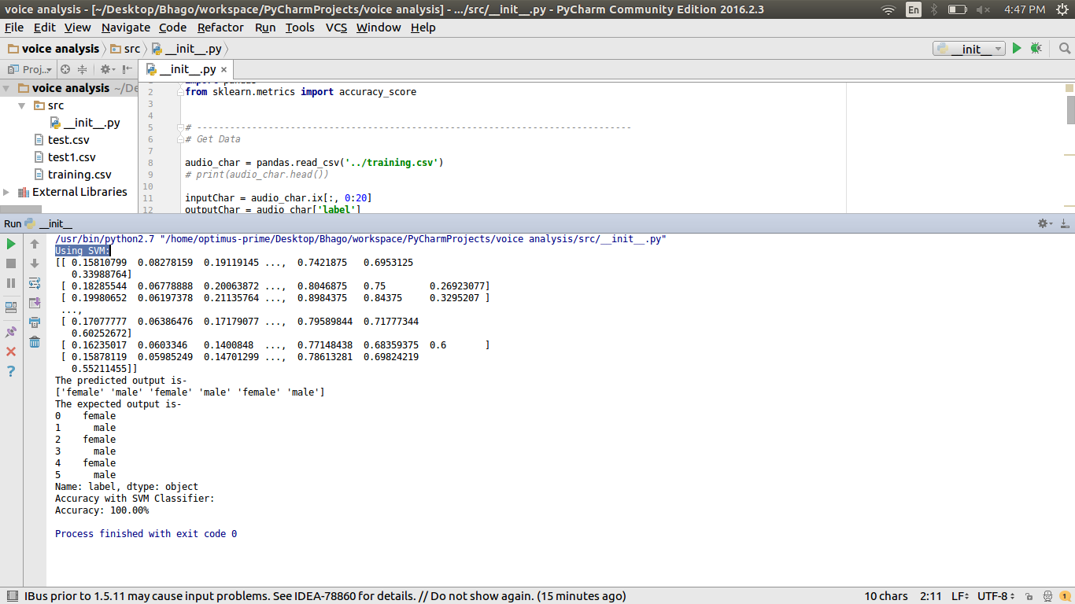
Progress contd.
Notes:
MFCC - Mel Frequency Cepstral Coefficients form a cepstral representation where the frequency bands are not linear but distributed according to the mel-scale. This value is used for calculating different frequencies which are used for predictions.

Slide 7
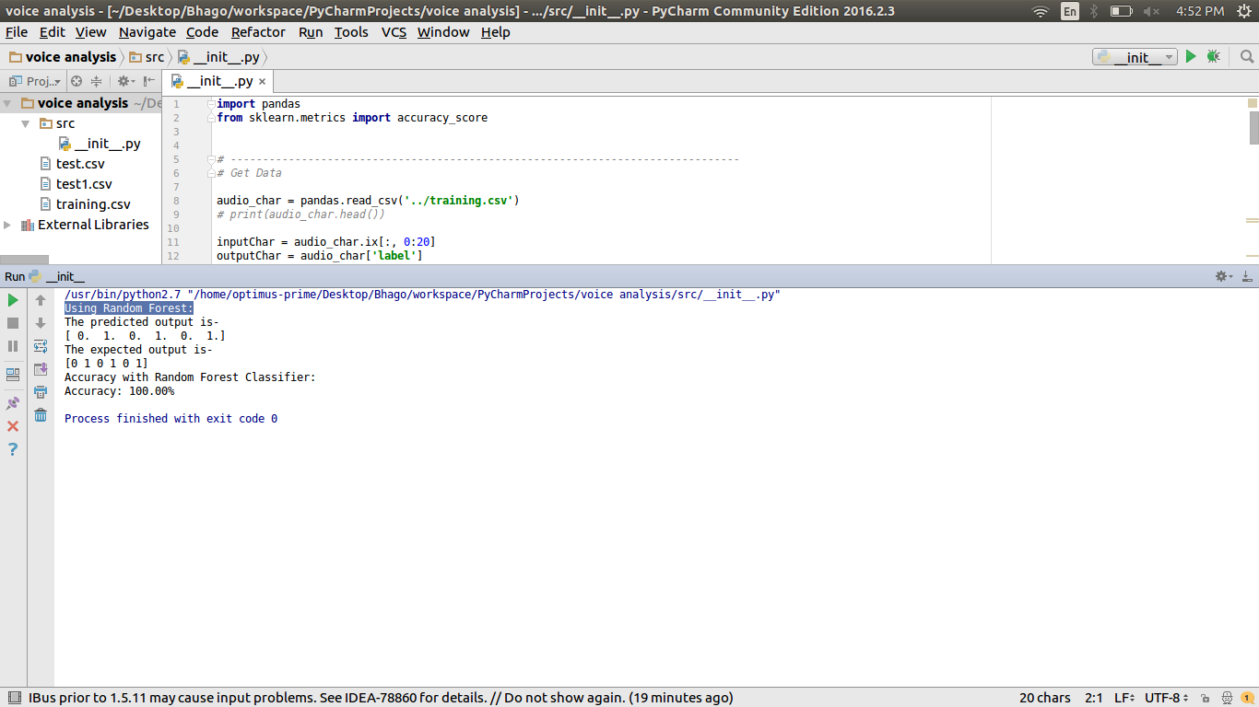
Progress contd.
Notes:
MFCC - Mel Frequency Cepstral Coefficients form a cepstral representation where the frequency bands are not linear but distributed according to the mel-scale. This value is used for calculating different frequencies which are used for predictions.

Slide 8
Plans for next two weeks
Retrieve frequencies from MFCC
Research for finding ways to identify accent from frequencies
Scrape training and test data for Accent Recognition
Integrate accent and gender recognition model

Slide 9
Future plans
Research for finding ways to identify age from frequencies
Decide number of age group classes to classify training/test data
Scrape training and test data for Age Recognition
Integrate age recognition into existing model

Slide 10
Thank You

