Slide 1
Eflex Hackathon
2024

Slide 2
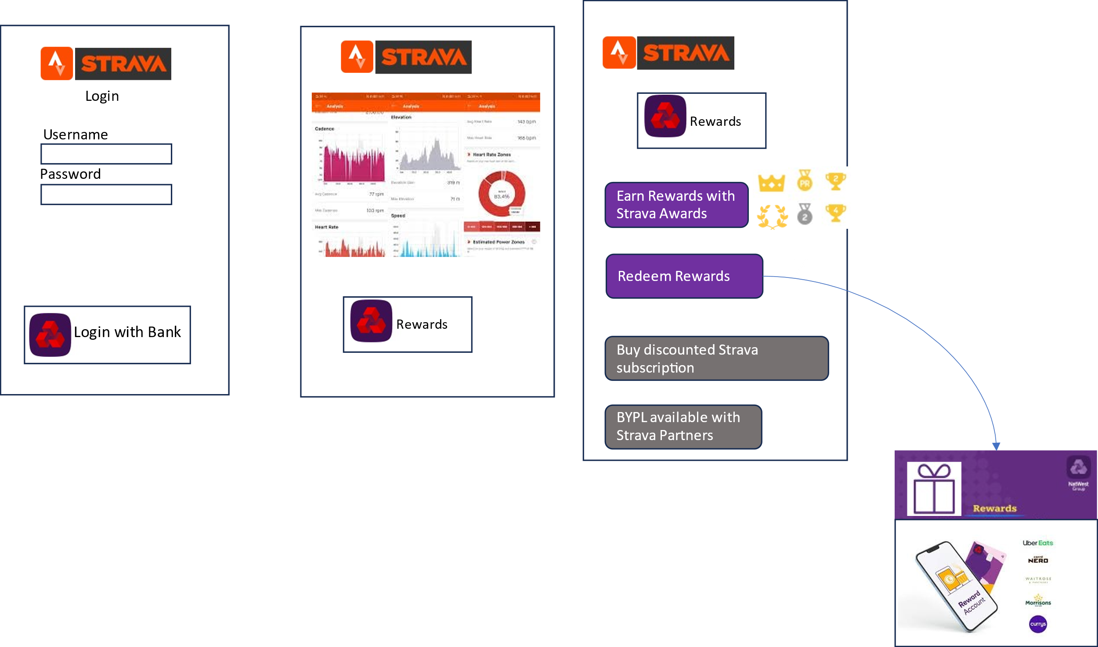
Initial Prototype

Slide 3
NatFit APIs Spec
Consumer API
CustomerIdentityCheck(AccessToken string)
Returns CustomerId
Get customer details
<<FUTURE API>>
PRODUCER API
EarnNWRewards (CustomerId number, AthleteId number, FitnessPoints number, clientId string)
returns RewardPoints number
1. Calculate Rewards- FitnessPoints(10) * NWRewardRate(0.10) -> NWReward(GBP 1)
2. Save NW Rewards for customer

Slide 4
NW API Spec
NW API:
Customer Discovery (Optional)
Customer Identity Check
{
"data": {
"id": "dfacca12375936129385823213addf",
"name": {
"title": "miss",
"given_name": "Jane",
"family_name": "Doe",
"middle_names": "Diane Lily",
"salutation": "Miss Doe",
"full_name": "Miss Jane Diane Lily Doe"
}
}
}
{ "given_name": "John", "family_name": "Smith", "birthdate": "2024-07-26" }
{ "data": { "match_status": "Match Pending" } }

Slide 5
API flow
Existing Natwest customer
Login with Online Banking
Call Customer Identity API
EarnNatwest RewardsAPI
Future Rewards API
Existing Bank API
Success
Fitness API

Slide 6
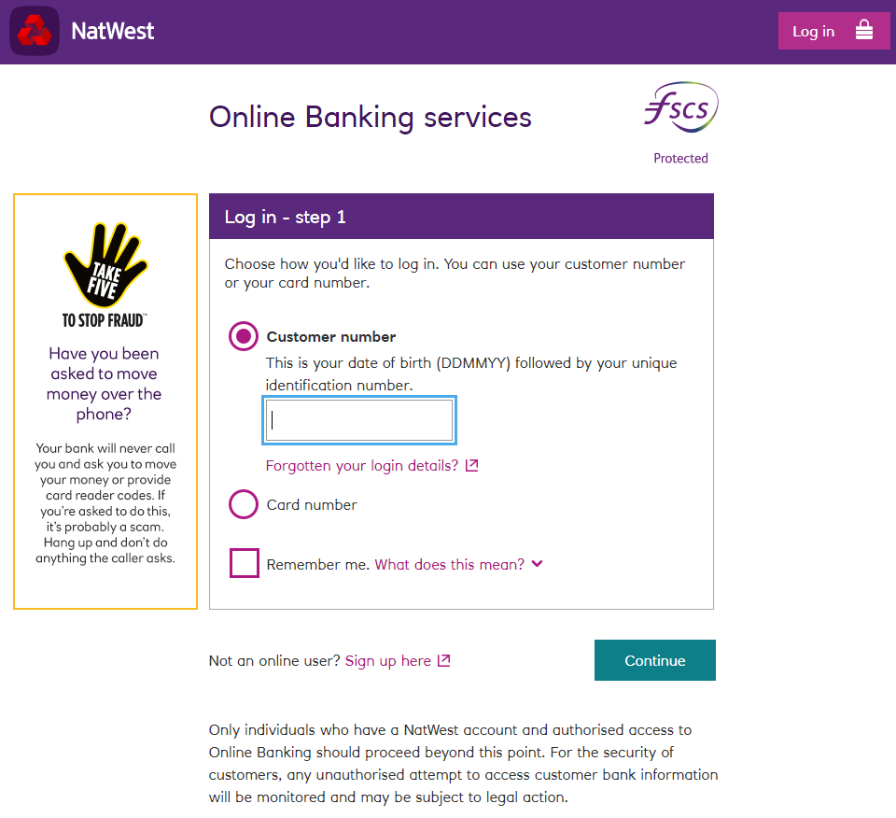
Login UI (reference)

