Slide 1

AIL723/ELL888 – Lecture 00X
Graph Machine Learning​
GRAPH LAPLACIAN: SPECTRAL ANALYIS​
January AB, 2024

Slide 2
OVERVIEW
Graph Laplacian: Spectral Analysis
Fidler vector analysis
Eigenvector of Graph Laplacian: Spectral Graph Theory
Application of Spectral Graph Theory
Spectral Embeddings
Graph Partitioning : Ratio cut Normalized Cut
Spectral Clustering
2

Slide 3
Recap
3

Slide 4
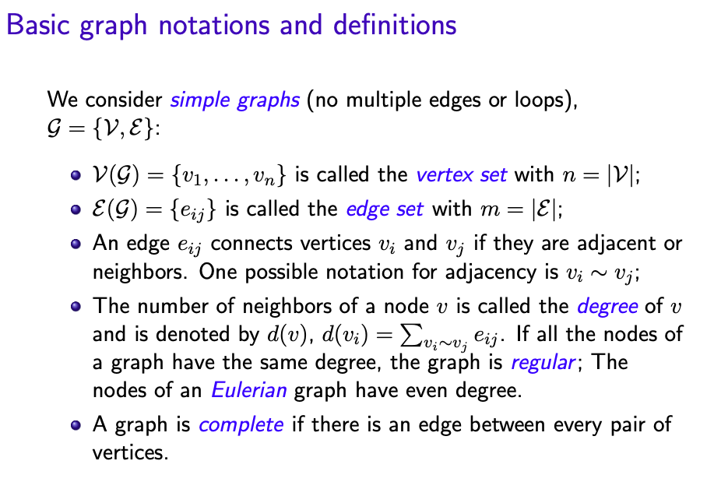

Slide 5
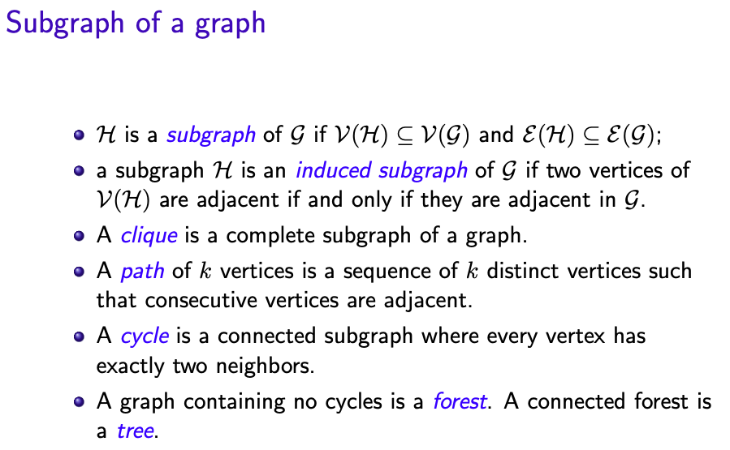

Slide 6
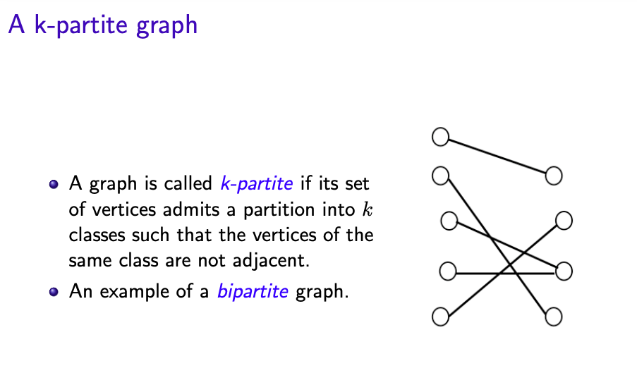

Slide 7
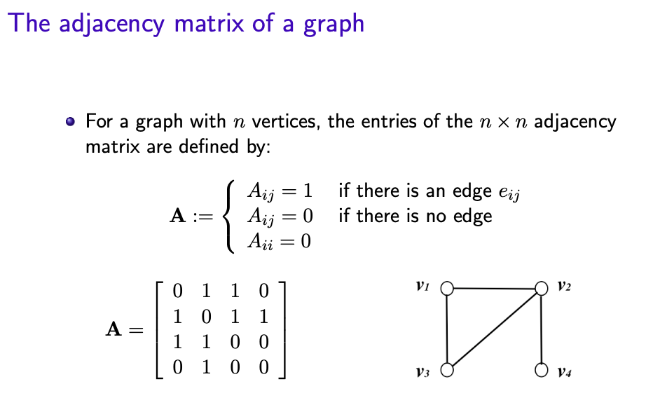

Slide 8
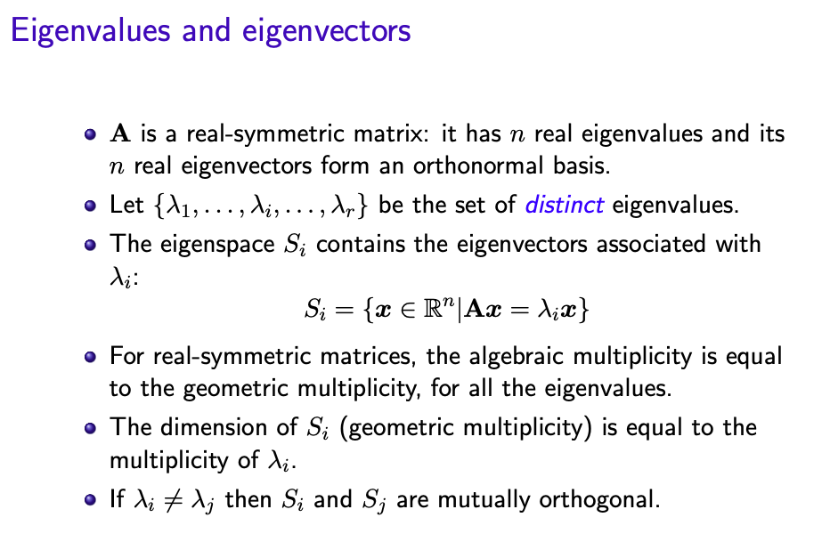

Slide 9
The Laplacian matrix of a graph
9

Slide 10
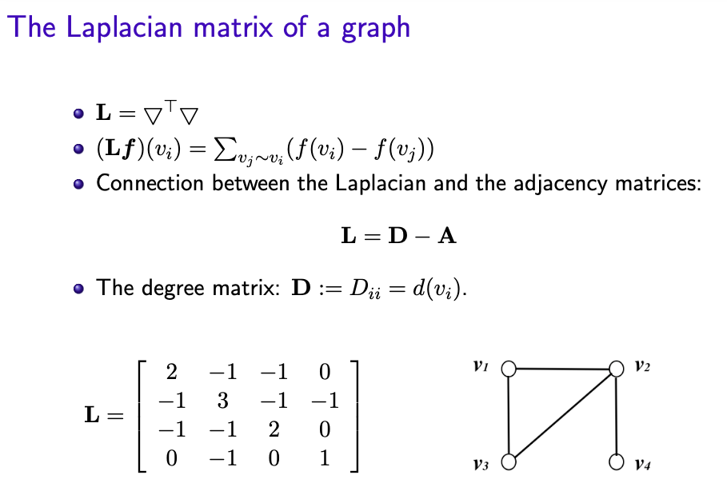

Slide 11
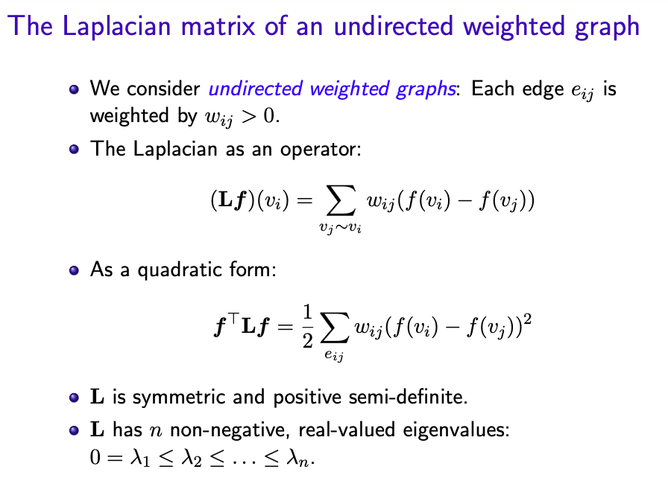

Slide 12
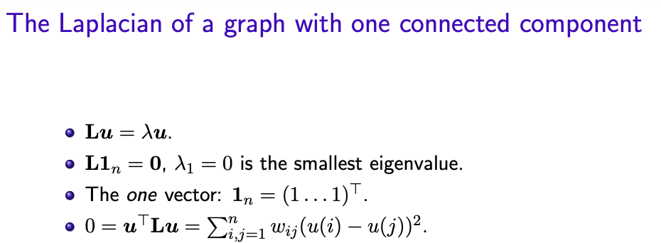
If any two vertices are connected by a path, then u = (u(1), . . . , u(n)) needs to be constant at all vertices such that the quadratic form vanishes. Therefore, a graph with one connected component has the constant vector u₁ = 1_{n} as the only eigenvector with eigenvalue 0.

Slide 13
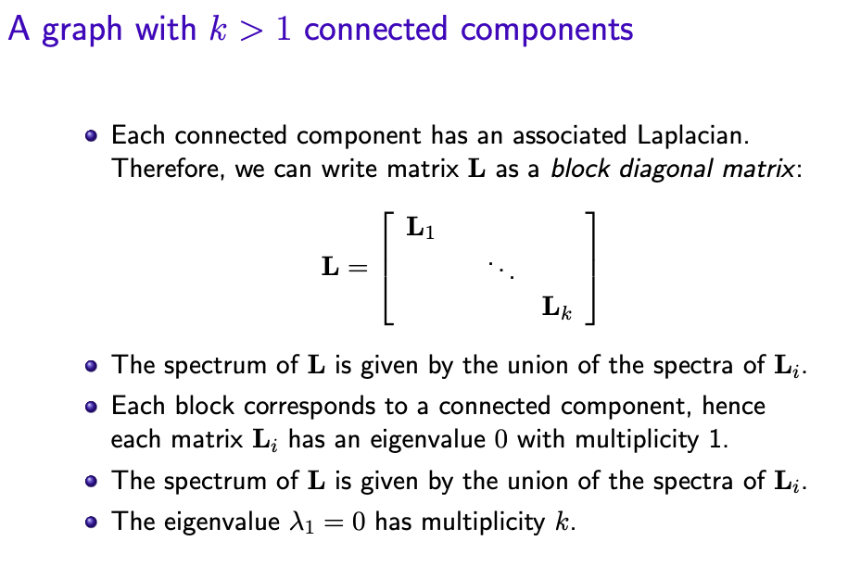

Slide 14
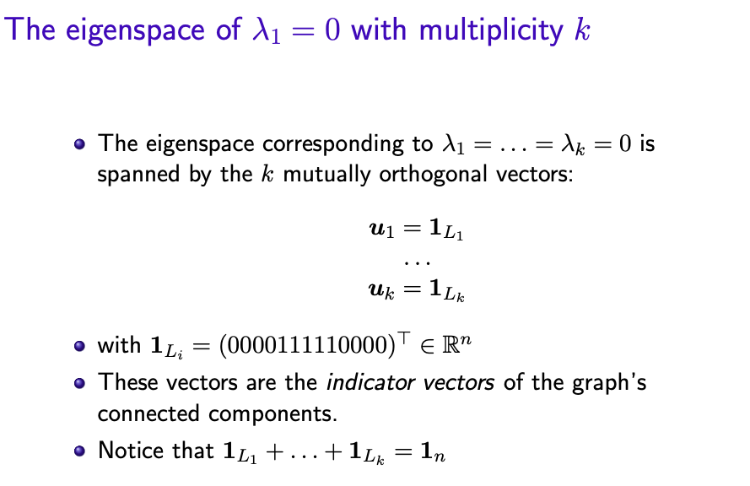

Slide 15
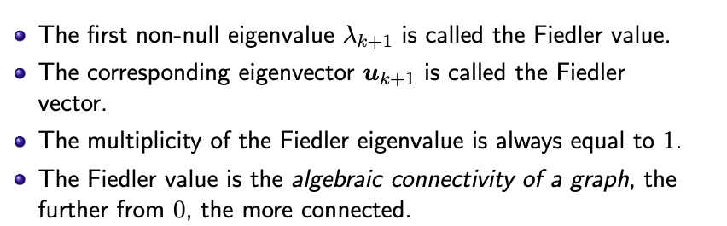
The Fiedler vector of the graph Laplacian

Slide 16
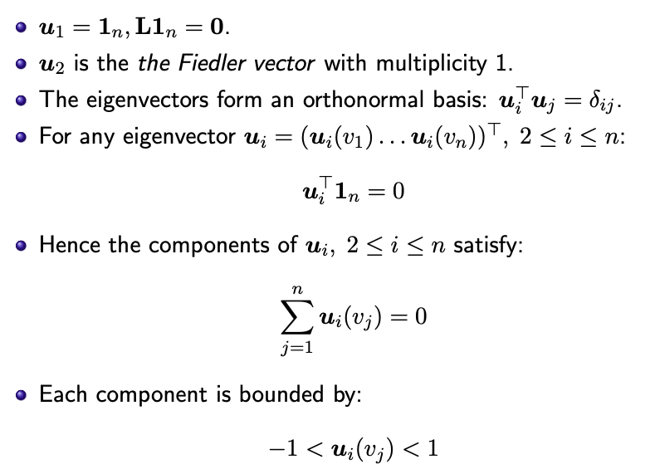
Eigenvectors of the Laplacian of connected graphs

Slide 17
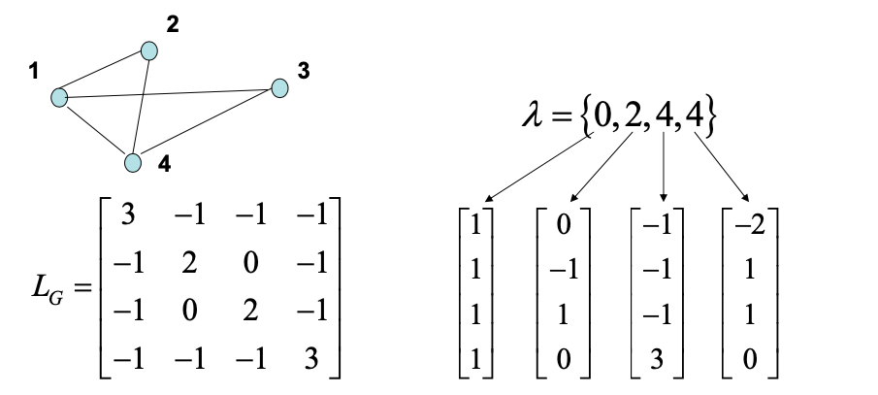
Examples: Properties of the Laplacian Matrix
Symmetric real eigenvalues; eigenspaces are mutually orthogonal
Orthogonally diagonalizable an eigenvalue with multiplicity k has k-dimensional eigenspace

Slide 18
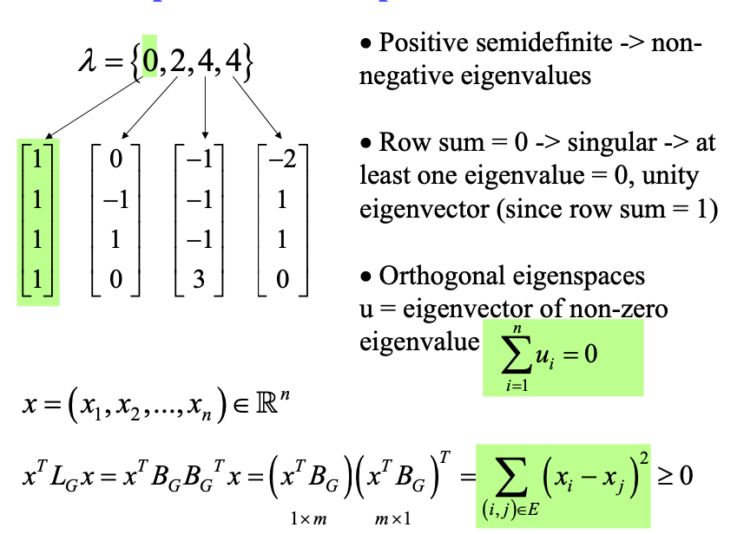
Examples: Properties of the Laplacian Matrix (cont.)

Slide 19
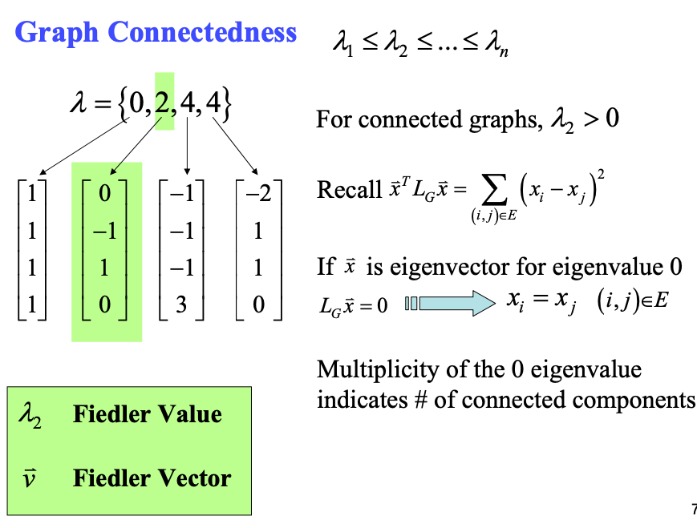
Examples: Properties of the Laplacian Matrix (cont.)

Slide 20
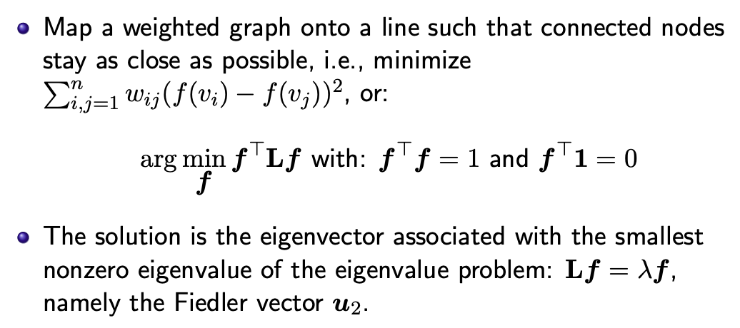
Application of Spectral Graph Theory: Laplacian Embedding
Mapping a graph on a line

Slide 21
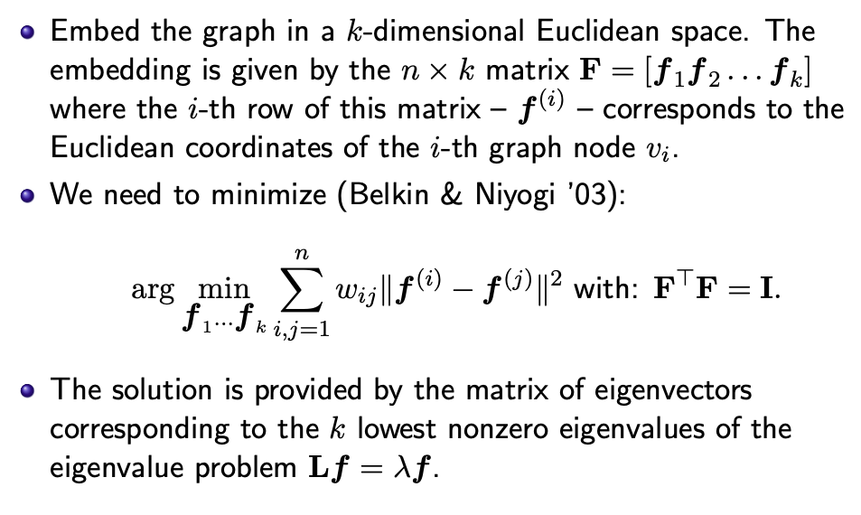
Application of Spectral Graph Theory: Laplacian Embedding
Mapping a graph in R^{k}

Slide 22
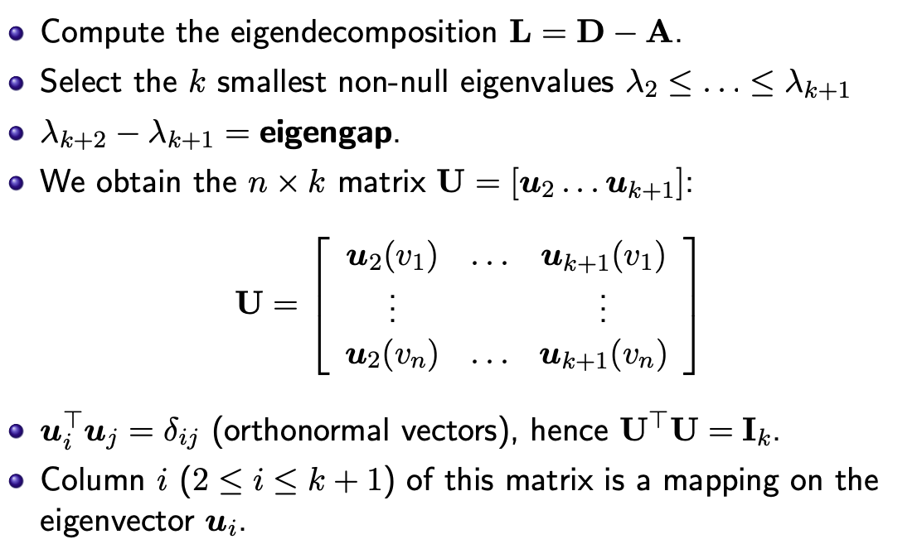
Application of Spectral Graph Theory: Spectral Embedding
Using the Unnormalized Laplacian

Slide 23
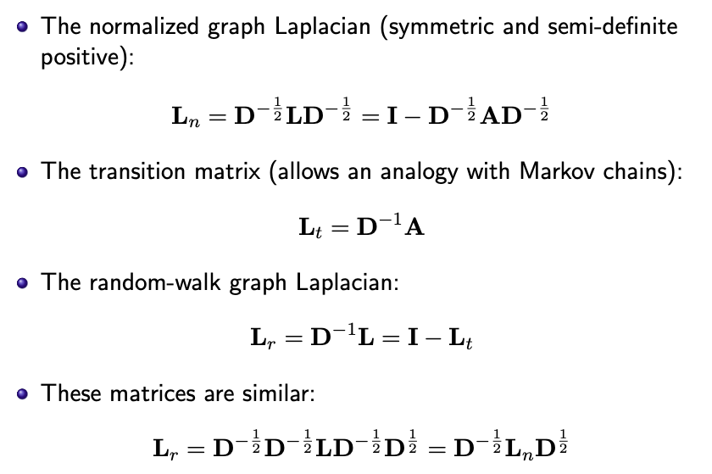
Normalized and Random Walk Laplacian Matrices

Slide 24
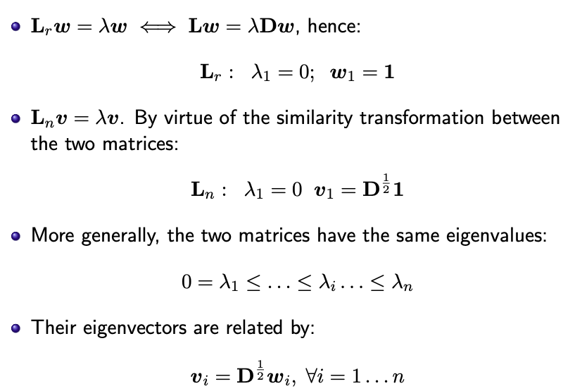
Eigen-spectrum of Normalized and Random Walk Laplacian Matrices

Slide 25
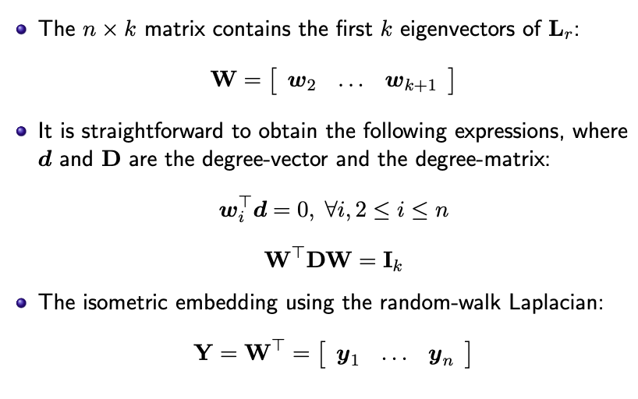
Spectral embedding using the random-walk Laplacian

Slide 26
Summary

Slide 27
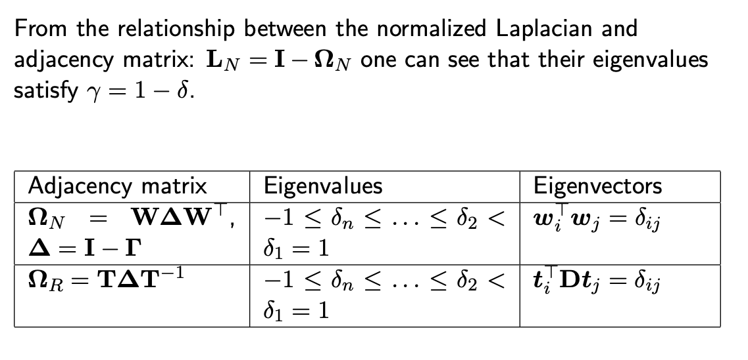
Spectral properties of Adjacency Matrices

Slide 28
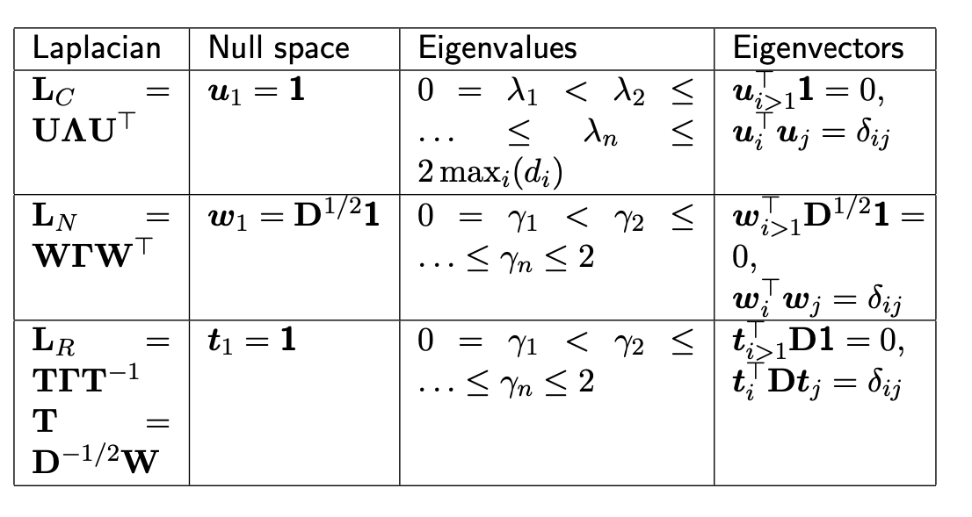
Spectral properties of the Laplacians

Slide 29
Spectral Clustering
U. von Luxburg. A Tutorial on Spectral Clustering. Statistics and Computing, 17(4), 395–416 (2007).

Slide 30
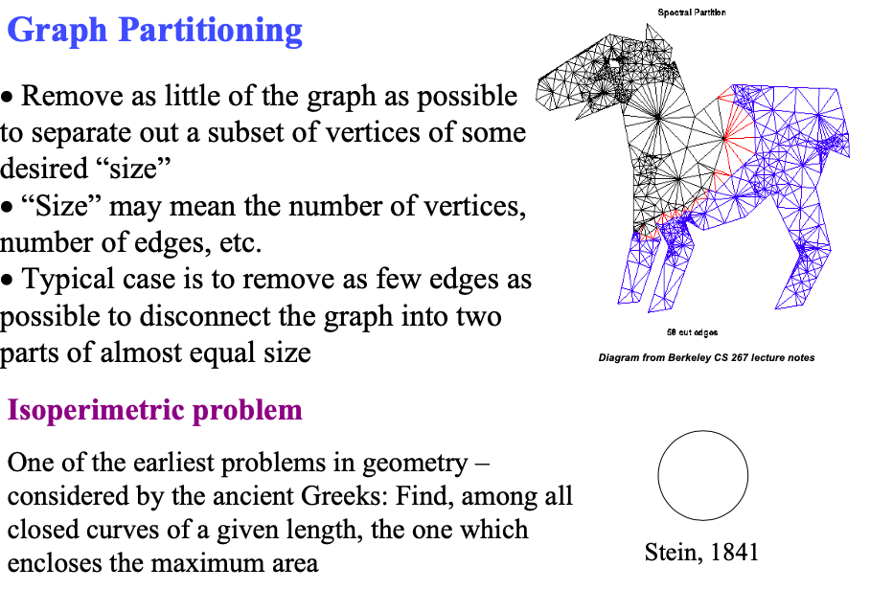
Application of Spectral Graph Theory: Graph Partitioning

Slide 31
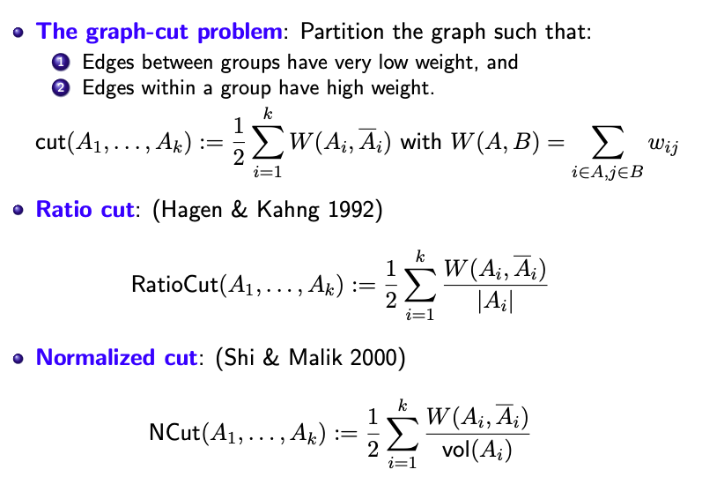
The graph partitioning problem
NP-hard problems

Slide 32
Spectral Clustering/Partitioning
Spectral clustering is a way to solve relaxed versions of these problems:
The smallest non-null eigenvectors of the unnormalized Laplacian approximate the RatioCut minimization criterion.
The smallest non-null eigenvectors of the random-walk Laplacian approximate the NCut criterion.

Slide 33
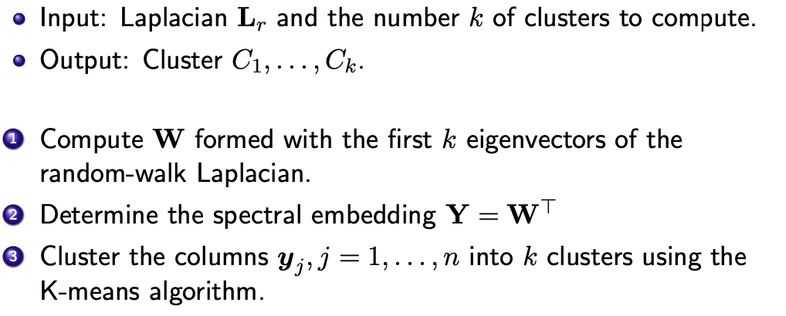
Spectral clustering using the random-walk Laplacian
For details see (von Luxburg ’07)

Slide 34
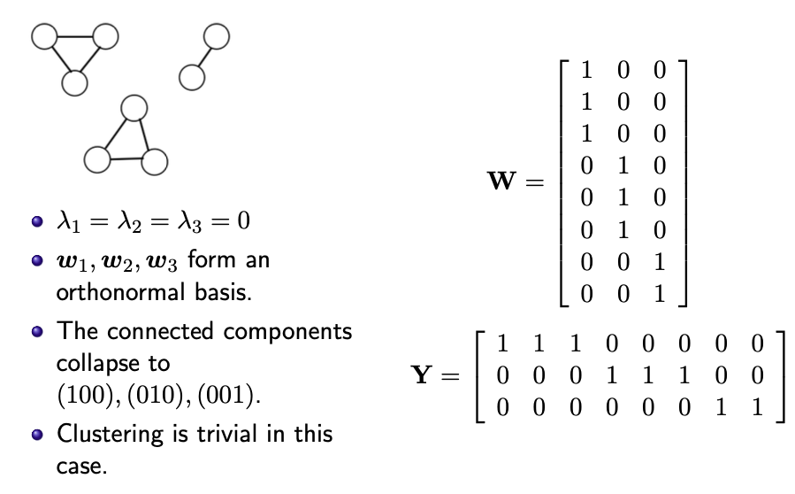
Spectral Clustering Analysis : The Ideal Case

Slide 35
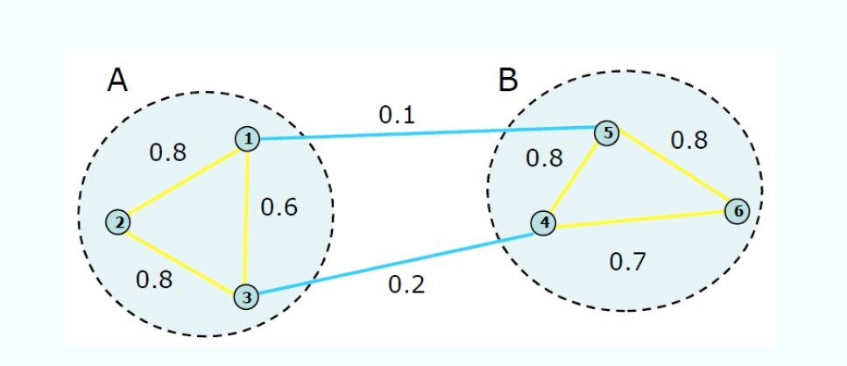
Example(1)
Now let’s go through an example.
n = 6, k=2

Slide 36
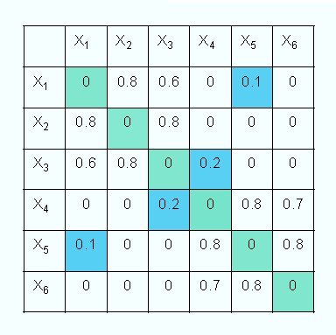
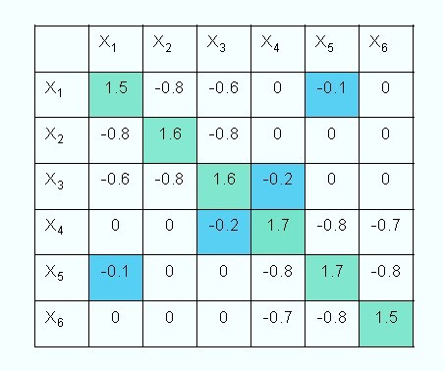
Example(2)
Step 1: Weighted adjacency matrix W and degree matrix D
0
0
0
0
0
0
0
0
0
0
0
0
0
0
0
0
0
Adjacency Matrix W
Degree Matrix D

Slide 37
Example(3)
Step 2: Laplacian matrix
L=D-W
Laplacian Matrix L

Slide 38

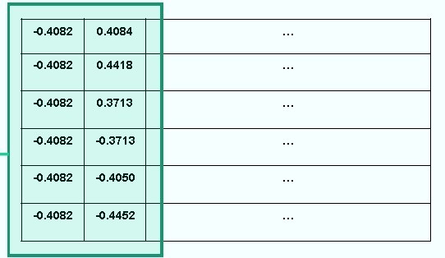
Example(4)
Step 3: Eigen-decomposition
Eigenvalues =
Eigenvectors=
Laplacian Matrix L

Slide 39
Example(5)
Step 3: Eigen-decomposition
Eigenvalues =
Eigenvectors=
U

Slide 40
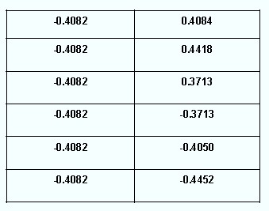
Example(6)
Step 4: Embedding
U=

Slide 41
Example(6)
Step 4: Embedding
U=
Each row represents a data point

Slide 42
Example(7)
Step 4: Embedding
U=
Map it to a two-dimensional space
0.5
0.25
0
-0.25
-0.5
-0.5
-0.25
0
0.25
0.5

Slide 43
Example(8)
Step 5: Clustering
K-means clustering
0.5
0.5
Cluster A
0.25
0.25
0
0
-0.25
-0.25
Cluster B
-0.5
-0.5
-0.5
-0.25
0
0.25
0.5
-0.5
-0.25
0
0.25
0.5

Slide 44
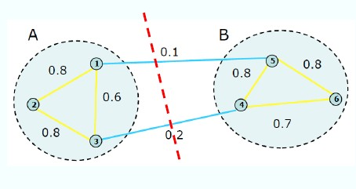
Example(8)
Step 5: Clustering
K-means clustering
0.5
0.5
Cluster A
0.25
0.25
0
0
-0.25
-0.25
Cluster B
-0.5
-0.5
-0.5
-0.25
0
0.25
0.5
-0.5
-0.25
0
0.25
0.5

