Slide 1
Lab Exam Presentation
Probabilistic Graphical Model
Anuj Kumar
PT2018
Reg. No.: 18ETCS224001
M. Tech. in MLIS
Module Leader: Mr. Divya Kiran
Module Name: Probabilistic Graphical Model
Module Code : MIS503

Slide 2
Presentation Outline
Problem Statement
Objectives
Approach
Solution

Slide 3
Problem Statement
For the given textual data perform the following tasks
Perform suitable text pre-processing and POS Tagging.
Perform Noun to Noun mapping.
Develop a Bayesian network with maximum of 10 nodes.
Analyse the conditional probability distribution for any two nodes of the developed network.

Slide 4
Objectives
Text Pre-processing
POS Tagging
Noun to Noun Mapping
Creation of Bayesian Network
Inference on Bayesian Network

Slide 5
Approach
We use open source software Python. Version 3.7
We use standard python modules such as Pandas, NumPy, NLTK, and Spacy
For interactive development we use Jupyter Notebook

Slide 6
Solution
Given Text (short description:)
“A strike by farmers in Maharashtra continues to affect normal life, despite the State government’s announcement of an end to the strike last week. The farmers, whose demands include full waiver of farm loans, hikes in the minimum support price for agricultural produce and writing off of pending electricity bills …..”

Slide 7
Solution
Text Pre-processing: -
Two Methods are implemented:
Word tokenization
Stop Word Removal
Output of Word Tokenization: -
['A', 'strike', 'by', 'farmers', 'in', 'Maharashtra', 'continues', 'to', 'affect', 'normal', 'life', ',', 'despite', 'the', 'State', 'government', '’', 's', 'announcement', 'of', 'an', 'end', 'to', 'the', 'strike', 'last', 'week', '.', 'The', 'farmers', ',', 'whose', 'demands', 'include', 'full', 'waiver', 'of', 'farm', 'loans', ',', 'hikes', 'in', 'the', 'minimum', 'support', 'price', 'for', 'agricultural', 'produce', 'and', 'writing', 'off', 'of', 'pending', 'electricity', 'bills', ',', 'have', 'been', 'on', 'an', 'indefinite', 'strike', 'since', 'June’, …….. ]
Note: -(full output not shown)

Slide 8
Solution
Output of Stop Word Removal :
words after stoppedwords are: ['A', 'strike', 'farmers', 'Maharashtra', 'continues', 'affect', 'normal', 'life', ',', 'despite', 'State', 'government', '’', 'announcement', 'end', 'strike', 'last', 'week', '.', 'The', 'farmers', ',', 'whose', 'demands', 'include', 'full', 'waiver', 'farm', 'loans', ',', 'hikes', 'minimum', 'support', 'price', 'agricultural', 'produce', 'writing', 'pending', 'electricity', 'bills', ',', 'indefinite', 'strike', 'since', 'June', '1', '.', 'As', 'strike', 'nears', 'end', 'first', 'week', ',', 'prices', 'essential', 'goods', 'milk’,
Note: -(full output not shown)

Slide 9
Solution
POS Tagging
Output: -
[('A', 'DT')] [('strike', 'NN')] [('by', 'IN')] [('farmers', 'NNS')] [('in', 'IN')] [('Maharashtra', 'NNP')] [('continues', 'VBZ')] [('to', 'TO')] [('affect', 'NN')] [('normal', 'JJ')] [('life', 'NN')] [(',', ',')] [('despite', 'IN')] [('the', 'DT')] [('State', 'NN')] [('government', 'NN')] [('’', 'NN')] [('s', 'NN')] [('announcement', 'NN’)]
Note: -(full output not shown)

Slide 10
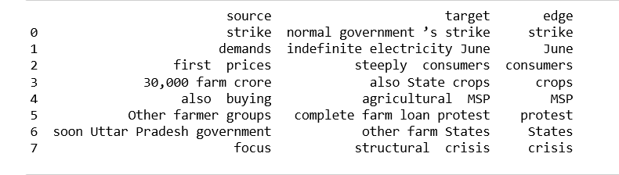
Solution
Noun to Noun Mapping: -
pattern = [{'DEP':'pobj','OP':'+'},
{'DEP':'nsubj','OP':'?'},
{'POS':'nsubj','OP':'?’}]
Output: -
['strike', 'June', 'consumers', 'crops', 'MSP', 'protest', 'States', 'crisis’]

Slide 11
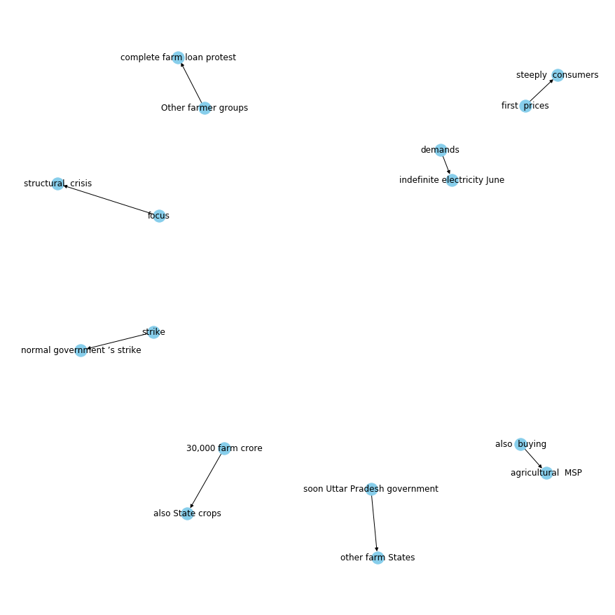
Solution
Bayesian Network

Slide 12
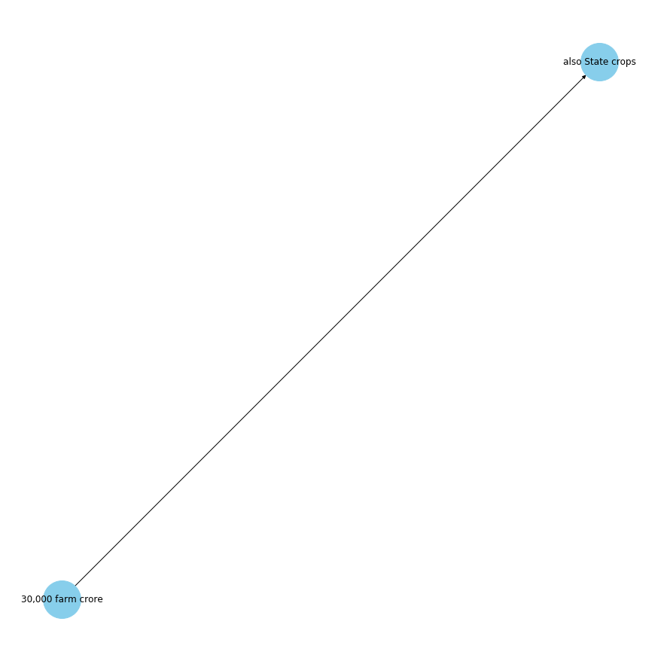
Solution
Bayesian Network Inference
Code:
G=nx.from_pandas_edgelist(kg_df[kg_df['edge']=="crops"], "source", "target",
edge_attr=True, create_using=nx.MultiDiGraph())

Slide 13
Thank You

