Slide 1
ORGAN DONATION SYSTEM
AED FINAL PROJECT

Slide 2
TEAM MEMBERS
KUNAL BHOYAR – 002773080
ANUJ KUMAR - 002766036
DISHA PATIL. - 002768900

Slide 3
ENTERPRISE NAME –
HOSPITAL ENTERPRISE
OPO ENTERPRISE
NGO ENTERPRISE
TRANSPORT ENTERPRISE

Slide 4
DEPARTMENT
PATHOLOGY DEPARTMENT
STAFF DEPARTMENT
HOSPITAL ENTERPRISE - MANAGING DEPARTMENT
TRANSPORT SYSTEM
OPO ENTERPRISE - MANAGING DEPARTMENT
NGO MANAGEMENT TEAM

Slide 5
ROLES
HOSPITAL ADMIN
DOCTOR
PATHOLOGIST
RECEPITIONIST
OP MANAGER
NGO MANAGER
TRANSPORT MANAGER
DRIVER
SYSTEM ADMIN

Slide 6
FUNCTIONALITY
Pathologist -
Creates report on Organ profile ( Tissue type, Blood type)
Sends organ report to doctor and OPO
Doctor
Approves if the patient is eligible for organ donation or organ receiving
Creates report on donor / receiver profile(age, height, weight , medical history )
Raise organ requests to admin
Receptionist
Registers patients for treatment
Register dead patients for donating organs
Assign doctors to patients(dead/alive) by checking Doctors Availability

Slide 7
FUNCTIONALITY
Hospital Admin
Creates doctor
Creates Receptionist
Creates Patho
Takes request for organ
Puts patient on National waiting list
Raise request for organ donation to OPO
Sends Data to the central Authority
Driver
Delivers organ from one hospital to another
Driver Admin
Creating Drivers
Managing shifts for Drivers

Slide 8
FUNCTIONALITY
OPO Admin
Tracking requests from hospitals
Gets access to the pathology reports from hospitals of both donor and receiver
Lists of all donors-organs-hospitals-patients
Sends list of organs to the hospital
Has national waiting list
Sends list of available organs to hospitals
Sends requests for drivers
NGO Admin
Person goes to NGO for registering himself as a DONOR
Takes the dead persons name from hospitals and checks if the person has registered himself as a donor

Slide 9
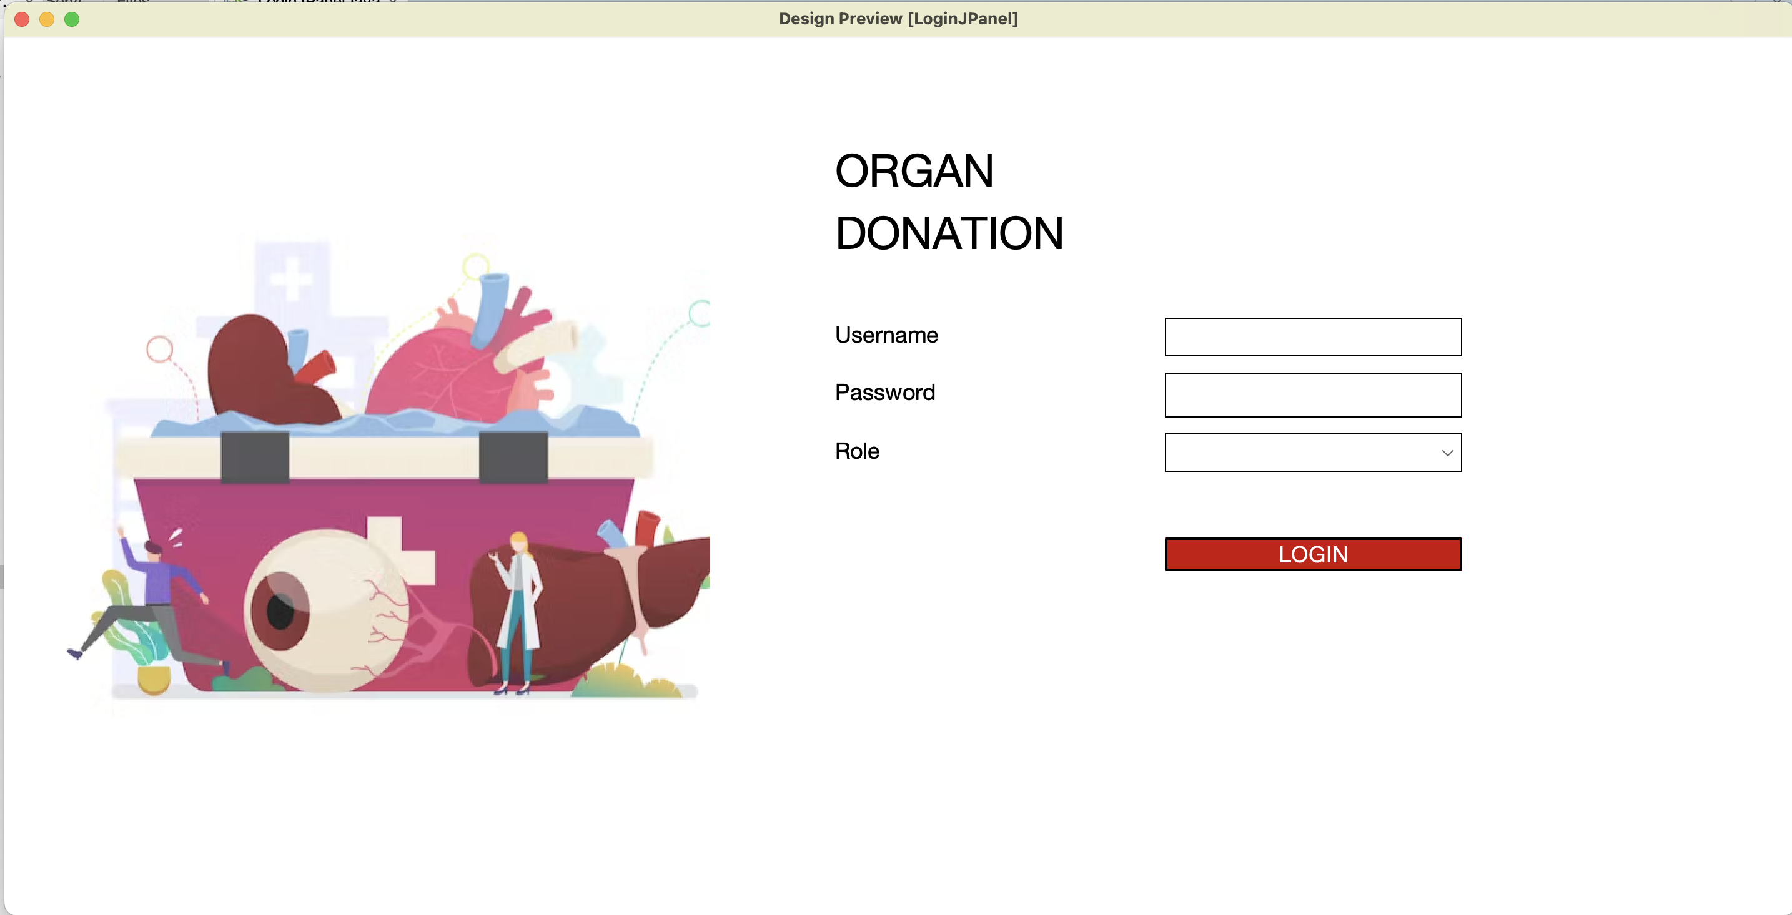
LANDING PAGE

Slide 10
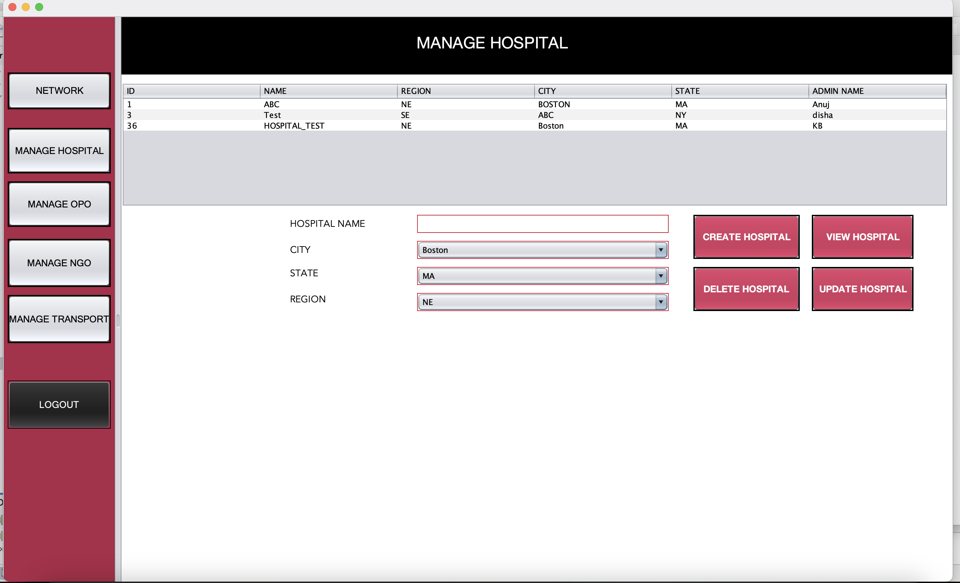
SYSTEM ADMIN – CREATE HOSPITAL

Slide 11
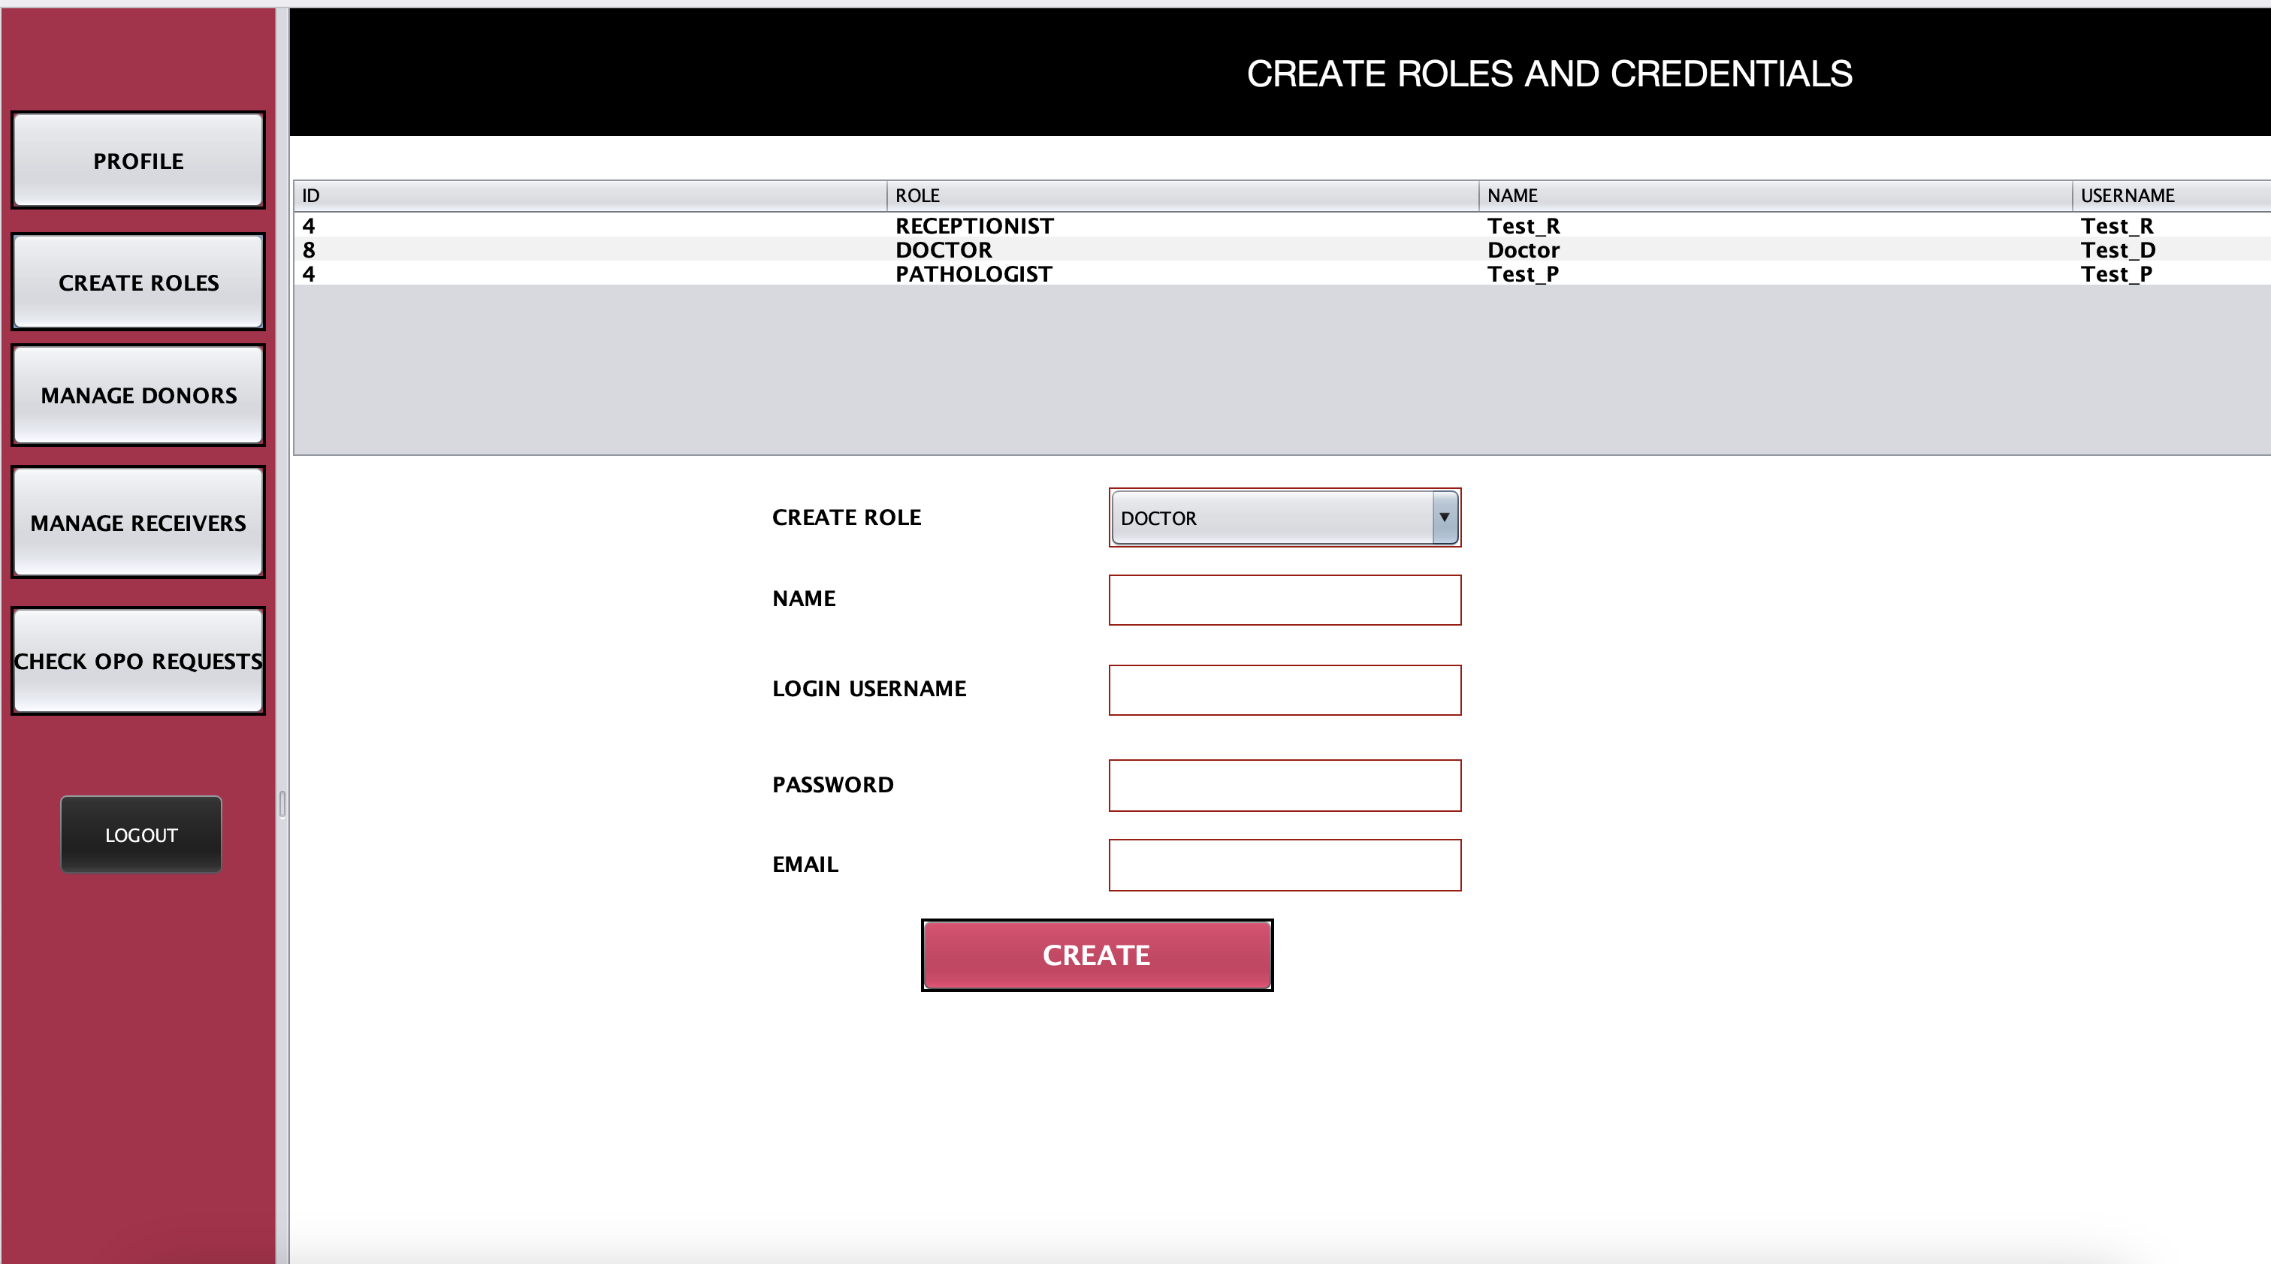
HOSPITAL ADMIN LANDING PAGE

Slide 12
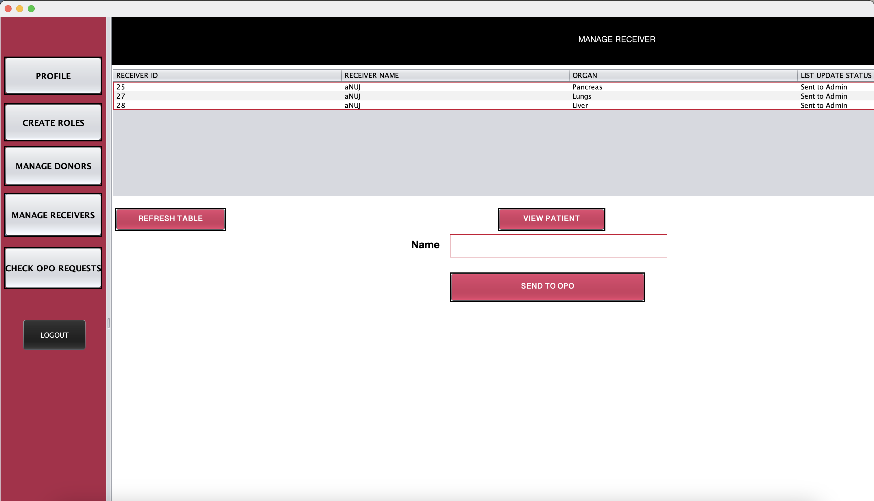
HOSPITAL ADMIN - MANAGE RECEIVER

Slide 13
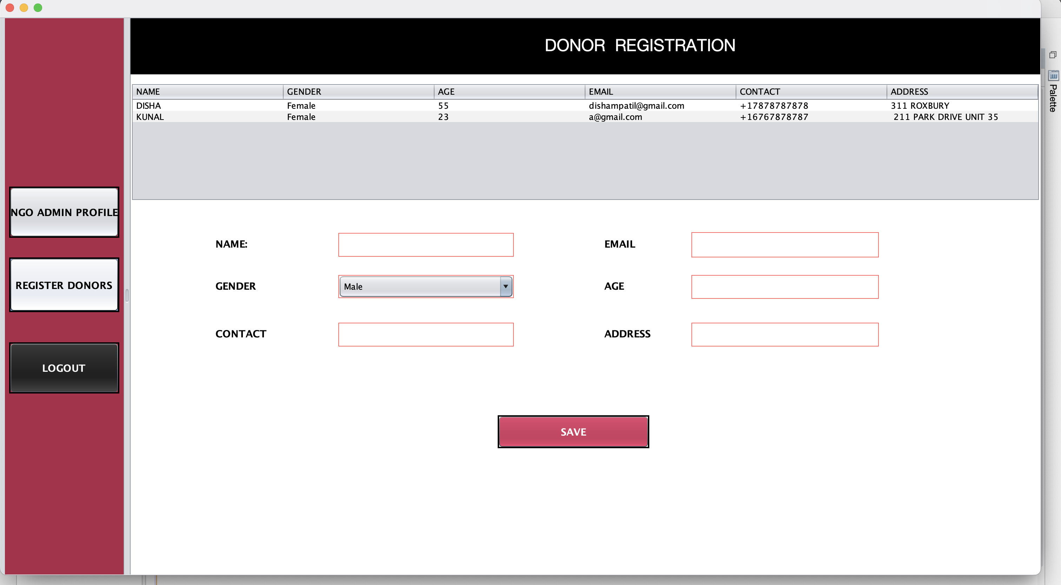
NGO – DONOR REGISTRATION

Slide 14
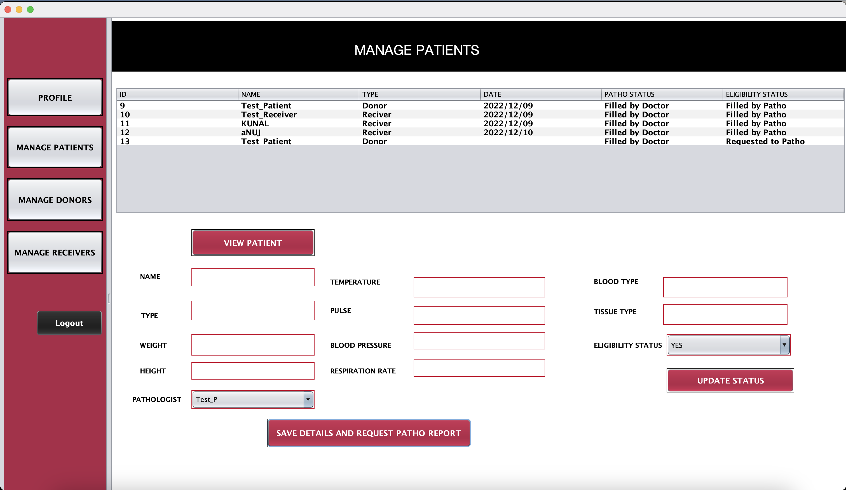
DOCTOR LANDING PAGE

Slide 15
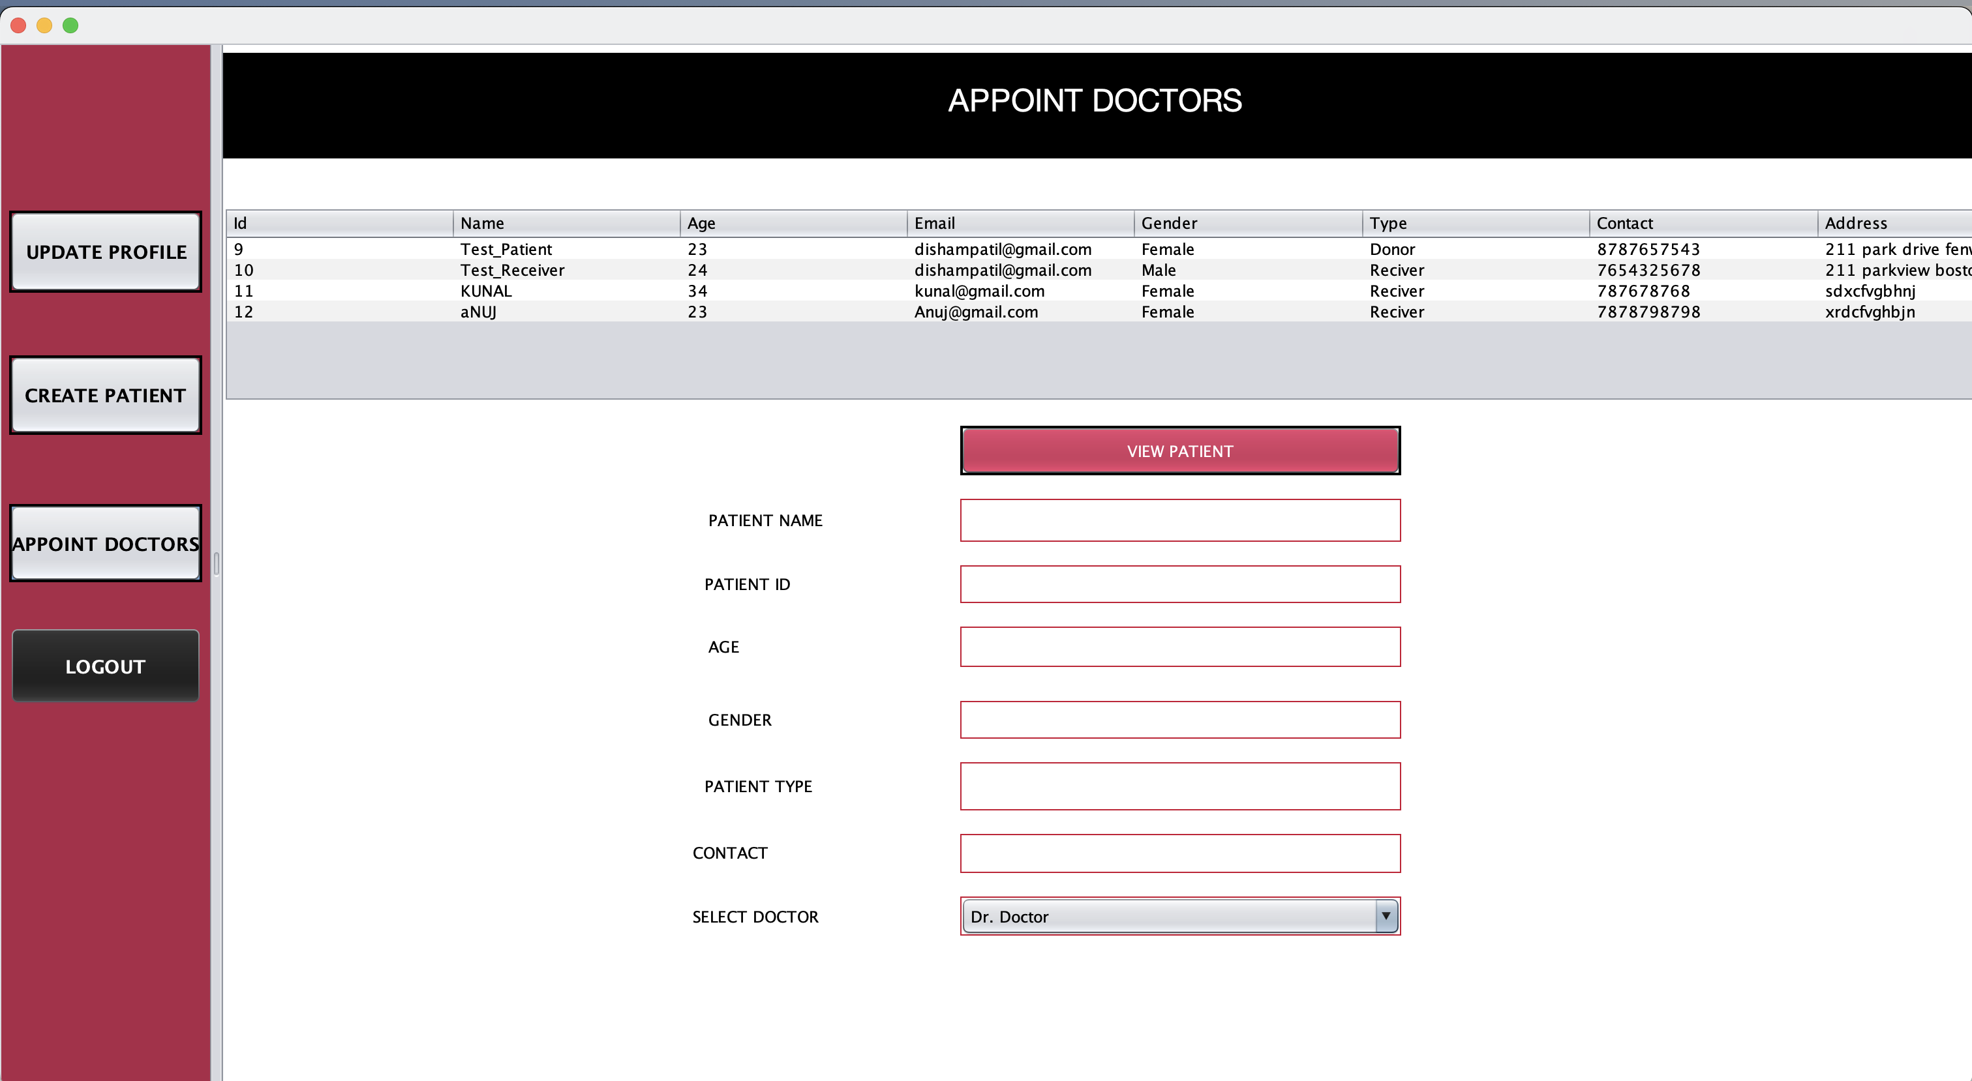
RECEPITIONIST APPOINT DOCTORS

Slide 16
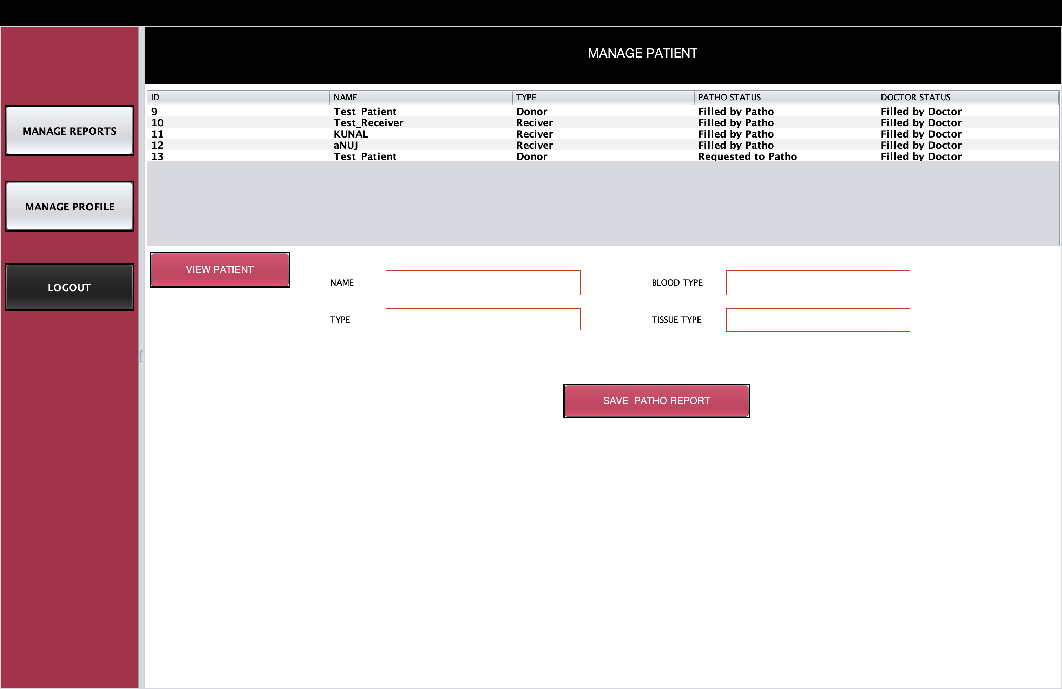
PATHOLOGIST MANAGE PATIENT REPORTS

Slide 17
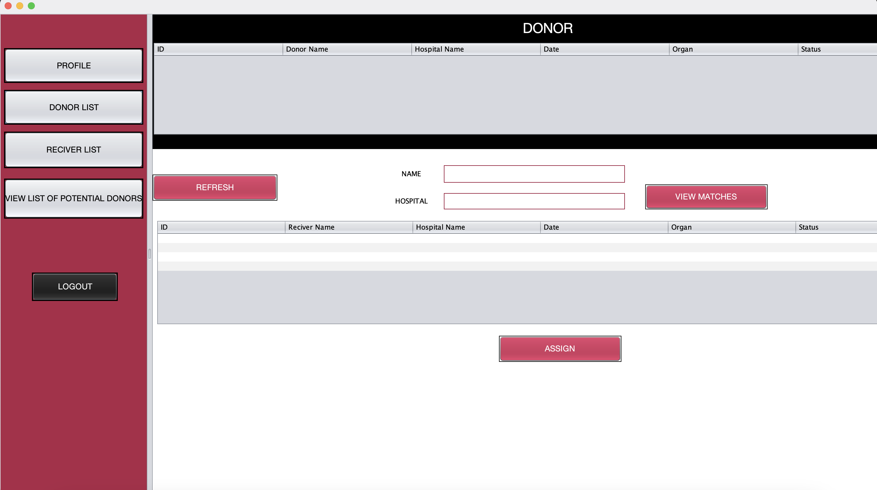
OPO FINDING MATCHES

