Slide 1

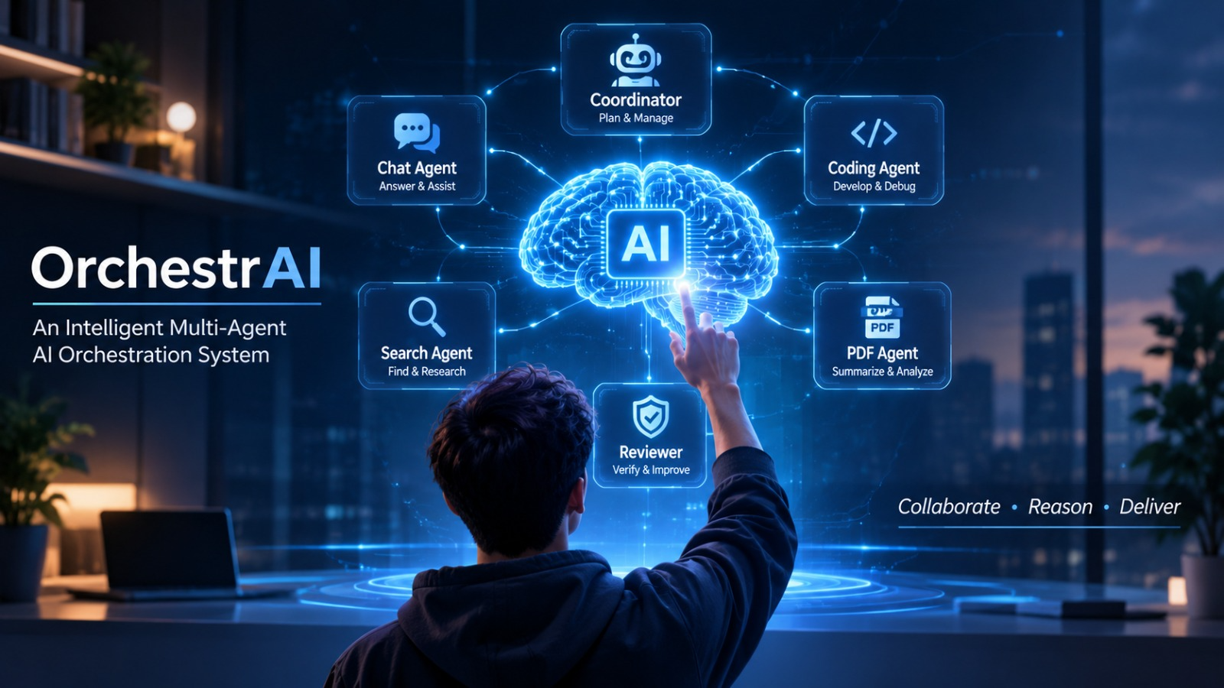
MINOR PROJECT PRESENTATION
OrchestrAI
An Intelligent Multi-Agent AI Orchestration System
Submitted by
Anuj Mahore (24U020054)
Maanas Negi (24U020041)
Department of Computer Science & Engineering
Indian Institute of Information Technology, Bhopal
Supervised by
Dr. Neeta Anna Eapen
Assistant Professor, Department of CSE
Indian Institute of Information Technology Bhopal
1

Slide 2
Intro & Background
Literature Review
Problem Statement
Methodology
Implementation
Results & Analysis
Conclusion
Presentation Overview
Introduction & Motivation
Literature Review
01
02
Why a single general-purpose model is not enough for every task.
Existing research on AI agents, task coordination, tool use and evaluation..
Problem & Objectives
Methodology & Architecture
03
04
Key challenges, identified gaps and objectives addressed by OrchestrAI..
Supervisor-based orchestration, specialized agents and reviewer-driven validation.
Implementation
Results & Conclusion
05
06
System development, technology stack, integrations
System evaluation, functional outcomes, limitations and future enhancements..
Indian Institute of Information Technology Bhopal
2

Slide 3
Intro & Background
Literature Review
Problem Statement
Methodology
Implementation
Results & Analysis
Conclusion
Introduction & Background
Why multi-agent orchestration? Diverse tasks need specialized execution, coordinated routing and quality checks.
Project Motivation
Single-Agent Limitations
Key Challenges We Address
Need for a unified AI platform.
Simplifying access to multiple AI capabilities.
Exploring intelligent agent collaboration.
High Workload – Handles multiple tasks alone.
Limited Specialization – Not equally effective in every domain.
Complex Management – Multiple tools and instructions.
Scalability Issues – New capabilities increase complexity.
Intelligent Routing – Selecting the right agent for each task.
Quality Assurance – Reviewing outputs and providing feedback.
Reliable Execution – Handling failures and controlled retries.
89%
40%
80%
Organizations regularly use AI
in at least one business function
Large organizations scaling AI agents
Respondents say AI improved
their individual productivity
Source: McKinsey Global Survey on the State of AI 2026 — online survey, 1,719 participants across 97 countries; fieldwork: 4 May–8 June 2026.
One Platform. Multiple Agents. Smarter Execution.
From isolated AI capabilities to coordinated intelligence.
Indian Institute of Information Technology Bhopal
3

Slide 4
Intro & Background
Literature Review
Problem Statement
Methodology
Implementation
Results & Analysis
Conclusion
Literature Review: Related Work
Selected studies (2022–2026) and the ideas that inform OrchestrAI’s design.
ReAct (2022) – Yao et al.
AutoGen (2023) – Wu et al.
Alternates reasoning with tool actions and observations.
Agents exchange messages, use tools and collaborate.
OrchestrAI link: Tool-enabled execution
OrchestrAI link: Agent communication
MetaGPT (2023) – Hong et al.
AgentMesh (2025) – Khanzadeh
Assigns specialist roles and follows structured workflows.
Coordinates Planner, Coder, Debugger and Reviewer roles.
OrchestrAI link: Task specialization
OrchestrAI link: Reviewer feedback loop
CollabEval (2026) – Qian et al.
CONCAT (2026) – Ma et al.
Uses multi-round evaluation to reach a final judgment.
Forms teams using consensus and confidence signals.
OrchestrAI link: Output quality review
OrchestrAI link: Task-appropriate agent selection
Research evolution
From tool-using agents to role-based collaboration, coordinated execution and review-aware systems.
Indian Institute of Information Technology Bhopal
4

Slide 5
Intro & Background
Literature Review
Problem Statement
Methodology
Implementation
Results & Analysis
Conclusion
Comparative Analysis & Research Gap
Comparative analysis of existing multi-agent approaches, highlighting their key contributions and OrchestrAI’s integrated capabilities
Research work | Primary focus | Coordination | Review / evaluation | Connection to OrchestrAI
ReAct (2022) | Reasoning + tools | Action / observation loop | External observations | Tool-enabled agent execution
AutoGen (2023) | Agent conversation | Message-based collaboration | Developer-configured | Supervisor-led agent coordination
MetaGPT (2023) | Role-based workflows | Structured hand-offs | Workflow checks | Specialized task agents
AgentMesh (2025) | Planner / coder / debugger | Specialist role pipeline | Reviewer + revision | Reviewer feedback workflow
CollabEval (2026) | Collaborative evaluation | Multi-round discussion | Consensus / final judgment | Independent output review
CONCAT (2026) | Adaptive team formation | Consensus-driven teaming | Confidence signals | Task-appropriate agent selection
OrchestrAI's Key Contributions
OrchestrAI brings these directions together in one application: Supervisor-led routing, seven specialist agents, independent review with bounded retries, multiple LLM providers, and integrated platform services.
Indian Institute of Information Technology Bhopal
5

Slide 6
Intro & Background
Literature Review
Problem Statement
Methodology
Implementation
Results & Analysis
Conclusion
Problem Statement & Objectives
Identifying the challenges of single-agent AI workflows and defining objectives for a coordinated, specialized and quality-driven multi-agent platform.
Problem statement
Project objectives
Intelligent Routing – Direct each request to the appropriate specialist agent.
Task Specialization – Support six agents for chat, coding, search, PPT, PDF and image.
Quality Assurance – Review outputs and enable bounded retries with feedback.
Provider Flexibility – Integrate multiple LLM providers and platform services.
Modular Architecture – Keep services independent and maintainable.
A single AI workflow can struggle with diverse tasks that require different tools, specialized capabilities and output validation. Maintaining these capabilities in one workflow also increases complexity.
Specialization
Quality control
Modularity
Task-specific prompts and tools
Reviewer verdict and feedback
Microservices and containers
Indian Institute of Information Technology Bhopal
6

Slide 7
Intro & Background
Literature Review
Problem Statement
Methodology
Implementation
Results & Analysis
Conclusion
Proposed Methodology & Workflow
A six-stage workflow integrating Supervisor-led routing, specialized execution and Reviewer-driven quality assurance.
1
2
3
4
5
6
Request
Validate
Route
Execute
Review
approved
Deliver
User submits text or image
Express API checks input, identity and credits
Supervisor selects one specialist
Agent uses its configured LLM / tool
Reviewer checks relevance and completeness
Return answer or signed file URL
Feedback
If review requests improvement: return feedback to the selected agent and retry within the configured limit.
OrchestrAI at a Glance
• 6 Specialized Agents • 1 Central Supervisor • 1 Independent Reviewer • Multiple LLM Providers • Feedback & Retry Mechanism
Indian Institute of Information Technology Bhopal
7

Slide 8
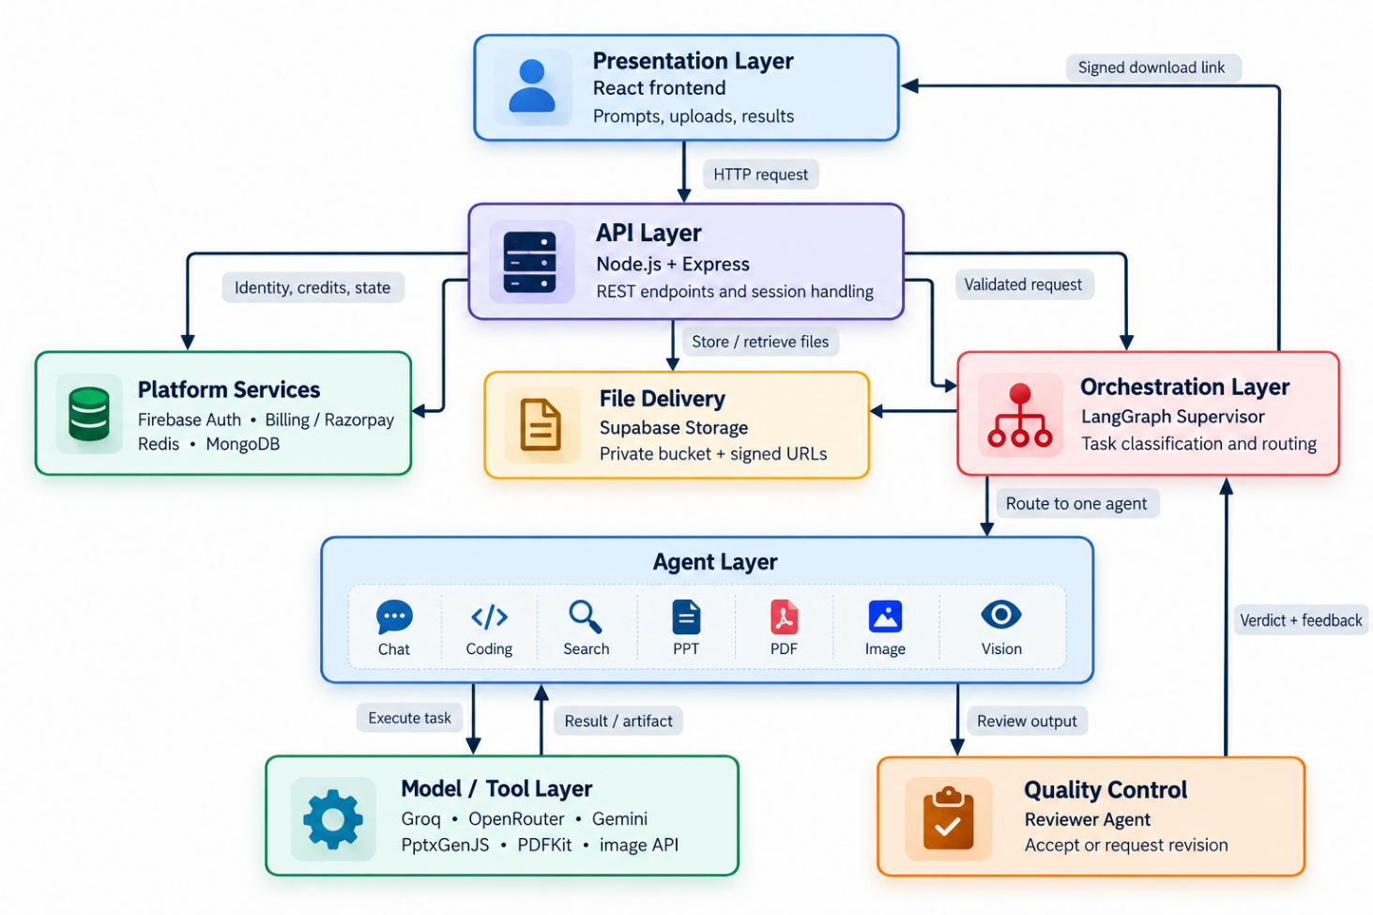
Intro & Background
Literature Review
Problem Statement
Methodology
Implementation
Results & Analysis
Conclusion
System Architecture & Module Interaction
End-to-end architecture showing request handling, Supervisor-led orchestration, specialized agents and reviewer-based quality control.
Indian Institute of Information Technology Bhopal
8

Slide 9
Intro & Background
Literature Review
Problem Statement
Methodology
Implementation
Results & Analysis
Conclusion
Implementation & Technology Stack
The platform combines a React interface, Node/Express APIs, graph-based orchestration and provider-specific model integrations.
Layer | Technology | Role in OrchestrAI
Frontend | React | Prompt entry, image upload and result display
Backend API | Node.js + Express.js | REST endpoints and service integration
Orchestration | LangGraph + LangChain | Supervisor routing, agent calls, review and retry
LLM providers | Groq , OpenRouter , Google Gemini | Chat/search, coding and multimodal vision tasks
Generation | PptxGenJS , PDFKit , Pollinations API | PPTX, PDF and image generation
Identity & billing | Firebase Auth / Admin SDK , Razorpay | Sign-in, token verification, plans and credits
Data & storage | Redis , MongoDB , Supabase Storage | Session/cache, persistent records and generated files
Provider independence
Each agent can use a provider suited to its task through shared integration interfaces.
Indian Institute of Information Technology Bhopal
9

Slide 10
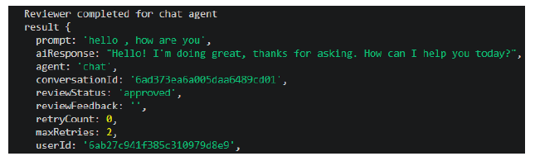
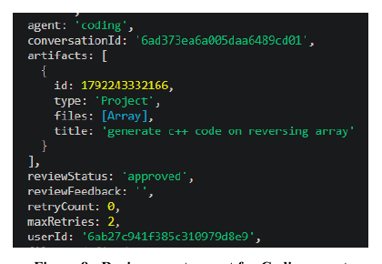
Intro & Background
Literature Review
Problem Statement
Methodology
Implementation
Results & Analysis
Conclusion
Results & Analysis: Chat and Coding Agents
Recorded functional tests showing task-specific execution and Reviewer validation.
CHAT AGENT
CODING AGENT
Test prompt: “hello, how are you”
Test prompt: “generate C++ code on reversing array”
Observed result: conversational response generated
Observed result: C++ code artifact + review report
Reviewer status: APPROVED • Retry count: 0
Outcome: Chat Agent handled the prompt and returned a conversational reply.
Reviewer status: APPROVED • Retry count: 0
Outcome: Coding Agent generated a task-specific code artifact for review.
2 agent demonstrations • 2 Reviewer approvals shown • Retry count: 0 in both recorded runs
Indian Institute of Information Technology Bhopal
10

Slide 11
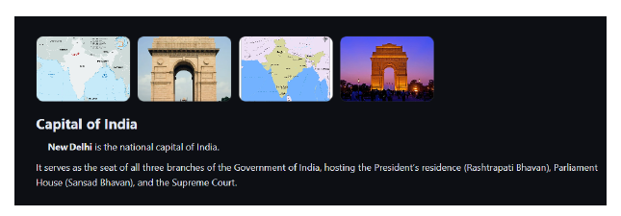

Intro & Background
Literature Review
Problem Statement
Methodology
Implementation
Results & Analysis
Conclusion
Results & Analysis: Search and PDF Agents
Functional demonstrations of information retrieval and downloadable document generation.
SEARCH AGENT
PDF AGENT
Test prompt: “What is the capital of India?”
Test prompt: “generate PDF on machine learning”
Search result
Outcome: Identifies New Delhi as India's capital and presents supporting visual results.
Generated artifact
Outcome: Generates a Machine Learning PDF Guide and provides a time-limited download link through Supabase Storage.
2 additional agent demonstrations • Search with supporting visuals • PDF delivery through a signed download link
Indian Institute of Information Technology Bhopal
11

Slide 12
Intro & Background
Literature Review
Problem Statement
Methodology
Implementation
Results & Analysis
Conclusion
Conclusion & Future Scope
A unified AI platform integrating intelligent task routing, specialized agents and reviewer-driven quality control.
Project Achievements
Current Limitations
6 specialized agents for chat, coding, search, PPT, PDF and image.
LangGraph Supervisor for intelligent task routing.
Independent Reviewer with feedback and bounded retries.
3 LLM providers: Groq, Gemini and OpenRouter.
Authentication, billing and cloud file storage.
Output quality depends on external LLM providers.
Reviewer approval cannot guarantee factual correctness.
API availability, rate limits and network failures affect operation.
Large-scale benchmark and load testing remain pending.
Future Scope
GitHub Repository
https://github.com/anujmahore/Minor-Project
Advanced agent intelligence: long-term memory and richer agent-to-agent collaboration.
Performance optimization: improve routing accuracy, response latency and API cost efficiency.
Reliability and security: stronger error recovery, monitoring and prompt-injection protection.
Platform expansion: introduce Data Analysis, Spreadsheet and Email agents.
6
SPECIALIZED AI AGENTS
3
LLM PROVIDERS
2
CORE PLATFORM SERVICES
Indian Institute of Information Technology Bhopal
12

Slide 13
Intro & Background
Literature Review
Problem Statement
Methodology
Implementation
Results & Analysis
Conclusion
References
[1] Yao et al. (2022). ReAct: Synergizing Reasoning and Acting in Language Models. arXiv:2210.03629.
[2] Li et al. (2023). CAMEL: Communicative Agents for 'Mind' Exploration of LLM Society. arXiv:2303.17760.
[3] Park et al. (2023). Generative Agents: Interactive Simulacra of Human Behavior. arXiv:2304.03442.
[4] Du et al. (2023). Improving Factuality and Reasoning through Multiagent Debate. arXiv:2305.14325.
[5] Qian et al. (2023). ChatDev: Communicative Agents for Software Development. arXiv:2307.07924.
[6] Chen et al. (2023). AgentVerse: Facilitating Multi-Agent Collaboration. arXiv:2308.10848.
[7] Hong et al. (2023). MetaGPT: A Multi-Agent Collaborative Framework. arXiv:2308.00352.
[8] Wu et al. (2023). AutoGen: Enabling Next-Gen LLM Applications via Multi-Agent Conversation. arXiv:2308.08155.
[9] Guo et al. (2024). Large Language Model based Multi-Agents: A Survey of Progress and Challenges. arXiv:2402.01680.
[10] Chen et al. (2024). A Survey on LLM-based Multi-Agent System: Recent Advances and New Frontiers. arXiv:2412.17481.
[11] Cao et al. (2024). LLM-Collab: Task Planning via Chain-of-Thought and Multi-Agent Collaboration. DOI: 10.3934/aci.2024019.
[12] Tran et al. (2025). Multi-Agent Collaboration Mechanisms: A Survey of LLMs. arXiv:2501.06322.
[13] Aratchige & Ilmini (2025). LLMs Working in Harmony: A Survey on Effective LLM-Based Multi-Agent Systems. arXiv:2504.01963.
[14] Khanzadeh (2025). AgentMesh: A Cooperative Multi-Agent Framework for Software Development. arXiv:2507.19902.
[15] Arunkumar et al. (2026). Agentic AI: Architectures, Taxonomies, and Evaluation of LLM Agents. arXiv:2601.12560.
[16] Qian et al. (2026). CollabEval: Enhancing LLM-as-a-Judge via Multi-Agent Collaboration. arXiv:2603.00993.
[17] Qi et al. (2026). Beyond Individual Intelligence: Collaboration, Failure Attribution and Self-Evolution. arXiv:2605.14892.
[18] Ma et al. (2026). CONCAT: Consensus- and Confidence-Driven Ad Hoc Teaming. arXiv:2605.29612.
Indian Institute of Information Technology Bhopal
13

Slide 14
Intro & Background
Literature Review
Problem Statement
Methodology
Implementation
Results & Analysis
Conclusion
THANK YOU
Questions & Discussion
Anuj Mahore & Maanas Negi
Supervised by
Dr. Neeta Anna Eapen
14
Indian Institute of Information Technology Bhopal
14
Indian Institute of Information Technology Bhopal

