Slide 1
Django
Batteries Included

Slide 2
Content
Introduction on Django
History
What exactly the framework means?
Why Django?
Django Architecture
Environment Setup
Pre Requirements
Python 3.6 +
OOP’s
HTML,CSS and Javascript basics
Developing a web application using Django
Creating a project
Understanding project structure
Setting up a project
Creating an app
Workflow of django

Slide 3
Introduction:
Django is a free and open source framework which is written in python.
It is a high-level Python web framework that enables in rapid development of web applications in a secure and maintainable.
It takes care of much of the hassle of web development, it mainly focuses on writing quality web application.
It has a thriving and active community, great documentation, and many options for free and paid-for support.

Slide 4
Introduction on Django
History:
Django was released on 21, July 2005
Django was design and developed by Lawrence journal
Django Software Foundation(DSF)
And the latest official version is 2.2.5 (LTS)

Slide 5
Why Django?
High-level Python Web framework
Encouraging rapid development and pragmatic, clean design
Rich ecosystem
Maturity
Admin panel by default
Good for search engine optimization (SEO)
Pluggable
Libraries
ORM

Slide 6
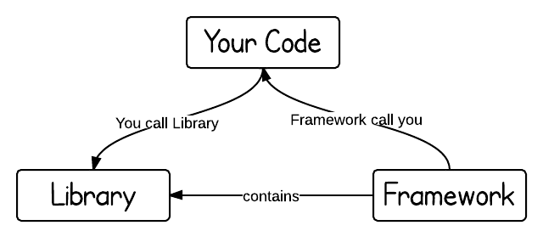
What exactly the framework means?

Slide 7
Model-View-Controller Architecture:
MVC pattern is largely accepted for standard development enviroment for software. Model, View and Controller pattern has
Model The model represents the state (data) and business logic of the application. Model is not the actual data, but an interface which will represents the accessing and processing the data. Model gives the complete representation of the organization of data.
View The view module is responsible to display data. Presentation logic where the display of data and viewing with proper format.
Controller The controller module acts as an interface between view and model. It intercepts all the requests i.e. receives input and commands to Model / View to change accordingly.

Slide 8
Model-View-Template Architecture:
Django follow the MVT Architecture, and usualy it is called as MTV framework. Model-View-Template pattern for the proper development.
‘M’ for Model: Model represents the organization and representation of data. Django follow model where the database connectivity and processing of data at one place. Models can be created and sync the database tables with any database on fly.
‘T’ for Template: Template is a presentation layer. In this layer the presentation of data in webpage will be represented.
‘V’ for View: Views in Django acts as business logic which interacts with the Model and Templates. Views will handle request and forward to Templates. Views will act as a intermediate between the models and templates.

Slide 9
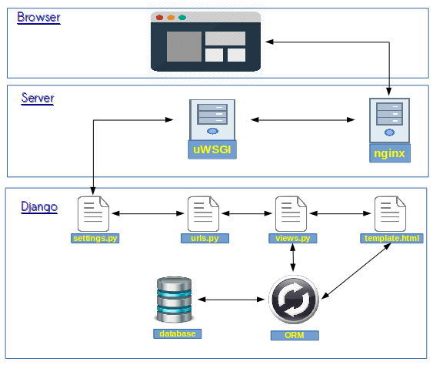
Django Architecture

Slide 10
Environment Setup
Directly into Host machine
# pip install django
Virtual environment
# pip install virtualenv
virtualenv venv
source ./venv/bin/activate
pip install django
** database : sqlite so no need to install anything

Slide 11
Pre Requirements
Python 3.6 +
OOP’s
Objects and Class
Modules
HTML,CSS and Javascript basics
Document Object Model(DOM)
Styling
Dynamic DOM Manipulator

Slide 12
Developing a web application using Django
Creating a project
# django-admin startproject demo
# cd demo
# python manage.py migrate
update demo/settings.py file
ALLOWED_HOSTS = [] To ALLOWED_HOSTS = [ ‘*’ ]
# python manage.py runserver 0.0.0.0:8000
open browser with URL: 0.0.0.0:8000

Slide 13
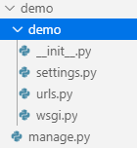
Workflow of django
Settings files
URL
WSGI
Manager

Slide 14
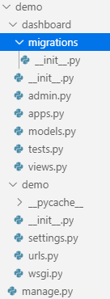
# python manage.py startapp dashboard
Views
Models
Admin

Slide 15
Let’s start coding...

Slide 16
Templates
ORM
Makemigrations
Migrate

Slide 17
Thank you…

