Slide 1



SUPERSTORE SALES
CASE STUDY

Slide 2
Overview
Case Study is about performing Exploratory Data Analysis on SuperStore Sales Data and uncover the insights and trends within the data and prepare it for further modelling and analysis

Slide 3
Dataset
  We were provided with raw data regarding the sales of a superstore within a csv file.
Features
  The dataset provided a diverse set of features, including categorical, numerical, and date-time data, making it ideal for practicing data cleaning, feature engineering, and visualization techniques.

Slide 4
Initial Exploration
  Loaded dataset into DataFrame and explored data structure, data types,missing values,duplicates. Summary stats & identified early quality issues.
Info Gathered
  Data has 100014 records and 21 columns
  Has null values in Ship Mode and Quantity column
  Has only 5009 unique order by Order ID
  Sales Price and Profit are highly skewed and have very heavy tails i.e more outliers

Slide 5
Problems
  Large number of duplicate records
  Inconsistency in Order Date and Ship Date column (format mismatched)
  Inconsistency in Order ID and Order Date
Data CLeaning
  Handled duplicated by simply removing them. 5005 duplicate records removed.
  Converted and Normalized Order Date and Ship Date column to proper format. Created new columns to fix inconsistency
  16 rows with Order Date inconsistency fixed.

Slide 6
Problems
  Missing values in Ship Mode and Quantity column
  Personal Identifiable Information
  Improper dtype for Postal Code column.
Data CLeaning
  Fixed Ship Date column and created a new column ‘Days to Ship’. Imputed missing values in Ship Mode on basis of average days taken to ship.
  Imputed missing value in quantity with median value.
  Created a new column ‘Customer Name Masked’, containg only the initials to protect PII
  converted Postal Code to Object and padded with zeroes for consistency

Slide 7
Problems
  Inconsistent dtypes
  Inconsistency in categorical data
Data CLeaning
  Converted Quantity and Sales Price to appropriate numeric dtypes
  Cleaned States column by replacing abbrevations with full state name

Slide 8
Feature Engineering
Created new columns to transform raw data into informative, business-relevant features
  Original Price (Sales Price / (1 - Discount))
  Total Sales (Sales Price × Quantity)
  Total Profit (Profit × Quantity)
  Discount Price (Original Price * Discount)
  Total Discount (Discount Price × Quantity)

Slide 9
Feature Engineering
  Shipping Urgency (Based on Days to Ship)
  Categorizes shipping speed into:
  "Immediate" (0 days)
  "Urgent" (1–3 days)
  "Standard" (more than 3 days)
  Days Since Last Order
  Shows the gap between a current date and customer's previous order.
  Customer-Level Aggregates
  Created a summary dataset with:
  Total Sales
  Total Quantity
  Total Discount per Customer ID

Slide 10
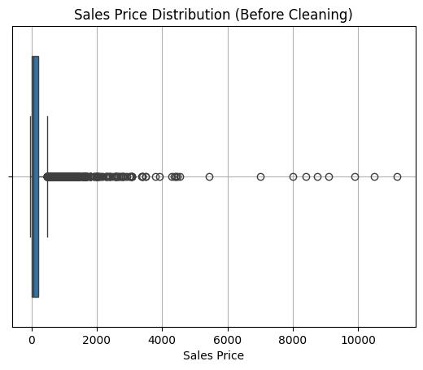
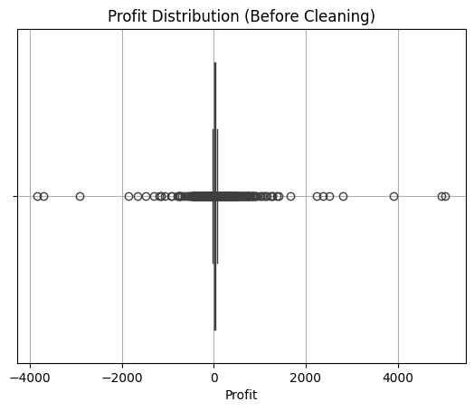
Outlier Detection and Handling
Initial Distributions

Slide 11
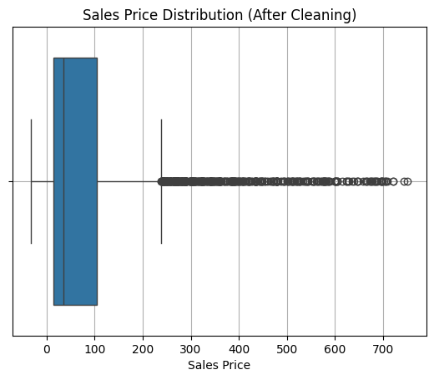
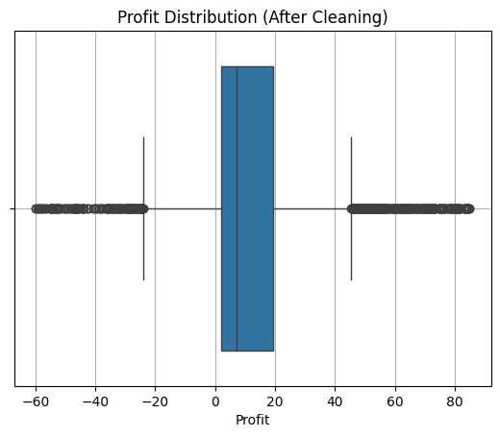
Handled Outliers with 3 iqr method
Cleaned Distributions

Slide 12
Customer Segmentation and Analysis
Segmenting customers using sales and profit quintiles helps identify high-value customers, inefficient spenders, and untapped opportunities.
  Created Cross-Tab Grid
  Created Two Segments:
  Combined both quintiles to form a matrix of customer types.
  → Helped identify:
  Top performers: Q5 Sales & Q5 Profit
  High spenders, low profit: Q5 Sales & Q1–Q2 Profit
  Low spenders, high profit: Q1–Q2 Sales & Q5 Profit
  Customer Sales Quintile → Based on total sales per customer
  Customer Profit Quintile → Based on total profit per customer

Slide 13
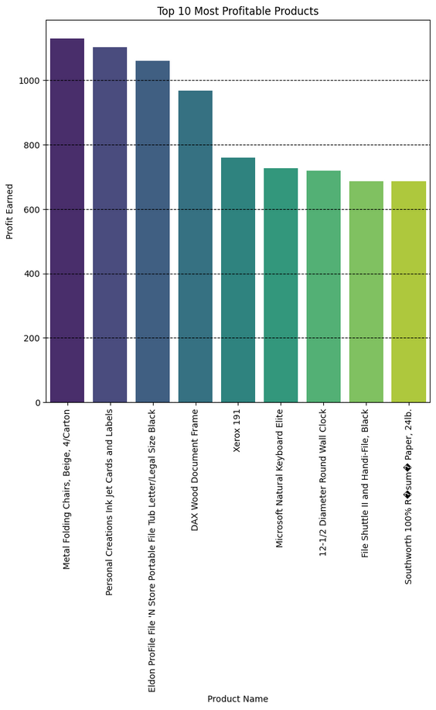
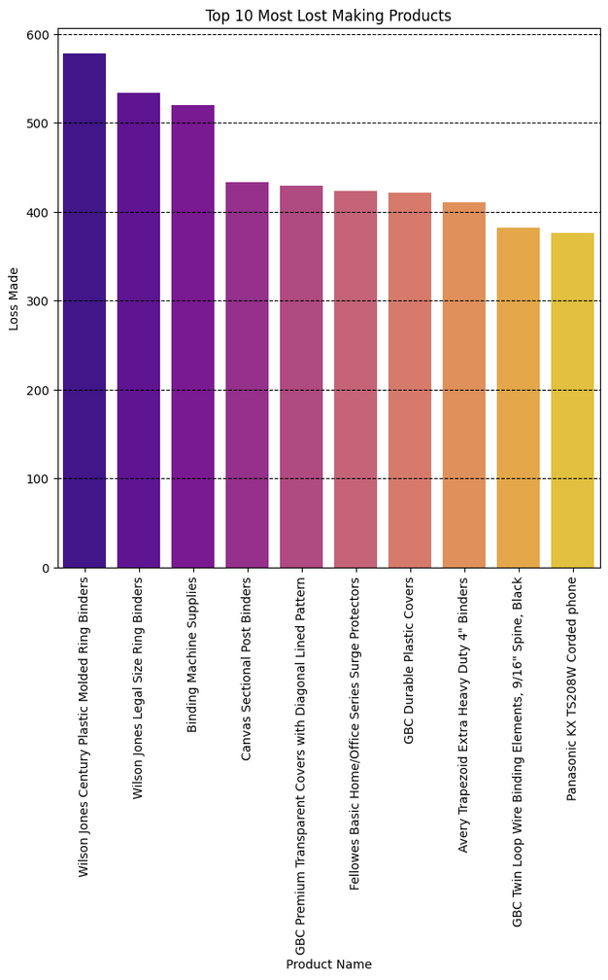
Final Analysis and Business Insights
  Top 10 Most Profitable Products
  Top 10 Most Loss-Making Products

Slide 14
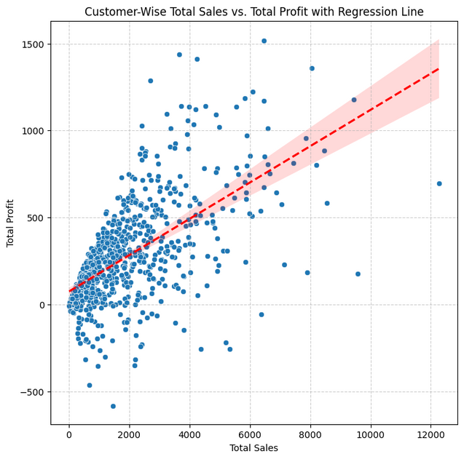
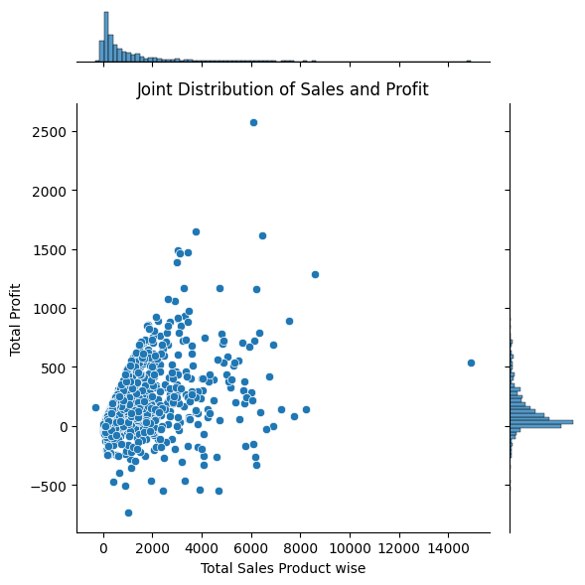
Final Analysis and Business Insights
  Sales vs. Profit Correlation
  Joint Distribution of Sales and Profit

Slide 15
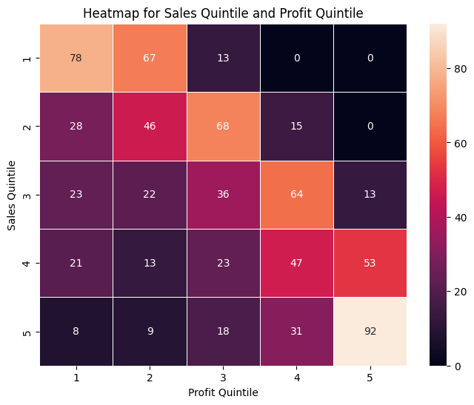
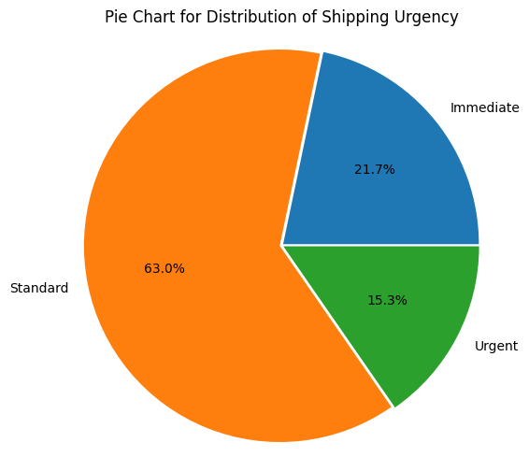
Final Analysis and Business Insights
  Customer Sales Quintile vs. Customer Profit Quintile
  Distribution of Shipping Urgency

Slide 16
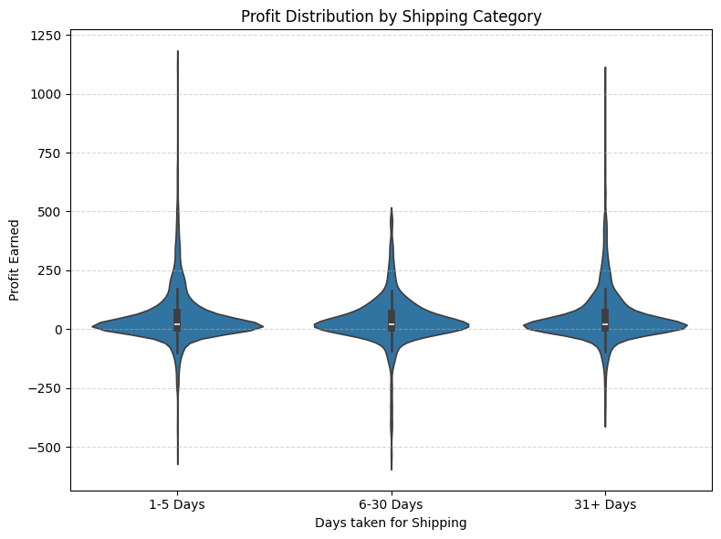
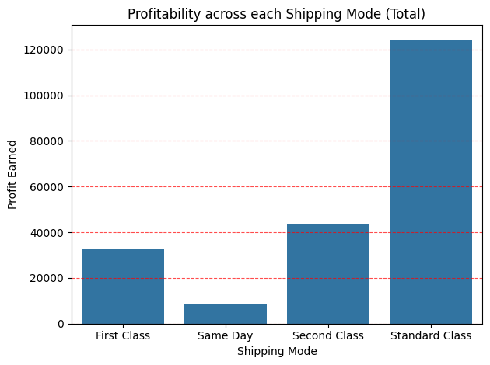
Final Analysis and Business Insights
  Days to Ship vs. Profit
  Shipping Mode and Profitability

Slide 17
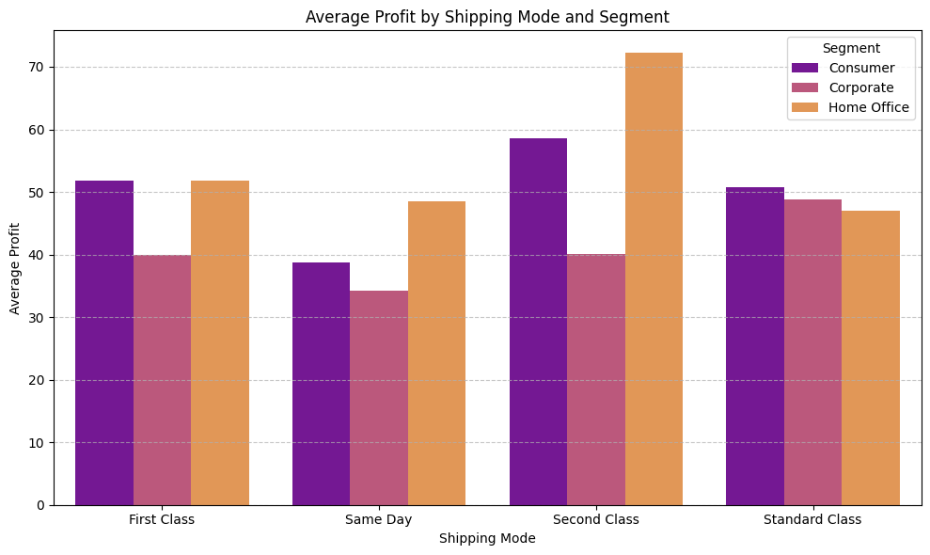
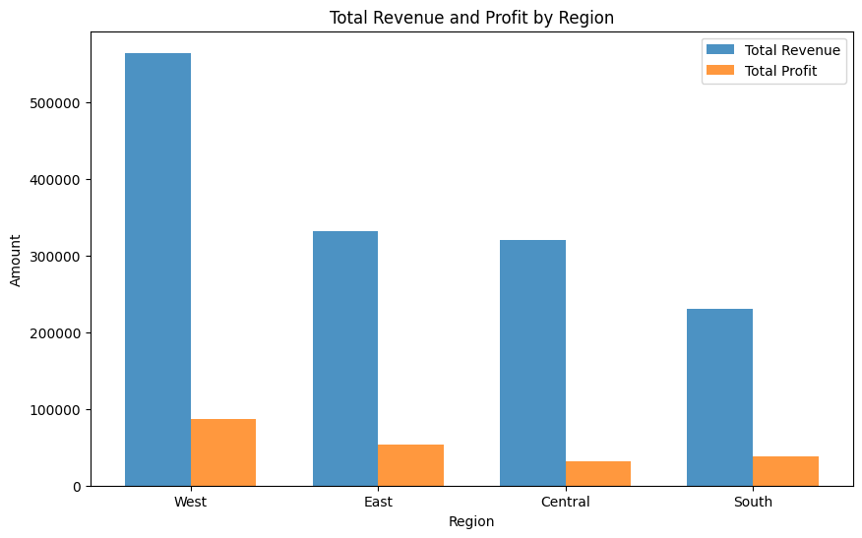
Final Analysis and Business Insights
  profit for each shipping mode per segment
  Sales and Profit by Region

Slide 18
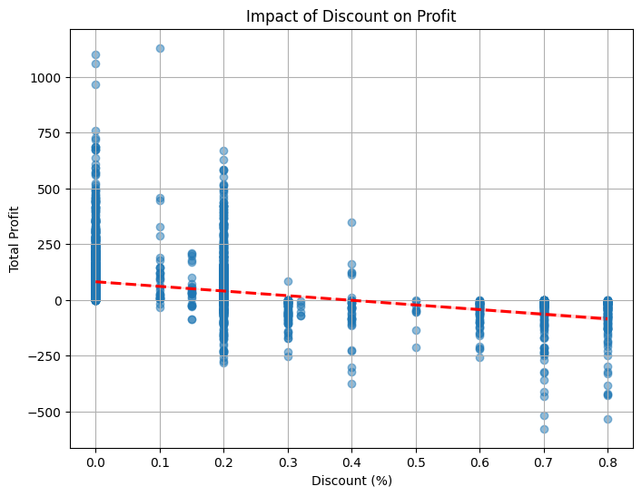
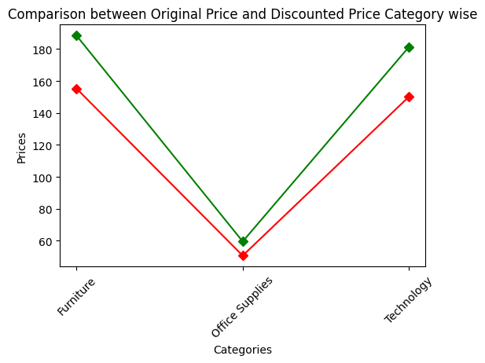
Final Analysis and Business Insights
  Impact of Discounts on Profitability
  Original Price vs. Discounted Price

Slide 19
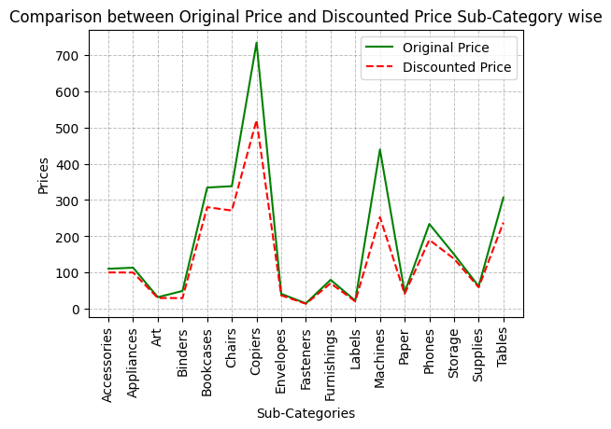
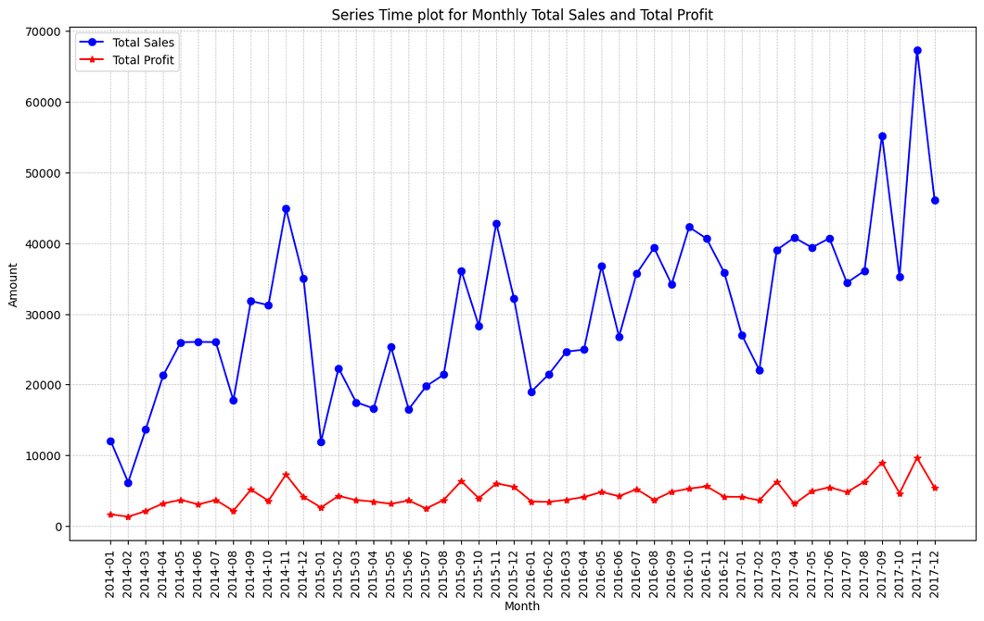
Final Analysis and Business Insights
  original price and discounted price sub-category wise
  Sales and Profit Trends Over Time

Slide 20
Pivot Table Analysis
  Category vs. Segment Profitability
  Created a pivot table showing total Sales and total Profit grouped by:
  Product Category
  Customer Segment
  To understand how each product category performs across different customer segments.
  Key Insights :
  Consumer drives the most profit and revenue, especially in Office Supplies and Technology.
  Corporate performs well in Office Supplies but underperforms in Furniture.
  Home Office is the least profitable across all categories.

Slide 21
Pivot Table Analysis
  Shipping Mode vs. Region Analysis
  Built a pivot table summarizing:
  Order count, Total Sales, Total Profit
  Grouped by:
  Region
  Shipping Mode
  To evaluate shipping preferences and their impact on profitability across regions.
  Key Insights:
  Standard Class is most used in all regions, with West having the highest orders.
  West generates highest profit from Standard Class; Central the least.
  Same mode, varying profits → cost differences across regions.
  West leads in avg. profit, followed by South and East.
  Central has lowest avg. profit → scope for improvement.

Slide 22
Pivot Table Analysis
  State-Wise Profitability Analysis
  Created a pivot table to calculate total profit by State.
  To assess geographical profitability and identify top-performing or underperforming states.
  Key Insights to Mention:
  Top 5 Profitable States:
  Vermont, West Virginia, Mississippi, Arkansas, Indiana.
  Bottom 5 States:
  Tennessee, Texas, Ohio, Pennsylvania, Illinois (loss-making).

Slide 23
Thank
You

