Slide 1
Model the Rate of Uninsured Individuals in the United States as a function of:
Poverty
Poverty and Unemployment
George Varkey
Jonathan Paradiso
Anuj Pandya GitHub Link Reference

Slide 2
Team / Roles
Anuj Pandya - Data Analyst / Scrum Master
Jonathan Paradiso - Data Sourcing /Data Cleansing
George Varkey - Visualizations
GitHub Link Reference

Slide 3
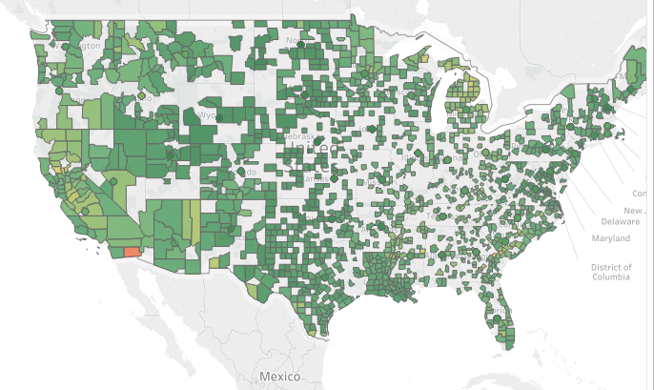
Data Sources
APIs from the US Census Bureau
US Bureau of Labor Statistics
Inkplant.com
County data for each state from 2008 - 2016 has been used in the project
GitHub Link Reference

Slide 4
The Project Journey
As we go through the presentation we may not see perfect correlations, perfect R2 scores or a near zero mean square error value.
A perfect score was not the sole objective of the project. The experiments with the dataset , fine tuning the data were a key factor is coming to picking up our regression model.
GitHub Link Reference

Slide 5
Technologies Used:
Python
Pandas
Matplotlib
Scikit Learn
Numpy
Jupyter Notebook
Sqlite
MS-Excel
Tableau
Agile Scrum
GitHub Link Reference

Slide 6
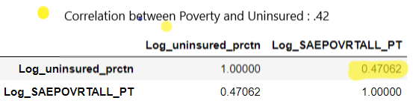
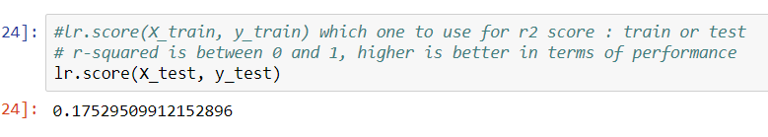
Univariate Regression
Uninsured as a function of Poverty
LINEAR REGRESSION
Notes:
We created a Univariate Linear Regression and calculated the correlation , R2 score and Mean Square Error.
The correlation between Poverty and people without Insurance is 47%.
The R2 score is around 0.17.

Slide 7
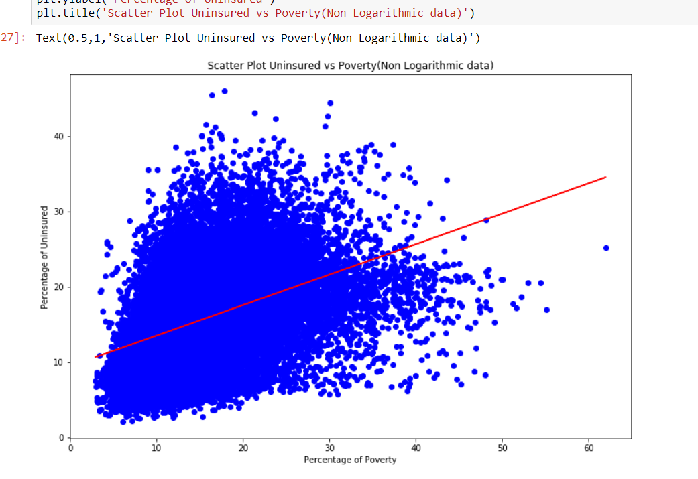
Univariate Regression
Uninsured as a function of Poverty
GitHub Link Reference
Notes:
We created as scatter plot and notice that the prediction of the model (shown in red), lies in between the actual data set, showing a positive correlation between the two parameters.
The counties on the line of best fit have the greatest correlation between poverty and uninsured.

Slide 8
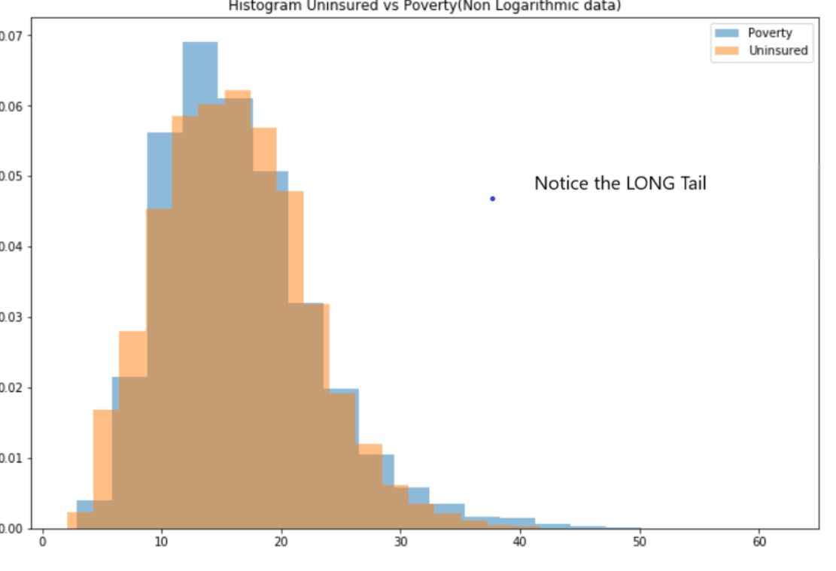
Univariate Regression
Uninsured as a function of Poverty
GitHub Link Reference
Notes:
Our next step was to draw a histogram of Uninsured and poverty. The data is skewed as we can see from the long tail of the histogram.

Slide 9
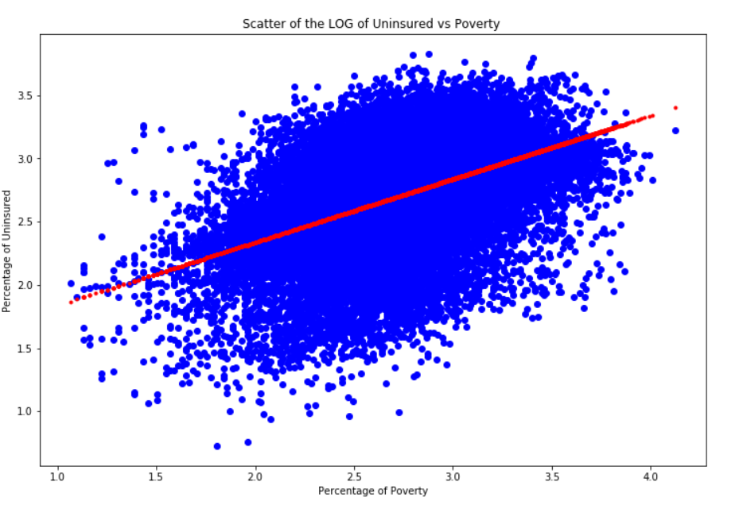


Univariate Regression
Uninsured as a function of Poverty
Notes:
To smoothen the data we took the LOGARITHMIC values ot the two parameters(Poverty and Uninsured). The scatter plot pretty much tells the same story.

Slide 10
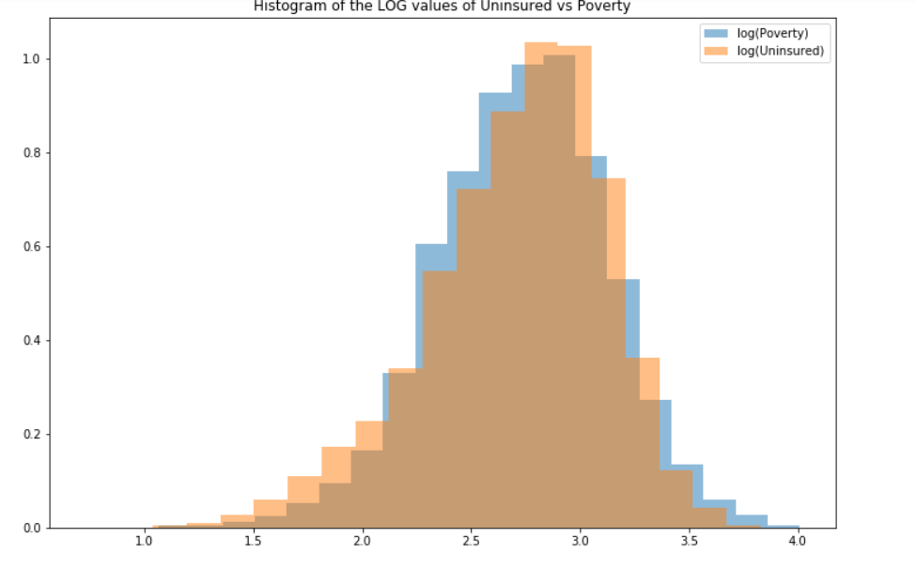
Univariate Regression
Uninsured as a function of Poverty
Univariate Regression
Uninsured as a function of Poverty
Notes:
To smoothen the data we took the LOGARITHMIC values ot the two parameters(Poverty and Uninsured). Notice that the histogram has a shorter tail and is closer to a BELL CURVE!

Slide 11
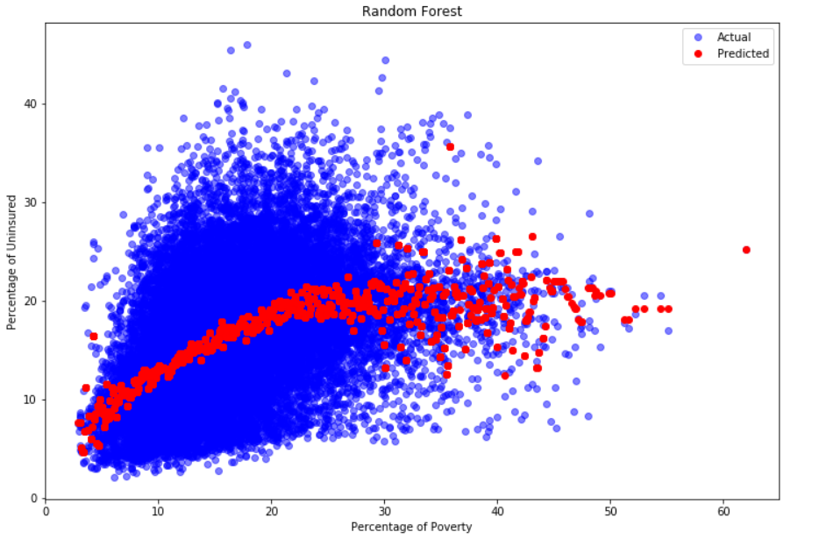
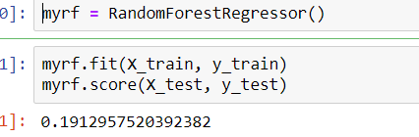
Univariate Regression
Uninsured as a function of Poverty - RANDOM FOREST
GitHub Link Reference
Notes:
We generated a Random Forest Regression and noticed a small reduction in the overall R2 score form 0.22 to 0.19. The scatter plot is very similar to the Linear Regression.

Slide 12
Analysis of the Univariate Regression
We see a positive correlation between % of poverty and % of uninsured people. It means that there is a direct relationship between these two parameters.
In other words, if % of poverty goes up, the % of uninsured people also goes up. However, the correlation value is approx. 0.47, which signifies a fairly strong correlation.
Also from the regression the R2 score is 0.22 , not very good. Therefore, it seems modeling the exact % of uninsured people from % of poverty is not straightforward , but the graph and correlation show a positive relationship.
A Linear Regression is better suited for the chosen data set.
GitHub Link Reference

Slide 13
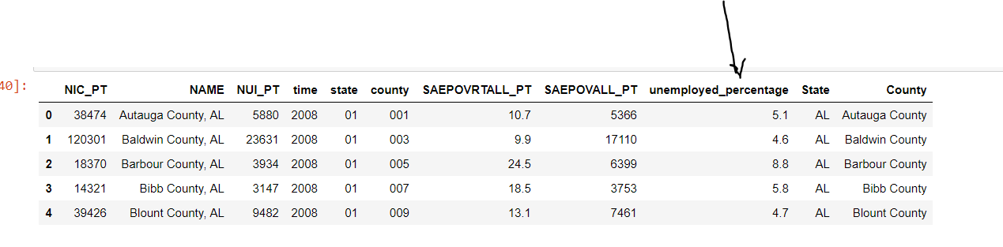
Multivariate Regression
Uninsured as a function of Poverty and Unemployment - LINEAR REGRESSION
Notes:
We have now added a second feature(% unemployed) to our data set.

Slide 14
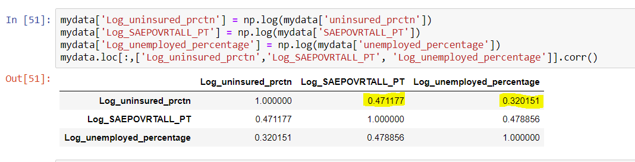
Multivariate Regression
Uninsured as a function of Poverty and Unemployment
Correlation between Uninsured/Poverty and Uninsured/Unemployment
Notes:
We notice that the correlation between Uninsured and Poverty is 47%
The correlation between Uninsured and Unemployed is 32%

Slide 15
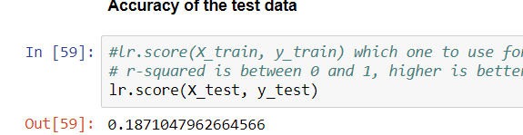
Multivariate Regression
Uninsured as a function of Poverty and Unemployment
Model Score
Notes:
The R2 score of the model still remains low around 0.18

Slide 16
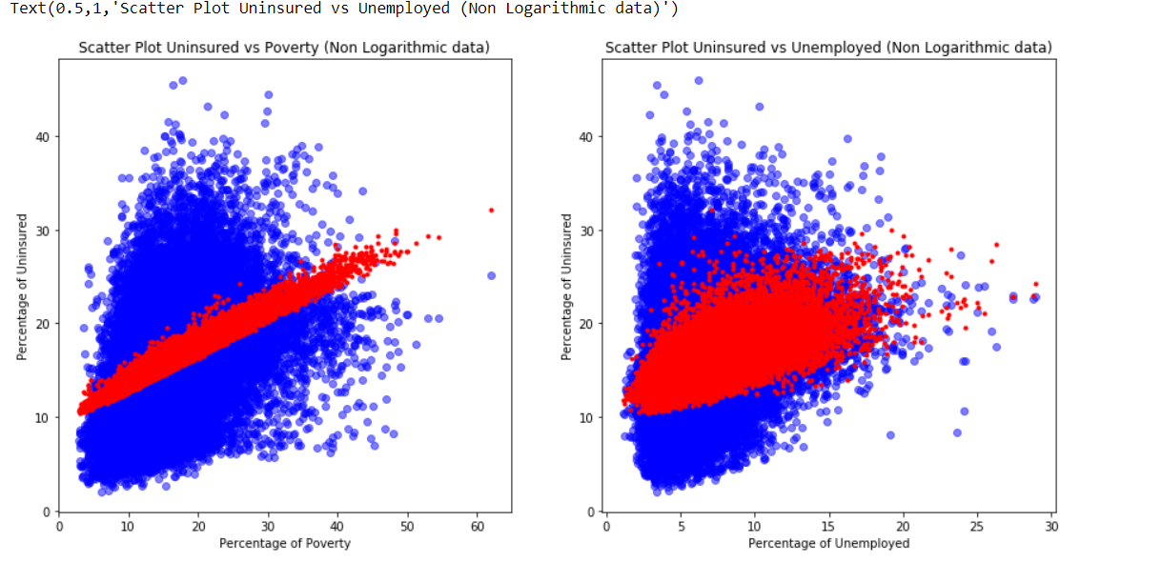
Multivariate Regression
Uninsured as a function of Poverty and Unemployment
Notes:
We created a subplot for Uninsured vs Poverty and Uninsured vs Unemployment.
The predictions of both the plots lie in the centre of the actual data. However the plot for the unemployment covers the variation in the actual data.

Slide 17
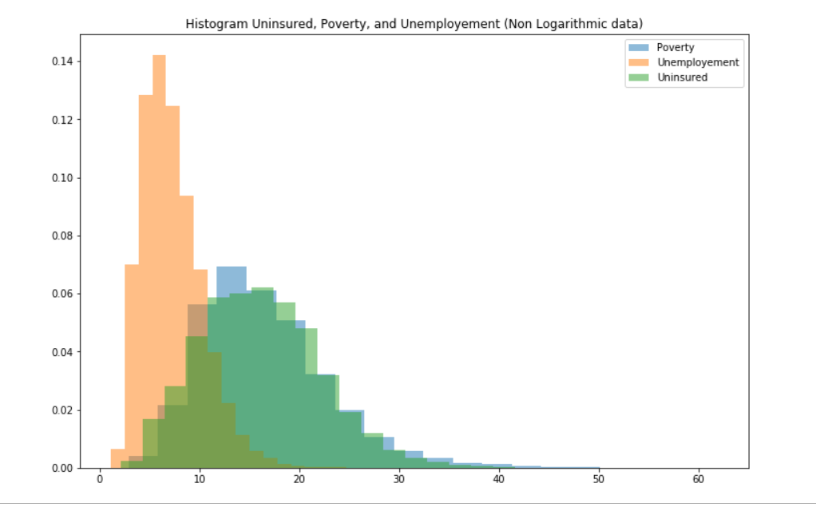
Multivariate Regression
Uninsured as a function of Poverty and Unemployment
Notes:
We created a histogram for Uninsured , Poverty and Unemployment.
The data appears to be skewed, which is reflected by the histogram having a Long Tail.

Slide 18
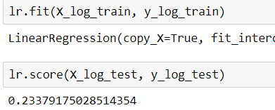
Multivariate Regression
Uninsured as a function of Poverty and Unemployment
GitHub Link Reference
Notes:
To smoothen the data we used the log values of the data set and noticed a small increment in the score of the model , 0.23

Slide 19
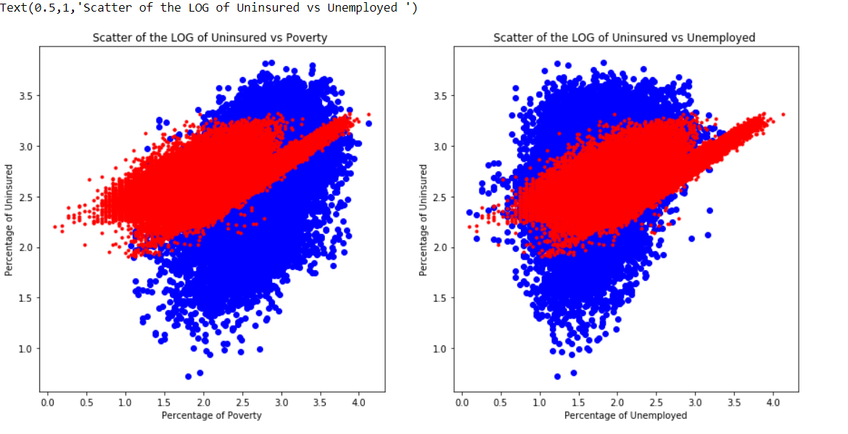
Multivariate Regression
Uninsured as a function of Poverty and Unemployment
Notes:
Created 2 subplots of the LOG data and notice that the prediction does cover a larger portion of the actual data set.

Slide 20
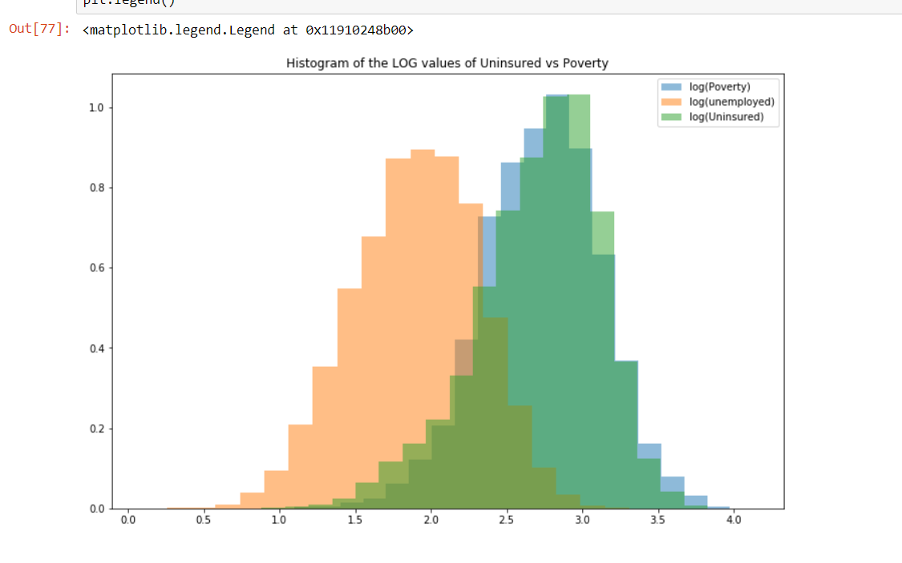
Multivariate Regression
Uninsured as a function of Poverty and Unemployment
Notes:
A histogram of the three attributes shows a close resemblance to a bell BELL CURVE!

Slide 21
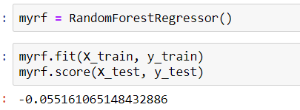
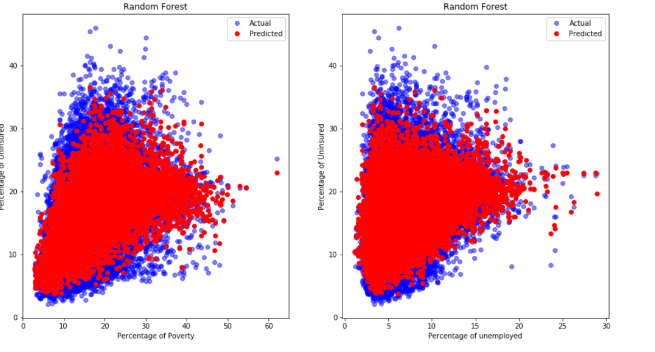
Multivariate Regression
Uninsured as a function of Poverty and Unemployment - RANDOM FOREST
Notes:
A Random Forest Regression reduces the score of the model drastically.
However the prediction does cover a large portion of the actual data set.

Slide 22
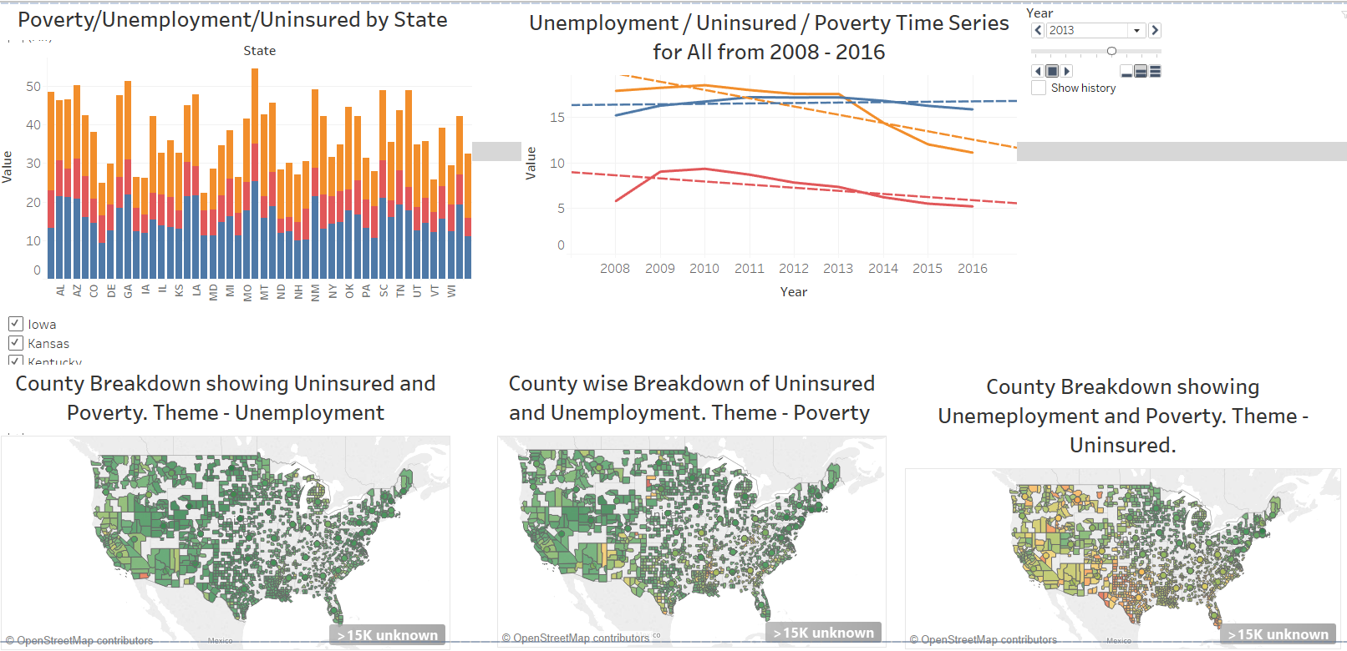
ViSuAlIzAtIoNs
Notes:
Stacked bar of Poverty / Unemployment / Uninsured by State
A Time series line graph of Poverty / Unemployment / Uninsured by State along with trend lines for each attribute
A county wise visualization of each theme with each feature being in a different color

Slide 23
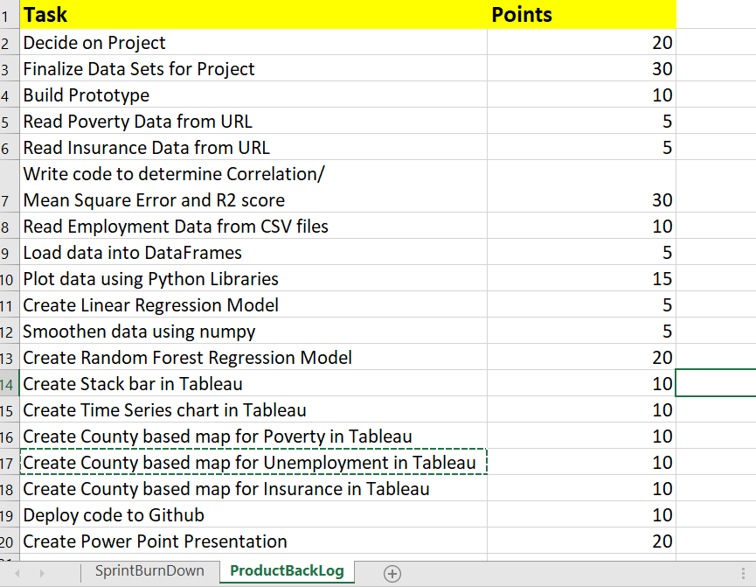
Project Management
Product Backlog
Notes:
Used Agile Scrum methodology to manage project

Slide 24
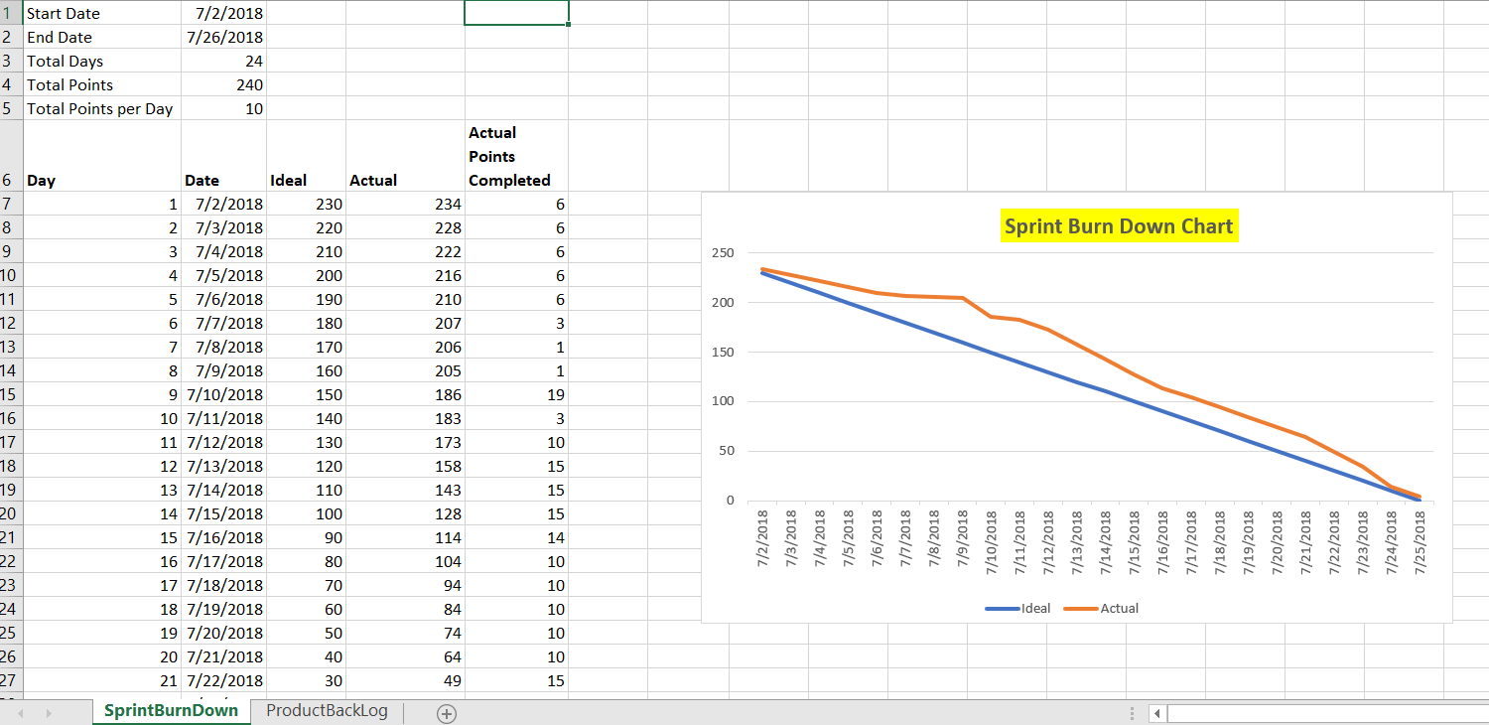
Sprint Burndown
Notes:
Sprint Burndown Chart

