Slide 1
FITNESS BUDDY - ai agent
Presented By:
Anuj Raghuwanshi
Technocrats Institute of Technology (Excellence)
raghuanuj810@edunetmail.com

Slide 2
OUTLINE
Problem Statement
Technology used
Wow factor
End users
Result
Conclusion
Git-hub Link
Future scope
IBM Certifications

Slide 3
Problem statement
In today’s fast-paced world, many individuals struggle to maintain a healthy lifestyle due to lack of personalized guidance, time constraints, and inconsistent motivation. Traditional fitness solutions often require expensive subscriptions, in-person consultations, or rigid schedules that don't adapt to personal preferences or daily routines. There is a growing need for an accessible, friendly, and intelligent virtual assistant that can provide on demand fitness advice, healthy lifestyle suggestions, and basic nutrition guidance—all tailored to individual needs and available at any time. Fitness Buddy aims to solve this problem by offering a conversational, AI-powered health and fitness coach that can: Recommend home workouts and routines based on user input. Provide motivational tips and daily fitness inspiration. • Suggest simple, nutritious meal ideas. • Encourage habit-building and consistency.

Slide 4
Technology used
Watsonx.ai Studio
- IBM Granite Model
- Watsonx Vector Index
- IBM Cloud Object Storage
- IBM IAM Authentication
- IBM Cloud Lite Account

Slide 5
IBM cloud services used
IBM Cloud Watsonx AI Studio
IBM Cloud Watsonx AI runtime
IBM Cloud Agent Lab
IBM Granite foundation model

Slide 6
Wow factors
- Adaptive workouts based on user goals and inputs
- No gym or equipment required
- Easy 10-minute workouts for daily consistency
- Uses real health documents as reference (e.g., WHO/CDC guidelines)
- Voice-based guidance with NLP
- Polite refusal of irrelevant questions
- Built entirely using IBM Cloud tools

Slide 7
End users
Fitness Enthusiasts – Individuals seeking personalized workout plans and progress tracking
Beginners – Newcomers to fitness who need guidance and motivation
Busy Professionals – People with limited time who prefer flexible, AI-led workouts
Seniors – Older adults needing safe, low-impact exercise routines
Rehabilitation Patients – Users recovering from injury or surgery
Corporate Employees – Workers participating in wellness programs
Students – Young users balancing academics and fitness
Home Workout Users – People preferring remote or home-based fitness solutions
Athletes – Advanced users optimizing performance and recovery
Mental Wellness Seekers – Individuals using fitness to support emotional health

Slide 8
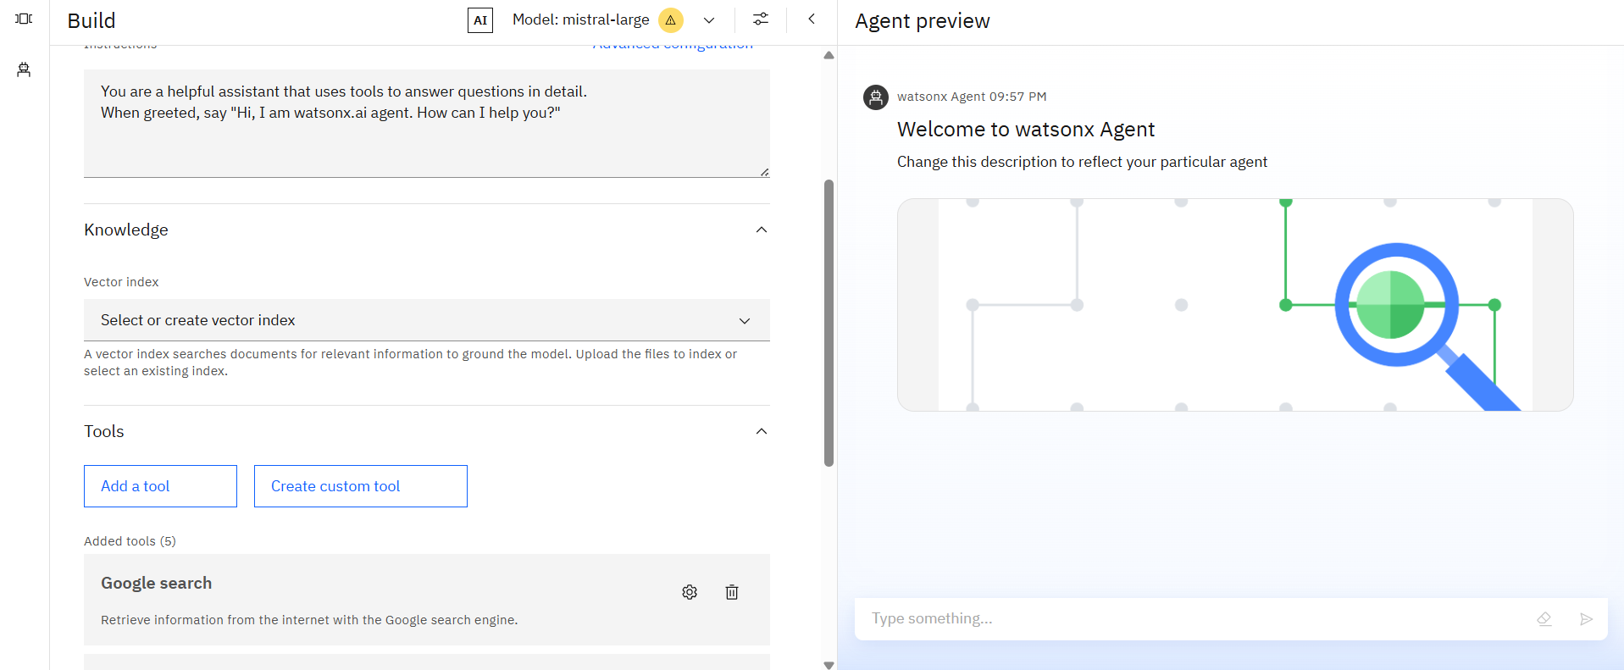
Results

Slide 9
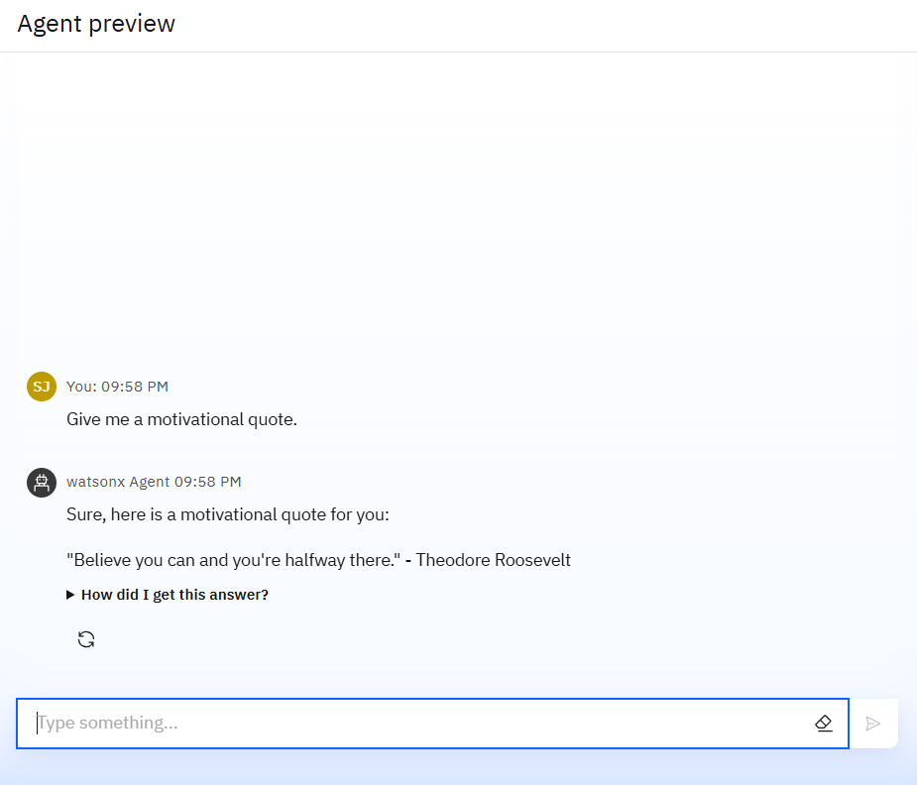
Results

Slide 10
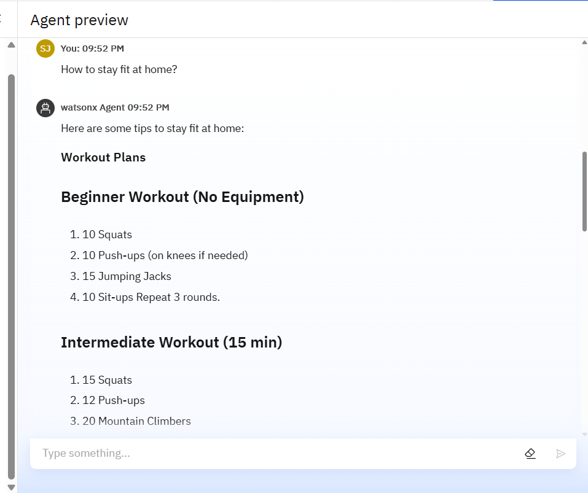
Results

Slide 11
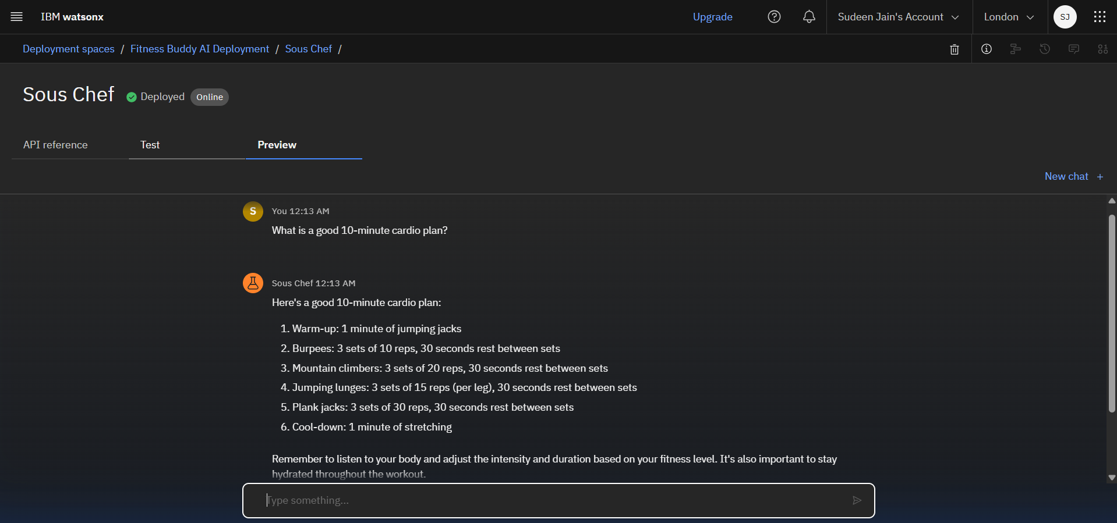
Results
Deployed AI Agent

Slide 12
Conclusion
Enhances fitness through personalized, data-driven workouts
Offers expert-level guidance with real-time feedback and coaching
Promotes holistic wellness by integrating nutrition, recovery, and mental health
Increases engagement via gamification and social features
Adapts to diverse user needs—from beginners to rehab patients
Poised to become a mainstream tool in personal and corporate wellness

Slide 13
GitHub Link
anujraghuwanshi9900/fitness-buddy-edunet-project

Slide 14
Future scope
Personalized workout plans based on goals, fitness level, and biometric data
Real-time form correction using computer vision
Voice/chat-based coaching for motivation and guidance
Integration with nutrition and recovery tracking
Gamification features like challenges and leaderboards
Mental wellness support through mood-based workout suggestions
Adaptive learning to optimize progress and prevent plateaus
Compatibility with wearables and smart home devices
Specialized modules for kids, seniors, and rehab patients
Corporate wellness and remote fitness program integration

Slide 15
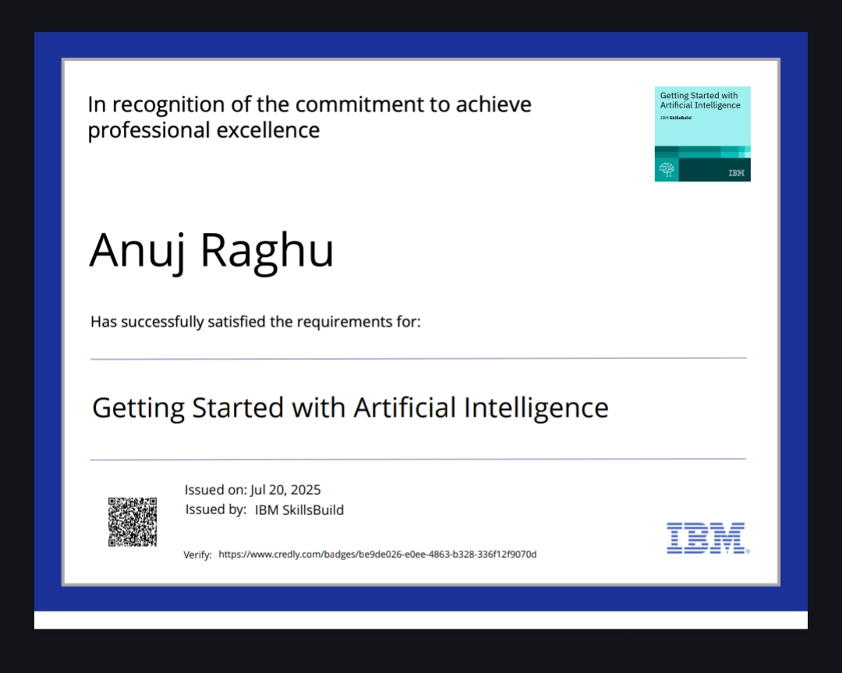
IBM Certifications

Slide 16
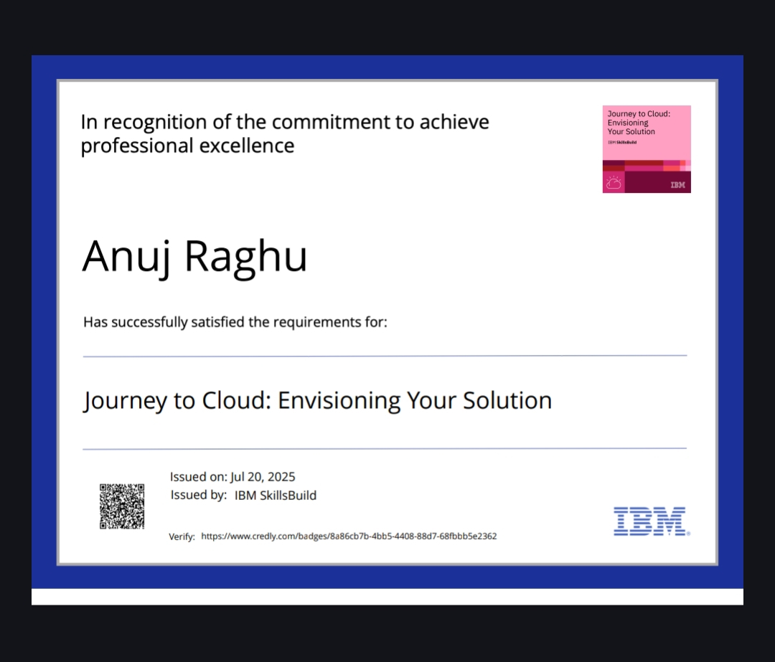

Slide 17
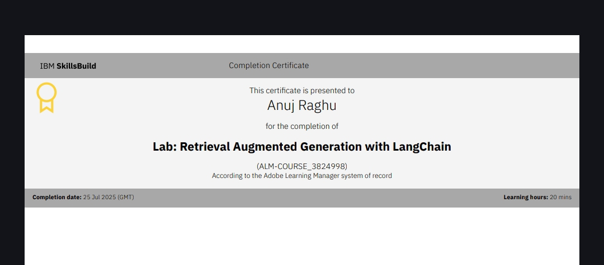

Slide 18
THANK YOU

