Slide 1

LAMX PRESENTS
Project on computer vision
Members :
Lokesh kapgate
Mahesh Bahadare
Om Malthane
Anuj suryawanshi

Slide 2
Problem statement :
Creating solution for a users which face difficulty in determining there original cloth size and providing a virtul
Cloth try on.
Why to solve this issue :
1)Human body sizes changes over time so users face difficulty to find there original size
2)Using physical cloth try on clients faces skin disease and health issue.
3)Companies loose sales counts due to customers are not getting there exact size

Slide 3
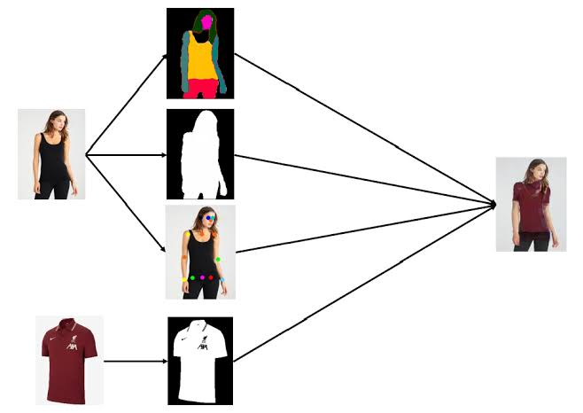
Impact of solution :
1)It help companies to increase sales
2)It provide alternate way to try cloth
3)It provide convenience to consumers.

Slide 4
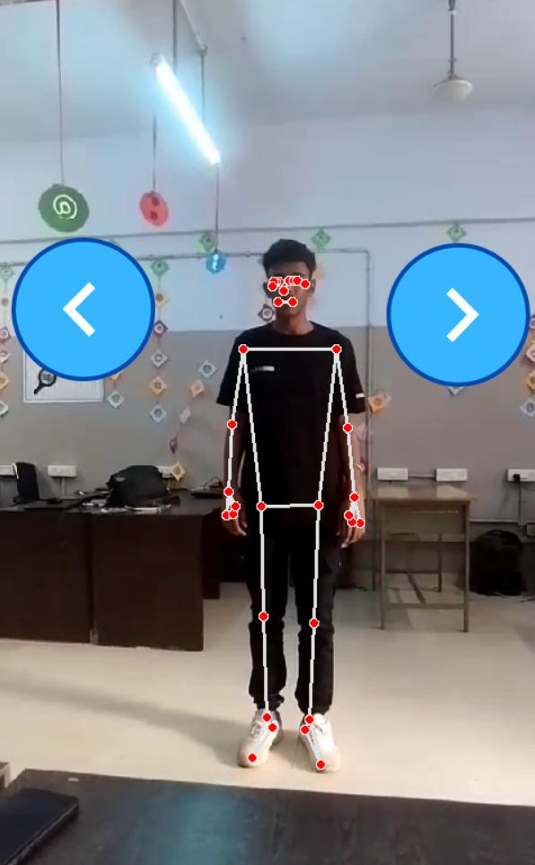
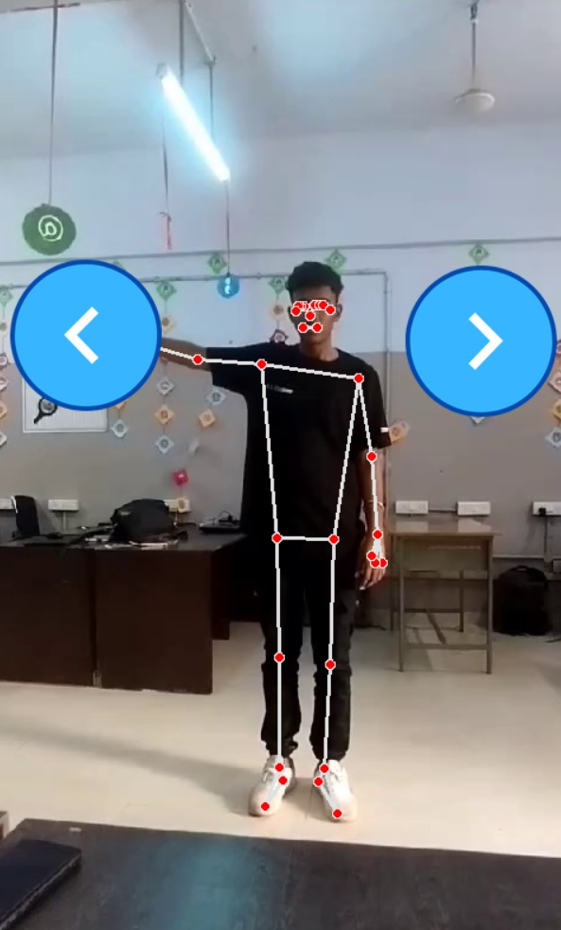
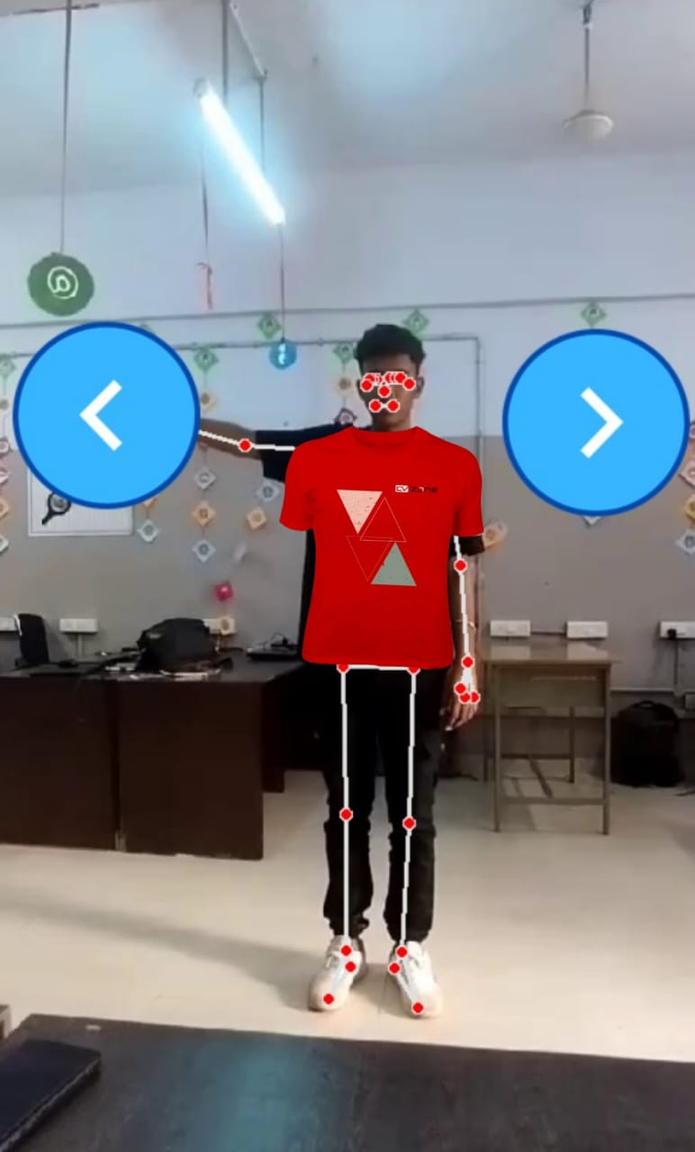
DEMO OF TRY OUT
1

Slide 5
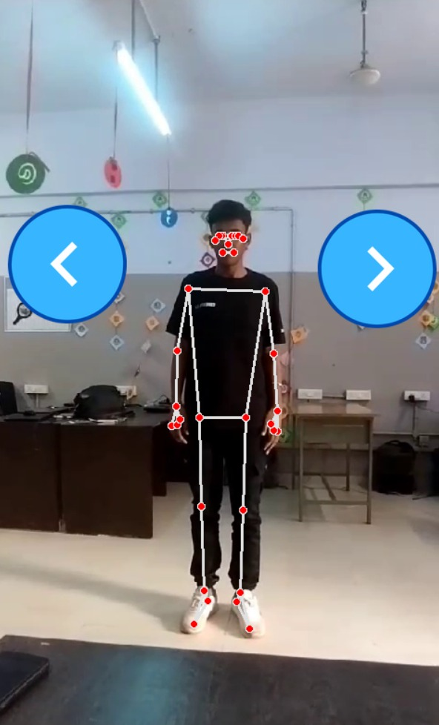
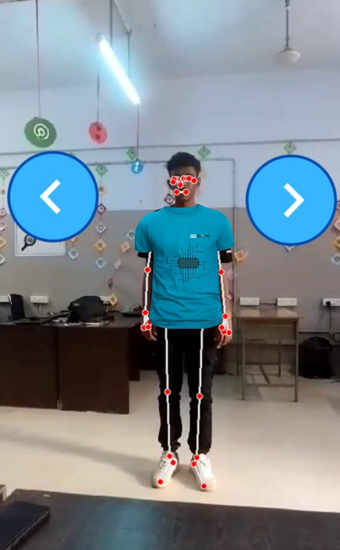

Slide 6
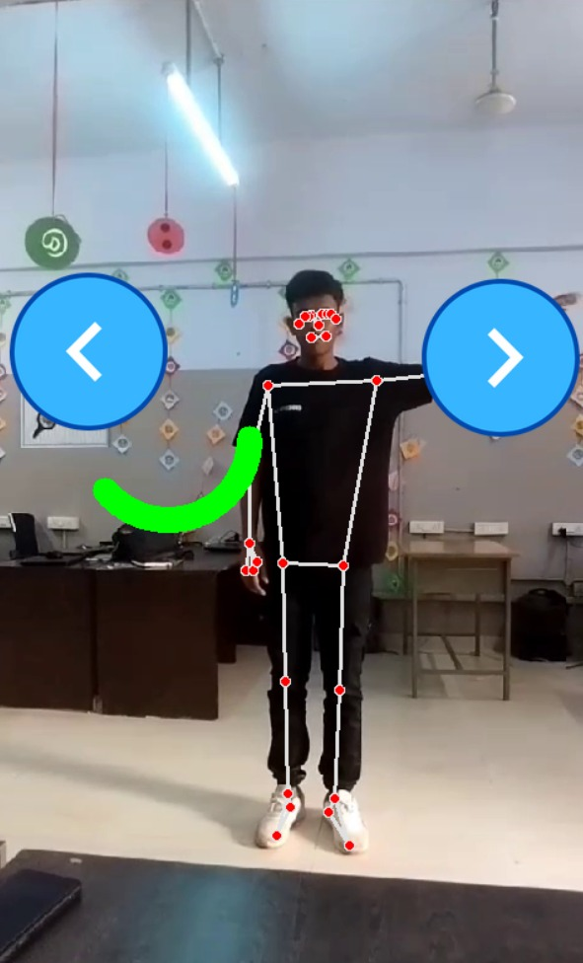
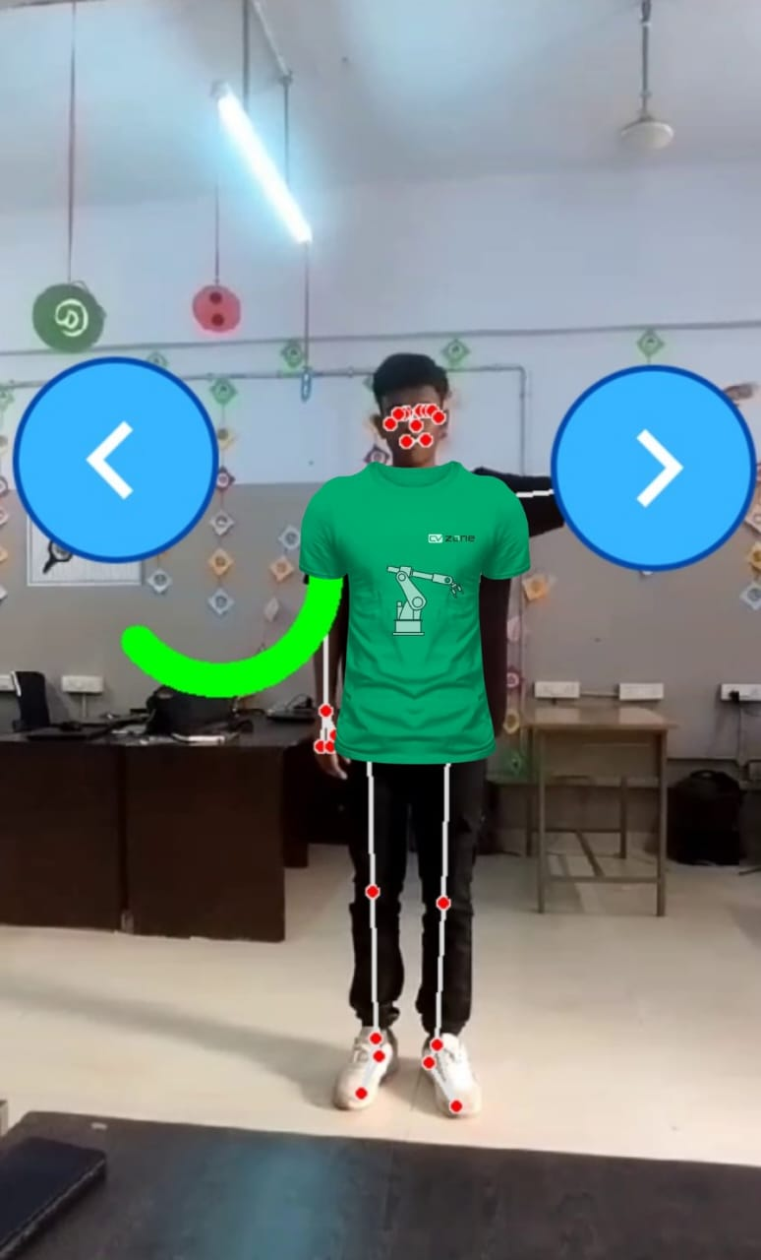

Slide 7
Components of solutions
Product data from store site
Processed output
User input in form of video or image

Slide 8

Advantages of projects :
Reduces skin diseases
Reduces man power
It provides ease to customer for selecting products
This Photo by Unknown Author is licensed under CC BY-NC

Slide 9
THANKS..

