Slide 1
Voice Biometric Authentication System with Real-time Liveness Detection Using Conversational Prompts

Slide 2
Abstract
Secure & User-Friendly – Voice biometrics leverages unique vocal features for contactless and convenient authentication.
Challenges in Existing Systems – Vulnerable to spoofing attacks like replayed precordings, synthetic speech, and deepfake audio.
Proposed Solution – A voice biometric system with real-time liveness detection using dynamic conversational prompts.
Core Approach – Users answer randomly generated questions in real-time,
preventing attackers from replaying or predicting responses.
Technical Implementation – Advanced speech processing + machine learning +deep learning enable spoof detection via acoustic, linguistic, and timing features.

Slide 3
Applications & Benefits – Useful in banking, mobile access, IoT, and remote authentication, providing a robust and resilient framework against
modern voice-based threats.
Keywords:
Voice biometrics, liveness detection, conversational prompts, anti-spoofing, speaker verification, replay attack prevention, speech recognition, secure authentication, speech processing, biometric security.

Slide 4
Introduction
Why Voice Authentication?
Unique Identity – Voice carries both physiological (vocal tract) and behavioral (speaking style) features.
Non-Intrusive – No physical contact required, unlike fingerprint or iris scans.
Ease of Use – Natural and convenient for everyday authentication.
Remote Suitability – Works well for mobile, IoT, and cloud-based services.
Cost-Effective – Requires only a microphone (no special hardware).

Slide 5
Why Conversational Prompts?
Dynamic Authentication – Replaces static passphrases with random questions, making attacks harder.
Prevents Replay Attacks – Attackers cannot reuse pre-recorded audio.
Spoof-Resistant – Detects deepfakes and synthetic speech by analyzing spontaneity.
Liveness Verification – Ensures the speaker is responding in real time.
User-Friendly – Mimics natural human interaction, improving usability.

Slide 6
challenges with existing system
Replay Attacks – Attackers can use recorded voices to bypass authentication.
Synthetic Speech & Deepfakes – AI-generated voices can mimic real users convincingly.
Static Passphrases – Fixed phrases make systems predictable and easier to spoof.
Environmental Noise – Background noise reduces accuracy and reliability.
Lack of Robust Liveness Detection – Many systems fail to differentiate between genuine
and fraudulent voices.

Slide 7
Problem Statement
Traditional password-based systems are vulnerable to theft, phishing, and brute-force attacks.
Conventional voice authentication using static passphrases can be easily bypassed.
Replay attacks using pre-recorded voices pose a serious threat.
Synthetic speech and deepfake technologies make spoofing more advanced and harder to detect.
Existing liveness detection methods are limited and often inaccurate under real-world conditions.
There is a need for a secure, real-time, and user-friendly authentication system that verifies both identity and liveness.

Slide 8
Objectives
To design a secure voice biometric authentication system.
To integrate real-time liveness detection to prevent spoofing.
To use dynamic conversational prompts instead of static passphrases.
To apply advanced speech processing and machine learning for accurate verification.
To detect and defend against replay, synthetic, and deepfake audio attacks.
To ensure the system is scalable, efficient, and user-friendly.

Slide 9
Scope
Banking & Finance – Secure authentication for transactions and customer identity.
E-Learning & Online Exams – Prevent impersonation and proxy attendance.
IoT & Smart Devices – Voice-based secure access and control.
Mobile Applications – Safe and convenient login for remote users.
Government & Defense – High-security access to sensitive systems.
Enterprise Solutions – Employee verification for secure logins and workplace systems.

Slide 10
Proposed System
Voice-Based Authentication: The system authenticates users by analyzing their unique vocal characteristics, ensuring a secure and convenient login method.
Real-Time Liveness Detection: It verifies that the speaker is physically present and responding in real time, preventing spoofing attacks from recorded or synthesized voices.
Conversational Prompts: Users are prompted with dynamically generated questions or phrases, which they must respond to, adding an extra layer of security against impersonation.
Feature Extraction and Matching: Advanced signal processing and machine learning algorithms extract unique voice features and compare them with stored templates to verify identity accurately.
User-Friendly and Secure: The system balances security and usability, offering a seamless authentication experience while maintaining robust protection against unauthorized access.

Slide 11
Methodology
Data Collection: Record voice samples from authorized users under different conditions to create a comprehensive voice database.
Preprocessing: Clean the audio data by removing noise, normalizing volume, and segmenting speech for accurate feature extraction.
Feature Extraction: Extract unique voice characteristics such as pitch, tone, MFCC (Mel Frequency Cepstral Coefficients), and speech dynamics for each user.
Conversational Prompt Generation: Generate dynamic text or question prompts for users to respond to, ensuring that liveness is verified in real time.
Voice Matching & Liveness Detection: Use machine learning algorithms to compare extracted voice features with stored templates and simultaneously detect liveness through response patterns and behavioral cues.
Authentication Decision: Grant or deny access based on the combined results of speaker verification and liveness detection, logging attempts for security auditing and system improvement.

Slide 12
Software Requirements (Functional)
User Registration: Allow new users to register by capturing their voice samples and creating a voice template.
Authentication: Verify user identity by matching live voice input against stored voice templates.
Real-Time Liveness Detection: Detect whether the user is live and responding to prompts to prevent spoofing.
Conversational Prompts: Generate dynamic questions or sentences for users to respond to during authentication.
Access Control: Grant or deny access based on the result of voice verification and liveness detection.

Slide 13
Software Requirements (Non Functional)
Performance: System should process authentication requests and liveness detection within 2–5 seconds.
Accuracy: Ensure high recognition accuracy (≥95%) to minimize false acceptances and rejections.
Scalability: Capable of handling multiple users and large voice databases without performance degradation.
Security: Protect voice data, templates, and authentication logs from unauthorized access and tampering.
Usability: Provide a simple, user-friendly interface for registration and authentication without requiring technical expertise.

Slide 14
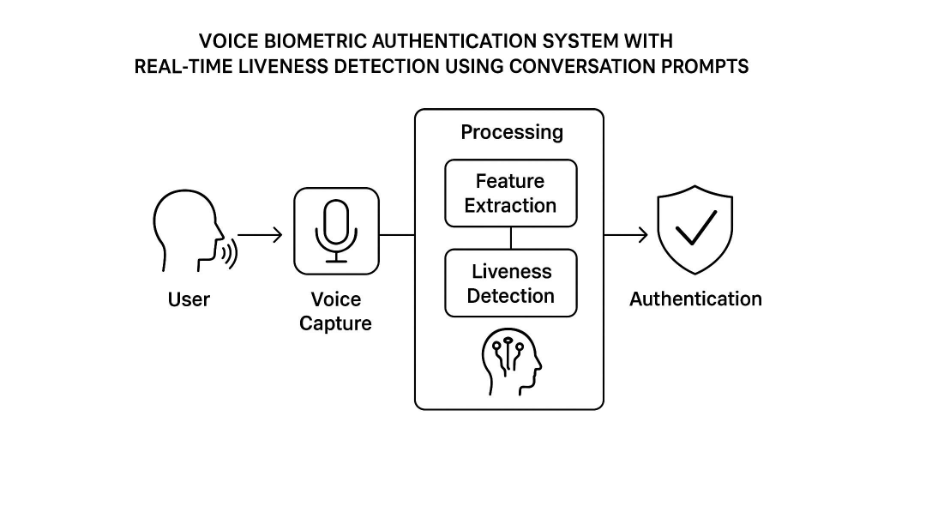
System Architecture

Slide 15
Summary
The system provides secure and convenient voice-based authentication.
Real-time liveness detection prevents spoofing attacks and unauthorized access.
Conversational prompts enhance security by dynamically challenging users.
Combines machine learning and signal processing for accurate feature extraction and verification.
Suitable for applications like banking, remote access, and secure systems, balancing security with user convenience.

