Slide 2
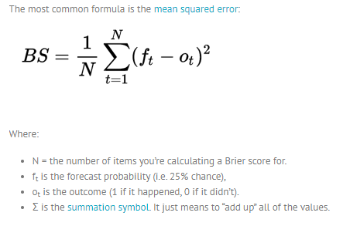
The score can only be used for binary outcomes, where there are only two possible events, like “it rained” or “it didn’t rain.” It could also be used for categorical outcomes as long as they can be structured as binary outcomes (i.e. “true” or “false”).
For uni dimensional predictions, it is strictly equivalent to the mean squared error as applied to predicted probabilities.

Slide 3
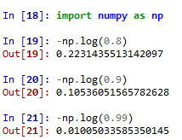

when a model overfits to cross entropy, it tends to result in a low-entropy softmax distribution over classes. This is visible, in part, by the fact that ResNet (2016) consistently tends to have higher confidence than accuracy.
As noted earlier, there is a disconnect between minimizing a cross entropy term and being well calibrated. Because minimizing a cross entropy loss does not ensure calibration, and even tends to overfit classification accuracy, it’s imperative to calibrate any model where probabilities are passed on to some other decision-making system. In practice, almost all deep models must be calibrated.

Slide 4
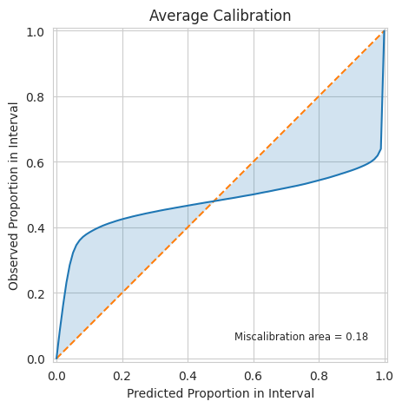
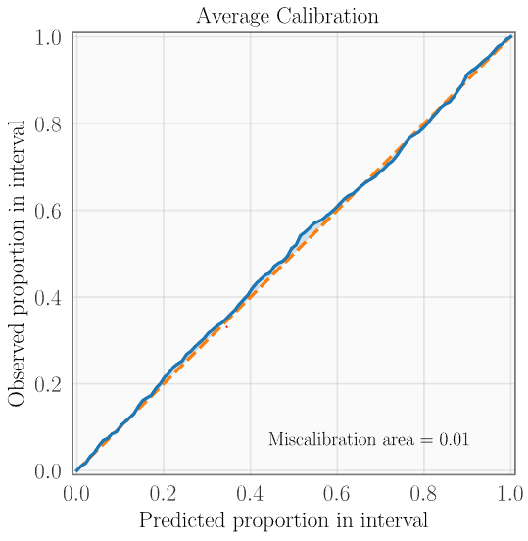
Mis calibrated Model
Perfectly calibrated Model
Under Confidence
Observed confidence (fraction of positives/accuracy)
Observed confidence (fraction of positives/accuracy)
Over Confidence
Predicted confidence
Predicted confidence

Slide 5
Neural Network 1
Samples | X₁ | X₂ | X₃ | X₄ | X₅ | X₆ | X₇ | X₈ | X₉ | X₁₀ | X₁₁ | X₁₂ | X₁₃ | X₁₄ | X₁₅
Predicted Probability | 0.7 | 0.67 | 0.23 | 0.19 | 0.9 | 0.97 | 0.54 | 0.77 | 0.15 | 0.3 | 0.85 | 0.69 | 0.34 | 0.45 | 0.53
Predicted Class | 1 | 1 | 0 | 0 | 1 | 1 | 1 | 1 | 0 | 0 | 1 | 1 | 0 | 0 | 1
True Class | 1 | 0 | 1 | 0 | 1 | 0 | 0 | 0 | 1 | 0 | 1 | 1 | 0 | 1 | 1
B_{m}
Neural Network 1
Bin Notation | Bins | Samples | Avg. predicted confidence | Avg. observed confidence (accuracy = num correct samples/num of samples in the bin)
B₁ | 0-0.2 | X₄, X₉ | (0.19+0.15)/2 = 0.17 | 1/2 = 0.5
B₂ | 0.2-0.4 | X₃, X₁₀, X₁₃ | (0.23+0.3+0.34)/3 = 0.29 | 2/3 = 0.667
B₃ | 0.4-0.6 | X₇, X₁₄, X₁₅ | (0.54+0.45+0.53)/3 = 0.5067 | 1/3 = 0.333
B₄ | 0.6-0.8 | X₁, X₂, X₈, X₁₂ | (0.7+0.67+0.77+0.69)/4 = 0.7075 | 2/4=0.5
B₅ | 0.8-1.0 | X₅, X₆, X₁₁ | (0.9+0.97+0.85)/3 = 0.9067 | 2/3=0.667

Slide 6
ECE computed for binary classification
Neural Network 1 - ECE
Bin Notation | Bins | Samples | Avg. predicted confidence | Avg. observed confidence (accuracy = num correct samples/num of samples in the bin) | Expected Calibration Error
B₁ | 0-0.2 | X₄, X₉ | (0.19+0.15)/2 = 0.17 | 1/2 = 0.5 | (2/15)*|0.5-0.17| = 0.044
B₂ | 0.2-0.4 | X₃, X₁₀, X₁₃ | (0.23+0.3+0.34)/3 = 0.29 | 2/3 = 0.667 | (3/15)*|0.667-0.29| = 0.0754 (MCE)
B₃ | 0.4-0.6 | X₇, X₁₄, X₁₅ | (0.54+0.45+0.53)/3 = 0.5067 | 1/3 = 0.333 | (3/15)*|0.333-0.506| = 0.0346
B₄ | 0.6-0.8 | X₁, X₂, X₈, X₁₂ | (0.7+0.67+0.77+0.69)/4 = 0.7075 | 2/4=0.5 | (4/15)*|0.5-0.707| = 0.0552
B₅ | 0.8-1.0 | X₅, X₆, X₁₁ | (0.9+0.97+0.85)/3 = 0.9067 | 2/3=0.667 | (3/15)*|0.667-0.906| = 0.0478
 |  |  |  |  | Total ECE = 0.257

Slide 7
ECE computed in Binary Setting
Predictions
Samples | X₁ | X₂ | X₃ | X₄ | X₅ | X₆ | X₇ | X₈ | X₉ | X₁₀ | X₁₁ | X₁₂ | X₁₃ | X₁₄ | X₁₅
Predicted Probability | 0.7 | 0.67 | 0.23 | 0.19 | 0.9 | 0.97 | 0.54 | 0.77 | 0.15 | 0.3 | 0.85 | 0.69 | 0.34 | 0.45 | 0.53
Predicted Class | 1 | 1 | 0 | 0 | 1 | 1 | 1 | 1 | 0 | 0 | 1 | 1 | 0 | 0 | 1
True Class | 1 | 0 | 1 | 0 | 1 | 0 | 0 | 0 | 1 | 0 | 1 | 1 | 0 | 1 | 1
ECE Computation
Bin Notation | Bins | Samples | Avg. predicted confidence | Avg. observed confidence (accuracy = num correct samples/num of samples in the bin) | Expected Calibration Error
B₁ | 0-0.2 | X₄, X₉ | (0.19+0.15)/2 = 0.17 | 1/2 = 0.5 | (2/15)*|0.5-0.17| = 0.044
B₂ | 0.2-0.4 | X₃, X₁₀, X₁₃ | (0.23+0.3+0.34)/3 = 0.29 | 2/3 = 0.667 | (3/15)*|0.667-0.29| = 0.0754 (MCE)
B₃ | 0.4-0.6 | X₇, X₁₄, X₁₅ | (0.54+0.45+0.53)/3 = 0.5067 | 1/3 = 0.333 | (3/15)*|0.333-0.506| = 0.0346
B₄ | 0.6-0.8 | X₁, X₂, X₈, X₁₂ | (0.7+0.67+0.77+0.69)/4 = 0.7075 | 2/4=0.5 | (4/15)*|0.5-0.707| = 0.0552
B₅ | 0.8-1.0 | X₅, X₆, X₁₁ | (0.9+0.97+0.85)/3 = 0.9067 | 2/3=0.667 | (3/15)*|0.667-0.906| = 0.0478
 |  |  |  |  | Total ECE = 0.257

Slide 8
ECE computed in Multiclass Setting
Predictions
Samples | X₁ | X₂ | X₃ | X₄ | X₅ | X₆ | X₇ | X₈ | X₉ | X₁₀ | X₁₁ | X₁₂ | X₁₃ | X₁₄ | X₁₅
Predicted Probability | (0.3,0.7) | (0.33,0.67) | (0.77,0.23) | (0.81,0.19) | (0.1,0.9) | (0.03,0.97) | (0.46,0.54) | (0.23,0.77) | (0.85,0.15) | (0.7,0.3) | (0.15,0.85) | (0.31,0.69) | (0.66,0.34) | (0.55,0.45) | (0.47,0.53)
Max Prob for ECE | 0.7 | 0.67 | 0.77 | 0.81 | 0.9 | 0.97 | 0.54 | 0.77 | 0.85 | 0.7 | 0.85 | 0.69 | 0.66 | 0.55 | 0.53
Predicted Class | 1 | 1 | 0 | 0 | 1 | 1 | 1 | 1 | 0 | 0 | 1 | 1 | 0 | 0 | 1
True Class | 1 | 0 | 1 | 0 | 1 | 0 | 0 | 0 | 1 | 0 | 1 | 1 | 0 | 1 | 1
ECE Computation
Bin Notation | Bins | Samples | Avg. predicted confidence | Avg. observed confidence (accuracy = num correct samples/num of samples in the bin) | Expected Calibration Error
B₁ | 0-0.2
B₂ | 0.2-0.4
B₃ | 0.4-0.6 | X₇, X₁₄, X₁₅ | (0.54+0.55+0.53)/3 = 0.54 | 1/3 = 0.333 | (3/15)*(0.54-0.333) = 0.0414
B₄ | 0.6-0.8 | X₁, X₂, X_{3,}X₈, X_{10,} X_{12,} X₁₃ | (0.7+0.67+0.77+0.77+0.7+0.69+0.66)/7 = 0.7086 | 4/7=0.5715 | (7/15)*(0.7086-0.5715) = 0.064
B₅ | 0.8-1.0 | X_{4,}X₅, X₆, X_{9,} X₁₁ | (0.81+0.9+0.97+0.85+0.85)/5 = 0.876 | 3/5=0.6 | (5/15)*(0.876-0.6) = 0.092 (MCE)
 |  |  |  |  | Total ECE = 0.1974

Slide 9
ECE computed for binary classification in context of multiclass classification taking max probability
Neural Network 1
Samples | X₁ | X₂ | X₃ | X₄ | X₅ | X₆ | X₇ | X₈ | X₉ | X₁₀ | X₁₁ | X₁₂ | X₁₃ | X₁₄ | X₁₅
Predicted Probability | 0.7 | 0.67 | 0.77 (1-0.3) | 0.81 (1-0.19) | 0.9 | 0.97 | 0.54 | 0.77 | 0.85 (1-0.15) | 0.7 (1-0.3) | 0.85 | 0.69 | 0.66 (1-0.34) | 0.55 (1-0.45) | 0.53
Predicted Class | 1 | 1 | 0 | 0 | 1 | 1 | 1 | 1 | 0 | 0 | 1 | 1 | 0 | 0 | 1
True Class | 1 | 0 | 1 | 0 | 1 | 0 | 0 | 0 | 1 | 0 | 1 | 1 | 0 | 1 | 1
Bin Notation | Bins | Samples | Avg. predicted confidence | Avg. observed confidence (accuracy = num correct samples/num of samples in the bin) | ECE
B₁ | 0-0.2
B₂ | 0.2-0.4
B₃ | 0.4-0.6 | X₇, X₁₄, X₁₅ | (0.54+0.45+0.53)/3 = 0.5067 | 1/3 = 0.333 | (3/15)*(0.506-0.333)
B₄ | 0.6-0.8 | X₁, X₂, X_{3,}X₈, X_{10,} X_{12,} X₁₃ | (0.7+0.67+0.77+0.77+0.7+0.69+0.66)/7 = 0.7086 | 4/7=0.5715 | (7/15)*(0.7086-0.5715)
B₅ | 0.8-1.0 | X_{4,}X₅, X₆, X_{9,} X₁₁ | (0.81+0.9+0.97+0.85+0.85)/5 = 0.876 | 3/5=0.6 | (5/15)*(0.876-0.6)
 |  |  |  |  | (3/15)*(0.506-0.333)+(7/15)*(0.7086-0.5715)+(5/15)*(0.876-0.6)=0.1906

Slide 10
Neural Network 1 – 0 calibration error issue in ECE
Samples | X₁ | X₂ | X₃ | X₄ | X₅ | X₆ | X₇ | X₈ | X₉ | X₁₀ | X₁₁ | X₁₂ | X₁₃ | X₁₄ | X₁₅
Predicted Probability | 0.7 | 0.41 | 0.23 | 0.42 | 0.9 | 0.43 | 0.425 | 0.415 | 0.15 | 0.42 | 0.85 | 0.69 | 0.43 | 0.45 | 0.53
Predicted Class | 1 | 1 | 0 | 0 | 1 | 1 | 1 | 1 | 0 | 0 | 1 | 1 | 0 | 0 | 1
True Class | 1 | 0 | 1 | 0 | 1 | 0 | 0 | 0 | 1 | 0 | 1 | 1 | 0 | 1 | 1
B_{m}
Neural Network 1
Bin Notation | Bins | Samples | Avg. predicted confidence | Avg. observed confidence (accuracy = num correct samples/num of samples in the bin)
B₁ | 0-0.2 | X₄, X₉ | (0.19+0.15)/2 = 0.17 | 1/2 = 0.5
B₂ | 0.2-0.4 | X₃, X₁₀, X₁₃ | (0.23+0.3+0.34)/3 = 0.29 | 2/3 = 0.667
B₃ | 0.4-0.6 | X₇, X₁₄, X₁₅ | (0.54+0.45+0.53)/3 = 0.5067 | 1/3 = 0.333
B₄ | 0.6-0.8 | X₁, X₂, X₈, X₁₂ | (0.7+0.67+0.77+0.69)/4 = 0.7075 | 2/4=0.5
B₅ | 0.8-1.0 | X₅, X₆, X₁₁ | (0.9+0.97+0.85)/3 = 0.9067 | 2/3=0.667

Slide 11
Neural Network 2
Samples | X₁ | X₂ | X₃ | X₄ | X₅ | X₆ | X₇ | X₈ | X₉ | X₁₀ | X₁₁ | X₁₂ | X₁₃ | X₁₄ | X₁₅
Predicted Probability | 0.62 | 0.87 | 0.39 | 0.13 | 0.88 | 0.59 | 0.66 | 0.77 | 0.25 | 0.48 | 0.85 | 0.69 | 0.24 | 0.25 | 0.93
Predicted Class | 1 | 1 | 0 | 1 | 1 | 1 | 1 | 1 | 0 | 0 | 1 | 1 | 0 | 0 | 1
True Class | 1 | 0 | 1 | 0 | 1 | 0 | 0 | 0 | 1 | 0 | 1 | 1 | 0 | 1 | 1
Neural Network 2
Bin Notation | Bins | Samples | Avg. predicted confidence | Avg. observed confidence (accuracy = num correct samples/num of samples in the bin)
B₁ | 0-0.2 | X₄ | 0.13 | 0/1 = 0
B₂ | 0.2-0.4 | X₃, X₉, X₁₃, X₁₄ | (0.39+0.25+0.24+0.25)/4 = 0.2825 | 1/4 = 0.25
B₃ | 0.4-0.6 | X₆, X₁₀ | (0.59+0.48)/2 = 0.535 | 1/2 = 0.5
B₄ | 0.6-0.8 | X₁, X₇, X₈, X₁₂ | (0.62+0.66+0.77+0.69)/4 = 0.725 | 2/4=0.5
B₅ | 0.8-1.0 | X₂, X₅, X₁₁, X₁₅ | (0.87+0.88+0.85+0.93)/4 = 0.8825 | 3/4=0.75

Slide 12
Neural Network 2 - ECE
Bin Notation | Bins | Samples | Avg. predicted confidence | Avg. observed confidence (accuracy = num correct samples/num of samples in the bin) | Expected Calibration Error
B₁ | 0-0.2 | X₄ | 0.13 | 0/1 = 0 | (1/15)*|0.0-0.13| = 0.0087
B₂ | 0.2-0.4 | X₃, X₉, X₁₃, X₁₄ | (0.39+0.25+0.24+0.25)/4 = 0.2825 | 1/4 = 0.25 | (4/15)*|0.25-0.282| = 0.0085
B₃ | 0.4-0.6 | X₆, X₁₀ | (0.59+0.48)/2 = 0.535 | 1/2 = 0.5 | (2/15)*|0.5-0.535| = 0.0047
B₄ | 0.6-0.8 | X₁, X₇, X₈, X₁₂ | (0.62+0.66+0.77+0.69)/4 = 0.725 | 2/4=0.5 | (4/15)*|0.5-0.725| = 0.06 (MCE)
B₅ | 0.8-1.0 | X₂, X₅, X₁₁, X₁₅ | (0.87+0.88+0.85+0.93)/4 = 0.8825 | 3/4=0.75 | (4/15)*|0.75-0.882| = 0.0352
 |  |  |  |  | Total ECE = 0.1171

Slide 13
ECE for Multiclass (Max Prob)
Predictions
Samples | X₁ | X₂ | X₃ | X₄ | X₅ | X₆ | X₇ | X₈ | X₉ | X₁₀ | X₁₁ | X₁₂ | X₁₃ | X₁₄ | X₁₅
Predicted Probability | [0.7,0.2,0.1] | [0.1,0.67,0.23] | [0.82,0.13,0.05] | [0.82,0.03,0.15] | [0.05,0.05,0.9] | [0.97,0.01,0.02] | [0.3,0.54,0.16] | [0.2,0.77,0.03] | [0.15,0.1, 0.75] | [0.6,0.1,0.3] | [0.05,0.85,0.1] | [0,25,0.06, 0.69,] | [0.4,0.34,0.26] | [0.42,0.45,0.13] | [0.3,0.17,0.53]
Max Prob for ECE | 0.7 | 0.67 | 0.82 | 0.82 | 0.9 | 0.97 | 0.54 | 0.77 | 0.75 | 0.6 | 0.85 | 0.69 | 0.4 | 0.45 | 0.53
Predicted Class | 0 | 1 | 0 | 0 | 2 | 0 | 1 | 1 | 2 | 0 | 1 | 2 | 0 | 1 | 2
True Class | 1 | 0 | 1 | 2 | 1 | 0 | 1 | 2 | 2 | 0 | 1 | 2 | 0 | 1 | 0
ECE Computation
Bin Notation | Bins | Samples | Avg. predicted confidence | Avg. observed confidence (accuracy = num correct samples/num of samples in the bin) | Expected Calibration Error
B₁ | 0-0.2 |  |  |  | 0
B₂ | 0.2-0.4 |  |  |  | 0
B₃ | 0.4-0.6 | X₇, X₁₃, X_{14,}X₁₅ | (0.54+0.4+0.45+0.53)/4 = 0.48 | 3/4 = 0.75 | (4/15)*|0.75-0.48| = 0.072
B₄ | 0.6-0.8 | X₁, X₂, X₈, X_{9,}X_{10,} X₁₂ | (0.7+0.67+0.77+0.75+0.6+0.69)/6 = 0.6967 | 3/6=0.5 | (6/15)*|0.5-0.6967| = 0.0787
B₅ | 0.8-1.0 | X₃, X₄, X_{5,} X₆, X₁₁ | (0.82+0.82+0.9+0.97+0.85)/5 = 0.872 | 2/5=0.4 | (5/15)*|0.4-0.872| = 0.1573 (MCE)
 |  |  |  |  | Total ECE = 0.308

Slide 14
SCE for Multiclass : ECE for class 0
Predictions
Samples | X₁ | X₂ | X₃ | X₄ | X₅ | X₆ | X₇ | X₈ | X₉ | X₁₀ | X₁₁ | X₁₂ | X₁₃ | X₁₄ | X₁₅
Predicted Probability | [0.7,0.2,0.1] | [0.1,0.67,0.23] | [0.82,0.13,0.05] | [0.82,0.03,0.15] | [0.05,0.05,0.9] | [0.97,0.01,0.02] | [0.3,0.54,0.16] | [0.2,0.77,0.03] | [0.15,0.1, 0.75] | [0.6,0.1,0.3] | [0.05,0.85,0.1] | [0,25,0.06, 0.69,] | [0.4,0.34,0.26] | [0.42,0.45,0.13] | [0.3,0.17,0.53]
Class 0 Prob for ECE | 0.7 | 0.1 | 0.82 | 0.82 | 0.05 | 0.97 | 0.3 | 0.2 | 0.15 | 0.6 | 0.05 | 0.25 | 0.4 | 0.42 | 0.3
Predicted Class | 0 | 1 | 0 | 0 | 2 | 0 | 1 | 1 | 2 | 0 | 1 | 2 | 0 | 1 | 2
True Class | 1 | 0 | 1 | 2 | 1 | 0 | 1 | 2 | 2 | 0 | 1 | 2 | 0 | 1 | 0
ECE Computation
Bin Notation | Bins | Samples | Avg. predicted confidence | Avg. observed confidence (accuracy = num correct samples/num of samples in the bin) | Expected Calibration Error
B₁ | 0-0.2 | X₂, X₅, X₉, X₁₁ | (0.1+0.05+0.15+0.05)/4 = 0.0875 | 0/4=0 | (4/15)*|0-0.0875| = 0.0233
B₂ | 0.2-0.4 | X₇, X₈, X₁₂, X₁₅ | (0.3+0.2+0.25+0.3)/4 = 0.2625 | 0/4=0 | (4/15)*|0-0.2625| = 0.07
B₃ | 0.4-0.6 | X₁₃, X₁₄ | (0.4+0.42)/2 = 0.41 | 1/2=0.5 | (2/15)*|0.5-0.41| = 0.012
B₄ | 0.6-0.8 | X_{1,}X₁₀ | (0.7+0.6)/2 = 0.65 | 1/6=0.1667 | (2/15)*|0.1677-0.65| = 0.0643
B₅ | 0.8-1.0 | X₃, X₄, X₆ | (0.82+0.82+0.97)/3 = 0.87 | 1/3=0.333 | (3/15)*|0.333-0.87| = 0.1074 (MCE)
 |  |  |  |  | Total ECE (class 0) = 0.277

Slide 15
SCE for Multiclass : ECE for class 1
Predictions
Samples | X₁ | X₂ | X₃ | X₄ | X₅ | X₆ | X₇ | X₈ | X₉ | X₁₀ | X₁₁ | X₁₂ | X₁₃ | X₁₄ | X₁₅
Predicted Probability | [0.7,0.2,0.1] | [0.1,0.67,0.23] | [0.82,0.13,0.05] | [0.82,0.03,0.15] | [0.05,0.05,0.9] | [0.97,0.01,0.02] | [0.3,0.54,0.16] | [0.2,0.77,0.03] | [0.15,0.1, 0.75] | [0.6,0.1,0.3] | [0.05,0.85,0.1] | [0.25,0.06, 0.69,] | [0.4,0.34,0.26] | [0.42,0.45,0.13] | [0.3,0.17,0.53]
Class 1 Prob for ECE | 0.2 | 0.67 | 0.13 | 0.03 | 0.05 | 0.01 | 0.54 | 0.77 | 0.1 | 0.1 | 0.85 | 0.06 | 0.34 | 0.45 | 0.17
Predicted Class | 0 | 1 | 0 | 0 | 2 | 0 | 1 | 1 | 2 | 0 | 1 | 2 | 0 | 1 | 2
True Class | 1 | 0 | 1 | 2 | 1 | 0 | 1 | 2 | 2 | 0 | 1 | 2 | 0 | 1 | 0
ECE Computation
Bin Notation | Bins | Samples | Avg. predicted confidence | Avg. observed confidence (accuracy = num correct samples/num of samples in the bin) | Expected Calibration Error
B₁ | 0-0.2 | X₃, X₄, X₅, X_{6,} X₉, X₁₀, X₁₂, X₁₅ | (0.13+0.03+0.05+0.01+0.1+0.1+0.06+0.17)/8 = 0.0813 | 0/8=0.5 | (8/15)*|0-0.0813| = 0.0434
B₂ | 0.2-0.4 | X₁, X₁₃ | (0.2+0.34)/2 = 0.27 | 0/2=0 | (2/15)*|0-0.27| = 0.036
B₃ | 0.4-0.6 | X₇, X₁₄ | (0.54+0.45)/2 = 0.495 | 2/2=1 | (2/15)*|1-0.495| = 0.0673
B₄ | 0.6-0.8 | X_{2,}X_{8,} | (0.67+0.77)/2 = 0.72 | 0/2=0 | (2/15)*|0-0.72| = 0.096(MCE)
B₅ | 0.8-1.0 | X₁₁ | (0.85)/1 = 0.85 | 1/1=1 | (1/15)*|1-0.85| = 0.01
 |  |  |  |  | Total ECE (class 1) = 0.2527

Slide 16
SCE for Multiclass : ECE for class 2
Predictions
Samples | X₁ | X₂ | X₃ | X₄ | X₅ | X₆ | X₇ | X₈ | X₉ | X₁₀ | X₁₁ | X₁₂ | X₁₃ | X₁₄ | X₁₅
Predicted Probability | [0.7,0.2,0.1] | [0.1,0.67,0.23] | [0.82,0.13,0.05] | [0.82,0.03,0.15] | [0.05,0.05,0.9] | [0.97,0.01,0.02] | [0.3,0.54,0.16] | [0.2,0.77,0.03] | [0.15,0.1, 0.75] | [0.6,0.1,0.3] | [0.05,0.85,0.1] | [0.25,0.06, 0.69,] | [0.4,0.34,0.26] | [0.42,0.45,0.13] | [0.3,0.17,0.53]
Class 2 Prob for ECE | 0.1 | 0.23 | 0.05 | 0.15 | 0.9 | 0.02 | 0.16 | 0.03 | 0.75 | 0.3 | 0.1 | 0.69 | 0.26 | 0.13 | 0.53
Predicted Class | 0 | 1 | 0 | 0 | 2 | 0 | 1 | 1 | 2 | 0 | 1 | 2 | 0 | 1 | 2
True Class | 1 | 0 | 1 | 2 | 1 | 0 | 1 | 2 | 2 | 0 | 1 | 2 | 0 | 1 | 0
ECE Computation
Bin Notation | Bins | Samples | Avg. predicted confidence | Avg. observed confidence (accuracy = num correct samples/num of samples in the bin) | Expected Calibration Error
B₁ | 0-0.2 | X₁, X₃, X₄, X_{6,} X₇, X₈,X_{11,} X₁₄ | (0.1+0.05+0.15+0.02+0.16+0.03+0.1+0.13)/8 = 0.0925 | 0/8=0 | (8/15)*|0-0.0925| = 0.0493
B₂ | 0.2-0.4 | X₂, X_{10,} X₁₃ | (0.23+0.3+0.26)/3 = 0.2633 | 0/3=0 | (3/15)*|0-0.2633| = 0.0527
B₃ | 0.4-0.6 | X₁₅ | (0.53)/1 = 0.53 | 0/1=0 | (1/15)*|0-0.53| = 0.0353
B₄ | 0.6-0.8 | X_{9,}X_{12,} | (0.75+0.69)/2 = 0.72 | 2/2=1 | (2/15)*|1-0.72| = 0.0373
B₅ | 0.8-1.0 | X₅ | (0.9)/1 = 0.9 | 0/1=0 | (1/15)*|0-0.9| = 0.06 (MCE)
 |  |  |  |  | Total ECE (class 2) = 0.2346

Slide 17
ECE vs ACE
Predictions
Samples | X₁ | X₂ | X₃ | X₄ | X₅ | X₆ | X₇ | X₈ | X₉ | X₁₀ | X₁₁ | X₁₂ | X₁₃ | X₁₄ | X₁₅
Predicted Probability | (0.3,0.7) | (0.33,0.67) | (0.77,0.23) | (0.81,0.19) | (0.1,0.9) | (0.03,0.97) | (0.46,0.54) | (0.23,0.77) | (0.85,0.15) | (0.7,0.3) | (0.15,0.85) | (0.31,0.69) | (0.66,0.34) | (0.55,0.45) | (0.47,0.53)
Max Prob for ECE | 0.7 | 0.67 | 0.77 | 0.81 | 0.9 | 0.97 | 0.54 | 0.77 | 0.85 | 0.7 | 0.85 | 0.69 | 0.66 | 0.55 | 0.53
Predicted Class | 1 | 1 | 0 | 0 | 1 | 1 | 1 | 1 | 0 | 0 | 1 | 1 | 0 | 0 | 1
True Class | 1 | 0 | 1 | 0 | 1 | 0 | 0 | 0 | 1 | 0 | 1 | 1 | 0 | 1 | 1
ECE Computation (even binning)
Bin Notation | Bins | Samples | Avg. predicted confidence | Avg. observed confidence (accuracy = num correct samples/num of samples in the bin) | Expected Calibration Error
B₁ | 0-0.2
B₂ | 0.2-0.4
B₃ | 0.4-0.6 | X₇, X₁₄, X₁₅ | (0.54+0.55+0.53)/3 = 0.54 | 1/3 = 0.333 | (3/15)*(0.54-0.333) = 0.0414
B₄ | 0.6-0.8 | X₁, X₂, X_{3,}X₈, X_{10,} X_{12,} X₁₃ | (0.7+0.67+0.77+0.77+0.7+0.69+0.66)/7 = 0.7086 | 4/7=0.5715 | (7/15)*(0.7086-0.5715) = 0.064
B₅ | 0.8-1.0 | X_{4,}X₅, X₆, X_{9,} X₁₁ | (0.81+0.9+0.97+0.85+0.85)/5 = 0.876 | 3/5=0.6 | (5/15)*(0.876-0.6) = 0.092 (MCE)
 |  |  |  |  | Total ECE = 0.1974

Slide 18
ECE vs ACE
Predictions
Samples | X₁ | X₂ | X₃ | X₄ | X₅ | X₆ | X₇ | X₈ | X₉ | X₁₀ | X₁₁ | X₁₂ | X₁₃ | X₁₄ | X₁₅
Predicted Probability | (0.3,0.7) | (0.33,0.67) | (0.77,0.23) | (0.81,0.19) | (0.1,0.9) | (0.03,0.97) | (0.46,0.54) | (0.23,0.77) | (0.85,0.15) | (0.7,0.3) | (0.15,0.85) | (0.31,0.69) | (0.66,0.34) | (0.55,0.45) | (0.47,0.53)
Max Prob for ECE | 0.7 | 0.67 | 0.77 | 0.81 | 0.9 | 0.97 | 0.54 | 0.77 | 0.85 | 0.7 | 0.85 | 0.69 | 0.66 | 0.55 | 0.53
Predicted Class | 1 | 1 | 0 | 0 | 1 | 1 | 1 | 1 | 0 | 0 | 1 | 1 | 0 | 0 | 1
True Class | 1 | 0 | 1 | 0 | 1 | 0 | 0 | 0 | 1 | 0 | 1 | 1 | 0 | 1 | 1
0.66, 0.7 , 0.77, 0.85, 1.
ECE Computation (Adaptive binning)
Bin Notation | Bins | Samples | Avg. predicted confidence | Avg. observed confidence (accuracy = num correct samples/num of samples in the bin) | Expected Calibration Error
B₁ | 0-0.66 | X₇, X₁₄, X₁₅ | (0.54+0.55+0.53)/3 = 0.54 | 1/3 = 0.333 | (3/15)*(0.54-0.333) = 0.0414
B₂ | 0.66-0.7 | X₂, X_{12,} X₁₃ | (0.67+0.69+0.66)/3=0.6733 | 2/3=0.667 | (3/15)*(0.6733-0.667) = 0.0013
B₃ | 0.7-0.77 | X₁, X₁₀ | (0.7+0.7)/2 = 0.7 | 2/2=1 | (2/15)*(1-0.7) = 0.04
B₄ | 0.77-0.85 | X_{3,} X_{4,}X₈,, | (0.77+0.81+0.77)/3 = 0.7833 | 1/3=0.333 | (3/15)*(0.7833-0.333) = 0.0901
B₅ | 0.85-1.0 | X₅, X₆, X_{9,} X₁₁ | (0.9+0.97+0.85+0.85)/4 = 0.8925 | 2/4=0.5 | (4/15)*(0.8925-0.5) = 0.1047 (MCE)
 |  |  |  |  | Total ACE = 0.2775

Slide 19
calibration

Slide 20
ECE computed in Binary Setting before calibration
Predictions
Samples | X₁ | X₂ | X₃ | X₄ | X₅ | X₆ | X₇ | X₈ | X₉ | X₁₀ | X₁₁ | X₁₂ | X₁₃ | X₁₄ | X₁₅
Predicted Probability | 0.7 | 0.67 | 0.23 | 0.19 | 0.9 | 0.97 | 0.54 | 0.77 | 0.15 | 0.3 | 0.85 | 0.69 | 0.34 | 0.45 | 0.53
Predicted Class | 1 | 1 | 0 | 0 | 1 | 1 | 1 | 1 | 0 | 0 | 1 | 1 | 0 | 0 | 1
True Class | 1 | 0 | 1 | 0 | 1 | 0 | 0 | 0 | 1 | 0 | 1 | 1 | 0 | 1 | 1
ECE Computation
Bin Notation | Bins | Samples | Avg. predicted confidence | Avg. observed confidence (accuracy = num correct samples/num of samples in the bin) | Expected Calibration Error
B₁ | 0-0.2 | X₄, X₉ | (0.19+0.15)/2 = 0.17 | 1/2 = 0.5 | (2/15)*|0.5-0.17| = 0.044
B₂ | 0.2-0.4 | X₃, X₁₀, X₁₃ | (0.23+0.3+0.34)/3 = 0.29 | 2/3 = 0.667 | (3/15)*|0.667-0.29| = 0.0754 (MCE)
B₃ | 0.4-0.6 | X₇, X₁₄, X₁₅ | (0.54+0.45+0.53)/3 = 0.5067 | 1/3 = 0.333 | (3/15)*|0.333-0.506| = 0.0346
B₄ | 0.6-0.8 | X₁, X₂, X₈, X₁₂ | (0.7+0.67+0.77+0.69)/4 = 0.7075 | 2/4=0.5 | (4/15)*|0.5-0.707| = 0.0552
B₅ | 0.8-1.0 | X₅, X₆, X₁₁ | (0.9+0.97+0.85)/3 = 0.9067 | 2/3=0.667 | (3/15)*|0.667-0.906| = 0.0478
 |  |  |  |  | Total ECE = 0.257

Slide 21
ECE computed in Binary Setting After Calibration
Predictions
Samples | X₁ | X₂ | X₃ | X₄ | X₅ | X₆ | X₇ | X₈ | X₉ | X₁₀ | X₁₁ | X₁₂ | X₁₃ | X₁₄ | X₁₅
Predicted Probability | 0.7 | 0.67 | 0.23 | 0.19 | 0.9 | 0.97 | 0.54 | 0.77 | 0.15 | 0.3 | 0.85 | 0.69 | 0.34 | 0.45 | 0.53
Predicted Probability calib | 0.667 | 0.5 | 0.4 | 0.4 | 0.667 | 0.667 | 0.5 | 0.667 | 0.4 | 0.4 | 0.667 | 0.667 | 0.4 | 0.5 | 0.5
Predicted Class | 1 | 1 | 0 | 0 | 1 | 1 | 1 | 1 | 0 | 0 | 1 | 1 | 0 | 0 | 1
True Class | 1 | 0 | 1 | 0 | 1 | 0 | 0 | 0 | 1 | 0 | 1 | 1 | 0 | 1 | 1
ECE Computation
Bin Notation | Bins | Samples | Avg. predicted confidence | Avg. observed confidence (accuracy = num correct samples/num of samples in the bin) | Expected Calibration Error
B₁ | 0-0.2
B₂ | 0.2-0.4
B₃ | 0.4-0.6 | X₂, X₃, X₄, X_{7,} X_{9,} X_{10,} X_{13,} X_{14,} X₁₅ | (0.5+0.4+0.4+0.5+0.4+0.4+0.4+0.5+0.5)/9 = 0.444 | 4/9 = 0.444 | (9/15)*|0.444-0.444| = 0.0
B₄ | 0.6-0.8 | X₁, X₅, X₆, X_{8,} X_{11,} X₁₂ | (0.667+0.667+0.667+0.667+0.667+0.667)/6 = 0.667 | 4/6=0.667 | (6/15)*|0.667-0.667| = 0.0
B₅ | 0.8-1.0
 |  |  |  |  | Total ECE = 0.0

Slide 22
ECE vs ACE before calibration
Predictions
Samples | X₁ | X₂ | X₃ | X₄ | X₅ | X₆ | X₇ | X₈ | X₉ | X₁₀ | X₁₁ | X₁₂ | X₁₃ | X₁₄ | X₁₅
Predicted Probability | (0.3,0.7) | (0.33,0.67) | (0.77,0.23) | (0.81,0.19) | (0.1,0.9) | (0.03,0.97) | (0.46,0.54) | (0.23,0.77) | (0.85,0.15) | (0.7,0.3) | (0.15,0.85) | (0.31,0.69) | (0.66,0.34) | (0.55,0.45) | (0.47,0.53)
Max Prob for ECE | 0.7 | 0.67 | 0.77 | 0.81 | 0.9 | 0.97 | 0.54 | 0.77 | 0.85 | 0.7 | 0.85 | 0.69 | 0.66 | 0.55 | 0.53
Predicted Class | 1 | 1 | 0 | 0 | 1 | 1 | 1 | 1 | 0 | 0 | 1 | 1 | 0 | 0 | 1
True Class | 1 | 0 | 1 | 0 | 1 | 0 | 0 | 0 | 1 | 0 | 1 | 1 | 0 | 1 | 1
0.66, 0.7 , 0.77, 0.85, 1.
ECE Computation (Adaptive binning)
Bin Notation | Bins | Samples | Avg. predicted confidence | Avg. observed confidence (accuracy = num correct samples/num of samples in the bin) | Expected Calibration Error
B₁ | 0-0.66 | X₇, X₁₄, X₁₅ | (0.54+0.55+0.53)/3 = 0.54 | 1/3 = 0.333 | (3/15)*(0.54-0.333) = 0.0414
B₂ | 0.66-0.7 | X₂, X_{12,} X₁₃ | (0.67+0.69+0.66)/3=0.6733 | 2/3=0.667 | (3/15)*(0.6733-0.667) = 0.0013
B₃ | 0.7-0.77 | X₁, X₁₀ | (0.7+0.7)/2 = 0.7 | 2/2=1 | (2/15)*(1-0.7) = 0.04
B₄ | 0.77-0.85 | X_{3,} X_{4,}X₈,, | (0.77+0.81+0.77)/3 = 0.7833 | 1/3=0.333 | (3/15)*(0.7833-0.333) = 0.0901
B₅ | 0.85-1.0 | X₅, X₆, X_{9,} X₁₁ | (0.9+0.97+0.85+0.85)/4 = 0.8925 | 2/4=0.5 | (4/15)*(0.8925-0.5) = 0.1047 (MCE)
 |  |  |  |  | Total ACE = 0.2775

Slide 23
ECE vs ACE after calibration
Predictions
Samples | X₁ | X₂ | X₃ | X₄ | X₅ | X₆ | X₇ | X₈ | X₉ | X₁₀ | X₁₁ | X₁₂ | X₁₃ | X₁₄ | X₁₅
Predicted Probability | (0.3,0.7) | (0.33,0.67) | (0.77,0.23) | (0.81,0.19) | (0.1,0.9) | (0.03,0.97) | (0.46,0.54) | (0.23,0.77) | (0.85,0.15) | (0.7,0.3) | (0.15,0.85) | (0.31,0.69) | (0.66,0.34) | (0.55,0.45) | (0.47,0.53)
Max Prob for ECE | 0.7 | 0.67 | 0.77 | 0.81 | 0.9 | 0.97 | 0.54 | 0.77 | 0.85 | 0.7 | 0.85 | 0.69 | 0.66 | 0.55 | 0.53
Max Prob cal for ECE | 0.5 | 0.4 | 0.5 | 0.5 | 0.75 | 0.75 | 0.4 | 0.5 | 0.75 | 0.5 | 0.75 | 0.5 | 0.4 | 0.4 | 0.4
Predicted Class | 1 | 1 | 0 | 0 | 1 | 1 | 1 | 1 | 0 | 0 | 1 | 1 | 0 | 0 | 1
True Class | 1 | 0 | 1 | 0 | 1 | 0 | 0 | 0 | 1 | 0 | 1 | 1 | 0 | 1 | 1
ECE Computation (Adaptive binning)
Bin Notation | Bins | Samples | Avg. predicted confidence | Avg. observed confidence (accuracy = num correct samples/num of samples in the bin) | Expected Calibration Error
B₁ | 0-0.5 | X₂, X_{7,} X_{13,}X₁₄, X₁₅ | (0.4+0.4+0.4+0.4+0.4+0.4)/5 = 0.4 | 2/5 = 0.4 | (5/15)*(0.4-0.4) = 0.0
B₂ | 0.5-0.75 | X₁, X_{3,} X_{4,} X_{8,} X_{10,} X₁₂ | (0.5+0.5+0.5+0.5+0.5+0.5)/6=0.5 | 4/6=0.667 | (6/15)*(0.5-0.667) = 0.0668
B₃ | 0.75-1 | X₅, X_{6,} X_{9,} X₁₁ | (0.75+0.75+0.75+0.75)/4 = 0.75 | 2/4=0.5 | (4/15)*(0.75-0.5) = 0.0667
B₄
B₅
 |  |  |  |  | Total ACE = 0.1335

Slide 24
ECE for Multiclass (Max Prob) uncalibrated
Predictions
Samples | X₁ | X₂ | X₃ | X₄ | X₅ | X₆ | X₇ | X₈ | X₉ | X₁₀ | X₁₁ | X₁₂ | X₁₃ | X₁₄ | X₁₅
Predicted Probability | [0.7,0.2,0.1] | [0.1,0.67,0.23] | [0.82,0.13,0.05] | [0.82,0.03,0.15] | [0.05,0.05,0.9] | [0.97,0.01,0.02] | [0.3,0.54,0.16] | [0.2,0.77,0.03] | [0.15,0.1, 0.75] | [0.6,0.1,0.3] | [0.05,0.85,0.1] | [0,25,0.06, 0.69,] | [0.4,0.34,0.26] | [0.42,0.45,0.13] | [0.3,0.17,0.53]
Max Prob for ECE | 0.7 | 0.67 | 0.82 | 0.82 | 0.9 | 0.97 | 0.54 | 0.77 | 0.75 | 0.6 | 0.85 | 0.69 | 0.4 | 0.45 | 0.53
Predicted Class | 0 | 1 | 0 | 0 | 2 | 0 | 1 | 1 | 2 | 0 | 1 | 2 | 0 | 1 | 2
True Class | 1 | 0 | 1 | 2 | 1 | 0 | 1 | 2 | 2 | 0 | 1 | 2 | 0 | 1 | 0
ECE Computation
Bin Notation | Bins | Samples | Avg. predicted confidence | Avg. observed confidence (accuracy = num correct samples/num of samples in the bin) | Expected Calibration Error
B₁ | 0-0.2 |  |  |  | 0
B₂ | 0.2-0.4 |  |  |  | 0
B₃ | 0.4-0.6 | X₇, X₁₃, X_{14,}X₁₅ | (0.54+0.4+0.45+0.53)/4 = 0.48 | 3/4 = 0.75 | (4/15)*|0.75-0.48| = 0.072
B₄ | 0.6-0.8 | X₁, X₂, X₈, X_{9,}X_{10,} X₁₂ | (0.7+0.67+0.77+0.75+0.6+0.69)/6 = 0.6967 | 3/6=0.5 | (6/15)*|0.5-0.6967| = 0.0787
B₅ | 0.8-1.0 | X₃, X₄, X_{5,} X₆, X₁₁ | (0.82+0.82+0.9+0.97+0.85)/5 = 0.872 | 2/5=0.4 | (5/15)*|0.4-0.872| = 0.1573 (MCE)
 |  |  |  |  | Total ECE = 0.308

Slide 25
ECE for Multiclass (Max Prob) calibrated
Predictions
Samples | X₁ | X₂ | X₃ | X₄ | X₅ | X₆ | X₇ | X₈ | X₉ | X₁₀ | X₁₁ | X₁₂ | X₁₃ | X₁₄ | X₁₅
Predicted Probability | [0.7,0.2,0.1] | [0.1,0.67,0.23] | [0.82,0.13,0.05] | [0.82,0.03,0.15] | [0.05,0.05,0.9] | [0.97,0.01,0.02] | [0.3,0.54,0.16] | [0.2,0.77,0.03] | [0.15,0.1, 0.75] | [0.6,0.1,0.3] | [0.05,0.85,0.1] | [0,25,0.06, 0.69,] | [0.4,0.34,0.26] | [0.42,0.45,0.13] | [0.3,0.17,0.53]
Max Prob for ECE | 0.7 | 0.67 | 0.82 | 0.82 | 0.9 | 0.97 | 0.54 | 0.77 | 0.75 | 0.6 | 0.85 | 0.69 | 0.4 | 0.45 | 0.53
Max Prob cal for ECE
Predicted Class | 0 | 1 | 0 | 0 | 2 | 0 | 1 | 1 | 2 | 0 | 1 | 2 | 0 | 1 | 2
True Class | 1 | 0 | 1 | 2 | 1 | 0 | 1 | 2 | 2 | 0 | 1 | 2 | 0 | 1 | 0
ECE Computation
Bin Notation | Bins | Samples | Avg. predicted confidence | Avg. observed confidence (accuracy = num correct samples/num of samples in the bin) | Expected Calibration Error
B₁ | 0-0.2 |  |  |  | 0
B₂ | 0.2-0.4 |  |  |  | 0
B₃ | 0.4-0.6 | X₇, X₁₃, X_{14,}X₁₅ | (0.54+0.4+0.45+0.53)/4 = 0.48 | 3/4 = 0.75 | (4/15)*|0.75-0.48| = 0.072
B₄ | 0.6-0.8 | X₁, X₂, X₈, X_{9,}X_{10,} X₁₂ | (0.7+0.67+0.77+0.75+0.6+0.69)/6 = 0.6967 | 3/6=0.5 | (6/15)*|0.5-0.6967| = 0.0787
B₅ | 0.8-1.0 | X₃, X₄, X_{5,} X₆, X₁₁ | (0.82+0.82+0.9+0.97+0.85)/5 = 0.872 | 2/5=0.4 | (5/15)*|0.4-0.872| = 0.1573 (MCE)
 |  |  |  |  | Total ECE = 0.308

Slide 26


SCE = (1/3)*(ECE class 0 + ECE class 1 + ECE class 2)
SCE = (1/3)*(0.3794+0.4273+0.3972)=0.4013
0.277+0.2527+0.2346=0.7643
0.7643/3=0.2548

Slide 27
Regression

Slide 28
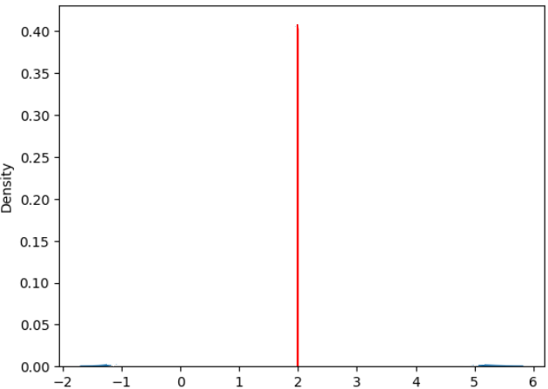
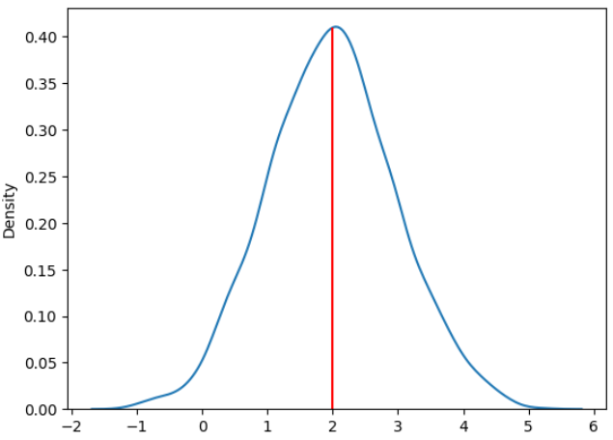
Deterministic Output
Learning point estimate
mu (μ) = 2
mu (μ)
Probabilistic Output
Learning distribution
mu (μ) = 2
σ = 1
sigma (σ) = 1
mu (μ)

Slide 29
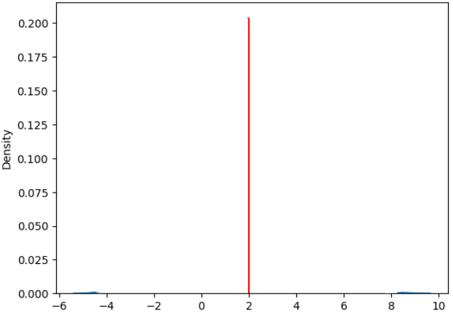
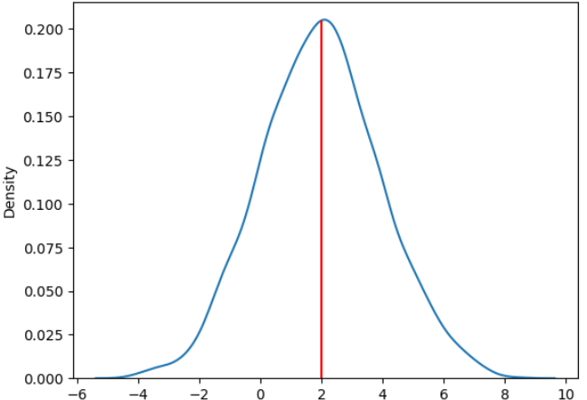

Deterministic Output
Learning point estimate
mu (μ) = 2
mu (μ)
Probabilistic Output
Learning distribution
mu (μ) = 2
σ = 2
variance (${\text{σ}}^{2}$) = 4
mu (μ)

Slide 30




Deterministic Output
Learning point estimate
Here sigma (σ) can be considered 1 or constant so we need to optimize second term alone.
This the loss function becomes a MSE
mu (μ)
NLL = ${−log(L}_{i}\left(ω\right))={(y_{i}−\text{μ})}^{2}$ = MSE
Probabilistic Output
Learning distribution
Here both mu (μ) and sigma (σ) need to be learned and optimized for
mu (μ)
variance (${\text{σ}}^{2}$)

Slide 31
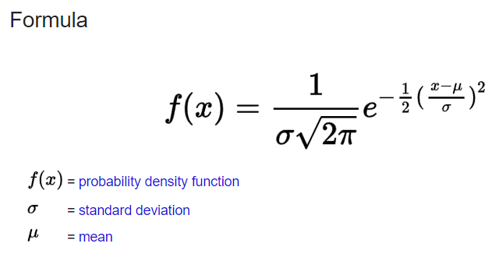
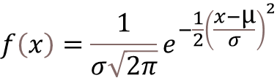

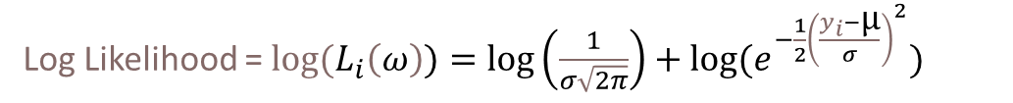



$$f\left(x\right)=\frac{1}{σ\sqrt{2π}}e^{−\frac{1}{2}{\left(\frac{x−\text{μ}}{σ}\right)}^{2}}$$
Likelihood = $L_{i}\left(ω\right)=\frac{1}{σ\sqrt{2π}}e^{−\frac{1}{2}{\left(\frac{y_{i}−\text{μ}}{σ}\right)}^{2}}$
Negative Log Likelihood (NLL) = ${−log(L}_{i}\left(ω\right))=\frac{1}{2}log\left(2{\text{σ}}^{2}\right)+\frac{{(y_{i}−\text{μ})}^{2}}{2{\text{σ}}^{2}}$c
NLL = ${−log(L}_{i}\left(ω\right))={(y_{i}−\text{μ})}^{2}$ = MSE
Log Likelihood = ${log(L}_{i}\left(ω\right))=log\left(\frac{1}{σ\sqrt{2π}}\right)+log⁡(e^{−\frac{1}{2}{\left(\frac{y_{i}−\text{μ}}{σ}\right)}^{2}})$
$${−log(L}_{i}\left(ω\right))=\frac{1}{2}log\left(2{\text{σ}}^{2}\right)+\frac{{(y_{i}−\text{μ})}^{2}}{2{\text{σ}}^{2}}$$
Log Likelihood = ${log(L}_{i}\left(ω\right))=−\frac{1}{2}log\left(2{\text{σ}}^{2}\right) −\frac{{(y_{i}−\text{μ})}^{2}}{2{\text{σ}}^{2}}$
NLL = ${−log(L}_{i}\left(ω\right))=\frac{1}{2}log\left(2{\text{σ}}^{2}\right)+\frac{{(y_{i}−\text{μ})}^{2}}{2{\text{σ}}^{2}}$

Slide 32
150
140
130
120
110
100
90
80
70
60
50
40
30
20
10
Q3 (75th Percentile)
Median
Q2 (50th Percentile)
Q1 (25th Percentile)

Slide 33
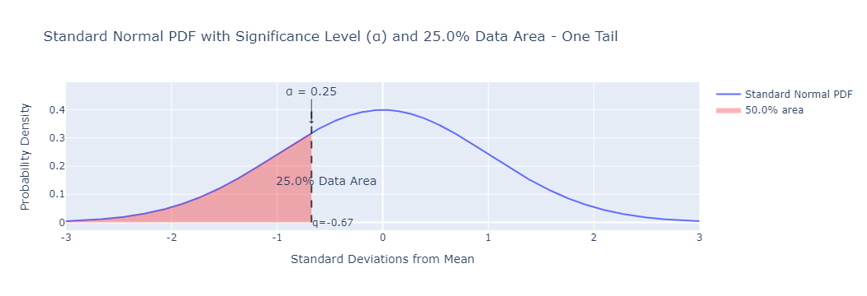
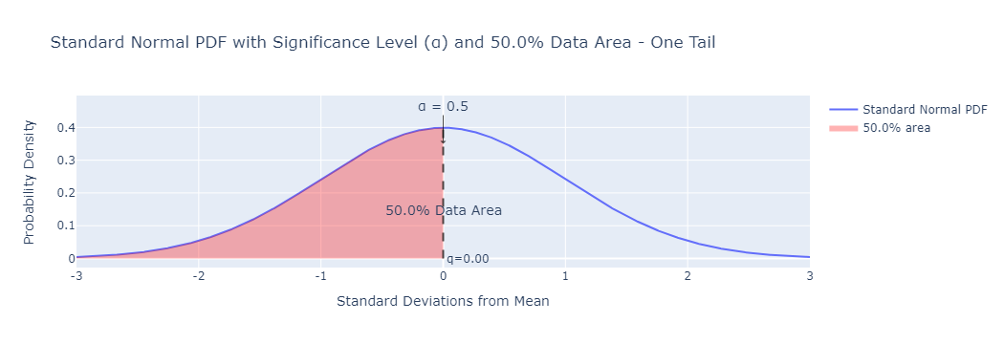
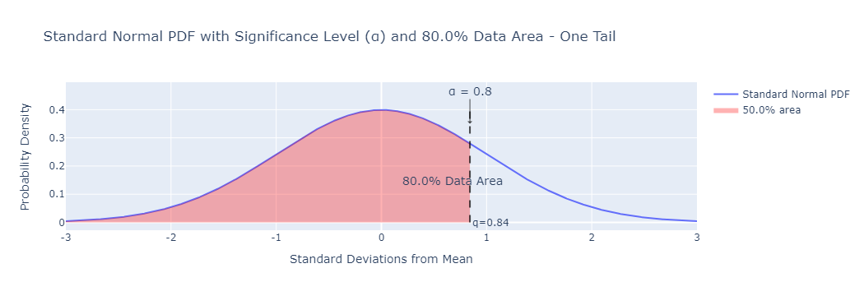
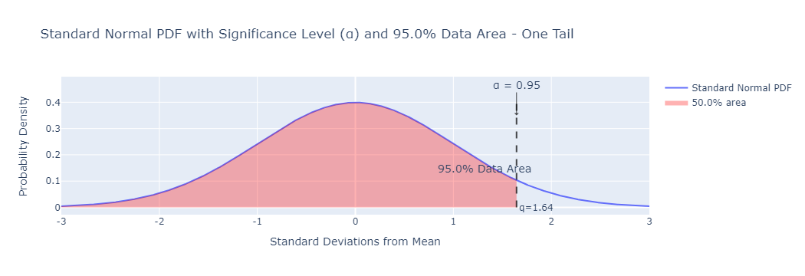

Slide 36
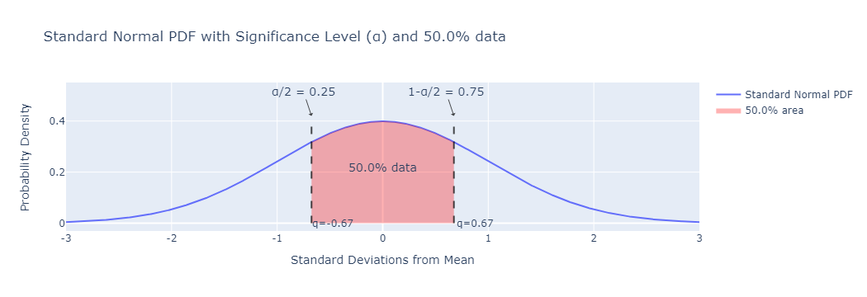
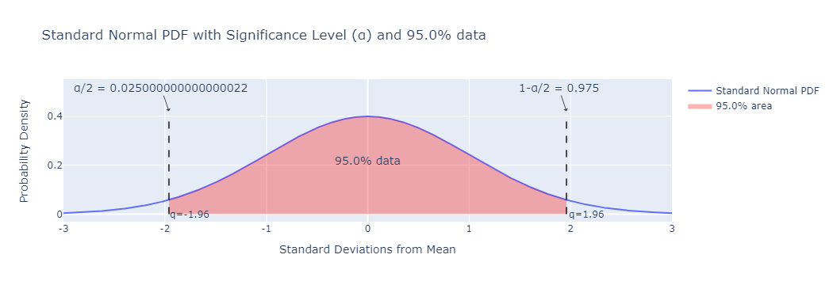
Remaining 25%
Remaining 25%
Remaining 2.5%
Remaining 2.5%

Slide 37
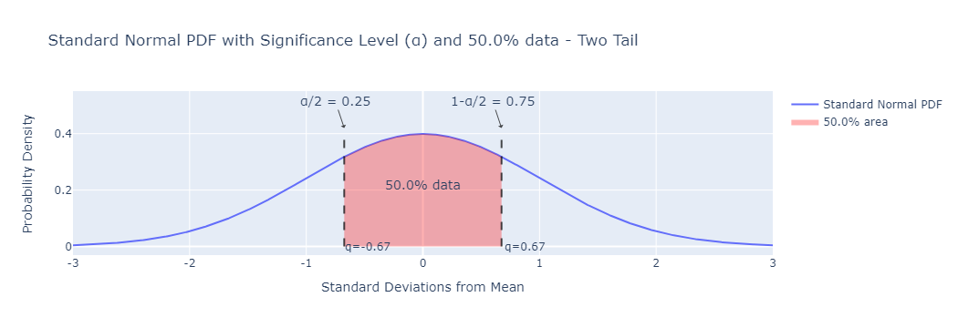
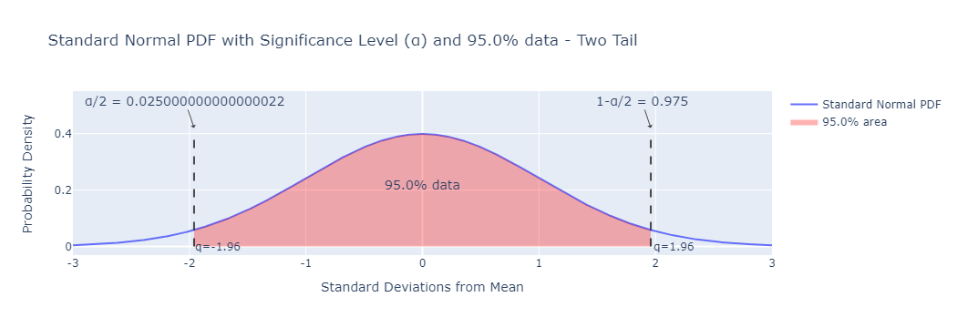
Remaining 25%
Remaining 25%
Remaining 2.5%
Remaining 2.5%

Slide 38
ECE for regression based in confidence interval
Predictions
Samples | X₁ | X₂ | X₃ | X₄ | X₅ | X₆ | X₇ | X₈ | X₉ | X₁₀ | X₁₁ | X₁₂ | X₁₃ | X₁₄ | X₁₅
Predicted Value | 43 | 40 | 50 | 60 | 70 | 80 | 66 | 43 | 40 | 64 | 71 | 60 | 46 | 52 | 45
Ground Truth Value | 48 | 42 | 52 | 65 | 69 | 82 | 60 | 43 | 44 | 66 | 75 | 50 | 52 | 53 | 45
Actual Residual Error (absolute) | 5 | 2 | 2 | 5 | 1 | 2 | 6 | 0 | 4 | 2 | 4 | 10 | 6 | 1 | 0
Predicted std | 0.1 | 2 | 3 | 5.1 | 2.2 | 3.1 | 5.5 | 2.4 | 3 | 1.3 | 2.2 | 1.1 | 0.4 | 1 | 0.8
ECE Computation (Adaptive binning)
Bin Notation | confidence | X₁ _{N(43,0.1)} | X₂ _{N(40,2)} | X₃ _{N(50,3)} | X₄ | X₅ | X₆ | X₇ | X₈ | X₉ | X₁₀
B₁ | 0 | 43 | 40 | 50 | 60 | 70 | 80 | 66 | 43 | 40 | 64
B₂ | 10 | 48 | 42 | 52 | 65 | 69 | 82 | 60 | 43 | 44 | 66
B₃ | 20 | 5 | 2 | 2 | 5 | 1 | 2 | 6 | 0 | 4 | 2
B₄ | 30 | 0.1 | 2 | 3 | 5.1 | 2.2 | 3.1 | 5.5 | 2.4 | 3 | 1.3
B₅ | 40
B₆ | 50
B₇ | 60
B₈ | 70
B₉ | 80
B₁₀ | 90
B₁₁ | 100

