Slide 1
Elasticsearch Basics / Installation / Usage
Kameswara Pullabhotla
Anuj Shah

Slide 2
What is Elasticsearch?
Elasticsearch is a distributed analytics search engine that works for all types of data like structured as well as unstructured.
It is built on top of Apache Lucene.
Log analytics, full-text search, security intelligence, business analytics, and operational intelligence use cases.

Slide 3
Basics
Default scoring algorithm is BM25
It uses an inverted index data structure which supports fast full-text searches.
Under the hood Apache Lucene uses TF-IDF for document level scoring.

Slide 4
Basics
Highly Scalable
Powerful search engine used to build complex search functionalities.
Allows us to store, search and analyze high volumes of data.
Document level search/Analyzing Logs/Aggregations.
Can also query aggregated results and can be used for analytics platforms.

Slide 5
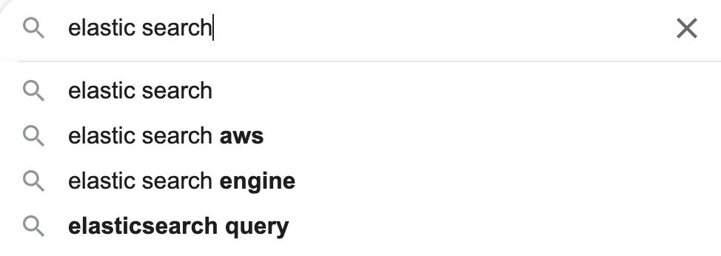
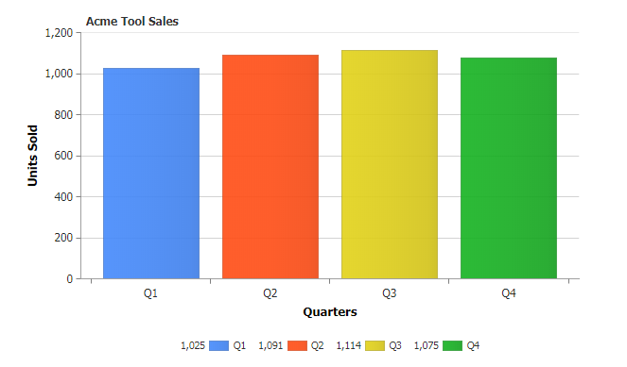
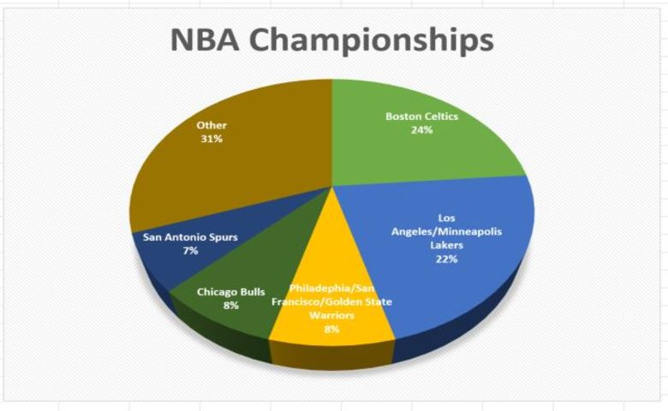
Basics
> Document Level Search
> Analyzing Logs/Data > Analyzing Logs/Data

Slide 6





Basics
Data Collection
Data Processing
Storage
Additional Data Monitoring, Authentication, ML
Data Visualization

Slide 7
Architecture
When we stated up an ES instance, what actually happened, was that we started up a NODE.
Node is nothing but an instance of elastic search that stores terabytes of data.
Each node will store a part of data.
A node refers to an instance of Elasticsearch and not a machine, so you can run any number of nodes on the same machine for any environment.
Cross cluster search is possible but not recommended.

Slide 8
Architecture
Cluster
Node A
Node C
Node B

Slide 9
Architecture - Documents
Each unit of data that you store within your cluster is called a document.
Documents are JSON Objects containing whatever data you desire.
ES stores every document along with some metadata that ES uses internally.
Data is stored as documents which are JSON Objects.

Slide 10
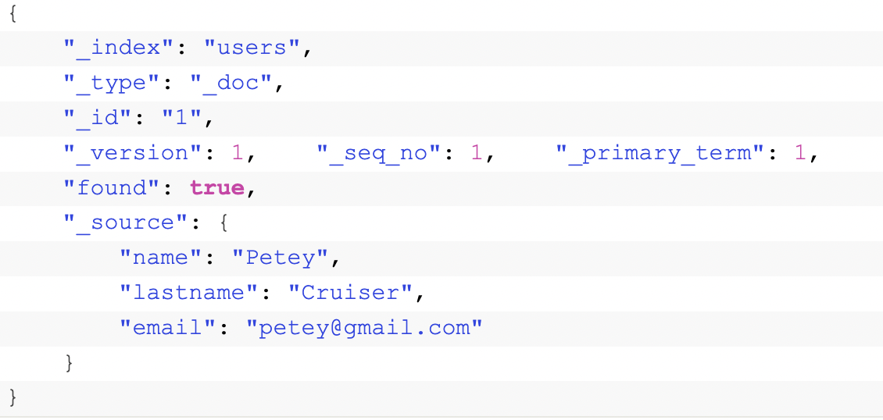
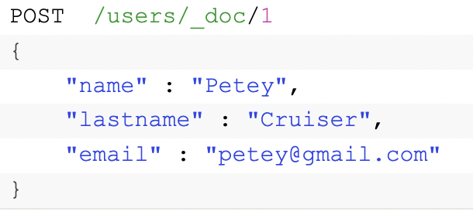
Architecture – Documents Example
Need to paste an example

Slide 11
How documents are stored?
They are stored within indices.
Every document in ES is stored within an index.
An index is therefore a collection of documents that have similar characteristics and are logically related.
We will run search queries against these indices.
We can query with elastic either by using CURL or any http clients like POSTMAN.

Slide 12
How documents are stored?
Employee
Department
John
Ross
Emily
CS
OMIS
Maths

Slide 13
Sharding & Scalability
Sharding is a way to divide an index into smaller pieces, where each piece is referred as shard.
Sharding is done at index level but not at cluster level.
Main purpose is to horizontally scale the data volume.
A shard may store up to about 2 million documents. However, there is no predefined size defined for a shard.

Slide 14
Sharding & Scalability
Node B
200 GB
Node B
200 GB
Node B
200 GB
Shard A
Node B
200 GB
Shard B
Sharding
Index
300 GB
Index
300 GB

Slide 15
Advantages Of Sharding
Mainly to be able to store more documents.
Easily fit large dataset on the nodes.
Improving Performance
Parallelism increases throughput of an index
Also, the shards may be stored on different nodes which means hardware of multiple nodes can be utilized.

Slide 16
Replication
ES supports replication in order to achieve fault tolerance and node failovers.
Replication is configured at index level and is enabled by default to 1.
Primary
Shard A
Replica A1
Replica A2
Primary
Shard B
Replica B1
Replica B2
Replication Group A
Replication Group B

Slide 17
Advantages Of Sharding
Node A
Node B
Primary Shard A
Primary Shard B
Primary Shard B1
Primary Shard A1
Primary Shard B2
Primary Shard A2

Slide 18
Managing Documents
Creating & Deleting an Index
Indexing Documents
Retrieving Documents
Updating Documents
Scripted Updates
Upserts
Deleting Documents

