Slide 1
Spot-A-Sport
Background
Spot-A-Sport makes it easy for anyone to organize a local sporting event or be a part of one of the many events already going on in the area. It provides you with a platform to find other people to play your favorite sports with as per your interests

Slide 2
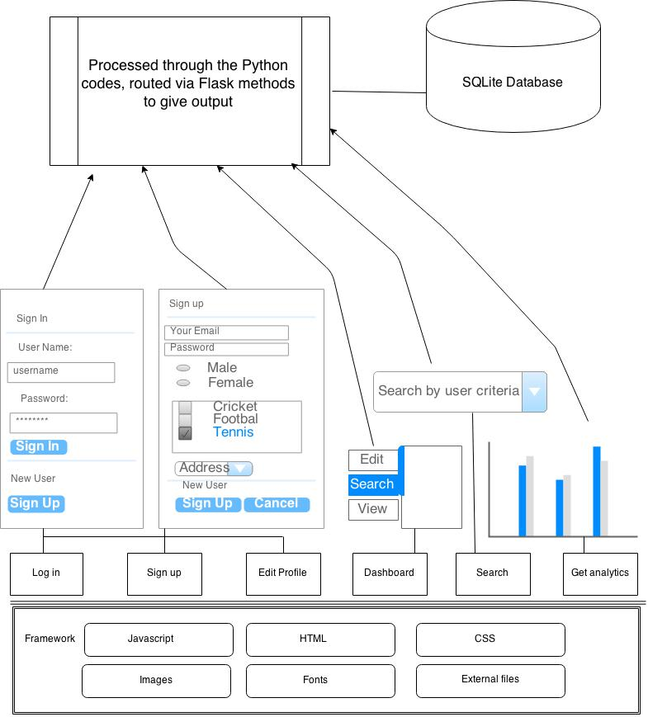
System Architecture

Slide 3
Use cases implemented
Profile creation/maintenance
Search for players based on location, sport and gender
Send invites to players for a sport
Accept or decline invitations for a sport
Broadcast a sport event that appears on users’ dashboard
Implementation of data analytics

