Slide 1
Mapping governance framework
Anuj Singh
The ADAPT Centre is funded under the SFI Research Centres Programme (Grant 13/RC/2106) and is co-funded under the European Regional Development Fund.

Slide 2
Context
The OSi has already identified the datasets (DBpedia) to which they want to link to and they have agreed they favor precision over recall.
In this experiment, you take on the role as someone from the OSi responsible for curating these links.
We assume that you and your group have already configured a matcher that will automatically propose correspondences between the two datasets based on a similarity metric.
You and your group can discuss and present your arguments with the help of mapping framework.
Conclusion could be make whether the links can be accepted or not, based on the mutual consent.

Slide 3
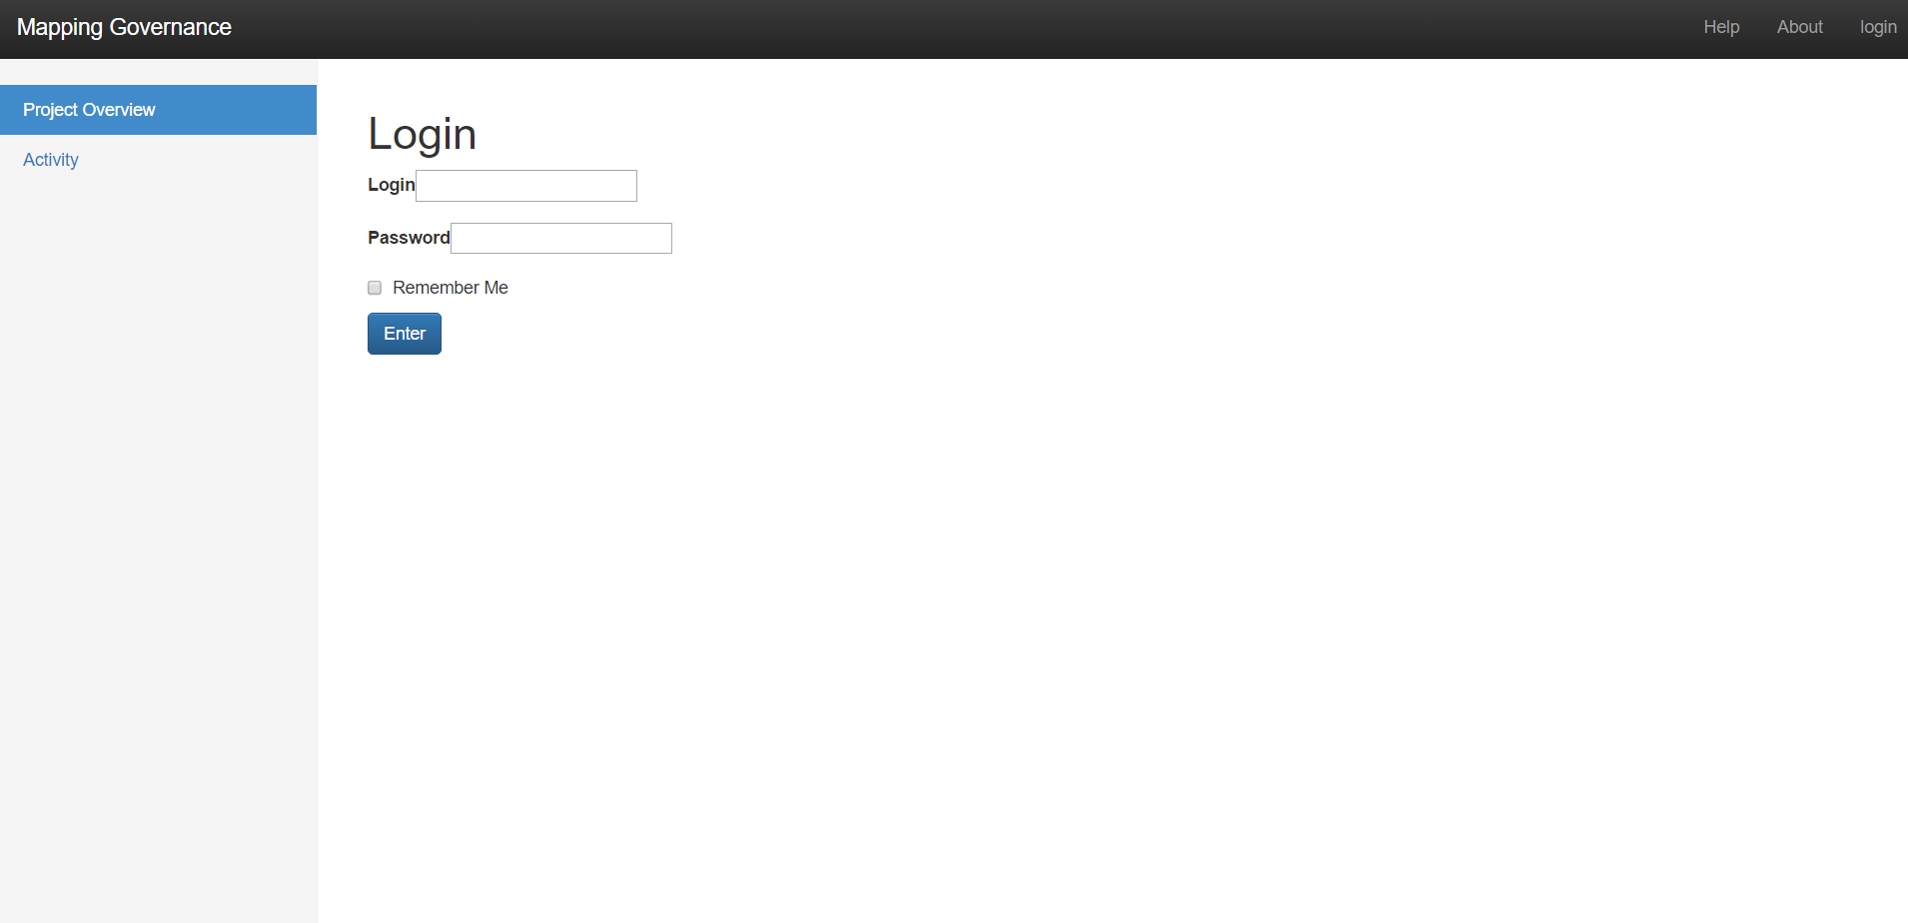
Step 1 to curate links

Slide 4
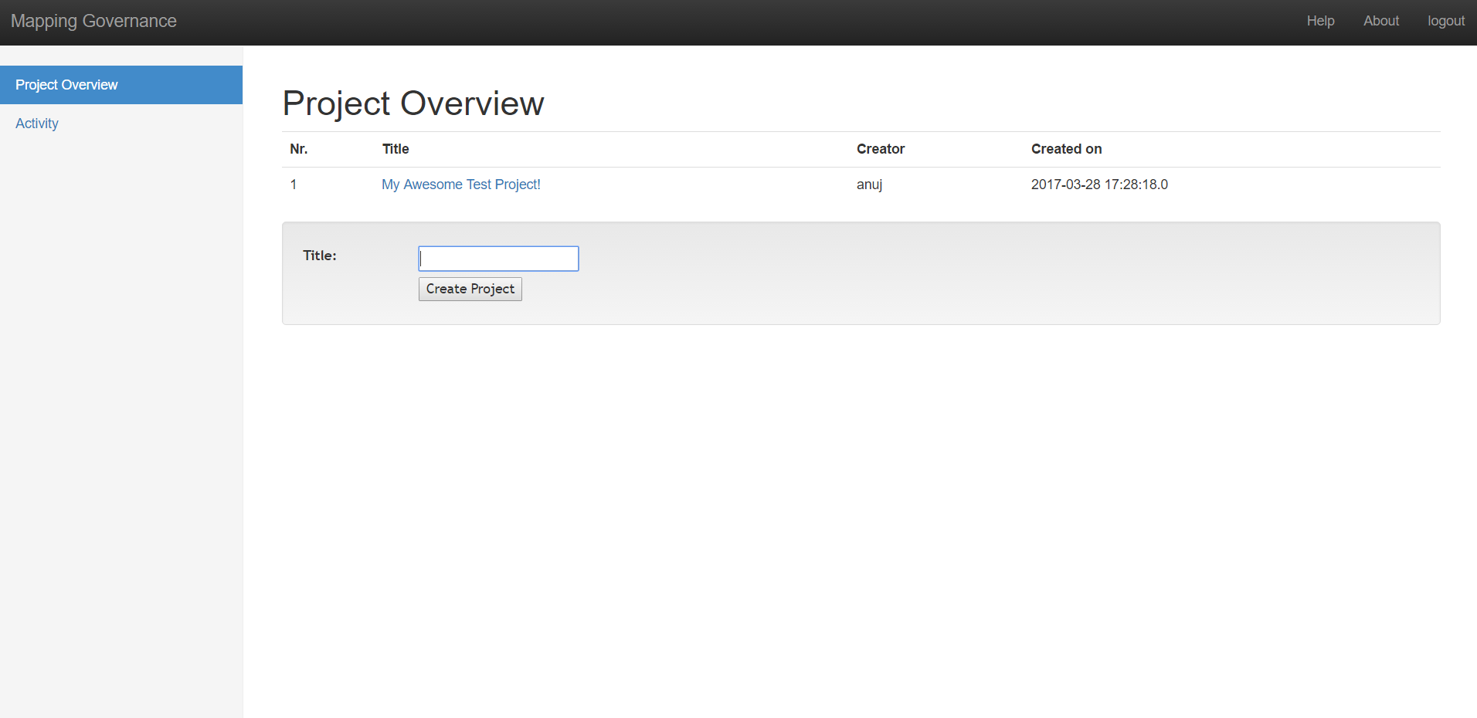
Step 2

Slide 5
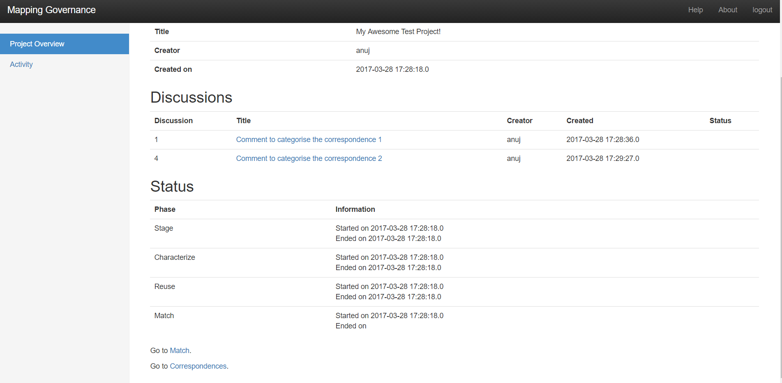
Step 3

Slide 6
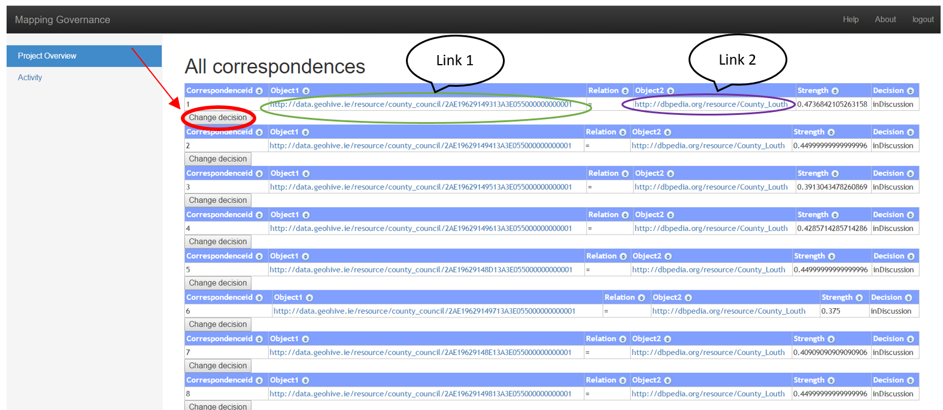
Step 4

Slide 7
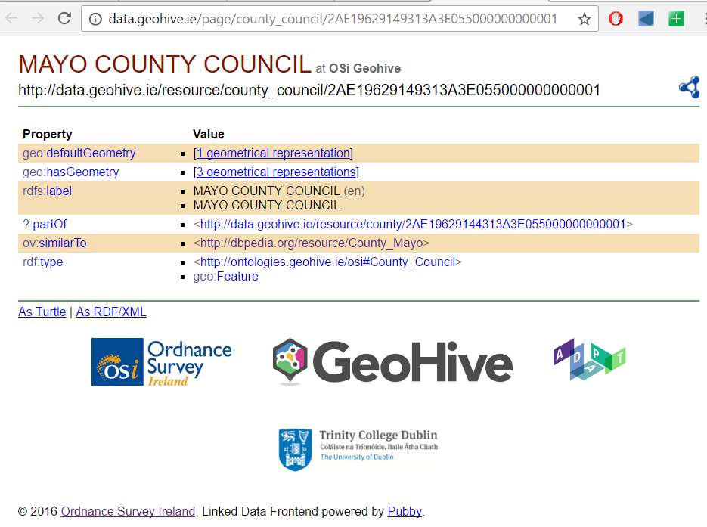
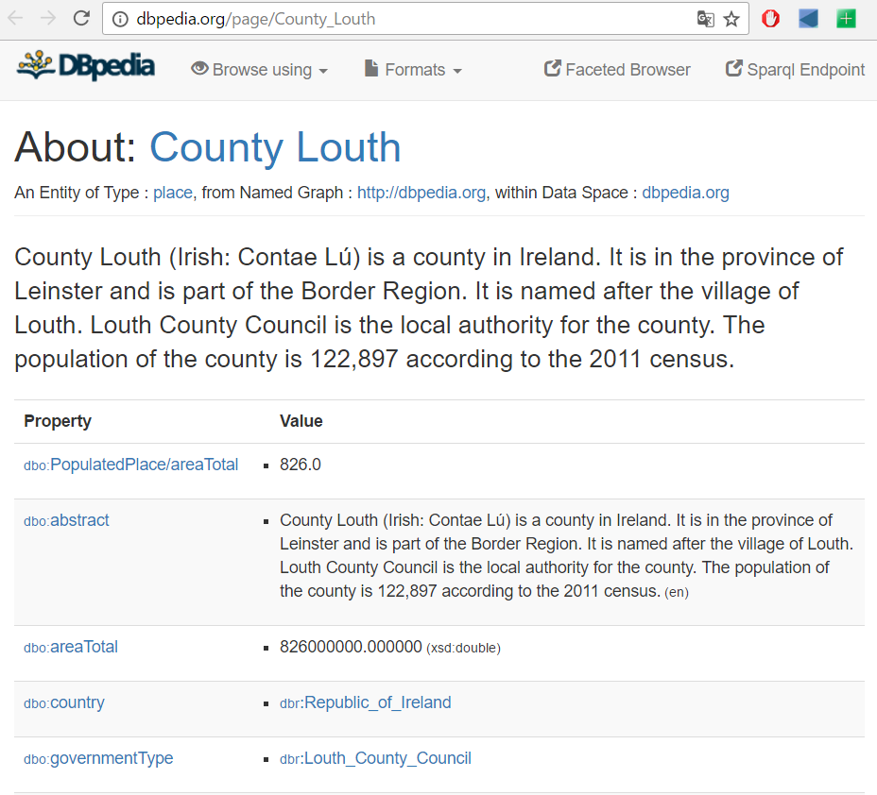
Identify if the correspondence is correct?
Link 1
Link 2

Slide 8
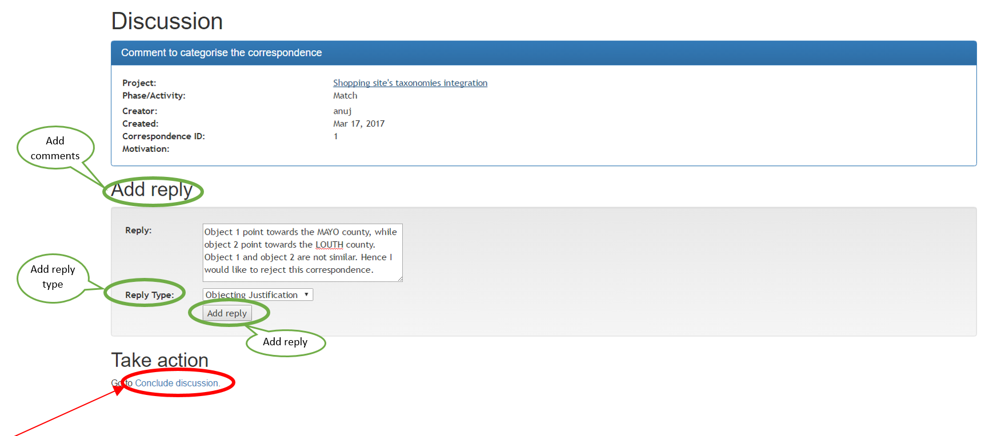
Discussions
Examples (not relevant for this experiment): Illustrating similar cases that may serve as a model for the correspondence to which they reply.
Motivation: Refers to criteria that help assess the strengths and weaknesses of a correspondence. (Eg: Given that we’re not sure whether the second URI refers to County Dublin or City Dublin, I suggest we do no accept we this correspondence. Remember, we prefer precision over recall.)
Justification: Describes the relevant circumstances that help to understand why a certain correspondence is supported or objected by a user. (eg: link 1 points towards county Louth while link 2 points towards county Laois, which is why I do not think this is a correct correspondence.)

Slide 9
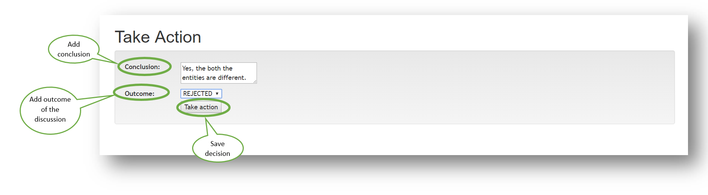
Conclusion: End of discussion

Slide 10
Let’s begin ☺

