Slide 1

Customer Churn Prediction Analysis
GROUP 8
Anuj Suchchal
Jagdeep Chawla
Rajeev Sharma
Sourabh Mahapatro

Slide 2
PART 1-INTRODUCTION

Slide 3
Problem statement
Objective: Can we build a model to predict, with a reasonable accuracy, the customers who are going to churn in the near future? Being able to accurately estimate when they are going to churn will be an added bonus
Definition of churn : A customer having closed all their active accounts with the bank is said to have churned. Churn can be defined in other ways as well, based on the context of the problem. A customer not transacting for 6 months or 1 year can also be defined as to have churned, based on the business requirements
Bank XYZ has been observing a lot of customers closing their accounts or switching to competitor banks over the past couple of quarters. As such, this has caused a huge dent in the quarterly revenues and might drastically affect annual revenues for the ongoing financial year, causing stocks to plunge and market cap to reduce by X %. A team of business, product, engineering and data science folks have been put together to arrest this slide.

Slide 4
From a Biz team/Product Manager's perspective
Business goal : Arrest slide in revenues or loss of active bank customers
Identify data source : Transactional systems, event-based logs, Data warehouse (MySQL DBs, Redshift/AWS), Data Lakes, NoSQL DBs.
Audit for data quality : De-duplication of events/transactions, Complete or partial absence of data for chunks of time in between, Obscuring PII (personal identifiable information) data
Define business and data-related metrics : Tracking of these metrics over time, probably through some intuitive visualizations
Business metrics : Churn rate (month-on-month, weekly/quarterly), Trend of avg. number of products per customer, %age of dormant customers, Other such descriptive metrics
Action to be taken based on model's output/insights : Based on the output obtained from Data Science team as above, various business interventions can be made to save the customer from getting churned. Customer-centric bank offers, getting in touch with customers to address grievances etc. Here, also Data Science team can help with basic EDA to highlight different customer groups/segments and the appropriate intervention to be applied against them
Data-related metrics : F1-score, Recall, Precision
Recall = TP/(TP + FN) ;Precision = TP/(TP + FP); F1-score = Harmonic mean of Recall and Precision
where, TP = True Positive, FP = False Positive and FN = False Negative
Prediction model output format : Since this is not going to be an online model, it doesn't require deployment. Instead, periodic (monthly/quarterly) model runs could be made and the list of customers, along with their propensity to churn shared with the business (Sales/Marketing) or Product team

Slide 5
How to set the target/goal for the metrics?
Data science-related metrics :
Recall : >70%
Precision : >70%
F1-score : >70%
Business metrics : Usually, it's top down. But a good practice is to consider it to make at least half the impact of the data science metric. For e.g., If we take Recall target as 70% which means correctly identifying 70% of customers who's going to churn in the near future, we can expect that due to business intervention (offers, getting in touch with customers etc.), 50% of the customers can be saved from being churned, which means at least a 35% improvement in Churn Rate

Slide 6
BASIC EDA

Slide 7
Numeric Variables | RowNumber | CustomerId | CreditScore | Age | Tenure | Balance | NumOfProducts | HasCrCard | IsActiveMember | EstimatedSalary | Exited
count | 10000 | 10000 | 10000.00 | 10000.00 | 10000.00 | 10000.00 | 10000.00 | 10000.00 | 10000.00 | 10000.00 | 10000.00
mean | 5000.5 | 15690940 | 650.53 | 38.92 | 5.01 | 76485.89 | 1.53 | 0.71 | 0.52 | 100090.24 | 0.20
std | 2886.9 | 71936 | 96.65 | 10.49 | 2.89 | 62397.41 | 0.58 | 0.46 | 0.50 | 57510.49 | 0.40
min | 1 | 15565700 | 350.00 | 18.00 | 0.00 | 0.00 | 1.00 | 0.00 | 0.00 | 11.58 | 0.00
25% | 2500.75 | 15628530 | 584.00 | 32.00 | 3.00 | 0.00 | 1.00 | 0.00 | 0.00 | 51002.11 | 0.00
50% | 5000.5 | 15690740 | 652.00 | 37.00 | 5.00 | 97198.54 | 1.00 | 1.00 | 1.00 | 100193.92 | 0.00
75% | 7500.25 | 15753230 | 718.00 | 44.00 | 7.00 | 127644.24 | 2.00 | 1.00 | 1.00 | 149388.25 | 0.00
max | 10000 | 15815690 | 850.00 | 92.00 | 10.00 | 250898.09 | 4.00 | 1.00 | 1.00 | 199992.48 | 1.00
Categorical Variables | Surname | Geography | Gender
count | 10000 | 10000 | 10000
unique | 2932 | 3 | 2
top | Smith | France | Male
freq | 32 | 5014 | 5457
Conclusion
Discard row number
Discard CustomerID as well, since it doesn't convey any extra info. Each row pertains to a unique customer
Based on the above, columns/features can be segregated into non-essential, numerical, categorical and target variables
In general, CustomerID is a very useful feature on the basis of which we can calculate a lot of user-centric features. Here, the dataset is not sufficient to calculate any extra customer features

Slide 8
Questioning the data
No date/time column. A lot of useful features can be built using date/time columns
When was the data snapshot taken? There are certain customer features like : Balance, Tenure, NumOfProducts, EstimatedSalary, which will have different values across time
Are all these values/features pertaining to the same single date or spread across multiple dates?
How frequently are customer features updated?
Will it be possible to have the values of these features over a period of time as opposed to a single, snapshot date?
Some customers who have exited still have balance in their account, or a non-zero NumOfProducts. Does this mean they have churned only from a specific product and not the entire bank, or are these snapshots of just before they churned?
Some features like, number and kind of transactions, can help us estimate the degree of activity of the customer, instead of trusting the binary variable IsActiveMember
Customer transaction patterns can also help us ascertain whether the customer has actually churned or not. For example, a customer might transact daily/weekly vs a customer who transacts annuallly
Here, the objective is to understand the data and distill the problem statement and the stated goal further. In the process, if more data/context can be obtained, that adds to the end result of the model performance

Slide 9
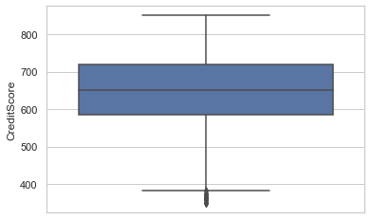
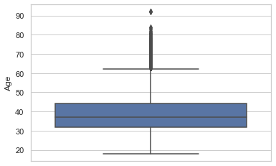
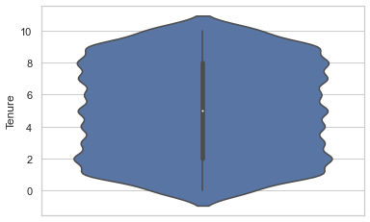
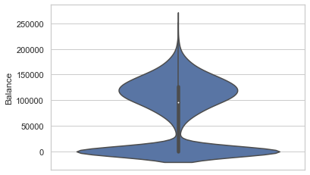
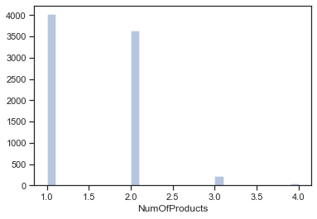
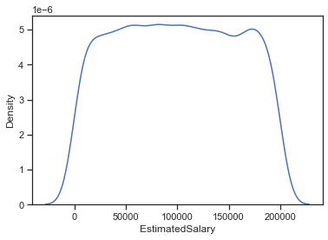
From the univariate plots, we get an indication that EstimatedSalary , being uniformly distributed, might not turn out to be an important predictor
Similarly, for NumOfProducts , there are predominantly only two values (1 and 2). Hence, its chances of being a strong predictor is also very unlikely
On the other hand, Balance has a multi-modal distribution. We'll see a little later if that helps in separation of the two target classes

Slide 10
Missing values and outlier treatment
Can be observed from univariate plots of different features
Outliers can either be logically improbable (as per the feature definition) or just an extreme value as compared to the feature distribution
As part of outlier treatment, the particular row containing the outlier can be removed from the training set, provided they do not form a significant chunk of the dataset (< 0.5-1%)
In cases where the value of outlier is logically faulty, e.g. negative Age or CreditScore > 900, the particular record can be replaced with mean of the feature or the nearest among min/max logical value of the feature
Outliers in numerical features can be of a very high/low value, lying in the top 1% or bottom 1% of the distribution or values which are not possible as per the feature definition.
Outliers in categorical features are usually levels with a very low frequency/no. of samples as compared to other categorical levels.
No outliers observed in any feature of this dataset
No missing values present in this dataset. Can also be observed from df.describe() commands. However, most real-world datasets might have missing values. A couple of things which can be done in such cases :
If the column/feature has too many missing values, it can be dropped as it might not add much relevance to the data
If there a few missing values, the column/feature can be imputed with its summary statistics (mean/median/mode) and/or numbers like 0, -1 etc. which add value depending on the data and context. For example, say, BalanceInAccount.

Slide 11
Categorical variable encoding
As a rule of thumb, we can consider using :Label Encoding ---> Binary categorical variables and Ordinal variables
One-Hot Encoding ---> Non-ordinal categorical variables with low to mid cardinality (< 5-10 levels)
Target encoding ---> Categorical variables with > 10 levels
HasCrCard and IsActiveMember are already label encoded; For Gender a simple Label encoding should be fine. For Geography, since there are 3 levels, OneHotEncoding should do the trick, For Surname, we'll try Target/Frequency Encoding
Label Encoding for binary variables
One-Hot encoding for categorical variables with multiple levels; Adding the one-hot encoded columns to the data frame and removing the original feature
Target encoding
Target encoding is generally useful when dealing with categorical variables of high cardinality (high number of levels).
Here, we'll encode the column 'Surname' (which has 2932 different values!) with the mean of target variable for that level
But, the problem with Target encoding is that it might cause data leakage, as we are considering feedback from the target variable while computing any summary statistic.A solution is to use a modified version : Leave-one-out Target encoding.In this, for a particular data point or row, the mean of the target is calculated by considering all rows in the same categorical level except itself. This mitigates data leakage and overfitting to some extent.
Summarize : How to handle unknown categorical levels/values in unseen data in production?
Use LabelEncoding, OneHotEncoding on training set and then save the mapping and apply on the test set. For missing values, use 0, -1 etc.
Target/Frequency encoding : Create a mapping between each level and a statistical measure (mean, median, sum etc.) of the target from the training dataset. For the new categorical levels, impute the missing values suitably (can be 0, -1, or mean/mode/median)
Leave-one-out or Cross fold Target encoding avoid data leakage and help in generalization of the model

Slide 12
BIVARIATE ANALYIS AND BASELINE MODEL

Slide 13
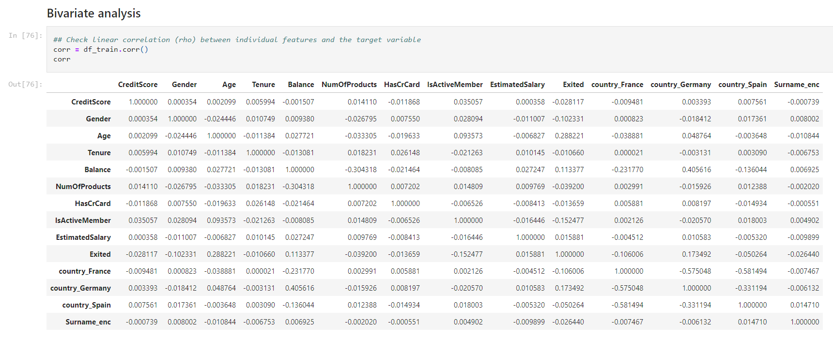
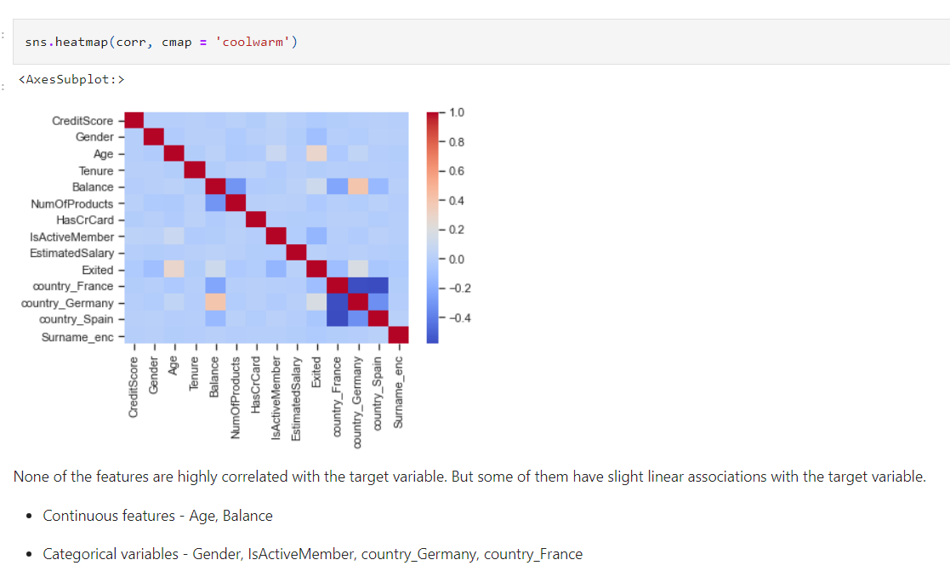
Bivariate Analysis
Age is the most positively correlated feature with customer churn (Exited). This suggests that older customers are more likely to leave the bank. A customer's Balance also shows a positive correlation, meaning those with higher balances might be at a higher risk of churning. Other features such as CreditScore, Tenure, NumOfProducts, HasCrCard, and EstimatedSalary seem to have a weak linear relationship with customer churn.

Slide 14
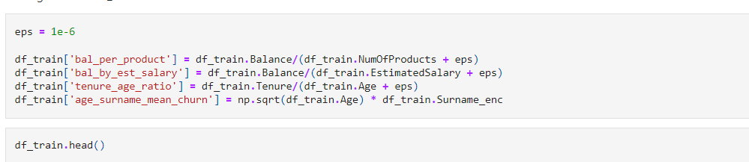
Feature Engineering
S.No | CreditScore | Gender | Age | Tenure | Balance | NumOfProducts | HasCrCard | IsActiveMember | EstimatedSalary | Exited | country_France | country_Germany | country_Spain | Surname_enc | bal_per_product | bal_by_est_salary | tenure_age_ratio | age_surname_mean_churn
0 | 678 | 1 | 36 | 1 | 117864.9 | 2 | 1 | 0 | 27619.06 | 0 | 0 | 1 | 0 | 0 | 58932.4 | 4.267519 | 0.027778 | 0
1 | 613 | 0 | 27 | 5 | 125167.7 | 1 | 1 | 0 | 199104.52 | 0 | 1 | 0 | 0 | 0 | 125167.6 | 0.628653 | 0.185185 | 0
2 | 628 | 1 | 45 | 9 | 0 | 2 | 1 | 1 | 96862.56 | 0 | 1 | 0 | 0 | 0.222222 | 0 | 0 | 0.2 | 1.490712
3 | 513 | 1 | 30 | 5 | 0 | 2 | 1 | 0 | 162523.66 | 0 | 1 | 0 | 0 | 0.3 | 0 | 0 | 0.166667 | 1.643168
4 | 639 | 1 | 22 | 4 | 0 | 2 | 1 | 0 | 28188.96 | 0 | 1 | 0 | 0 | 0.5 | 0 | 0 | 0.181818 | 2.345208

Slide 15
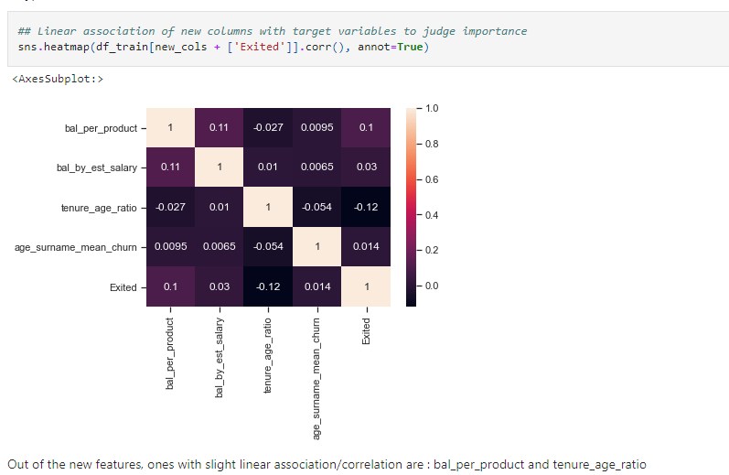
Feature Engineering
Out of the new features, bal_per_product and tenure_age_ratio seem to have the most significant correlations with the target variable and could be pivotal in a predictive model. The other features might still be valuable, especially when combined with other predictors or when used in more complex models.

Slide 16
Feature Scaling and Normalization
Feature scaling and normalization
Different methods :
Feature transformations - Using log, log10, sqrt, pow
MinMaxScaler - Brings all feature values between 0 and 1
StandardScaler - Mean normalization. Feature values are an estimate of their z-score.
By ensuring that features have a mean of 0 and a standard deviation of 1, it helps many algorithms perform better and produce more reliable outcomes.
Features shortlisted through EDA/manual inspection and bivariate analysis :
Age, Gender, Balance, NumOfProducts, IsActiveMember, the 3 country/Geography variables, bal per product, tenure age ratio
Now, let's see whether feature selection/elimination through RFE (Recursive Feature Elimination) gives us the same list of features, other extra features or lesser number of features.
To begin with, we'll feed all features to RFE + LogReg model.
cont_vars
cat_vars
['CreditScore',
'Age',
'Tenure',
'Balance',
'NumOfProducts',
'EstimatedSalary',
'Surname_enc',
'bal_per_product',
'bal_by_est_salary',
'tenure_age_ratio',
'age_surname_mean_churn']
['Gender',
'HasCrCard',
'IsActiveMember',
'country_France',
'country_Germany',
'country_Spain']

Slide 17
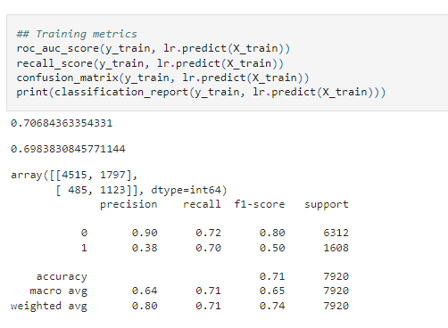
Baseline Model (Logistic Regression)
Training Metrics:
ROC-AUC Score: 0.71
This score is an indicator of the model's ability to differentiate between the positive and negative classes. A score of 0.71 suggests that the model has a decent discriminatory power, but there's room for improvement.
Recall: 0.70
Recall represents the model's ability to correctly identify the positive class. A recall of 0.70 means that the model correctly identifies 70% of the actual positive instances. This is a decent score, especially given the class imbalance.
Confusion Matrix:
True Negative (TN): 4515
False Positive (FP): 1797
False Negative (FN): 485
True Positive (TP): 1123
Classification Report:
For the majority class (0): Precision is high at 0.90, but recall is at 0.72, indicating that the model is missing some of the actual non-churners.
For the minority class (1): Precision is 0.38, and recall is 0.70. The low precision indicates that a significant portion of the predicted churners doesn't actually churn.

Slide 18
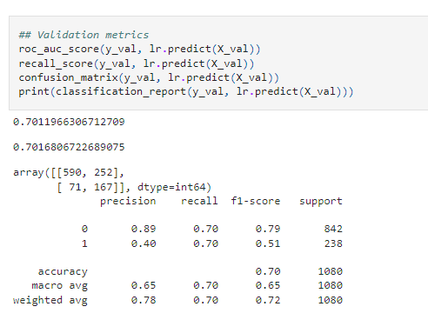
Baseline Model (Logistic Regression)
Validation Metrices
ROC-AUC Score: 0.70
Similar to the training set, the ROC-AUC score on the validation set is decent, which suggests that the model is generalizing reasonably well.
Recall: 0.70
The recall on the validation set matches the training set, which is a good sign. It suggests that the model's performance is consistent across both datasets.
Confusion Matrix:
True Negative (TN): 590
False Positive (FP): 252
False Negative (FN): 71
True Positive (TP): 167
Classification Report:
The precision, recall, and F1-score values for the validation set are in line with the training set's values, which indicates that the model is generalizing well without overfitting.
Summary
The Logistic Regression model is performing reasonably well given the class imbalance, particularly in terms of recall.
The model tends to predict more false positives (predicting churn when there isn't) as indicated by the lower precision for the positive class. This can be a strategic decision, as the cost of falsely predicting churn (and perhaps offering incentives to stay) might be less than missing an actual churn.
While the model is a good baseline, there's room for improvement. Additional feature engineering, hyperparameter tuning, or even trying more complex models might yield better results.
The choice of metrics and the desired balance between them (e.g., precision vs. recall) often depends on the business context and the costs associated with different types of errors

Slide 19
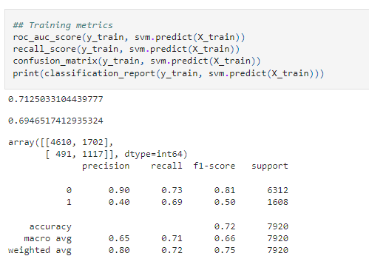
SVM Model
Training Metrics:
ROC-AUC Score: 0.71
Similar to the logistic regression model, the SVM has a ROC-AUC score of 0.71, indicating decent discriminatory power.
Recall: 0.69
The model correctly identifies 69% of the actual positive instances.
Confusion Matrix:
True Negative (TN): 4610
False Positive (FP): 1702
False Negative (FN): 491
True Positive (TP): 1117
Classification Report:
The precision, recall, and F1-scores are quite similar to those from the logistic regression model. The SVM model performs slightly better on the training set, particularly in terms of precision for the positive class.

Slide 20
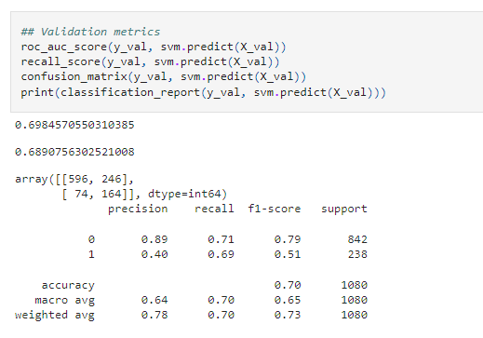
SVM Model
Validation Metrics:
ROC-AUC Score: 0.70
The score is slightly lower than the training set but is still reasonably good.
Recall: 0.69
The recall on the validation set is consistent with the training set.
Confusion Matrix:
True Negative (TN): 596
False Positive (FP): 246
False Negative (FN): 74
True Positive (TP): 164
Classification Report:
The performance metrics on the validation set are consistent with the training set. The model seems to generalize well without overfitting.
Summary
The Logistic Regression model is performing reasonably well given the class imbalance, particularly in terms of recall.
The model tends to predict more false positives (predicting churn when there isn't) as indicated by the lower precision for the positive class. This can be a strategic decision, as the cost of falsely predicting churn (and perhaps offering incentives to stay) might be less than missing an actual churn.
While the model is a good baseline, there's room for improvement. Additional feature engineering, hyperparameter tuning, or even trying more complex models might yield better results.
The choice of metrics and the desired balance between them (e.g., precision vs. recall) often depends on the business context and the costs associated with different types of errors

Slide 21
BASELINE MODELS (NON-LINEAR) : DECISION TREE

Slide 22
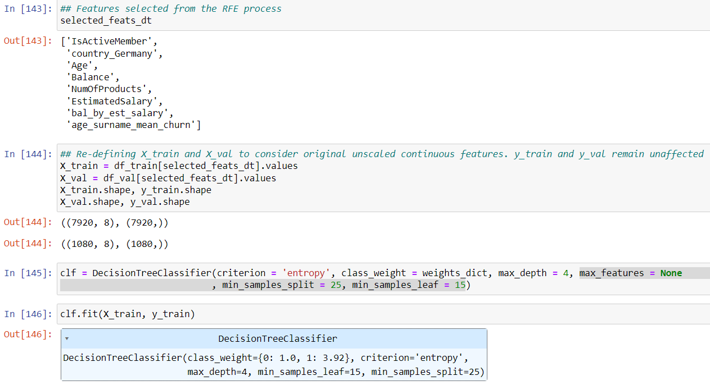
DECISION TREE Model
Model:
Decision trees are versatile machine learning algorithms that can perform both classification and regression tasks, and even multioutput tasks. They are powerful algorithms, capable of fitting complex datasets.
One of the many qualities of decision trees is that they require very little data preparation. In fact, they don’t require feature scaling or centering at all.
We define instance of decision tree classifier with criterion : Entropy , class weights as per weights dictionary, maximum depth = 4 , max_features = None, min_samples_split = 25, min_samples_leaf = 15.
We use selected features from RFE process for Re-defining X_train and X_val. Then we fit the classifier on X_train and y_train.

Slide 23
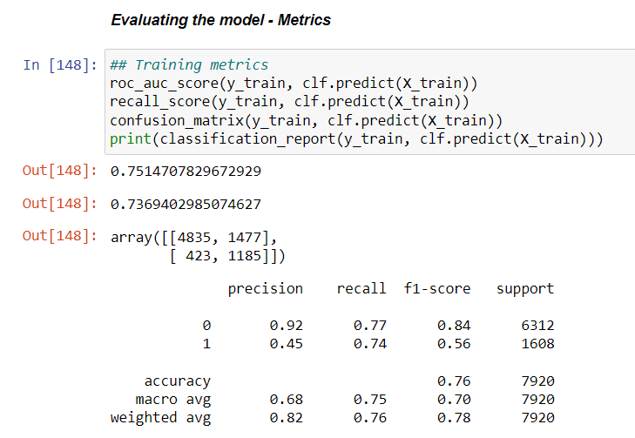
DECISION TREE Model
Training Metrics:
ROC-AUC Score: 0.7514 (better than SVM Model)
This is better than SVM and logistic regression model with ROC-AUC score of 0.71, indicating better discriminatory power, but there is room for further improvement.
Recall: 0.7369 which is better than 0.69 for SVM and logistic regression.
The model correctly identifies 73.69% of the actual positive instances. This is a decent score, especially given the class imbalance.
Confusion Matrix:
True Negative (TN): 4835
False Positive (FP): 1477
False Negative (FN): 423
True Positive (TP): 1185
Classification Report:
For the majority class (0): Precision is high at 0.92, but recall is at 0.77, indicating that the model is missing some of the actual non-churners.
For the minority class (1): Precision is 0.45, and recall is 0.74. The low precision indicates that a significant portion of the predicted churners doesn't actually churn.

Slide 24
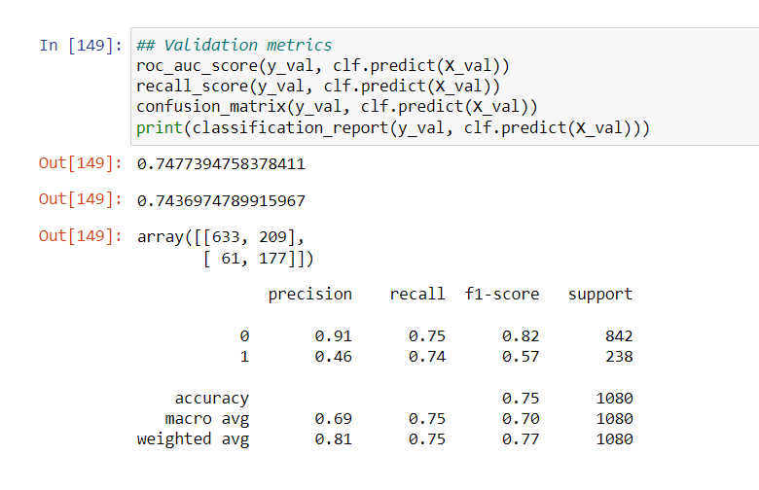
DECISION TREE Model
Validation Metrics:
ROC-AUC Score: 0.7477
The score is slightly lower than the training set but is still reasonably good.
Recall: 0.7436
The recall on the validation set is consistent with the training set.
Confusion Matrix:
True Negative (TN): 633
False Positive (FP): 209
False Negative (FN): 61
True Positive (TP): 177
Classification Report:
The performance metrics on the validation set are consistent with the training set. The model seems to generalize well without overfitting.
Summary
The Decision Tree model is performing reasonably well given the class imbalance, particularly in terms of recall.
The model tends to predict more false positives (predicting churn when there isn't) as indicated by the lower precision for the positive class. As already shared in previous slides, this can be a strategic decision, as the cost of falsely predicting churn (and perhaps offering incentives to stay) might be less than missing an actual churn.
While the Decision Tree model is also a good baseline, there's room for improvement. Additional feature engineering, hyperparameter tuning, or even trying more complex models might yield better results.
The choice of metrics and the desired balance between them (e.g., precision vs. recall) often depends on the business context and the costs associated with different types of errors

Slide 25
DECISION TREE Model

Slide 26
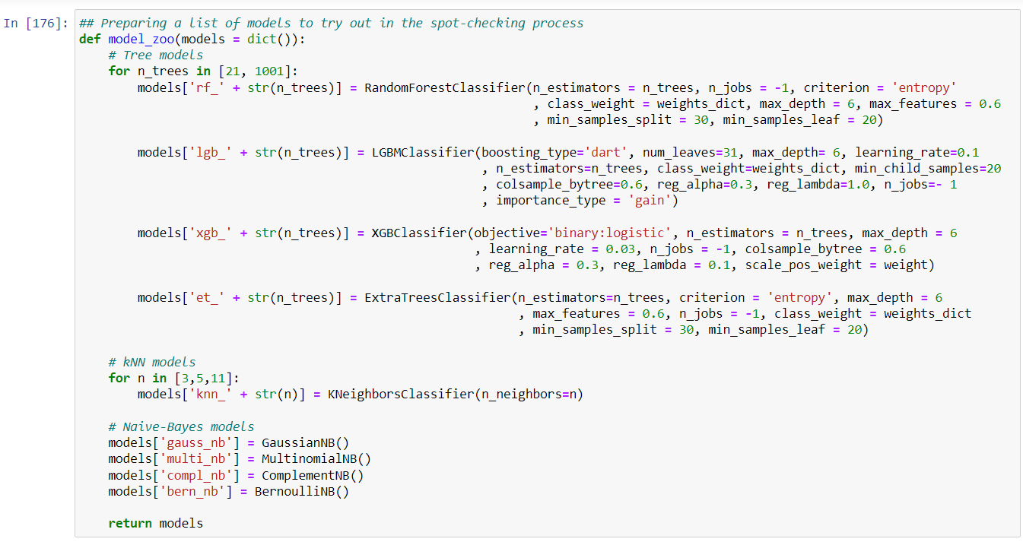
MODEL Zoo
Models used are : RF, LGBM, XGB, Extra Trees Classifier, kNN, Naive Bayes models

Slide 27
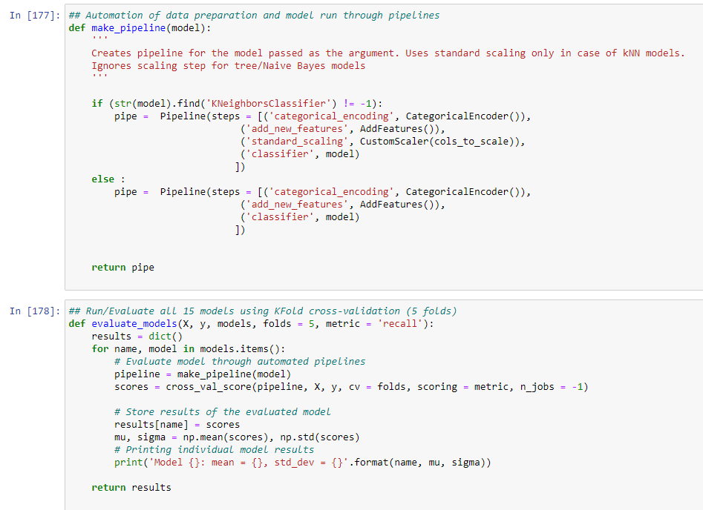
MODEL Evaluation

Slide 28
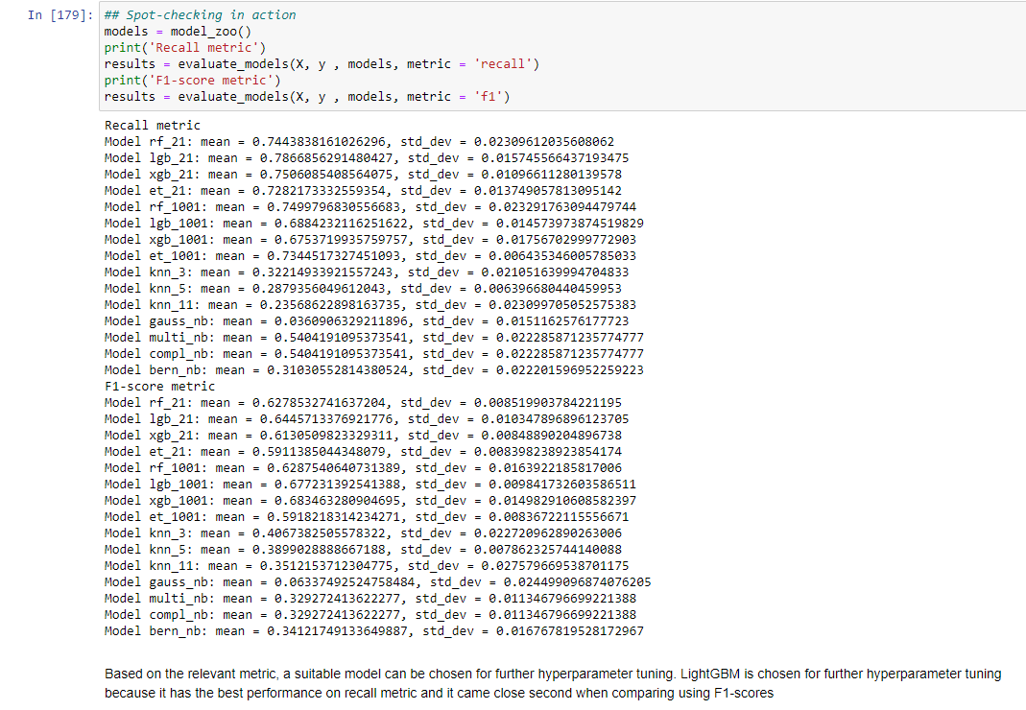
MODEL Selection
Based on the relevant metric, a suitable model can be chosen for further hyperparameter tuning.
LightGBM is chosen for further hyperparameter tuning because it has the best performance on recall metric.
It came close second when comparing using F1-scores

Slide 29
Hyperparameter Tuning

Slide 30
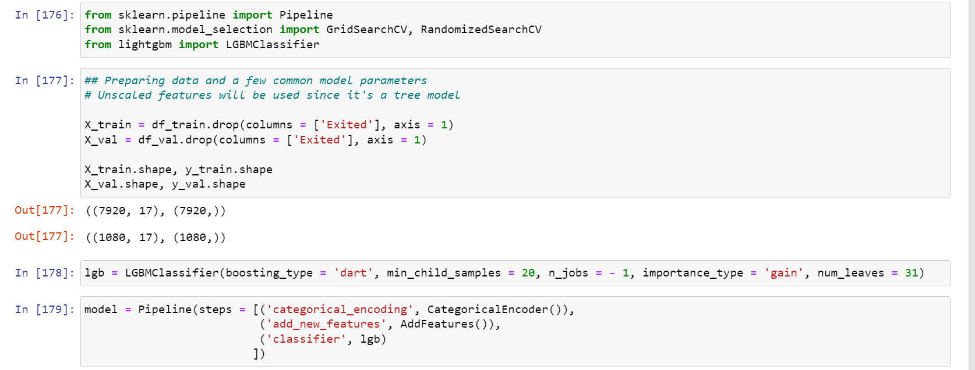
RandomSearchCV vs GridSearchCV
Random Search is more suitable for large datasets, with a large number of parameter settings
Grid Search results in a more precise hyperparameter tuning, thus resulting in better model performance. Intelligent tuning mechanism can also help reduce the time taken in GridSearch by a large factor
Will optimize on F1 metric. We could easily reach 75% Recall from the default parameters as seen earlier

Slide 31
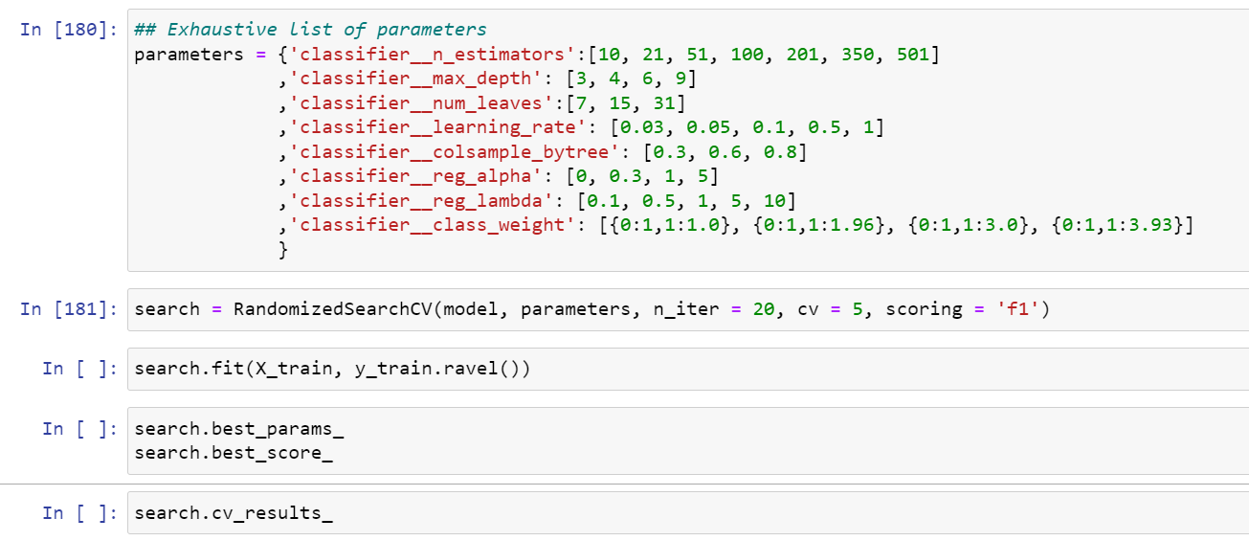
Randomized Search
Randomized Search is an alternative to Grid Search, which exhaustively searches through a predefined set of hyperparameter combinations. In Randomized Search, instead of trying every possible combination, you randomly sample a specific number of combinations from a given hyperparameter space.

Slide 32
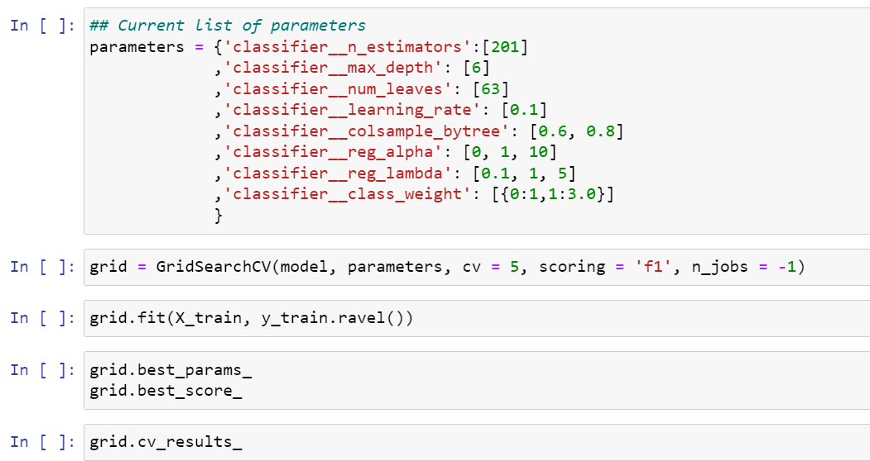
Grid Search
Grid Search is a hyperparameter tuning technique used in machine learning to systematically search through a predefined set of hyperparameter combinations for a model and identify the combination that yields the best performance.

Slide 33
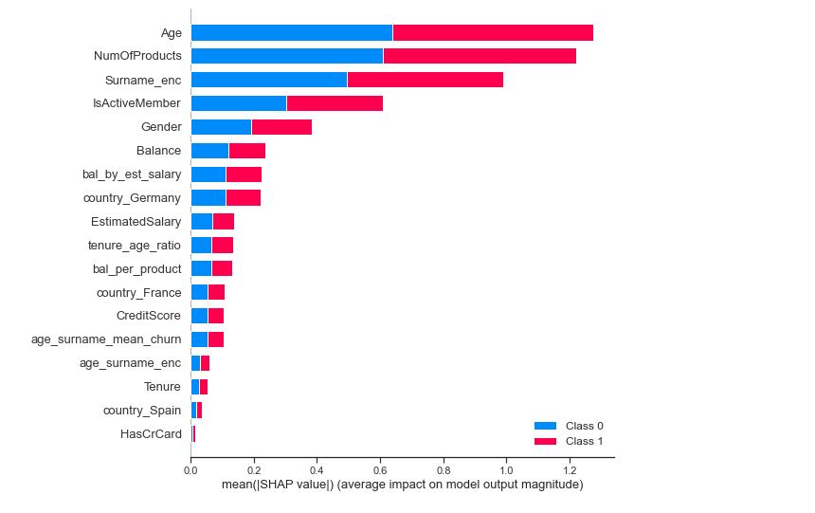
Variable importance

Slide 34
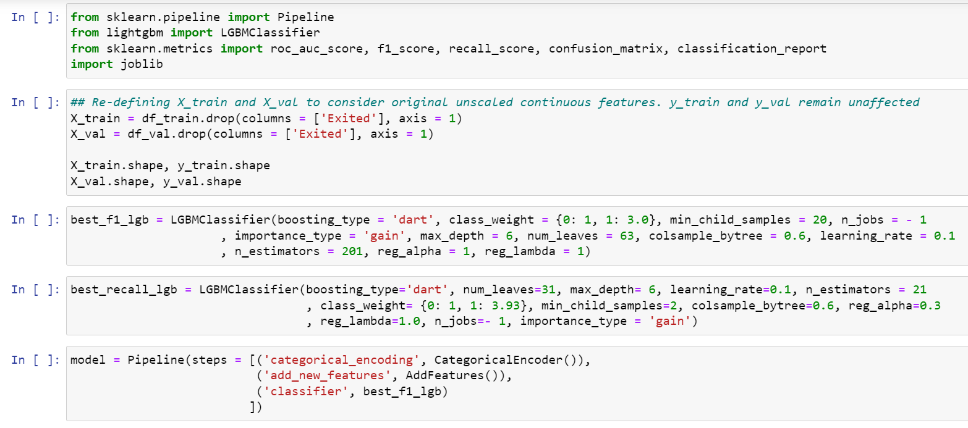
Train and Save final model and its parameters
The final model is trained using the best hyperparameters found during the hyperparameter tuning process. It's then evaluated on a separate test set, and finally, it's saved using the joblib library. There are other ways as well to save the model. For example – Pickle and HDF5.

Slide 35
Ending notes
Note on common issues with a model in production
Data drift / Covariate shift
Importance of incremental training
Ensure parity between training and testing environments (model and library versions etc.)
Tracking core business metrics
Creation and monitoring of metrics of specific user segments
Highlight impact to business folks : Through visualizations, Model can potentially reduce the Churn rate by 30-40% etc.
Future steps
The model can be expanded to predict when will a customer churn. This will further help sales/customer service teams to reduce churn rate by targeting the right customers at the right time

