Slide 1
CleanAir & Clear Streets
Real-time pollution hotspot detection & forecasting for Delhi NCR
Team – Code Smashers
Live at gen-lang-client-0882700239.web.app

Slide 2



The Problem
City-level AQI apps miss hyper-local pollution events. These blind spots directly harm nearby residents, and municipal teams have no way to know where to deploy cleanup crews or water-mist cannons before a spike happens.
Garbage dump fires
Industrial clusters
Smog-trapping junctions
Localized, short-lived, invisible to city sensors
Concentrated emissions in specific pockets
Traffic + geography creates hidden hotspots

Slide 3




Our Solution
A living pollution map that fuses ground sensors, satellite data, and citizen photos into real-time hotspots, 24-hour forecasts, and plain-language AI briefings — in English and Hindi.
Detect
Predict
Explain
Fuses CPCB sensors + satellite fire data + citizen photos into a per-zone hotspot score
Forecasts each zone's AQI 24 hours ahead using a model trained on live + historical data
Gemini writes a plain-language briefing reasoning about likely cause — not just numbers

Slide 4





How It Works
Citizen Photos
CPCB Ground Sensors
NASA FIRMS Satellite
Gemini Vision classifies
smoke / dust / haze
Real PM2.5 / PM10
station readings
Active fire / smoke
detections
Hotspot Fusion Engine
50% ground AQI + 30% satellite fire data + 20% citizen photo severity = one 0-1 score / zone
24h AQI Prediction
Bilingual AI Briefing
Regression model, live + historical training data
Gemini (Groq fallback) reasons about cause, EN + HI
Live Dashboard — map, ranked zones, alerts, EN/HI + voice

Slide 5

AI in Action
Three distinct AI roles — each doing real interpretive work, not decoration
Vision Classification
Gemini (via Firebase AI Logic) classifies each citizen photo into smoke, dust, garbage burning, haze, or none — with a severity score and a one-sentence reasoning, not just a label.
Predictive Forecasting
A regression model forecasts each zone's AQI 24 hours ahead, trained on real CPCB + weather data accumulated live, bootstrapped with historical reanalysis data — clearly tagged as such.
Bilingual Reasoning Briefing
Gemini (falling back to Groq/Llama automatically if quota is exhausted) writes a plain-language briefing per zone — explaining likely cause, in English and Hindi, generated together in one call.

Slide 6
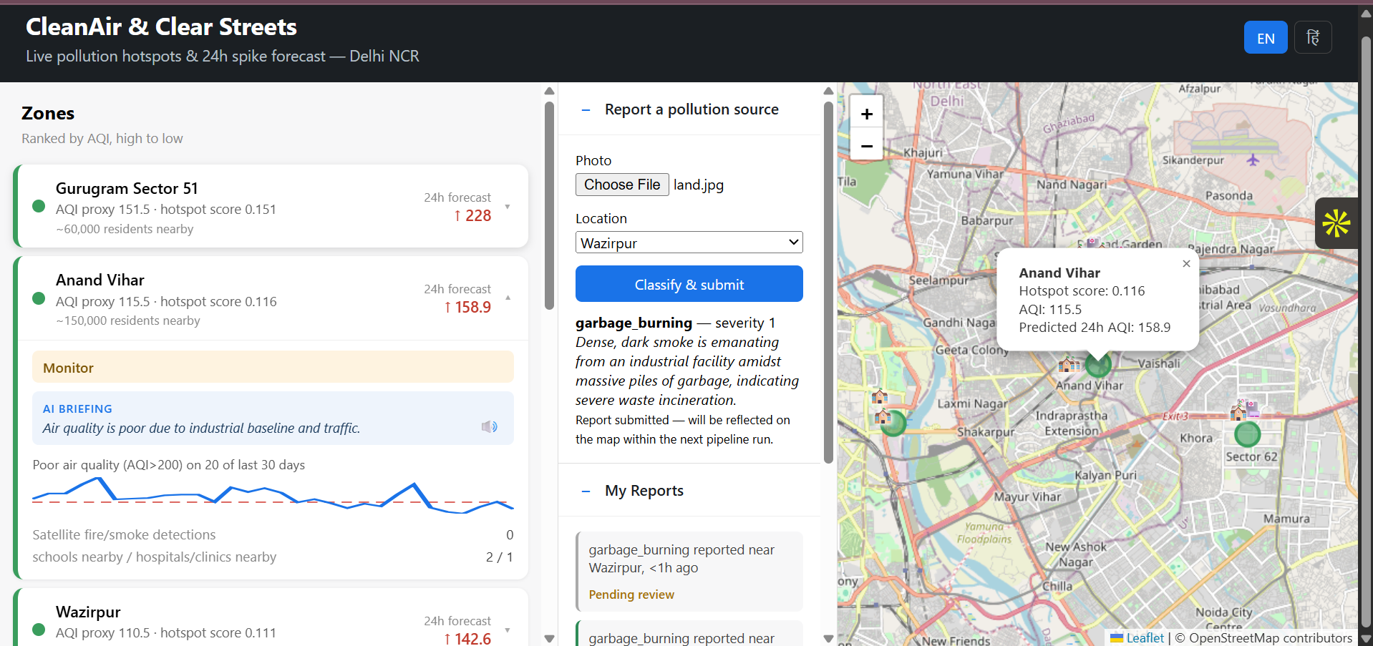
The Live Dashboard
Zones ranked by AQI, colour-coded by severity
Live map with hotspot markers + school/hospital icons
[ Insert dashboard screenshot here ]
gen-lang-client-0882700239.web.app
AI briefing per zone, in English or Hindi + voice playback
24h forecast badge and historical recurrence sparkline

Slide 7



Who It Serves
Municipal Cleanup Crews
MP's Office & District Officials
Citizens
Get a ranked, actionable list of where to deploy water-mist cannons and crews
A 5-minute-readable briefing per zone, no technical background needed
Report a source, and see it acknowledged when it shapes the live map
12
~1.42M
126
zones monitored
across Delhi NCR
residents estimated
across monitored zones
schools & hospitals
mapped near hotspots

Slide 8



Inclusivity & Accessibility
English + Hindi
Voice Playback
Mobile-Responsive
Every label, action, and AI briefing switches language instantly — including zone names
Browser text-to-speech reads any briefing aloud, for low-literacy users, in either language
Full layout reflows for phones — the device most citizens will actually use
Every one of these runs on free, zero-quota infrastructure: hand-maintained translations, the browser's native SpeechSynthesis API, and pure CSS reflow — no per-request cost, ever.

Slide 9

Why It's Deployable Today
Zero infrastructure cost
Firebase free Spark plan + GitHub Actions + free-tier APIs — no billing account anywhere in the stack
Fully automated pipeline
No manual steps — three independent GitHub Actions schedules keep it running
Already live in production
Not a local demo — a real, public URL running on its own schedule today
Data Refresh
AI Briefings
Facility Data
Every 3 hours
Daily
Weekly

Slide 10
This Is a Recurring Problem
30-day AQI trend — Anand Vihar (real data from our system)
20
of the last 30 days had
"Poor" air quality (AQI > 200)
in this single zone
This isn't a one-off reading — it's a persistent pattern the system tracks automatically for every zone.

Slide 11


Scaling Beyond Delhi NCR
Config-driven architecture: every zone is one entry in a single JSON file. Adding a new city means adding its monitoring stations to that file — no code changes to the fusion, prediction, or dashboard logic.
Honest roadmap — what's next
WhatsApp / SMS citizen intake
For citizens without a smartphone or data connection
Proactive municipal alerts
Push a notification the moment a zone newly crosses severe, instead of requiring a dashboard check
Earth Engine satellite imagery
Deeper aerosol/visual satellite layers alongside our current NASA FIRMS fire-detection data

Slide 12
Try It Live
gen-lang-client-0882700239.web.app
github.com/anujtrivedi06/cleanair-clearstreets
Thank you

