Slide 1
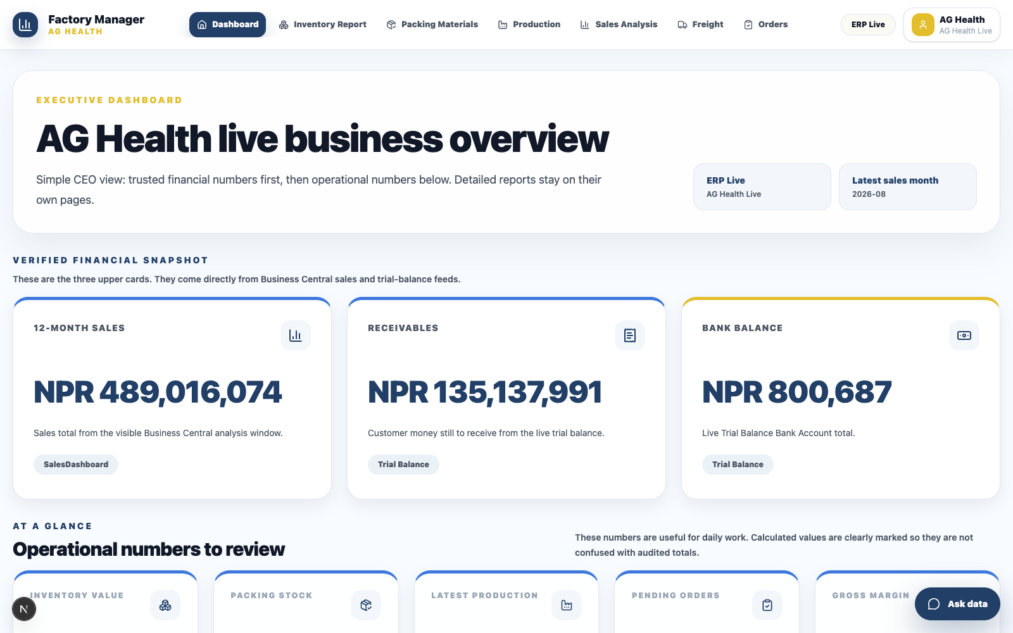
AG HEALTH
ERP intelligence,
beautifully simple.
A premium Business Central layer for sales, inventory, production, orders, freight, and fast answers.
Live dashboard • ERP data • CEO-ready
AG HEALTH ERP
01
Notes:
[Sources]
Project screenshot captured from http://localhost:3002/ag-health.
Visual direction informed by Apple.com and LouisVuitton.com: minimal hero layouts, premium whitespace, restrained typography, and product-first imagery.

Slide 2
THE PROBLEM
The data exists.
The decision still feels slow.
Business Central already holds the truth. The hard part is turning rows, ledgers, and reports into a view that anyone can read in seconds.
Too many places
Too much interpretation
Too little executive clarity
Sales, stock, production, orders and finance live in separate views.
The reader has to know which table, filter, and source to trust.
The important answer should appear before the detailed report.
AG HEALTH ERP
02
Notes:
[Sources]
Problem framing based on user project requirements and current AG Health ERP dashboard scope.

Slide 3
THE PRODUCT
One calm workspace
for factory decisions.
The app does not replace Business Central. It presents the mapped ERP data in a cleaner, faster, more human way.
Financial snapshot
01
Operational health
02
AI-style data assistant
03
AG HEALTH ERP
03
Notes:
[Sources]
Project screenshot captured from http://localhost:3002/ag-health.

Slide 4
EXECUTIVE VIEW
The first screen answers
the boardroom question.
Sales
What revenue is moving
Sales, receivables, bank balance, margin, freight, orders and inventory are separated so the viewer sees meaning — not clutter.
Receivables
What money is pending
Bank
What cash is visible
Only trusted ERP values should sit at the top. Calculated operational values are clearly described below.
AG HEALTH ERP
04
Notes:
[Sources]
Slide based on current AG Health dashboard structure and user requirement for CEO-readable financial cards.

Slide 5
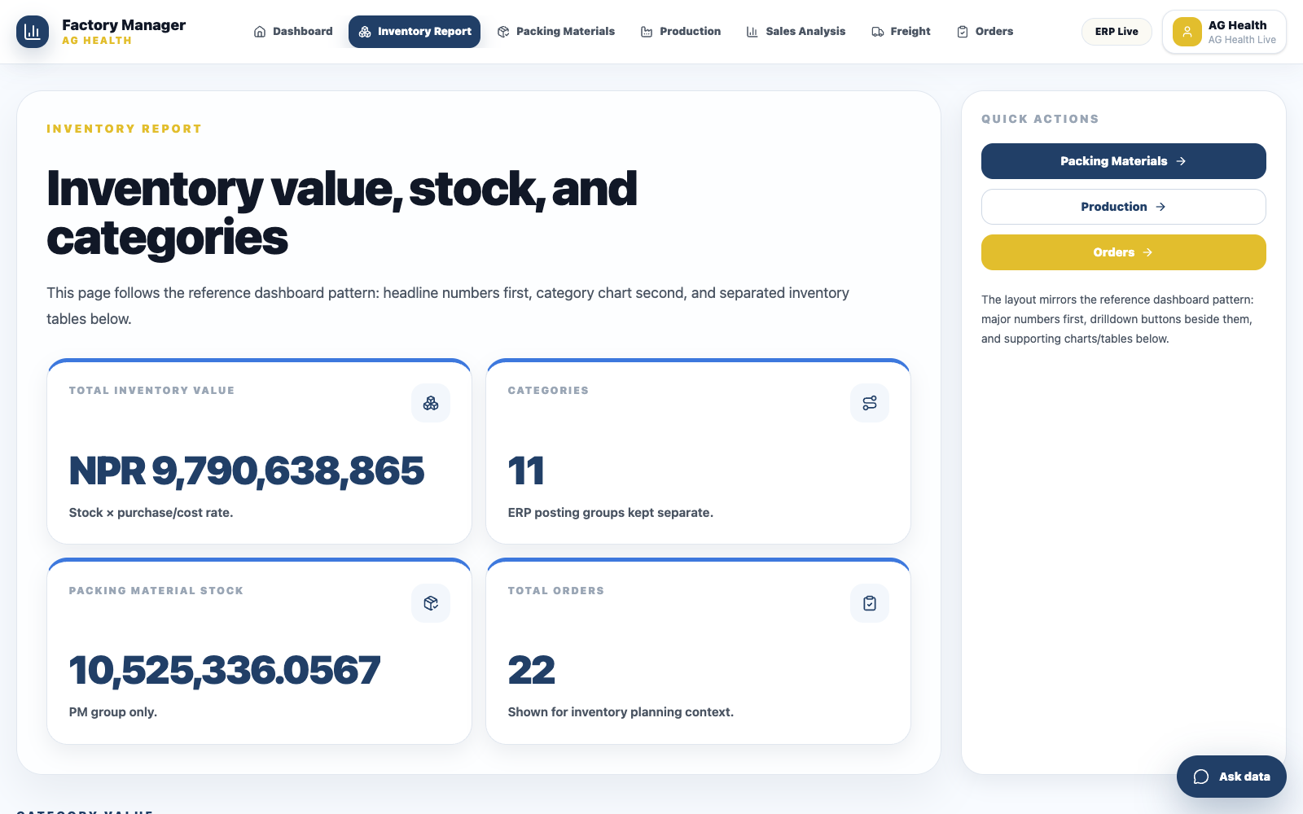
INVENTORY
Stock becomes easier
to explain.
Inventory is grouped by category, with stock quantity, unit cost, and value presented as a report people can audit.
What this page clarifies
• Which category holds stock
• Which items carry the highest value
• Which quantities and rates need review
AG HEALTH ERP
05
Notes:
[Sources]
Project screenshot captured from http://localhost:3002/ag-health/inventory-report.

Slide 6
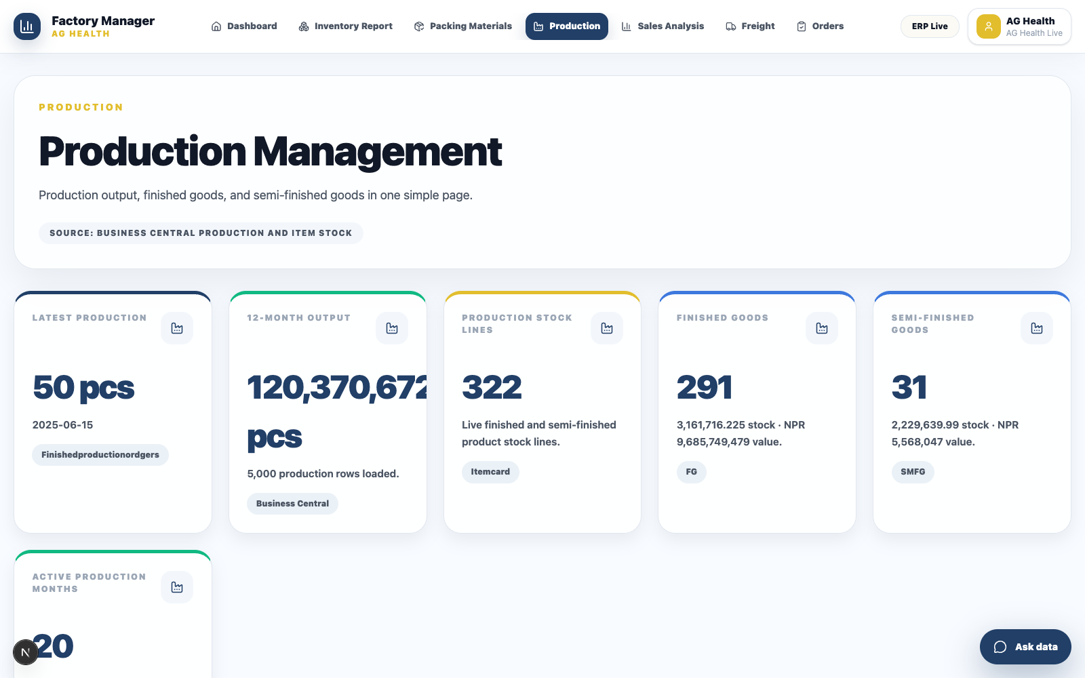
PRODUCTION
Output is shown
as pieces, not guesswork.
The production page highlights monthly output, finished rows, and item-level production so teams can see what was made and when.
CEO-readable rule
Every chart should show the name and the value, with pcs used for production output.
AG HEALTH ERP
06
Notes:
[Sources]
Project screenshot captured from http://localhost:3002/ag-health/production.

Slide 7
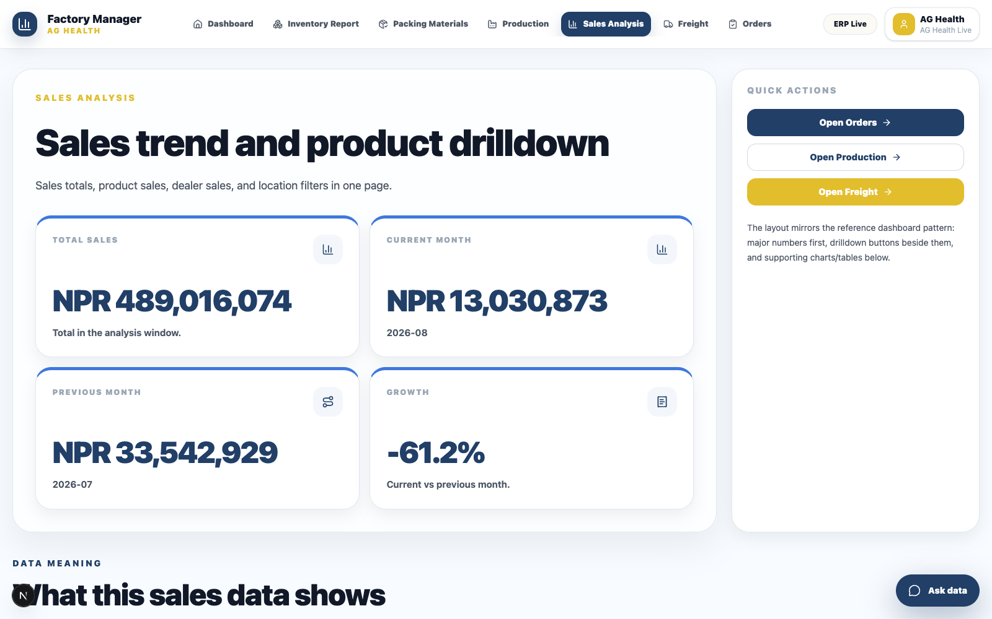
SALES
Sales analysis is built
for questions.
The sales view is structured for drill-down: Nepal to location, dealer, product, month and year — with cards, trend charts and product tables.
Product — Which item sold most
Dealer — Who bought it
Place — Where demand is strongest
AG HEALTH ERP
07
Notes:
[Sources]
Project screenshot captured from http://localhost:3002/ag-health/sales-analysis.

Slide 8
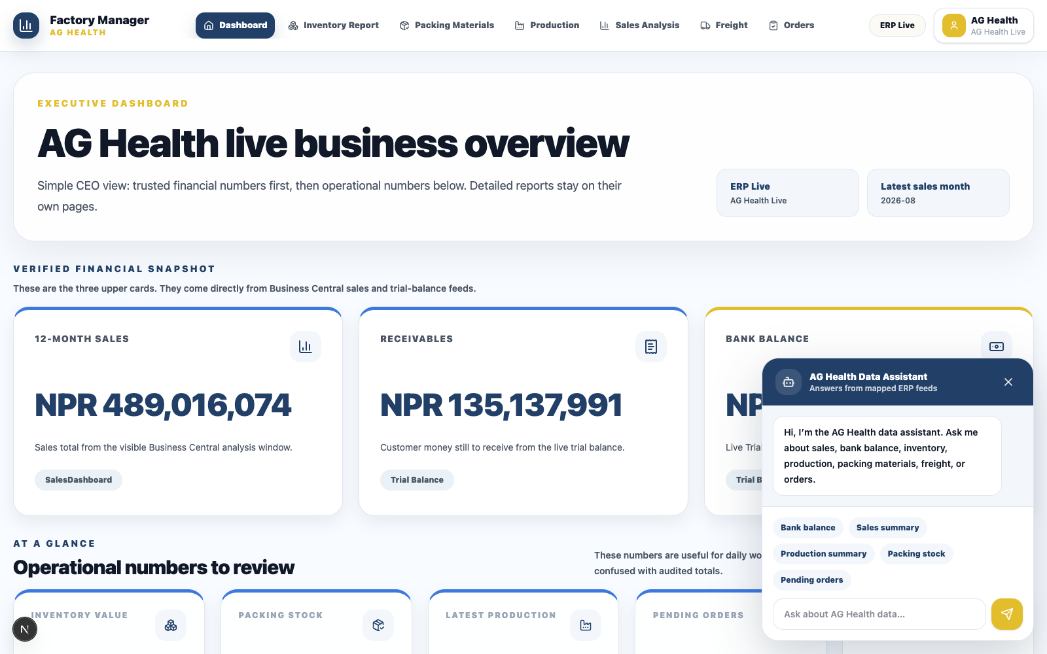
DATA ASSISTANT
Ask the system
in plain language.
The assistant answers from mapped ERP feeds only. It explains source, units, product names, values, and what is still not mapped.
Example questions
• What is the bank balance?
• Show M5 sales.
• What did we produce this month?
• Which inventory category has the highest value?
AG HEALTH ERP
08
Notes:
[Sources]
Project screenshot captured from http://localhost:3002/ag-health with chatbot open.

Slide 9
FINAL MESSAGE
A premium ERP layer
people will actually use.
What makes it valuable
• Real ERP numbers
• Clear source labels
• Better charts and tables
• Chatbot for fast answers
AG Health gets one place for trusted numbers, clear reporting, product-level analysis, and faster conversations around the same ERP truth.
Next: validate mappings, then present
AG HEALTH ERP
09
Notes:
[Sources]
Final synthesis based on user requirements and current project functionality.

